Slide 1
Leo Hayes Catchment Study
May 2016

Slide 2
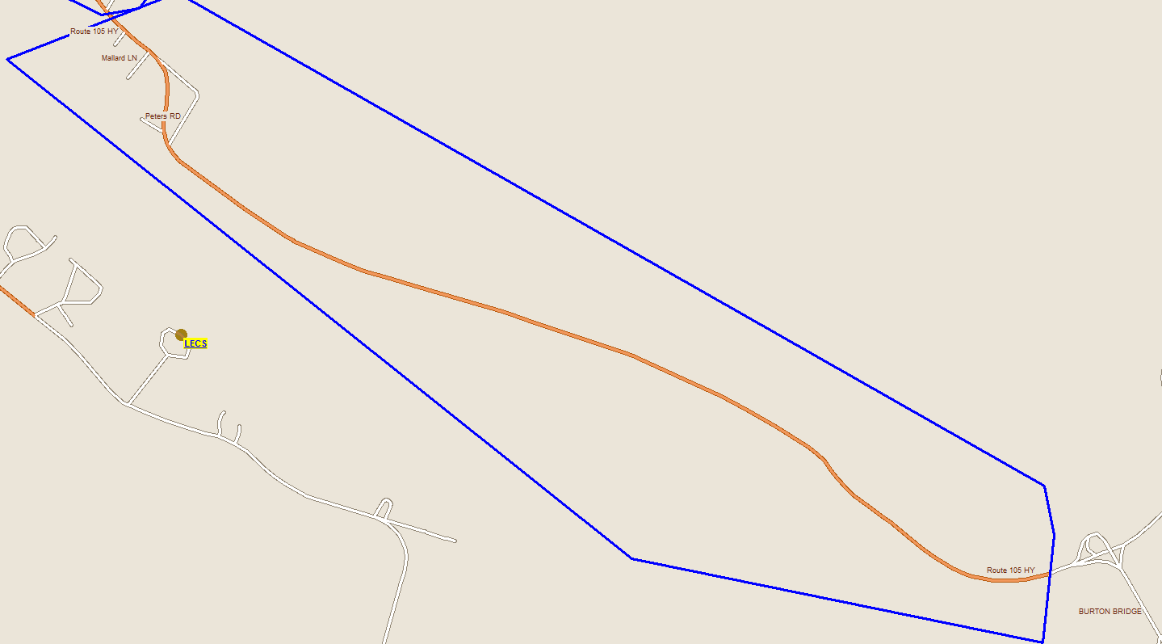
Proposed Below Portabello Drive to Burton Bridge
# of potentially impacted students in zone
K - 5 = 14
6 - 8 = 4
9 - 12 = 11
Total = 29

Slide 3
Below Portabello Drive to Burton Bridge - Stats
Impacted School | Current Enrolment | Functional Capacity
Barker's Point School | 351 | 81.3%
Devon Middle School | 499 | 70.4%
Oromocto High School | 1135 | 64.5%
Ridgeview Middle School | 319 | 36.9%
Harold Peterson Middle School | 328 | 35.2%
Hubbard Avenue Elementary School | 269 | 53.2%
Assiniboine Avenue Elementary School | 249 | 62.2%

Slide 4
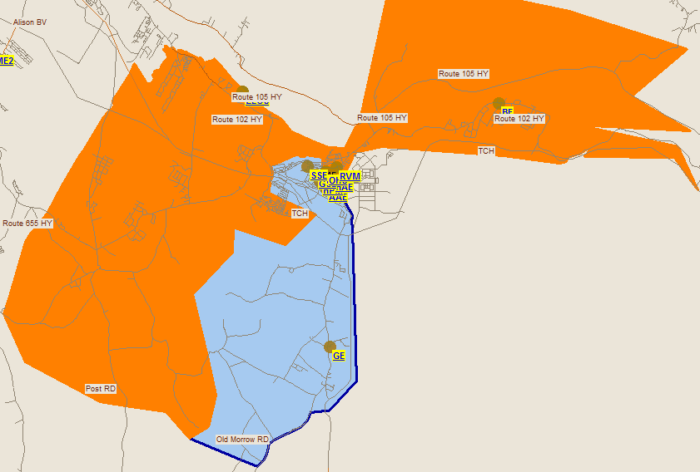
Oromocto Schools Catchment Area

Slide 5
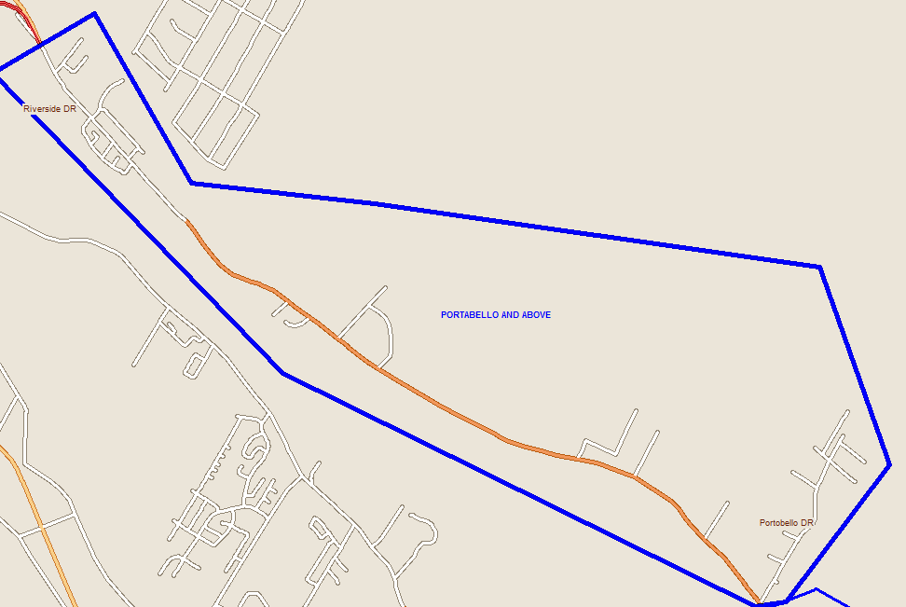
Proposed Portabello Drive and Above
# of potentially impacted students in zone
6 - 8 = 22
9 - 12 = 36
Total = 58

Slide 6
Portabello Drive and Above
Impacted School | Current Enrolment | Functional Capacity
Bliss Carman Middle School | 582 | 86.8%
Fredericton High School | 1960 | 67.9%

Slide 7
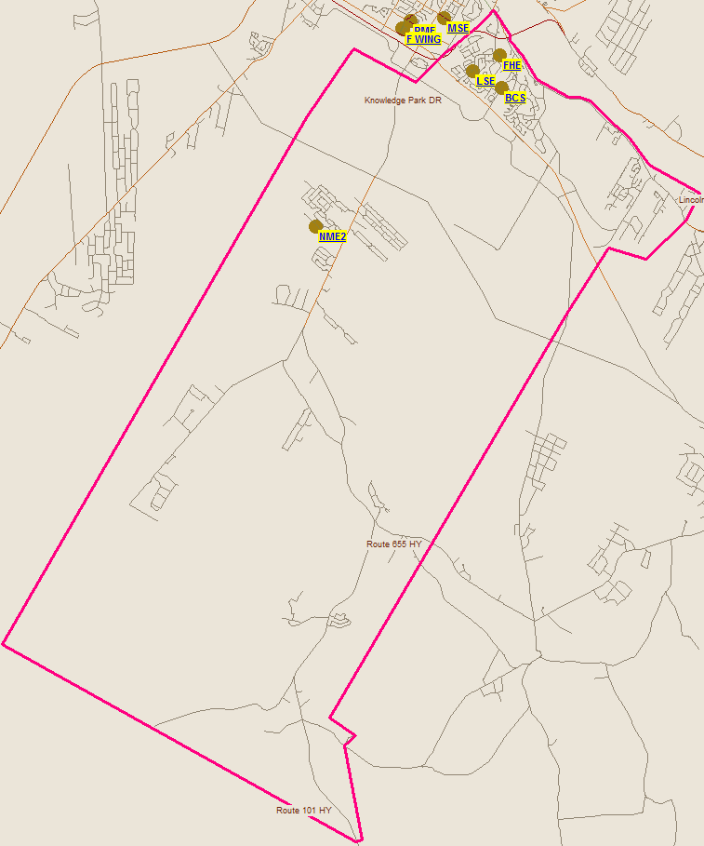
Bliss Carmen Catchment Area

Slide 8
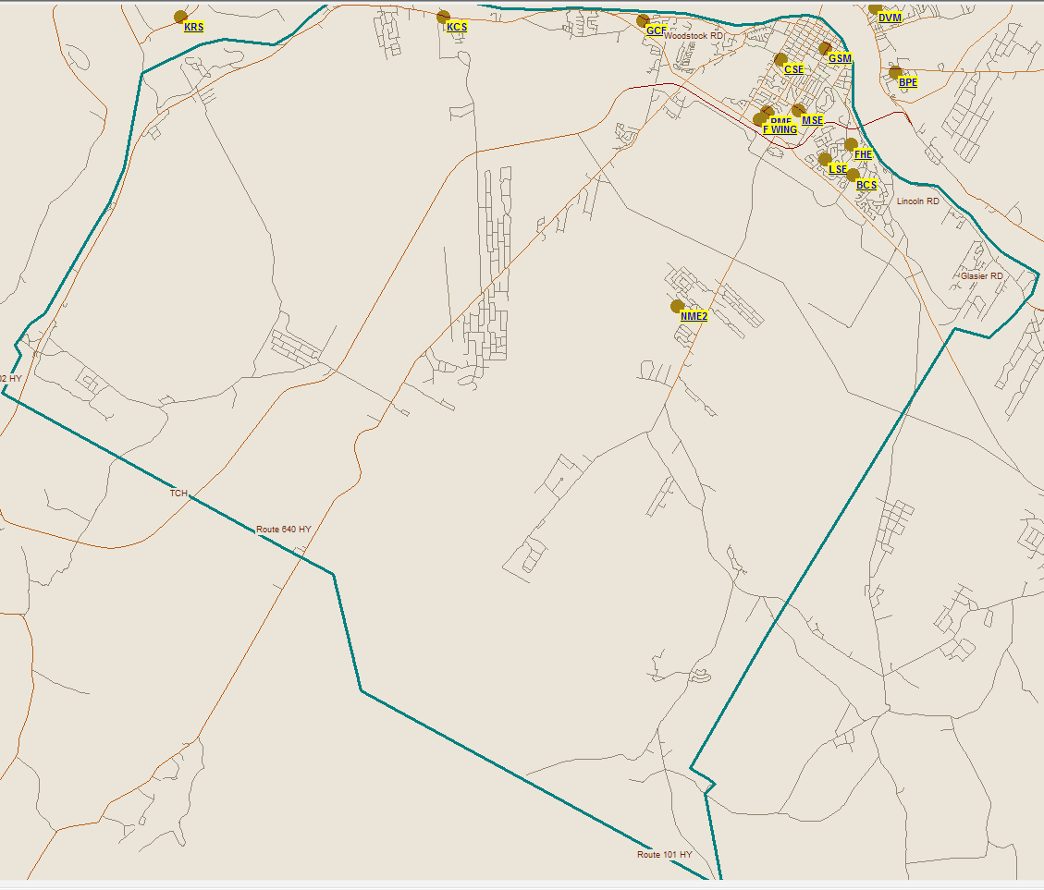
Fredericton High Catchment Area

Slide 9
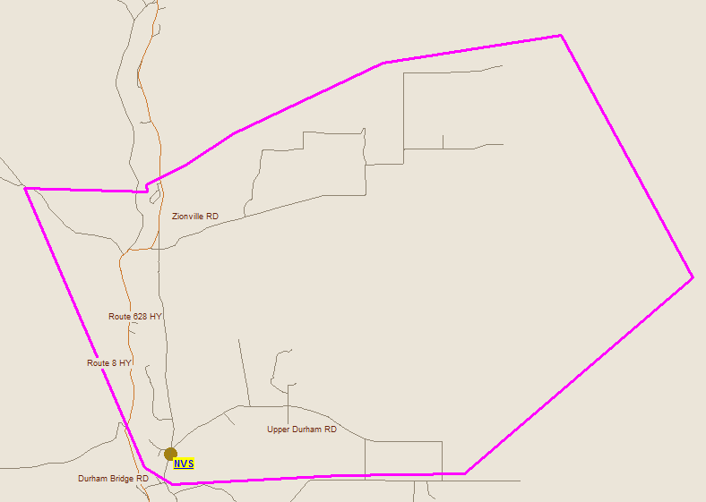
Proposed Durham Bridge
# of potentially impacted students in zone
6 - 8 = 21
9 - 12 = 36
Total = 57

Slide 10
Durham Bridge Split
Impacted School | Current Enrolment | Functional Capacity
Stanley Regional High School | 250 | 51.7%
Devon Middle School | 499 | 70.4%

Slide 11
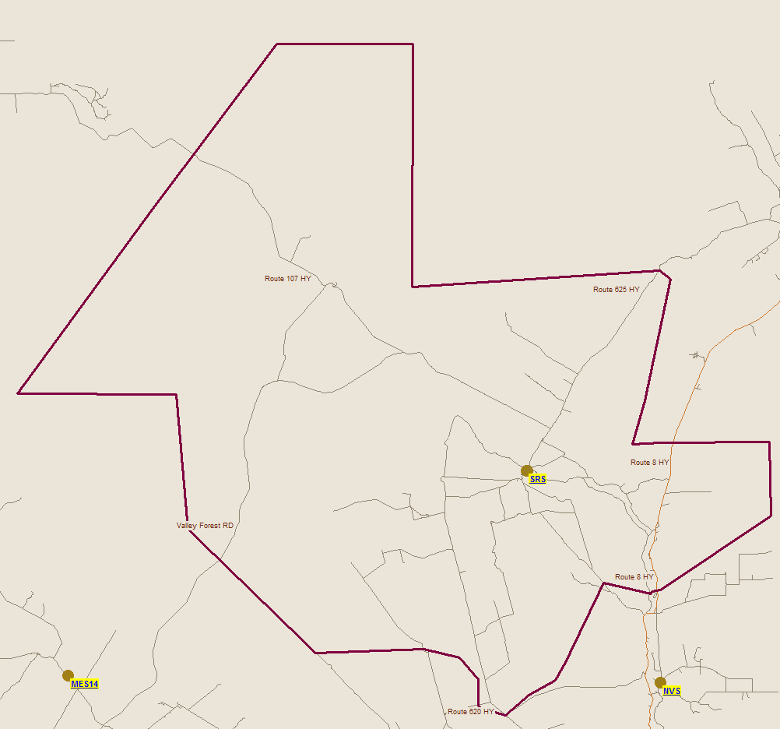
Stanley Catchment Area

Slide 12
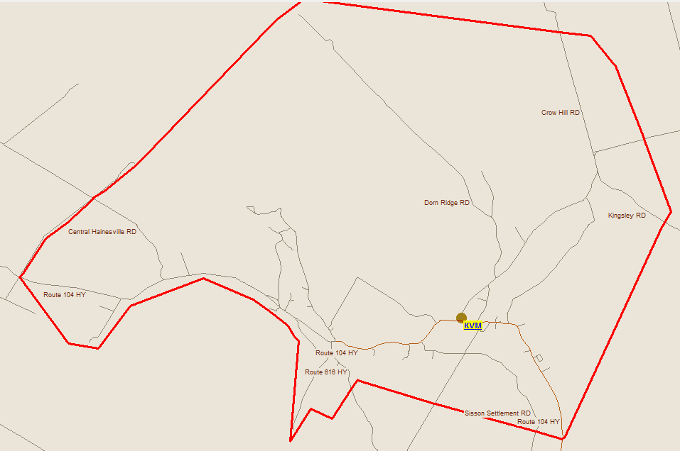
Keswick Valley Catchment Area
# of potentially impacted students in zone
9 - 12 = 69

Slide 13
Keswick Valley
Impacted School | Current Enrolment | Functional Capacity
Nackawic High School | 262 | 45.0%

Slide 14
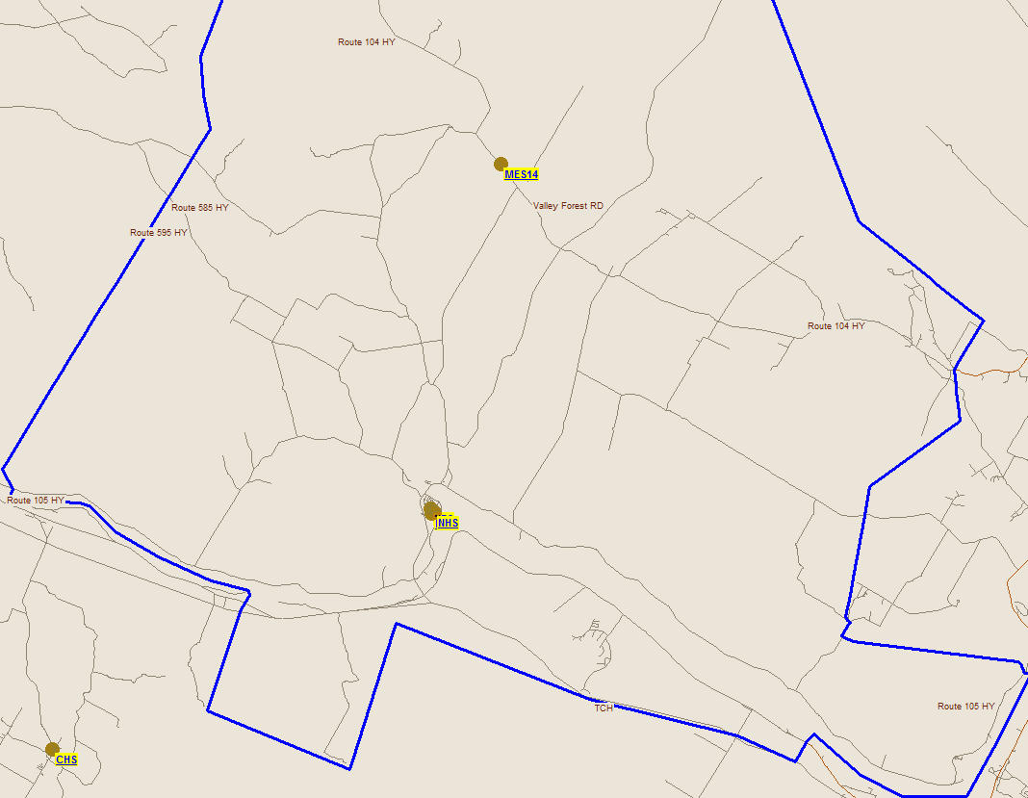
Nackawic High School Catchment Area

Slide 15
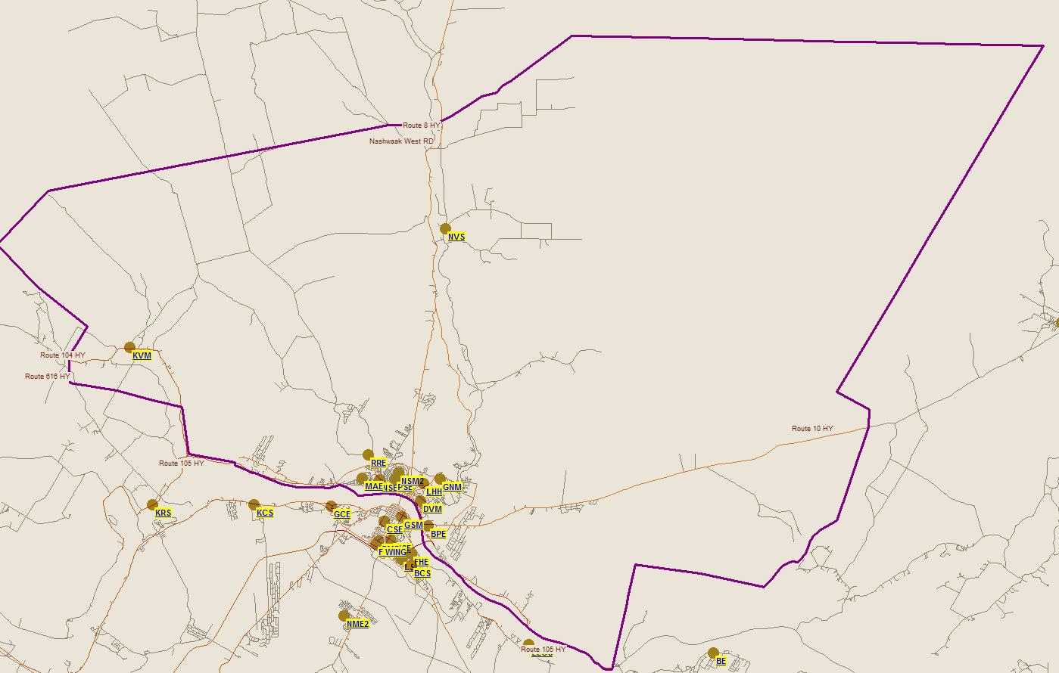
Leo Hayes Catchment Area

Slide 16
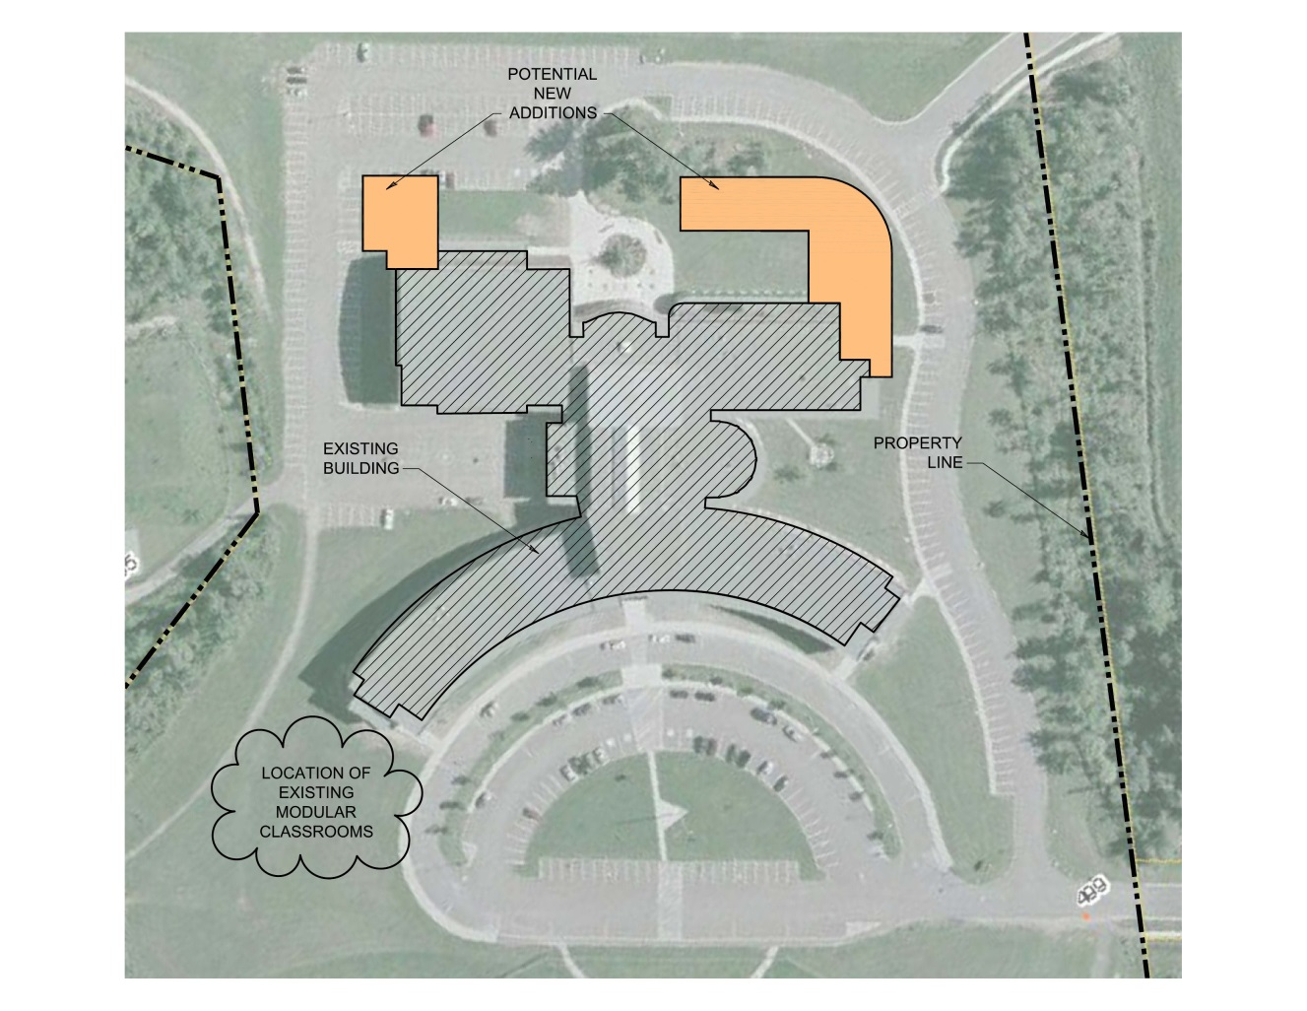
Scenario 1: New school wing addition for Leo Hayes High School (site confirmation of space) – conceptual footprint shows new addition fits the lot
  New school wing addition – Leo Hayes High
  Conceptual footprint of a two-story extension to Leo Hayes High School based on EECD Planning Guidelines for Educational Facilities and 2014-15 enrolment projections
  Site appears to have sufficient space for extensions
  Topography (bedrock/elevations) should be verified before proceeding
  Conceptual drawing illustrates new additions could be built on both the northeast and northwest corners of the current structure
  This would require an amendment to the contract with the P3 owner
  These additions would eliminate the need to bus students to Fredericton High School for shop classes (see Scenario 3 for financial implications)
Note: there is potential to build in the area where the modular classrooms are, however, the mobiles would have to be moved to another location during construction of an addition.
Source: EECD Infrastructure Planning.

Slide 17
Questions?

