Slide 1

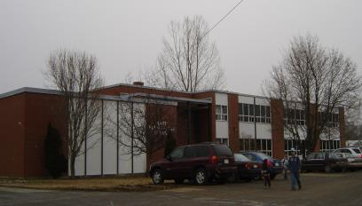
Sustainability Study of Bath Elementary School

Slide 2
Public Meeting #1 Agenda
Introductions
Review of Provincial Policy 409 Multi–Year School Infrastructure Planning
Presentation of Facts – Bath Elementary School
Question and Answer
What’s Next?
  Online Resources and Feedback
  Next Meetings

Slide 3
Provincial Policy 409: Multi-year School Infrastructure Planning
Outlines a number of responsibilities to do with facilities in our system
Sections 6.4, 6.5 and 6.6 are relevant for Sustainability Studies
Three Public Meetings
  #1 – Presentation of Facts from District regarding School, in line with Policy 409 template
  #2 - Presentation from Stakeholders regarding their thoughts on the sustainability of the school and relevant factors
  #3 – Final Review of Information by DEC and subsequent motion on next steps
Not Designed as an “Us-Against-Them” process; public meetings are not designed to facilitate debate between two parties
3 Possible Outcomes
  Status Quo
  Recommendation to Minister for Significant Investment in Building/Programs
  Recommendation to Minister for Closure

Slide 4

Enrolment

Slide 5
Enrolment
February 12th , 2015

Slide 6
Enrolment by Grade Level

Slide 7
Projected Enrolment

Slide 8
Functional Capacity
Functional Capacity Data | School Capacity | Number of Classrooms | Classrooms in Use | Student Enrolment | Capacity Rating
Based on 24 Students per class | 240 | 10 | 8* | 141 | 58.8%

Slide 9

Quality of Education Programs and Services

Slide 10
Quality of Education Programs and Services
Provincial staffing formula calls for:
  8.8 FTE for Classroom teachers
  0.5 FTE for Administration (0.52)
  0.4 FTE for Guidance (0.28)
  1.0 FTE for Resource (0.78)
  Total is 10.7 FTE teaching staff, including principal of the school;

Slide 11
Quality of Education Programs and Services
Student-teacher ratio is 13.2:1 for Bath Elementary (141:10.7)
Likewise, it is:
  14.7:1 in Florenceville Elementary School (229:15.6)
  12.9:1 for Bristol Elementary (122:9.5)
  14.4:1 for Townsview School (394:27.3)

Slide 12
Quality of Education Programs and Service
Grade 8 students from Bath Middle School feed into Carleton North High School for Grade 9.
Grade 5 Students from Bath Elementary School enter Bath Middle School for Prime Programs, beginning in Grade 6
Grade 5 Students from Bath Elementary School enter Florenceville Middle School for Late French Immersion Programs, beginning in Grade 6
Grade 2 Students from Bath Elementary School enter Florenceville Elementary School for Early French Immersion Programs, beginning in Grade 3

Slide 13
BES Student: Teacher Ratio
Years | Total Number Student: Teacher | Student: Teacher
2014-2015 | 141 : 10.7 | 13.2 : 1
2013-2014 | 140 : 10.7 | 13.1 : 1
2012-2013 | 144 : 10.4 | 13.8 : 1
2011-2012 | 141: 9.5* | 14.8 : 1
*Guidance provided through itinerant support

Slide 14
Maximum class sizes
Grade Level | Maximum Number of Students
Grades K to 2 | 21
Grades 3 | 26
Grade 4 - 5 | 28
Grades K to 3 in Combined | 16
Grades 3 to 5 Combined | 23

Slide 15
Bath Elementary School
Actual Class Sizes 2014-2015
Class | Size
K | 19
K/1 | 15
1 | 16
2 | 18
3 | 24
4 | 17
5 | 16
5 | 16
Average Class Size | 17.6

Slide 16
Florenceville Elementary School
Comparable Class Sizes 2014-2015
Class | Size
K | 20
K / 1 | 14
1 | 21
1 /2 | 16
2 | 19
3 / 4 Prime | 21
3 Early FI | 19
3 Early FI | 20
4 Early FI | 16
4 Early FI | 16
5 Prime | 22
5 Early FI | 25
Average Class Size | 19.1

Slide 17
Bristol Elementary School
Comparable Class Sizes 2014-2015
Class | Size
K | 19
1 | 15
2 | 17
2 / 3 | 16
3 | 13
4 | 16
5 | 26
Average Class Size | 17.4

Slide 18
Townsview School Comparable Class Sizes 2014-2015
Class | Size
K | 18
K | 19
K | 18
1 | 20
1 | 19
1 | 18
1/2 | 16
2 | 17
2 | 18
2 | 20
2 | 19
3 Prime | 22
3 / 4 Prime | 20
3 Early FI | 15
3 Early FI | 15
4 Prime | 21
4 Early FI | 24
5 Prime | 19
5 Prime | 19
5 Early FI | 18
5 Early FI | 19
Average Class Size | 18.8

Slide 19
Other Staff
4.0 - Educational Assistants
Administrative Assistant: 36 ¼ hours a week
Library Assistant: 6.5 hours a week
Custodian II: 40 hours per week
Custodian I: 8 hours per week

Slide 20
Delivery of Programs
Prime program is offered; students who wish to take Late French Immersion enter the program at Florenceville Middle School; students who wish to take Early French Immersion enter the program at Florenceville Elementary School
Pre-Intensive French is offered as part of French Second Language programming for 200 minutes per week; the Intensive French program is offered in Grade 5
EST- Literacy support as part of a cluster of 6 schools

Slide 21
Delivery of Programs
EST- Numeracy support is provided upon request
Resource and Methods – 1.0 FTE, this is covered by a teacher on staff
Guidance – 0.4 FTE, this is a shared position with Bath Middle School and Bristol Elementary School

Slide 22
Impact on Other Schools
With Florenceville Middle School serving as the receiving school for French Immersion students entering grade 6, this school could be one choice should a decision be made to relocate students from Bath Middle School; there is capacity for this move.
Another consideration could be to create a K-8 school in Bath by joining Bath Middle and Bath Elementary; this would best be served in the middle school facility
Distribution of FTE’s; using this year’s numbers, and making projections to next year, if the BMS students were in a K-8 setting, we expect a need for three middle level prime classes (and four at FMS); if they were at FMS, there would be a need for six middle level prime classes
Teachers moving into different settings
Teamwork
Combination of resources (inherit P.E., technology, literacy, and math manipulatives, etc.)

Slide 23
Special Events That Encourage Collegiality/Student Spirit
Student Engagement Days
HIVES (Grade K-5 multi-age grouping)
BEST Awards
After school Basketball (k/1 and 2/3)
Drama
Music Festival
Student Helpers
Random Acts of Kindness
Bucket Filling Activities

Slide 24
Special Events That Encourage Collegiality/Student Spirit
Fire Safety Week – Volunteer Fire Fighter come to the school
Winter Carnival
Pink Shirt Day
End of the Year Field Trips
Visits to Andrew and Laura McCain Library
“100 days of Learning” at BES
Remembrance Day Program (k-8)
Christmas Dinner (Grade k-8)
Saint John Mill Rats Visitation
Magic with a Message (Peaceful Schools Message)

Slide 25
Special Events That Encourage Community School Partnership
Meet the Teacher Evening
Grade K to 2 yearly visits the Save Easy, Post Office, Bank and Diner Down Under
Fire Safety Week – visits to the Fire Hall and Volunteer Fire Fighters visit the school
Andrew and Laura McCain Library – visits by the K-2 students
Hackmatack Club- Andrew and Laura McCain Librarian comes to the school
Summer Reading Club – is promoted at the school
Meduxnekeag Presentations
Winter Carnival - skating at the Northern Carleton Arena

Slide 26
Special Events That Encourage Community School Partnership
Community donations to the BES Technology Fund
(Proceeds from the SNOWBLAST supper)
Community donations to the BES Breakfast Program
(Proceeds from the CO-OP 50/50 draw)
BES Choir sings at the Tree Lighting at Village Office
BES Choir sings at the Riverview Manor at Christmas
Andrew and Laura McCain Art Gallery – afterschool art programs
All classes and the choir sing at the Festival of Musical Arts
BES collects donations for the IWK and Cystic Fibrosis
Family Literacy Nights

Slide 27
Special Events That Encourage Community School Partnership
ELF Reading Program
BES staff supports a family at Christmas
Falls Brook Centre Visits– Wetland and Student Government
The gym is used for K-3 Basketball,
C.F. Walk
Grade 3 to 5 Drama attends Drama Festival and has a Public Performance
Step Ahead Pre-School (located on the primary student floor)
Pre-School Invited to Special Events

Slide 28
Special Events That Encourage Community School Partnership
Family Literacy Day is promoted at the school
Enrichment Activity days with community volunteers (knitting, orienteering, art, etc)
Christmas Dinner – Cooked and served by Community Volunteers
Christmas Concert (Age 2-Grade 5)
Grade 5 Safety Day (WorkSafe NB)
Students from CNHS do Co-op/work study placements

Slide 29
Student Voice
Tell Them from Me Survey
Student input for Student Engagement Activities
Grade 4-5 lunch time helpers
Grade 5 Leadership in HIVES (K-5 groups)
Grade Two Student Highlighted in the provincial “Fire Safety Gazette”
Grades 3-5 Student Choice of Activities for Inside Recess
Student Led Fundraising for Grade Five Trip
Student Greeters for Special Events
Grade Five Intensive French Reading Aloud to younger students (Promoting French Language)

Slide 30
Provincial
Assessments

Slide 31
Provincial Assessment Results
    Grade 2 Reading
Year | Bath Elementary | District | Province
2009-10 | 84.2% | 72.5% | 83.6%
2010-11 | 52.4% | 75.8% | 80.3%
2011-12 | 43.8% | 78.0% | 79.1%
2012-13 | 59.1% | 80.3% | 79.5%
2013-14 | 55.2% | 76.8% | 77.5%
February 12th , 2015

Slide 32
Provincial Assessment Results
    Grade 4 Reading
Year | Bath Elementary | District | Province
2009-10 | 82.8% | 78.4% | 83.4%
2010-11 | 63.6% | 74.3% | 80.5%
2011-12 | 77.8% | 77.5% | 77.1%
Results not available after 2011-12 due to changes in the Provincial Assessment system.

Slide 33
Provincial Assessment Results
    Grade 5 Numeracy
Year | Bath Elementary | District | Province
2009-10 | 60.7% | 54.3% | 59.4%
2010-11 | 80.6% | 60.4% | 60.8%
2011-12 | 68.0% | 63.7% | 63.7%
2012-13 | 66.7% | 64.0% | 62.9%
2013-14 | NA | 60.0%* | 59.4%*
* Based on a 20% sample of students.

Slide 34
Student Perception Data
Based on the 2013-14 Student Perception of Survey Results of Grades 4-5 students;
93% of students reported that they feel accepted and valued by peers and others in the building, contributing to a positive sense of belonging.
85% of students reported that that they have friends at school they trust and who encourage them to make positive choices. This contributes to overall positive relationships.
91% of students reported that they were interested and motivated in their learning.
100% of students reported that they are trying hard to succeed in their learning.
89% of students reported that they feel safe attending their school.
February 12th , 2015

Slide 35
School Benefits
Strong Knowledge of individual students, as well as their strengths and needs.
Smaller class settings create the opportunity for staff to provide one on one attention more readily.
Culture of collaboration is established among staff.

Slide 36
School Challenges
Staff in positions of responsibility are often required to teach specialty subjects and have a large percentage of time dedicated to teaching.
Lack of ability to consistently provide instruction by subject experts in music and PE.

Slide 37

Health and Safety
Building Assessment

Slide 38
Building Summary
School was constructed in 1967.
Renovations have included:
  New boiler installed August 2010.
  Windows replaced in summer of 2014.
  Exterior cladding replaced in summer of 2014.

Slide 39
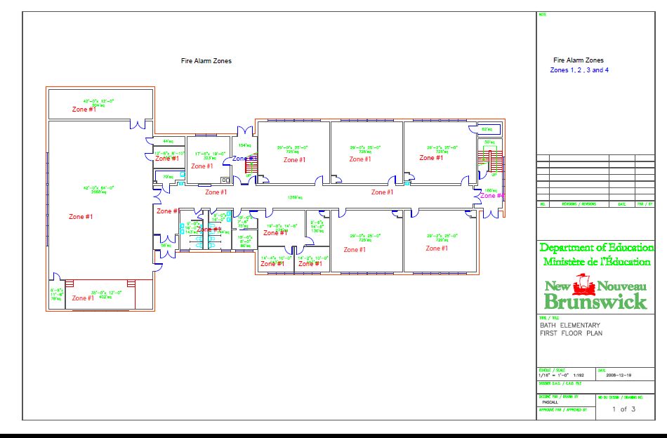

Slide 40
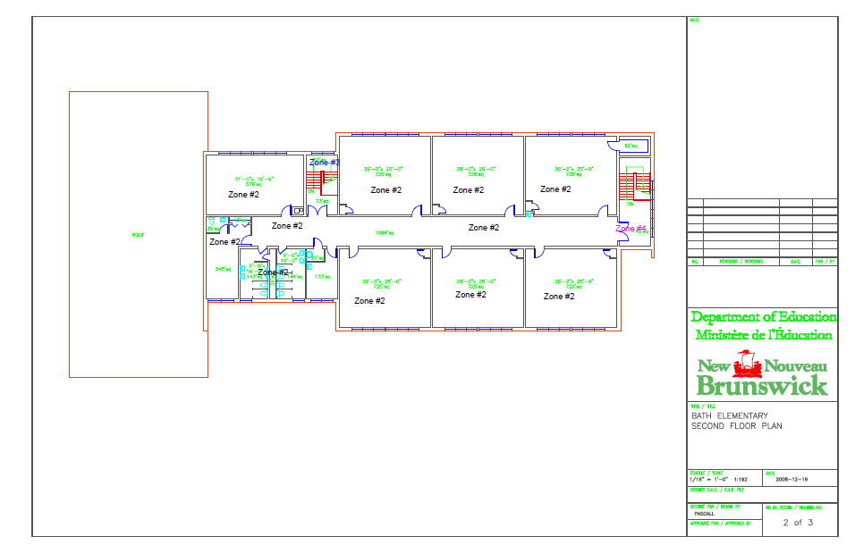

Slide 41
Classrooms
The school was constructed with 12 classrooms.
Presently:
  8 classrooms are being used for classroom teaching spaces
  1 classroom is being used for literacy (Primary)
  1 classroom is being used for literacy (Elementary)
  1 classroom is being used daily for preschool and three year olds
  1 classroom has been converted to office space

Slide 42
Stairwells and Corridors
Stairways are enclosed to meet fire separation requirements complete with fire rated doors, frames and hardware.
Corridor walls are plaster.

Slide 43
Fire Protection
The building is equipped with a Fire Shield fire alarm system.
Fire extinguishers are located throughout the building and fire alarm pull stations are located in corridors.

Slide 44
Domestic & Waste Water
Water is supplied by the Municipality and has backflow prevention installed.
There is a water softener connected into the water supply.
Hot water is heated with a Giant Cascade 100 gallon hot water heater.
The septic is municipal.

Slide 45
Heating & Ventilation
School is heated by an oil fired De Dietrich boiler installed in 2010.
Heating is controlled by the school.
The building has no mechanical ventilation except for exhaust fans in washrooms.
Installation of ventilation system is identified on the capital improvement project list.

Slide 46
Controls & Communications
The building has individual pneumatic thermostats in every classroom, pneumatics are in good condition.
The building has a Dukane Compact 3200 series PA system.

Slide 47
Electrical & Lighting
There is a 400 amp, 120/240 volt entrance through an overhead connection.
An electrical distribution upgrade has been identified as a Capital Improvement Project.
Interior lighting is fluorescent in good condition.

Slide 48
Interior
Washrooms have original urinals, sinks (in good condition), Washroom upgrade is listed on the Capital Improvement Project list.
Floors are tile in the classrooms with terrazzo flooring in the halls and washrooms. Flooring upgrades are on the capital improvement Project list.
Interior doors are fire rated wood doors.
There is no lift or elevator, Lift or Elevator upgrade is listed on the Capital Improvement Project list.

Slide 49
Interior continued
Gym floor is tile in fair condition.
There is no wheel chair access to the stage.
There is proper access to the roof.
Roof is in good condition and does not leak.
Corridor walls are masonry in good condition.

Slide 50
Exterior
Exterior windows are new, installed 2014.
Exterior doors are in fair condition; they are on the Capital Improvement Project list for replacement.
The exterior cladding is masonry brick in good condition. New metal cladding was installed at window locations in 2014.
Exterior lighting is H.I.D (high intensity discharge).

Slide 51
Property
Staff and visitors share the school parking lot which has been identified on the Capital Improvement project list to replace the asphalt.
The parking area is shared with the bus loading zone. Recent changes improved the bus loading zone separating it from the parent drop off area.
Playground has a soccer field, swings, slides, 10 teeter totters, and 3 sets of play structures.

Slide 52
Capital Investments
Year | Scope of Work | Cost
2009 - 2010 | Boiler | $90,163.00
2010 - 2011 | Radon Remediation | $64,751.00
2010 - 2011 | Roof Replacement | $156,581.00
2013 | Building Envelope | $15,025.00
2014 | Window and Siding replacement | $165,000.00

Slide 53
School Physical Plant Status
Building Exterior and Site |  | Description | Estimated Cost
Building Envelope | Exterior Doors upgrade | PHASE II – replacement of entrance doors with automatic openers.
Site | Site Improvement | Paving areas around the school where asphalt has deteriated.
Building Interior | Interior Accessibility | Install a lift/elevator

Slide 54
School Physical Plant Status (continued)
Building Interior and Additions |  | Description | Estimated Cost
Interior | Washroom | Renovate existing washrooms
Interior | Floors | Installation of new tile floors

Slide 55
School Physical Plant Status (continued)
Mechanical and Electrical Systems |  | Description | Estimated Cost
Electrical | Electrical Supply and Distribution | Electrical upgrade (panels)
Heating and Ventilation | Heating System | Replace piping in boiler room.
Heating and Ventilation | Ventilation System | Install ventilation system in building Estimated Cost: | $1,080,630.00

Slide 56

Transportation

Slide 57
Bath Transportation Study
Currently students in grades 9-12 that reside in the Bath Schools Catchment area are bussed to Carleton North High School.
Also, any French immersion students in grade 3-8 are bussed from Bath Middle and Elementary Schools Catchment area to Florenceville Middle and Florenceville Elementary Schools.
The morning school bus system currently sees seven buses transport students within the Bath Schools Catchment area into the Bath Middle School and Bath Elementary, where the grade 9-12 students transfer onto three busses and proceed to Carleton North High School.

Slide 58
Bus Transportation Study
The afternoon school bus system currently sees five school busses transport the K-8 students home who attend Bath Elementary and Middle Schools. There would not be any impact with regards to the number of school buses or drivers if there was a K-8 school.

Slide 59
Current Student Address Distances (BMS)
 | Distance to BMS (KM) | Distance to BES (KM) | Distance to FMS(KM)
Average Distance | 7.5 | 7.5 | 15.8
Maximum Distance | 15.9 | 15.9 | 24.3
Minimum Distance | 0.5 | 0.5 | 7.6

Slide 60
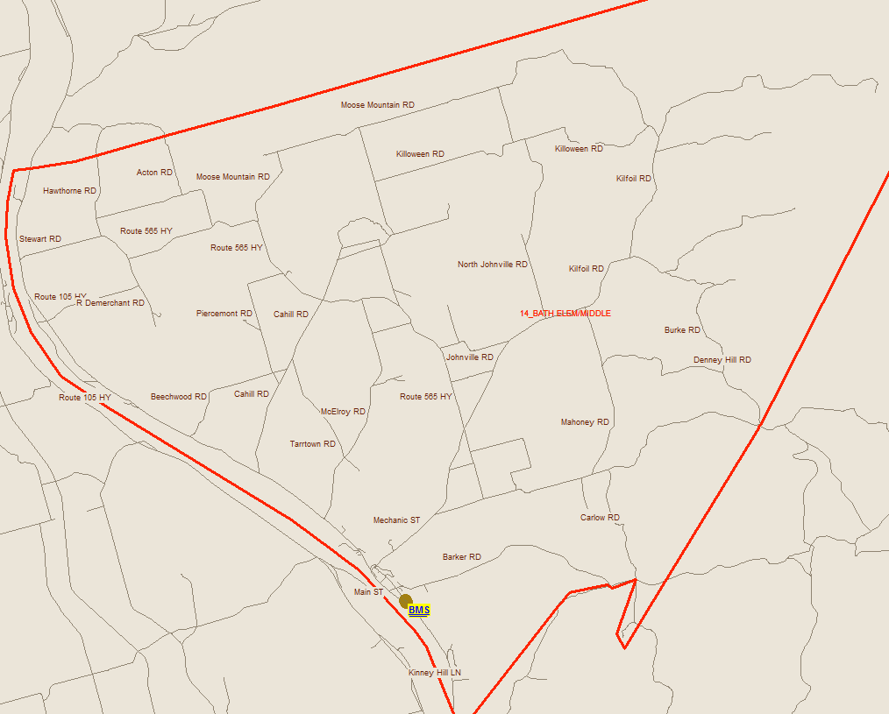
Bus Transportation Study

Slide 61

Finances

Slide 62
Salaries
 | Actual Costs
Cost Centers | Fiscal Year | Fiscal Year | Fiscal Year
 | 2013-2014 | 2012-2013 | 2011-2012
Salaries
Administration | 12,309 | 12,252 | 12,254
Teacher | 753,526 | 700,822 | 723,842
Admin. Assistant | 24,603 | 25.036 | 24,038
Educational Assistant | 64,482 | 61,475 | 76,063
Library Assist | 4,479 | 4,734 | 2,950
Custodian | 39,336 | 37,959 | 37,144
Total | 899,136 | 842,257 | 876,292

Slide 63
Assigned Budgets
 | Actual Costs
Cost Centers | Fiscal Year | Fiscal Year | Fiscal Year
 | 2013-2014 | 2012-2013 | 2011-2012
Assigned Budgets
Regular Instruction | 12,290 | 12,450 | 10,355
Admin.Support | 3,033 | 2,952 | 2,934
Library | - | - | 884
Teachers Working Conditions | 2,146 | 2,743 | 4,672
Tutor Support | - | - | 1,200
Nutrition | 1,335 | 2,322 | 2,866
Bilingual Learning Environ. | - | 300 | -
Wellness Grant | 543 | 542 | -
Co/Extra Trips | 638 | 621 | 818
PSSC | 426 | 466 | 393
Total | 20,412 | 22,396 | 24,122

Slide 64
Facilities Costs
 | Actual Costs
Cost Centers | Fiscal Year | Fiscal Year | Fiscal Year
 | 2013-2014 | 2012-2013 | 2011-2012
Facilities Costs
Electricity | 12,300 | 11,096 | 11,196
Water and Sewer | 7,040 | 9,639 | 7,058
Garbage Removal | 2,040 | 2,040 | 2,040
Ground Maintenance | -------- | -------- | -------
Heating Fuel | 27,678 | 22,593 | 26,991
Cleaning Supplies | 2,543 | 2,676 | 2,555
Minor Repairs | 10,264 | 8,381 | 4,595
Total | 61,867 | 56,424 | 54,437

Slide 65
Total Costs
 | Actual Costs
Cost Centers | Fiscal Year | Fiscal Year | Fiscal Year
 | 2013-2014 | 2012-2013 | 2011-2012
TOTAL COSTS | 981,451 | 921,077 | 954,851

Slide 66
Economic Development

Slide 67
Economic Development
Consultations:
Rebecca Derrah, Director, Step Ahead-Bath Family Learning Centre
Gaylen Drost, Owner Save Easy
Jim Rankin, Businessman and Developer of Bath Hospital Project
Gerald Sullivan, Principal, BMS
Troy Stone, Mayor, Village of Bath
NB Department of Economic Development
Charles McNair, Councilor, Village of Bath

Slide 68
Economic Development
Businesses/Organizations That Have Closed:
Hospital (7 years ago)
Gas Station
Andrea’s Flower Shop (relocated to Florenceville)
Smith Drug (relocated to Florenceville)
Kilcollin’s Funeral Home (relocated to Florenceville)

Slide 69
Economic Development
Existing Businesses/Organizations in the Area:
Lions Villa
Greco
Down Home Bakery / Restaurant
Drs. Colin and Bruce Lockhart Medical Office
Dr. Jeremy Fournier Dental Office

Slide 70
Economic Development
Existing Businesses/Organizations in the Area:
Step Ahead – Bath Family Learning Center (BMS)
Family and Early Childhood West Inc. (BMS)
Marks the Spot Convenience
Scotia Bank
All Aboard Convenience (Ultramar Gas Station)
Diner Down Under
Drost Save Easy

Slide 71
Economic Development
Existing Businesses/Organizations in the Area:
Steal of a Deal (Second Hand Store)
Riverview Manor Apartments
Carleton Victoria Community Vocational Board Inc.
Bath Community Academic Service Program
Bath Lions Club
The Cooperators Insurance
Monquarter Restaurant and Lounge

Slide 72
Economic Development
Findings:
Residents state the closing of the hospital, and the relocation to Florenceville of a number of businesses affected the community’s tax base. They are concerned that if Bath Middle School closes this will further decrease the Village’s tax base.
There are a number of community groups and organizations that use the school on a regular basis. Community members use the gym for basketball and volleyball. The Step-A-Head Family Learning Centre provides childcare and additional programming; namely, diabetes clinic, cooking classes, community kitchen initiatives, speech therapy, family resource center, breakfast program, and training sessions for early childhood educators. Additionally, there are currently 7 full time employees, and one part-time bookkeeper, generating $120,000 - $140,000 in wages.

Slide 73
Economic Development
There is hope that the special care home will bring in new families. There is concern that if there is no middle school families will choose to live in another community.
The local schools, Bath Elementary and Bath Middle currently collaborate on a number of projects (Remembrance Day, Christmas dinner, ESST, transition, common FTE) and systematic concerns (school bus safety, administrative trouble shooting). The loss of BMS would result in the loss of opportunity for the two schools to partner, if the students went to FMS.

Slide 74
Economic Development
One business owner stated that at one time his business employed 32 people. Currently he employs 17 people. He is concerned about the viability of his business if the school is closed.
One individual has spoken about the possibility of redeveloping the former hospital into a senior care facility ($7 million) with a potential employment of 40 – 50 people. He has also suggested a possible subdivision on the existing hospital lot (25 acres), and the possibility of 3 other businesses to be announced by businessmen and partners. He is concerned the school closure would put these redevelopment plans in jeopardy.

Slide 75
Impact on the Community of Bath
Community and School usage of the gymnasium

Slide 76

Questions and Answers

Slide 77
Bath Middle and Bath Elementary School Sustainability Study – Visit our Website for Details!
  Sustainability Study Timeline
  Minister Letters
  Parent Letters
  Bath Elementary School at a Glance
  Link to Policy 409
  Public Meeting #1 – Presentation
  www.asd-w.nbed.nb.ca
Feedback can be given
  via email at asdwsustainability@nbed.nb.ca
  through our discussion board at the Bath Elementary and Bath Middle School Sustainability Study site on our webpage
  mail to Carol Clark-Caterini, Anglophone West School District, 1135 Prospect Street, Fredericton, NB E3B-3B9

Slide 78
Thank you for coming!

