Slide 1

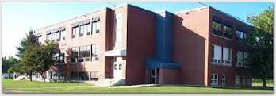
Sustainability Study of Bath Middle School

Slide 2
Public Meeting #1 Agenda
Introductions
Review of Provincial Policy 409 Multi–Year School Infrastructure Planning
Presentation of Facts – Bath Middle School
Question and Answer
What’s Next?
  Online Resources and Feedback
  Next Meetings

Slide 3
Provincial Policy 409: Multi-year School Infrastructure Planning
Outlines a number of responsibilities to do with facilities in our system
Sections 6.4, 6.5 and 6.6 are relevant for Sustainability Studies
Three Public Meetings
  #1 – Presentation of Facts from District regarding School, in line with Policy 409 template
  #2 - Presentation from Stakeholders regarding their thoughts on the sustainability of the school and relevant factors
  #3 – Final Review of Information by DEC and subsequent motion on next steps
Not Designed as an “Us-Against-Them” process; public meetings are not designed to facilitate debate between two parties
3 Possible Outcomes
  Status Quo
  Recommendation to Minister for Significant Investment in Building/Programs
  Recommendation to Minister for Closure

Slide 4

Enrolment

Slide 5
Enrolment

Slide 7
Projected Enrolment

Slide 8
Functional Capacity
Functional Capacity Data | Student Enrollment | Number of Classrooms | Classrooms in Use | School Capacity | Capacity Rating
Based on 28 Students per class | 44 | 7 | 3* | 196 | 22.4%

Slide 9

Quality of Education Programs and Services

Slide 10
Quality of Education Programs and Services
Provincial staffing formula calls for:
  2.4 FTE for Classroom teachers
  0.4 FTE for Administration (0.16)
  0.3 FTE for Guidance (0.09)
  0.4 FTE for Resource (0.24)
  Total is 3.5 FTE teaching staff, including principal of the school;
  This is the first year in the last 4 that there has been two classes instead of three

Slide 11
Quality of Education Programs and Services
Student-teacher ratio is 12.6:1 for Bath Middle
Likewise, it is:
  13.3:1 in Florenceville Middle School (194:14.6)
  13.1:1 for Centreville Community School (196:15.0)
  14.9:1 for Woodstock Middle School (402:26.9)

Slide 12
Quality of Education Programs and Service
Grade 8 students from Bath Middle School feed into Carleton North High School for Grade 9.
Grade 5 Students from Bath Elementary School enter Bath Middle School for Prime Programs, beginning in Grade 6
Grade 5 Students from Bath Elementary School enter Florenceville Middle School for Late French Immersion Programs, beginning in Grade 6

Slide 13
BMS Student: Teacher Ratio
Years | Total Number Student: Teacher | Student: Teacher
2014-2015 | 44 : 3.5 | 12.6 : 1
2013-2014 | 41 : 4.0 | 10.3 : 1
2012-2013 | 52 : 4.4 | 11.8 : 1
2011-2012 | 57 : 4.2 | 13.6 : 1

Slide 14
Maximum class sizes
Grade Level | Maximum Number of Students
Grades 4 to 6 | 28
Grades 7 to 12 | 29
Grades 6 to 8 in Combined Classes | 24

Slide 15
Bath Middle School
Actual Class Sizes 2014-2015
Class | Size
6/7 | 18 + 5 = 23
7/8 | 7 + 14 = 21
Average Class Size | 22

Slide 16
Florenceville Middle School
Comparable Class Sizes 2014-2015
Class | Size
6 LFI | 16
6 EFI | 21
6 | 25
6/7 | 22
7 LFI | 16
7 EFI | 15
7/8 | 22
8 LFI | 16
8 EFI | 16
8 | 25
Average Class Size | 19.4

Slide 17
Centreville Community School
Comparable Class Sizes 2014-2015
Class | Size
6 | 16
7 | 14
8 | 20
Average Class Size | 16.6

Slide 18
Woodstock Middle School
Comparable Class Sizes 2014-2015
Class | Size
6 LFI | 16
6 EFI | 26
6 EFI | 25
6 | 21
6 | 20
6 | 22
7 LFI | 16
7 EFI | 17
7 EFI | 16
7 | 26
7 | 26
7 | 25
7/8 | 23
8 LFI | 24
8 EFI | 26
8 | 24
8 | 24
8 | 25
Average Class Size | 22.3

Slide 19
Other Staff
2.0 - Educational Assistants
Administrative Assistant: 36 ¼ hours a week
Library Assistant: 2.25 hours a week
Custodian II: 40 hours per week
Custodian I: 28 hours per week

Slide 20
Delivery of Programs
Prime program is offered; students who wish to take Late French Immersion enter the program at Florenceville Middle School.
Post Intensive French is offered as part of French Second Language program for 200 minutes per week.
EST- Literacy support as part of a cluster of 6 schools

Slide 21
Delivery of Programs
EST- Numeracy support is provided upon request
Resource and Methods – 0.4 FTE, this is covered by a teacher on staff
Guidance – 0.3 FTE, this is a shared position with Bath Elementary School

Slide 22
Delivery of Programs
Full size Gym; PE taught by the principal (who also teachers Art, Technology and Social Studies)
Sport teams - Co-Ed Programs, regular teams, when numbers allow
Strong school initiative with Me to We program
Three District Leads are housed at the school
Family and Early West Services have offices at the school
Family Resource Center

Slide 23
Impact on Other Schools
With Florenceville Middle School serving as the receiving school for French Immersion students entering grade 6, this school could be one choice should a decision be made to relocate students from Bath; there is capacity for this move.
Another consideration could be to create a K-8 school in Bath by joining Bath Middle and Bath Elementary.
Distribution of FTE’s; using this year’s numbers, and making projections to next year, if the BMS students were at BMS or BES, there would be a need for three middle level prime classes (and four at FMS); if they were at FMS, there would be a need for six middle level prime classes
Teachers moving into different settings
Teamwork
Combination of resources (inherit P.E., technology, literacy, and math manipulatives, etc.)

Slide 24
Special Events That Encourage Community School Partnerships
Meet the Teacher Evening
Drive for Hunger Challenge
Donated handmade quilts for Lions Medical Travel Auction
Spaghetti Dinner made by Staff/Students/Community for Global Project.
St. Patrick’s Dinner made by Staff/Students/Community For Global Project
Global Project Celebration

Slide 25
Special Events That Encourage Community School Partnerships
Bake Sale organized by Staff/Students/Community for Global Project
Movie Night organized by Staff/Students/Community for Global Project
Yard Sale organized by Staff/Students/Community for Global Project
Family Night organized by Staff/Students/Community for Global Project
Car Wash organized by Staff/Students/Community for Global Project
Grade 8 Art Exhibit

Slide 26
Special Events That Encourage Collegiality/Student Spirit
Terry Fox Walk
Christmas Dinner
Falls Brook Center Visit
Link Program Launch
School Dance
BMS Olympics
Pink Shirt Day
Bake Sales
Snowshoeing
Sports Hall of Fame Young Ambassadors
WE DAY trip to Halifax
Career Exposure at NBCC
District Track & Field

Slide 27
Student Voice
Tell Them From Me Survey
School based initiative survey on student engagement
Follow up meeting with students on TTFM survey
Student Leadership Group Program
Global Projects Initiatives

Slide 28
Provincial
Assessments

Slide 29
Provincial Assessment Results
    Grade 7 Reading
Year | Bath Middle | District | Province
2009-10 | 48.1% | 61.6% | 66.9%
2010-11 | 45.5% | 65.1% | 69.8%
2011-12 | 50.0% | 67.7% | 69.4%
2012-13 | 60.0% | 74.5% | 76.2%
2013-14 | 69.2% | 77.8% | 77.1%

Slide 30
Provincial Assessment Results
Grade 7 Writing
Year | Bath Middle | District | Province
2009-10 | 63.0% | 50.6% | 51.9%
2010-11 | 36.4% | 50.2% | 53.1%
2011-12 | 35.0% | 60.8% | 64.5%
2012-13 | 45.0% | 59.7% | 62.6%
2013-14 | NA | 52.9%* | 59.7%*
* Based on a 20% sample of students

Slide 31
Provincial Assessment Results
Grade 8 Math
Year | Bath Middle | District | Province
2009-10 | 46.9% | 59.7% | 59.3%
2010-11 | 56.0% | 53.9% | 57.6%
2011-12 | 42.1% | 52.6% | 57.5%
2012-13 | 33.3% | 53.6% | 58.5%
2013-14 | 61.1% | 49.5% | 57.6%

Slide 32
Student Perception Data
Based on the 2013-14 Student Perception of Survey Results of Grades 6-8;
64% of students reported that they feel accepted and valued by peers and others in the building, contributing to a positive sense of belonging.
82% of students reported that they feel safe attending their school.
85% of students reported that they value school outcomes and the importance of education to their future.
62% of students had aspirations of finishing high school.
38% of students reported that they were interested and motivated in their learning.

Slide 33
School Benefits
Strong Knowledge of individual students, as well as their strengths and needs.
All students are active participants in school wide initiatives.
Smaller class settings create the opportunity for staff to provide one on one attention more readily.
Culture of collaboration is established among staff.

Slide 34
School Challenges
Staff in positions of responsibility are often required to teach specialty subjects and have a large percentage of time dedicated to teaching.
Lack of ability to consistently provide instruction by subject experts in music and PE.
Funding for extra curricular activities is determined by student enrolment. School is limited in activities it can attend or host in support of educational experiences, without fundraising.

Slide 35

Health and Safety
Building Assessment

Slide 36
Building Summary
Constructed in 1954.
Renovations have included:
New ventilation unit installed in 1996.
Windows are in good condition - Phase one upgrade in 1999.
Radon remediation completed in 2009.
New doors installed at top and bottom of stairwells in 1998.

Slide 37
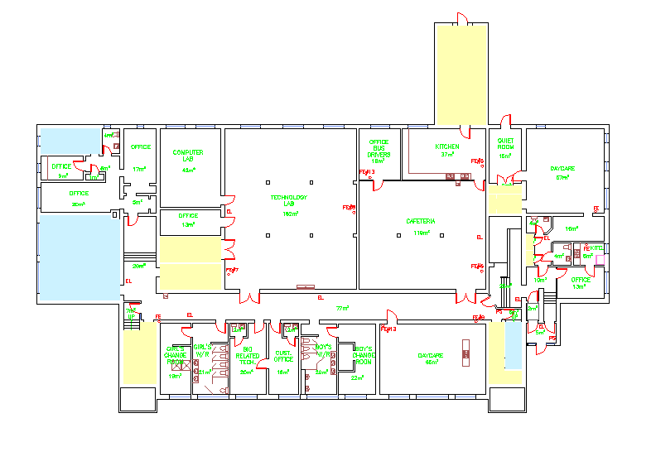

Slide 38
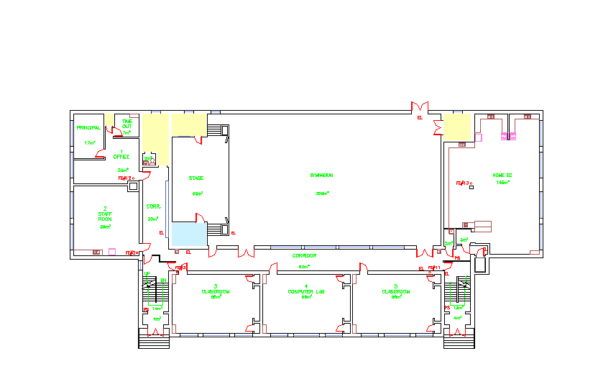

Slide 39
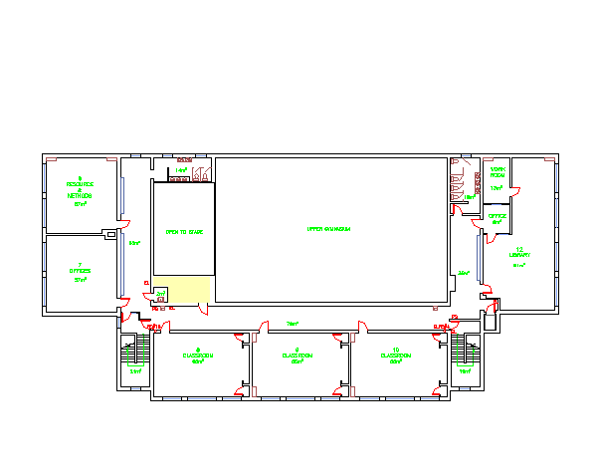

Slide 40
Classrooms
The school was constructed with 10 classrooms.
Presently:
  2 classrooms are being used for classroom teaching spaces
  1 classroom is being used for an computer lab
  2 classrooms are being used by the early childhood center.
  District has office space in the lower level.

Slide 41
Stairwells and Corridors
Stairways are enclosed to meet fire separation requirements complete with fire rated doors, frames and hardware.
Corridor walls are plaster.

Slide 42
Fire Protection
The building is equipped with a Fire Shield fire alarm system.
Fire extinguishers are located throughout the building and fire alarm pull stations are located in corridors.

Slide 43
Domestic & Waste Water
Water is supplied by the Municipality and has a backflow preventer installed.
Water softener connected to water supply.
Hot water is heated with a Giant Cascade 100 gallon hot water heater.
The septic system is municipal.

Slide 44
Heating & Ventilation
Two oil fired Weil-McLain boilers original to the building complete, with new Riello burners (one replaced in 2013, the other replaced in 2014) and two pumps circulate hot water heat.
Heating is controlled by the school.
The building has mechanical ventilation.

Slide 45
Controls & Communications
The building does have a Delta Direct Digital Controls (DDC) for the ventilation system; This system is controlled by a computer in the mechanical room.
The building has a Dukane Public Address system.

Slide 46
Electrical & Lighting
There is a 600 amp, 420 volt entrance through an overhead connection.
An electrical distribution upgrade has been identified as a Capital Improvement Project.
Interior lighting is fluorescent in good condition.

Slide 47
Interior
Washrooms have original urinals, sinks (in good condition), showers are poor and are original. Listed on the Capital Projects.
Floors are tile in the classrooms (original). The halls were new 3-4 years ago.

Slide 48
Interior continued
Interior doors are wood. Panic hardware in the gym.
Gym floor is hardwood with a square footage of 4230.
There is no wheel chair access to the stage.
There is a Whirltec lift with a capacity of 550 pounds.
There is proper access to the roof.
Roof is in good condition and does not leak.

Slide 49
Exterior
Exterior windows are in good shape, although complete replacement was not finished.
Exterior doors are in good condition; 15-20 years old. They are on the Capital Projects list for replacement.
The exterior cladding is masonry brick in good condition.
Parking is adequate to formula, but presents challenges in the winter; pavement is in poor condition.
Exterior lighting is H.I.D. (high intensity discharge).

Slide 50
Property
Staff and visitors share the school parking lot which has been identified on the Capital Improvement list to replace the asphalt.
The driveway is shared by the bus loading zone and parent drop off, and Bath Elementary.
Playground has a soccer field and swings.

Slide 51
Capital Investments
Year | Scope of Work | Cost
2000 | Exterior Windows | $11,691.00
2000 | Roof replacement | $8,600.00
2001 | Exterior Windows | $157,591.00
2001 | Roof replacement | $49,898.00
2009 | Radon Remediation | $12,420.00
2011 | Heating System | $56,284.00

Slide 52
School Physical Plant Status
Building Exterior and Site |  | Description | Estimated Cost
Building Envelope | Exterior Windows | PHASE II (completion of replacements from years ago)
Site | Site Improvement | Paving areas around the school where asphalt has deteriorated.
Building Envelope | Exterior Doors | Six sets are required to be replaced

Slide 53
School Physical Plant Status (continued)
Building Interior and Additions |  | Description | Estimated Cost
Interior | Flooring | Renovate entrance stairways with hard tile
Interior | Bathroom | Renovate and upgrade bathrooms

Slide 54
School Physical Plant Status (continued)
Mechanical and Electrical Systems |  | Description | Estimated Cost
Electrical | Electrical Supply and Distribution | Electrical upgrade (panels)
Heating and Ventilation | Heating System | Replace Boilers. Estimated price to be determined.
 |  | Total estimated cost | $525,000.00

Slide 55

Transportation

Slide 56
Bath Transportation Study
Currently students in grades 9-12 that reside in the Bath Schools Catchment area are bussed to Carleton North High School.
Also, any French immersion students in grade 3-8 are bussed from Bath Schools Catchment area to Florenceville Middle and Elementary Schools.
The morning school bus system currently sees seven buses transport students within the Bath Schools Catchment area into the Bath Middle School, where the grade 9-12 students transfer onto three busses and proceed to Carleton North High School.

Slide 57
Bus Transportation Study
French Immersion students are transferred onto one school bus and are transported to Florenceville Middle School.
The afternoon school bus system currently sees five school busses transport the K-8 students home who attend Bath Elementary and Middle Schools. If these students were sent to Bath Elementary School or Florenceville Middle School, there would not be any impact with regards to the number of school buses or drivers.

Slide 58
Bath Transportation Study
School | Distance 1 way from BMS | Longest Ride In | Longest Ride Out | Earliest Pick-up | Latest Drop Off
Bath Middle School |  | 44 min | 47 min | 7:10 | 3:35
Bath Elementary School |  | 44 min | 47 min | 7:10 | 3:35
Florenceville Middle School | 9.7 km | 55 min | 1 hour- 10 min | 7:10 | 4:00

Slide 59
Current Student Address Distances
 | Distance to BMS (KM) | Distance to BES (KM) | Distance to FMS(KM)
Average Distance | 7.5 | 7.5 | 15.8
Maximum Distance | 15.9 | 15.9 | 24.3
Minimum Distance | 0.5 | 0.5 | 7.6

Slide 60
Current Student Address Distances
Student | Distance to BMS (KM) | Distance to BES (KM) | Distance to FMS(KM)
1 | 15.2 | 15.2 | 23.7
2 | 13.7 | 13.7 | 22.4
3 | 5.8 | 5.8 | 14.2
4 | 13.7 | 13.7 | 22.4
5 | 5.4 | 5.4 | 13.9
6 | 13.2 | 13.2 | 21.6
7 | 4.5 | 4.5 | 12.9
8 | 4 | 4 | 12.4
9 | 4.5 | 4.5 | 12.9
10 | 9.6 | 9.6 | 18.1
11 | 4.6 | 4.6 | 13.2
12 | 12.7 | 12.7 | 21.2
13 | 12.2 | 12.2 | 20.7
14 | 1.2 | 1.2 | 8.5
15 | 13.4 | 13.4 | 21.9
16 | 1.3 | 1.3 | 10
17 | 0.8 | 0.8 | 9.6
18 | 10.4 | 10.4 | 18.8
19 | 6.5 | 6.5 | 14.9
20 | 7.9 | 7.9 | 12.8
21 | 6.5 | 6.5 | 14.9

Slide 61
Current Student Address Distances
Student | Distance to BMS (KM) | Distance to BES (KM) | Distance to FMS(KM)
22 | 0.5 | 0.5 | 9.4
23 | 8.2 | 8.2 | 16.7
24 | 6.3 | 6.3 | 14.7
25 | 5 | 5 | 12.8
26 | 2.7 | 2.7 | 11.1
27 | 14.4 | 14.4 | 22.9
28 | 11.9 | 11.9 | 20.4
29 | 15.9 | 15.9 | 24.3
30 | 1.4 | 1.4 | 8.3
31 | 2 | 2 | 7.6
32 | 12.1 | 12.1 | 20.6
33 | 1.2 | 1.2 | 9.9
34 | 12.1 | 12.1 | 20.6
35 | 5.7 | 5.7 | 14.2
36 | 14.2 | 14.2 | 22.6
37 | 6 | 6 | 14.4
38 | 7.1 | 7.1 | 15.6
39 | 4.2 | 4.2 | 12.6
40 | 9.7 | 9.7 | 18.2
41 | 5.7 | 5.7 | 14.3
42 | 11.3 | 11.3 | 20.1
43 | 5.7 | 5.7 | 14.3
44 | 1.1 | 1.1 | 9.9

Slide 62
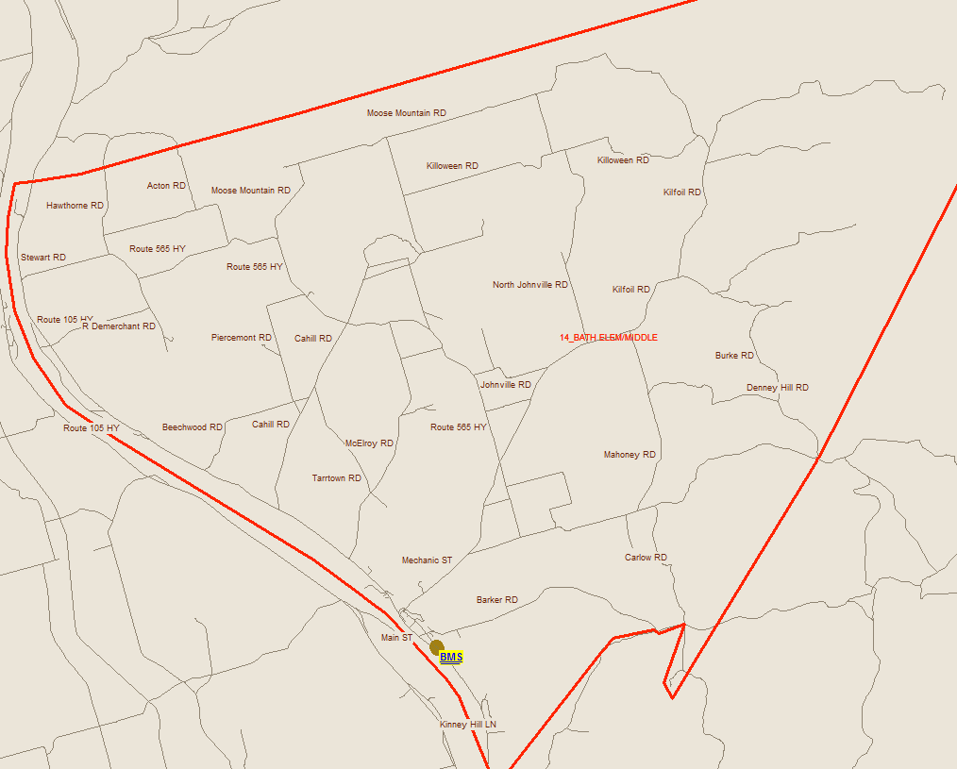
Bus Transportation Study

Slide 63

Finances

Slide 64
Salaries
 | Actual Costs
Cost Centers | Fiscal Year | Fiscal Year | Fiscal Year
 | 2013-2014 | 2012-2013 | 2011-2012
Salaries
Administration | 12,309 | 12,252 | 12,254
Teacher | 348,620 | 451,256 | 443,746
Admin. Assistant | 30,004 | 26,576 | 24,778
Educational Assistant | 42,673 | 36,450 | 21,718
Custodian | 54,582 | 47,790 | 54,827
Total | 488,188 | 574,324 | 557,323

Slide 65
Assigned Budgets
 | Actual Costs
Cost Centers | Fiscal Year | Fiscal Year | Fiscal Year
 | 2013-2014 | 2012-2013 | 2011-2012
Assigned Budgets
Regular Instruction | 7,810 | 7,789 | 6,270
Admin.Support | 1,927 | 2,027 | 3,003
Library | - | - | 383
Teachers Working Conditions | 1,643 | 1,666 | 2,868
Tutor Support | - | - | 1,400
Nutrition | - | - | 1,532
Bilingual Learning Environ. | - | 250 | -
Wellness Grant | 1,507 | 1,516 | -
Co/Extra Trips | 406 | 427 | 510
PSSC | 155 | 320 | 400
Total | 13,448 | 13,994 | 16,367

Slide 66
Facilities Costs
 | Actual Costs
Cost Centers | Fiscal Year | Fiscal Year | Fiscal Year
 | 2013-2014 | 2012-2013 | 2011-2012
Facilities Costs
Electricity | 17,906 | 17,592 | 19,109
Water and Sewer | 9,415 | 9,865 | 10,109
Garbage Removal | 2,340 | 2,340 | 2,340
Ground Maintenance | 3,680 | 3,680 | 3,680
Heating Fuel | 38,683 | 28,464 | 38,125
Cleaning Supplies | 2,406 | 1,198 | 1,060
Minor Repairs | 16,661 | 12,220 | 7,442
Total | 91,090 | 75,359 | 81,865

Slide 67
Total Costs
 | Actual Costs
Cost Centers | Fiscal Year | Fiscal Year | Fiscal Year
 | 2013-2014 | 2012-2013 | 2011-2012
TOTAL COSTS | 592,727 | 663,678 | 655,554

Slide 68
Economic Development

Slide 69
Economic Development
Consultations:
Rebecca Derrah, Director, Step Ahead-Bath Family Learning Centre
Gaylen Drost, Owner Save Easy
Jim Rankin, Businessman and Developer of Bath Hospital Project
Gerald Sullivan, Principal, BMS
Troy Stone, Mayor, Village of Bath
NB Department of Economic Development
Charles McNair, Councilor, Village of Bath

Slide 70
Economic Development
Businesses/Organizations That Have Closed:
Hospital (7 years ago)
Gas Station
Andrea’s Flower Shop (relocated to Florenceville)
Smith Drug (relocated to Florenceville)
Kilcollin’s Funeral Home (relocated to Florenceville)

Slide 71
Economic Development
Existing Businesses/Organizations in the Area:
Step Ahead-Bath Family Learning Centre (located in Bath Middle)
Family and Early Childhood West Inc. (located in Bath Middle)
Marks the Spot Convenience
Scotia Bank
All Aboard Convenience
Diner Down Under
Drost Save Easy

Slide 72
Economic Development
Existing Businesses/Organizations in the Area:
Lions Villa
Greco
Down Home Bakery
Drs. Colin and Bruce Lockhart Medical Office

Slide 73
Economic Development
Existing Businesses/Organizations in the Area:
Steal of a Deal (Second Hand Store)
Riverview Manor Apartments
Carleton Victoria Community Vocational Board Inc.
Bath Community Academic Service Program
Bath Lions Club
The Cooperators Insurance
Monquarter Restaurant and Lounge

Slide 74
Economic Development
Findings:
Residents state the closing of the hospital, and the relocation to Florenceville of a number of businesses affected the community’s tax base. They are concerned that if Bath Middle School closes this will further decrease the Village’s tax base.
There are a number of community groups and organizations that use the school on a regular basis. Community members use the gym for basketball and volleyball. The Step-A-Head Family Learning Centre provides childcare and additional programming; namely, diabetes clinic, cooking classes, community kitchen initiatives, speech therapy, family resource center, breakfast program, and training sessions for early childhood educators. Additionally, there are currently 7 full time employees, and one part-time bookkeeper, generating $120,000 - $140,000 in wages.

Slide 75
Economic Development
There is hope that the special care home will bring in new families. There is concern that if there is no middle school families will choose to live in another community.
The local schools, Bath Elementary and Bath Middle currently collaborate on a number of projects (Remembrance Day, Christmas dinner, ESST, transition, common FTE) and systematic concerns (school bus safety, administrative trouble shooting). The loss of BMS would result in the loss of opportunity for the two schools to partner, if the students went to FMS.

Slide 76
Economic Development
One business owner stated that at one time his business employed 32 people. Currently he employs 17 people. He is concerned about the viability of his business if the school is closed.
One individual has spoken about the possibility of redeveloping the former hospital into a senior care facility ($7 million) with a potential employment of 40 – 50 people. He has also suggested a possible subdivision on the existing hospital lot (25 acres), and the possibility of 3 other businesses to be announced by businessmen and partners. He is concerned the school closure would put these redevelopment plans in jeopardy.

Slide 77
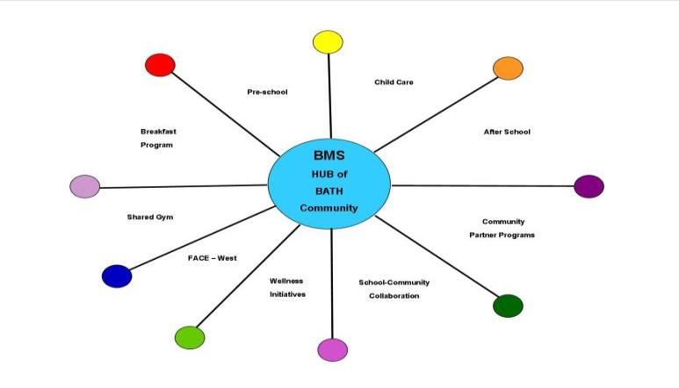
Bath Middle School In The Community

Slide 78
Impact on the Community of Bath
Bath Middle School has become a “COMMUNITY CENTRE”.
Flag Ship of the McCain Early Years sites.
$3000.00 start up funds from Province of New Brunswick
42 families and 71 children registered at Step Ahead Early Learning Centre in Pre School, Child Care and After School programs
11 different Community Partner programs.
Me to We with community support raised 18,000 to build school in Nicaragua.

Slide 79
Impact on the Community of Bath
Family and Early West have offices in school
Community and School usage of the gymnasium and fitness centre
Step Ahead provides a successful universal breakfast program to BMS students

Slide 80

Questions and Answers

Slide 81
Bath Middle School Sustainability Study – Visit our Website for Details!
  Sustainability Study Timeline
  Minister Letters
  Parent Letters
  Bath Middle School at a Glance
  Link to Policy 409
  Public Meeting #1 – Presentation
  www.asd-w.nbed.nb.ca
Feedback can be given
  via email at asdwsustainability@nbed.nb.ca
  through our discussion board at the Bath Middle School Sustainability Study site on our webpage
  mail to Carol Clark-Caterini, Anglophone West School District, 1135 Prospect Street, Fredericton, NB E3B-3B9
Notes:
Reminder of what “sustainability” means:
Maintain the status-quo at Coles Island School
Invest dollars into the infrastructure/programming at Coles Island School
Close Coles Island School and move the students to another school for their continued education

Slide 82
Thank you for coming!

