Slide 1
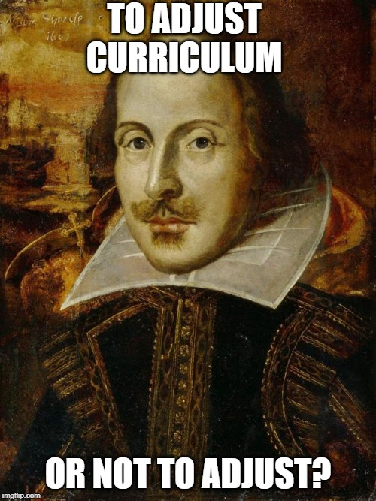
PLP- Adjusted Curriculum
How do I decide to adjust?
How do I ensure that adjustments are appropriate?
These are the questions!

Slide 2
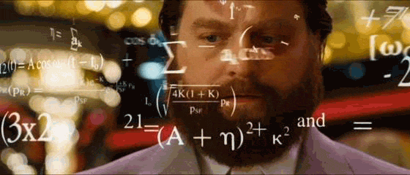
Making the Decision to Adjust Curriculum
This decision should never be made by one person; this is a team decision that should include all stakeholders, including the student's family.
The choice to adjust a student's curriculum can have a significant impact on their future; a major decision not to be taken lightly.
The Decision Rubric guides ESS Teams by laying out many important considerations for a PLP-Adj. Curriculum.
There are also resources available to help with parent information meetings (posted under PLPs on Teams site).
PLP-ADJ: Decision-making should be a thoughtful process, but not “unsolvable”. There are clear steps we can follow.

Slide 3
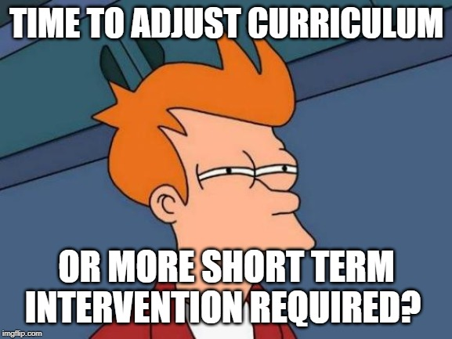
Decision Rubric for PLP-Adjusted Curriculum
A tool located within ESS Connect for ESS teams considering a PLP-Adjusted Curriculum for a student
Compiles a body of evidence and data to inform decision making
Ensures validity of PLP-Adjusted Curriculum
Notes:
Wendy will do a quick demo showing how Decision Rubric works

Slide 4
Considerations FOR Adjusting Curriculum:
When NOT to Adjust Curriculum:
In K-2 (without a diagnosis or supporting assessment data)
Universal or Justified Accommodations have not been put in place
Without evidence-informed interventions
There’s an LD (stand-alone)
An exceptionality (or characteristics of an exceptionality) AND an educational delay
Targeted, evidence-informed interventions at all three tiers has occurred
Assessment data (formal, informal, formative, observations etc.) has been completed by teacher and ESTs

Slide 5
Considerations FOR Adjusting Curriculum:
When NOT to Adjust Curriculum:
A lack of reliable evidence/data to support the decision
A lack of ongoing collaboration, consultation, and communication with all stakeholders, including family
When the timing is not ideal (nearing end of semester or school year)
Accommodations (universal and/or justified), support, strategies, resources, technology have been in place, but student still making few gains
ESS Team and stakeholders have all been involved in discussions and decision-making process
Post-secondary implications have been clearly discussed (see family brochure)

Slide 6
PLOF vs. PLOP
The PLOF or Present Level of Function (supported by formal/informal assessments), located in the Justification Summary, is the portion of the learner’s Personalized Learning Plan that gives an idea of where a student is performing at in a general sense.
The PLOP or Present Level of Performance, located under Adjusted Curriculum, demonstrates where a student is at in a particular area of the curriculum.
An accurate and complete PLOP is essential for determining appropriate goals. It is essential to know where the learner is starting from, to determine where they need to go.

Slide 7
Guidelines for Writing an Effective PLOP:
Uses positive language
(ex: student CAN....)
Is specific, complete, and accurate
(ex: John can add two-digit numbers on a calculator with 50% accuracy)
Is based on current information gathered from a variety of sources
(ex: formal/informal assessments, portfolios, observations, interviews)
Addresses a variety of abilities
(ex: academic, non-academic, transitions)
Tip: Begin with a learner's strengths in an area of concern and conclude with needs.
Notes:
Postive language: Ex: Student...spells creatively, requires visual or auditory cues, follows one-step directions, is willing to try again, completes directions when they are repeated, requires transitions with preparation
Specific: Ex: Student...adds two-digit numbers correctly 50% of the time using a calculator, copies simple shapes (circles and triangles) with a large crayon, can put on her indoor shoes with verbal prompting.
Sources: Informal and formal testing
Portfolios of work
Observations of classroom performance, behavior, and/or social interactions
Interviews with parents, teachers, therapists, administrators, and/or the student

Slide 8
Example of Well-Written PLOP:
Example 1:
Asher attends class regularly, attempts all in-class assignments, and completes homework assigned in math class. When Asher uses a calculator, his computation accuracy is between 50 and 60 percent for most assignments and quizzes. Without a calculator, his computation accuracy is 20 percent. Additionally, Asher has difficulty staying on task. He needs to increase his computation accuracy using a calculator.

Slide 9
Strengthening Adjusted Curriculum Goals
  Clear justification/rationale for adjustment of curriculum must be present.
  Each goal should start with an effectively written PLOP.
  Strongly written (SMART) descriptions of changed outcomes to show how student will build upon their PLOP.

Slide 10
Changed Outcome
SCO 4.3: Use pictures and illustrations, word structures and text features (eg. Table of contents, heading and subheadings, glossaries, indices, structures of narrative and different types of expository texts, key ideas, margin notes) to locate topics and obtain or verify their understanding of information.
Description of Changed Outcome
By the end of November 2019, Hannah will be able to locate and name the following features of non-fiction books: Table of Contents, Glossary. She will label these features in 4 out of 5 different texts.
Notes:
Time sensitive, describes what Hannah will be able to do. Measurable success (4/5).

Slide 11
Changed Outcome
SCO 4.3: Use pictures and illustrations, word structures and text features (eg. Table of contents, heading and subheadings, glossaries, indices, structures of narrative and different types of expository texts, key ideas, margin notes) to locate topics and obtain or verify their understanding of information.
Description of Changed Outcome
Hannah will meet this outcome by then end of 2nd term with 70% accuracy
Notes:
Hannah is just scoring 70% on an outcome. The outcome has not been adjusted at all.

Slide 12
Changed Outcome
SCO 4.3: Use pictures and illustrations, word structures and text features (eg. Table of contents, heading and subheadings, glossaries, indices, structures of narrative and different types of expository texts, key ideas, margin notes) to locate topics and obtain or verify their understanding of information.
Description of Changed Outcome
Leveled text will be used for this outcome as appropriate.
Notes:
The level of the text does not reflect the actual skills being developed in the outcome; therefore no change to the actual outcome has been made.

Slide 13
Changed Outcome
SCO 4.3: Use pictures and illustrations, word structures and text features (eg. Table of contents, heading and subheadings, glossaries, indices, structures of narrative and different types of expository texts, key ideas, margin notes) to locate topics and obtain or verify their understanding of information.
Description of Changed Outcome
Hannah will receive EA support to use pictures and illustrations, word structures, and text features to locate topics and obtain or verify their understanding of information.
Notes:
Description of changed outcomes should identify what student will be able to do independently. Including “with EA or teacher support” does not reflect student’s individual skills and abilities.

Slide 14
Can we
"Un-Adjust" a Student's PLP?
A yearly review of a student's Justification Summary and Adjusted Curriculum Plan is necessary to ensure it is aligned with student's strengths and needs.
Continued communication with home/stakeholders is key to keep up to date on skill acquisition and current needs.
Decision Rubric can be used on an ongoing basis to evaluate the need for PLP-Adjusted Curriculum.
After completing the steps above, it is sometimes determined that certain curricular adjustments are no longer needed for a student.
Of Course!

Slide 15
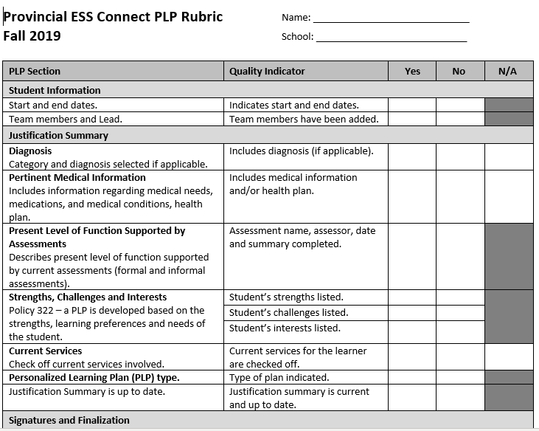
Using the PLP Evaluation Rubric
Let's take a few moments to review the Provincial PLP Evaluation Rubric (DRAFT)
Let's use it to evaluate one of our own PLP-Adjusted Curriculum.
Notes:
Having an EST-R and subject teacher use the rubric to evaluate (or co-evaluate) PLPs can be an excellent form of PL.

