Slide 1
Welcome to Barnhill Memorial School

Slide 2
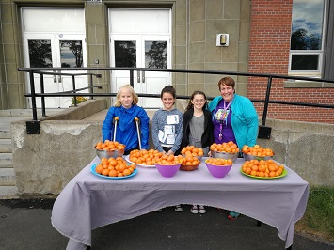
Agenda/Topics to be Covered
Introduction
Vision Statement
Mission Statement
Who’s Who
Student Behaviour
Barnhill Supports & Activities
Parent-Teacher Communication
Closed Campus
Daily Schedule
How To
Enter the school in the morning
Exit the school in the afternoon
Clementines on Terry Fox Day!

Slide 3
Agenda/Topics to be Covered Continued…
Nutrition Breaks & Lunch
Nut/Scent Free Policy
Electronic Device Policy
Missed Work
Lost & Found Items
Procedures & Routines
Going from class to class
Entering and leaving classrooms
Using the washroom
Transportation

Slide 4
Vision Statement
Barnhill does
their
BEST!
Better Every Single Time!

Slide 5
Mission Statement
The Community of Barnhill Memorial School provides a variety of quality learning experiences to support students in reaching their potential and to become contributing members of society.

Slide 6
Who’s Who
Ms. Jill Ferguson – Principal
Mrs. Liza Muise – Vice Principal (Acting)
Ms. Kristen Sloat & Mrs. Cheryl Kennedy (EST-Resource)
Ms. Jennifer Levesque – Guidance Counsellor
PSSC – Parent School Support Committee
Grade 6, 7 & 8 – English Prime & French Immersion
Current School population: 363
14 homerooms

Slide 7
Student Behaviour We are a Restorative Practice School
All students have the right to a safe and healthy learning environment.
To achieve this, students are asked to develop and demonstrate a sense of responsibility and accountability for their actions.

Slide 8
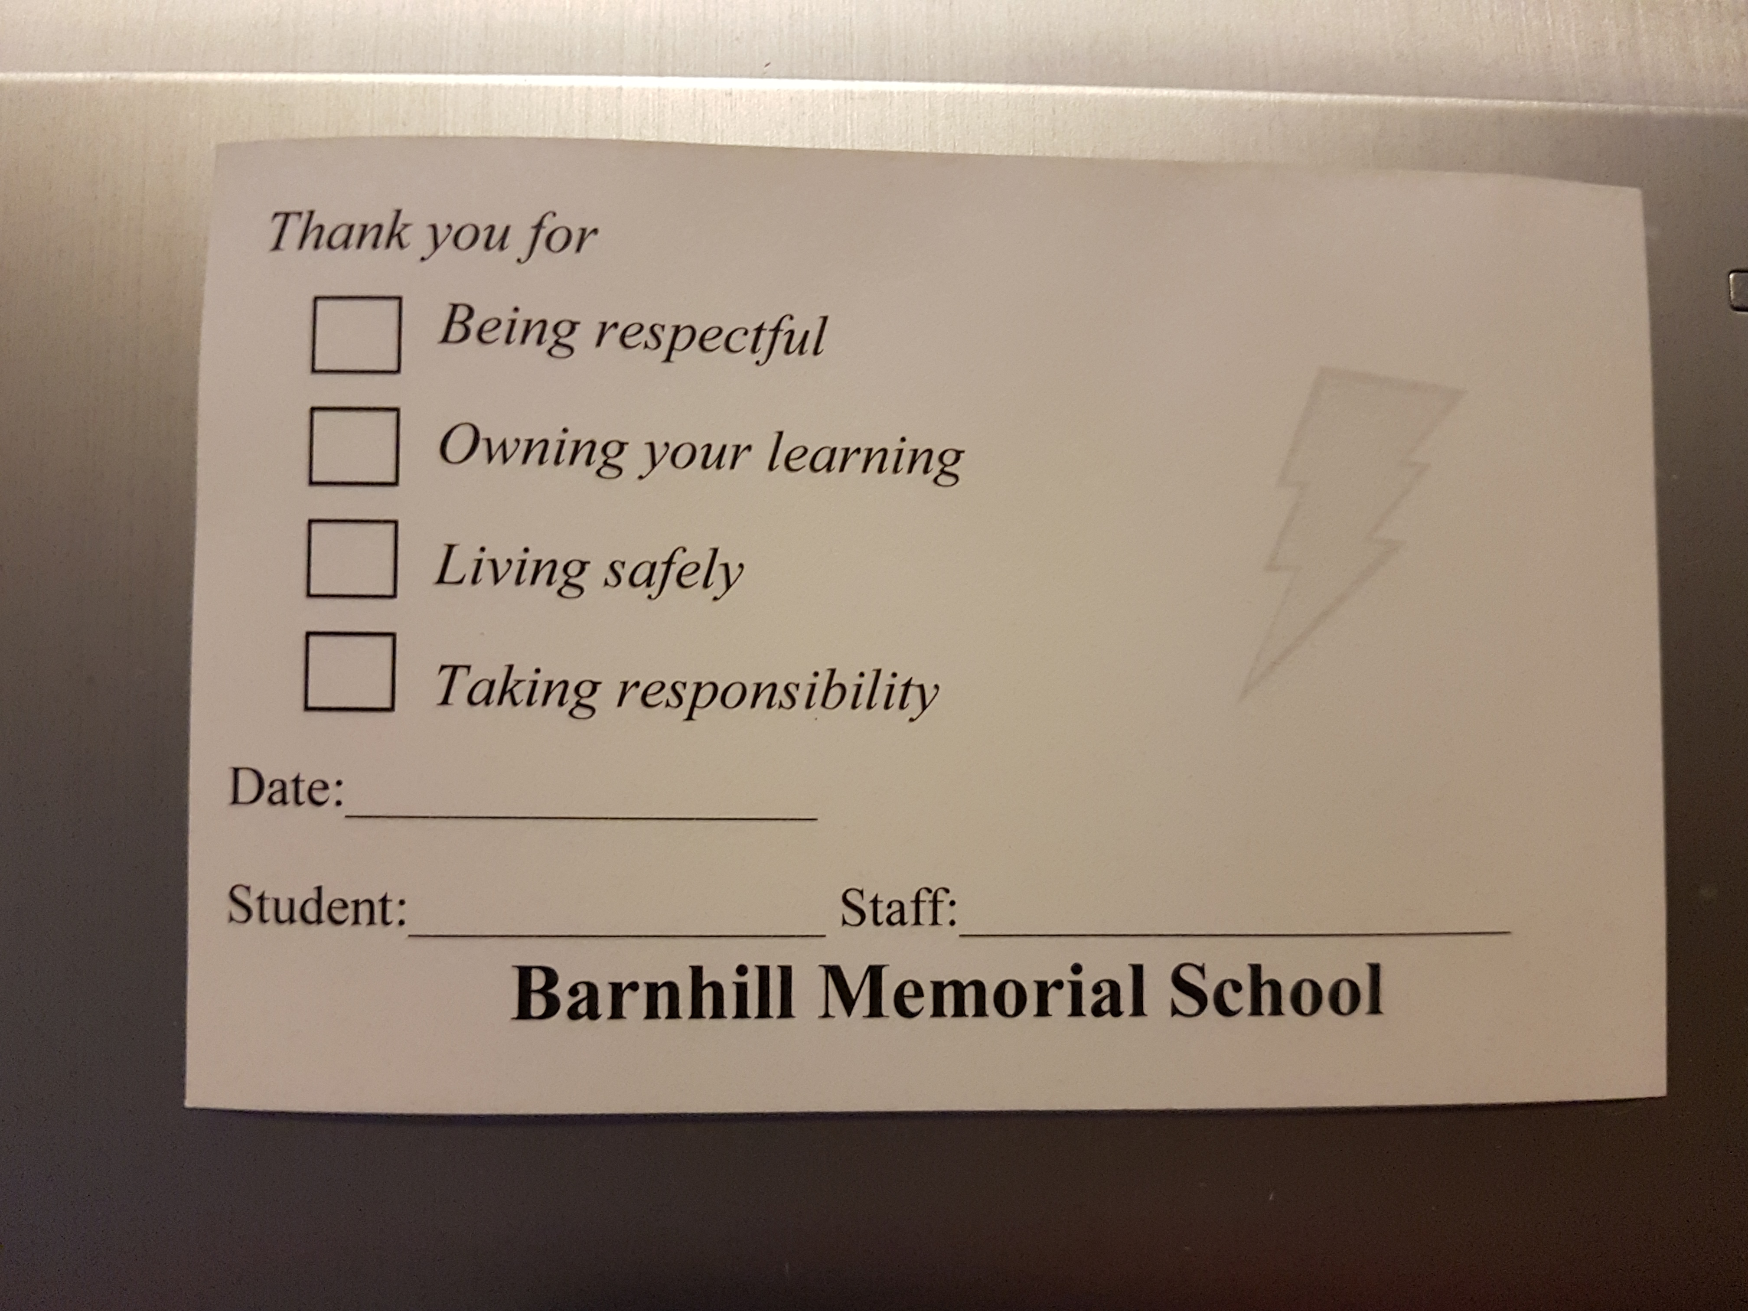
Barnhill BOLT
Be Respectful
Own Your Learning
Live Safely
Take Responsibility
You can receive a BOLT ballot from a Barnhill staff member for displaying one of the traits. There will be weekly prizes in your classroom bubble given by your homeroom teacher.

Slide 9
Grade 6 Classes
English Prime
French Immersion
Specialties
English Language Arts – 5 times a week
Math – 5 times a week
Post Intensive French – 3 times a week
Science - 3 times a week
Social Studies – 3 times a week
PDCP / Health – once a week
Physical Education – twice a week
English Language Arts - 3 times a week
Math – 5 times a week
French Immersion Language Arts – 5 times a week
Science - 3 times a week
Social Studies – 3 times a week
PDCP / Health – once a week
Physical Education – twice a week
Each student at Barnhill has three speciality classes a week. They are:
Art – once a week
Music – once a week
Technology – once a week

Slide 10
Parent-Teacher Communication
Agenda
Phone/Email
An agenda will be provided to all students in the fall.
An agenda is an excellent form of communication for parents and teachers to stay connected.
Homeroom teachers will have made initial contact with families before the first week of school
We will be connecting throughout the school year by email or phone calls.

Slide 11
Parent-Teacher Communication Continued…
Lightning News/Social Media
The Barnhill Lightning News will be on the Barnhill Memorial School Website, and it will be emailed to families. The Lightning News has updates, as well as important dates to make note of.
Barnhill updates the website weekly. To inform home of important information: http://web1.nbed.nb.ca/sites/district8/schools/barnhill/pages/welcome.aspx
We are also on Twitter https://twitter.com/BarnhillMiddle
and Facebook! https://www.facebook.com/pages/category/Middle-School/Barnhill-Memorial-School-172223096823543/

Slide 12
Closed Campus
Barnhill Memorial School is a closed campus for the safety of our students.
Students are to remain on-site when they arrive in the morning until they are dismissed at the end of the day.
A parent/guardian must sign his/her child out in the office if he/she has to leave for any reason prior to dismissal. Parents are asked to not enter the building when picking up students, please call the office when you arrive.
Drop-off and pick-up area in the morning and after school is
at the Cenotaph, between Barnhill and St. Rose School.

Slide 13
Your Daily Schedule
8:25 am Arrival
8:25 – 8:35 Homeroom
8:35 - 9:00 Foundations
9:00 – 10:00 Period 1
10:00 – 10:05 Break
10:05 -11:05 Period 2
11:05 - 11:10 Break
11:10 - 12:10 Period 3
12:10 - 12:50 Lunch
12:50 - 1:50 Period 4
1:50 - 1:55 Break
1:55 - 2:55 Period 5
2:55 pm Dismissal

Slide 14
How to Properly Enter the School
Morning supervision begins at 7:55 AM. Each student goes immediately to his/her assigned entry door and makes his/her way to his/her homeroom in a calm and orderly manner. While in the hallway students must wear a clean community face mask.
Organize all necessary materials for your first class and use the washroom/get a drink.
Upon arriving in class, take a seat and begin silent reading.

Slide 15
How to Properly Exit the School
Return to your homeroom classroom bubble.
Gather your belongings.
Wear your facemask until exiting building using assigned door.
-Bus students walk to the bus area.
- Walkers leave school grounds immediately.
- Pick-ups are to walk directly to guardian's vehicle.

Slide 16
Nutrition Breaks
There are two breaks in the morning. One between 1st and 2nd period and another between 2nd and 3rd period. They are each 5 minutes.
In the afternoon, between 4th and 5th period, you have a third break. This break is also 5 minutes in length.
During these times you may:
Get a snack;
Prepare materials for next class.

Slide 17
Lunch
The 14 homerooms will be divided into two groups. Group A will be eating first and then going outside. Each week, each homeroom in Group A will be assigned a designated eating area and a designated outdoor space. While Group A is eating, Group B is outside. At transition, both groups switch.
The first of February is the halfway point of the school year and this is when both groups will switch schedules – Group B will now eat first and then go outside. The designated eating areas are the Lunch Room, the Lightning Lounge, the Balcony, the Games Room, and the Learning Commons.
Hot Lunch is also available starting in October and will be delivered to each homeroom class.
When the bell rings signaling the end of lunch and if you are outside, you line up at your designated door. You wait for the teacher on duty to unlock it. You go straight to your homeroom classroom and gather all of your materials for 4th period.

Slide 18
Nut/Scent Free Policy
ASD-S is nut and scent free. We at Barnhill, wish to create a healthy environment for all students and staff.

Slide 19
Phone Use and Electronic Device Policy
The office phone is available for use. Details are outlined in your Agenda.
The Electronic Device Policy is also available on our website.
Texting: Students can receive texts before 8:25 AM, at lunch, and after 2:55 PM.

Slide 20
Missed Work
It is your responsibility to catch up on missed work when you are absent.
Follow these steps:
Check your teacher’s homework website. http://web1.nbed.nb.ca/sites/district8/schools/barnhill/Pages/Homework-Blogs.aspx
Call or text a friend from your class and ask him/her what assignment(s) you have for homework.
Ask your teachers if you are uncertain.

Slide 21
Lost and Found Items
Items that are misplaced will be turned into the office.
Items will be returned upon request.

Slide 22
Going From Class to Class
The only time you will move to a different classroom is for Physical Education, art and Music classes.
Classes will be escorted by an adult.
Masks must be worn while in the hallway.
Use an indoor voice (with this many people, it gets noisy VERY QUICKLY!)
please WALK from class to class AND stay TIGHT TO The righT.

Slide 23
Entering and Leaving Classrooms
Always use hand sanitizer when entering and leaving a room.
Always ask permission before leaving the room.
Always ensure your area is cleaned and sanitized before leaving a room.

Slide 24
Using the Washroom
Trips to the Washroom are to be as minimal as possible.
Masks must be worn at all times in the washroom.
Always sign out when you leave the room for any reason (washroom, medical appointment, etc.) every teacher has a sign out binder in his/her classroom. You need to indicate what time you left, where you went, and what time you returned.
Go to the washroom on the same floor as the room you are currently in.

Slide 25
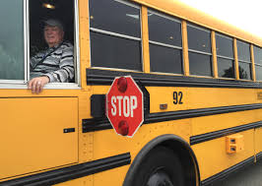
Transportation
Travelling on a school bus is a privilege.
Follow the rules, be respectful to your bus driver, and enjoy your ride!

Slide 26
Communication
If you have any questions, please feel free to contact:
Principal – Ms. Jill Ferguson at Jill.Ferguson@nbed.nb.ca
Vice Principal (Acting) Mrs. Liza Muise at Liza.Muise@nbed.nb.ca

