Slide 1

Welcome to
Barnhill Memorial School

Slide 2
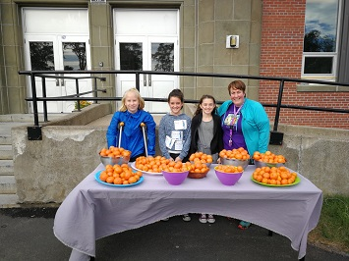
Agenda/Topics to be Covered
Introduction
Vision Statement
Mission Statement
Who’s Who
Student Behaviour
Barnhill Supports & Activities
Parent-Teacher Communication
Closed Campus
Daily Schedule
How To
  Enter the school in the morning
  Exit the school in the afternoon
Clementines on Terry Fox Day!

Slide 3

Agenda/Topics to be Covered Continued…
Nutrition Breaks & Lunch
Nut/Scent Free Policy
Electronic Device Policy
Missed Work
Lost & Found Items
Procedures & Routines
  Going from class to class
  Entering and leaving classrooms
  Using the washroom
Transportation
School Dances

Slide 4
Vision Statement
Barnhill does
their
BEST!
Better Every Single Time!

Slide 5

Mission Statement
The Community of Barnhill Memorial School provides a variety of quality learning experiences to support students in reaching their potential and to become contributing members of society.

Slide 6
Who’s Who
Jill Ferguson – Principal
Liza Muise – Vice Principal (Acting)
Lindsey Carleton (EST-Guidance)
Kristen Sloat & Cheryl Kennedy (EST-Resource)
Christy Cunningham (PSSC – Parent School Support Committee)
Grade 6, 7 & 8 – English Prime & French Immersion
Current School population: 400
  15 classes – French and English

Slide 7

Student Behaviour
We are a Restorative Practice School
All students have the right to a safe and healthy learning environment.
To achieve this, students are asked to develop and demonstrate a sense of responsibility and accountability for their actions.

Slide 8

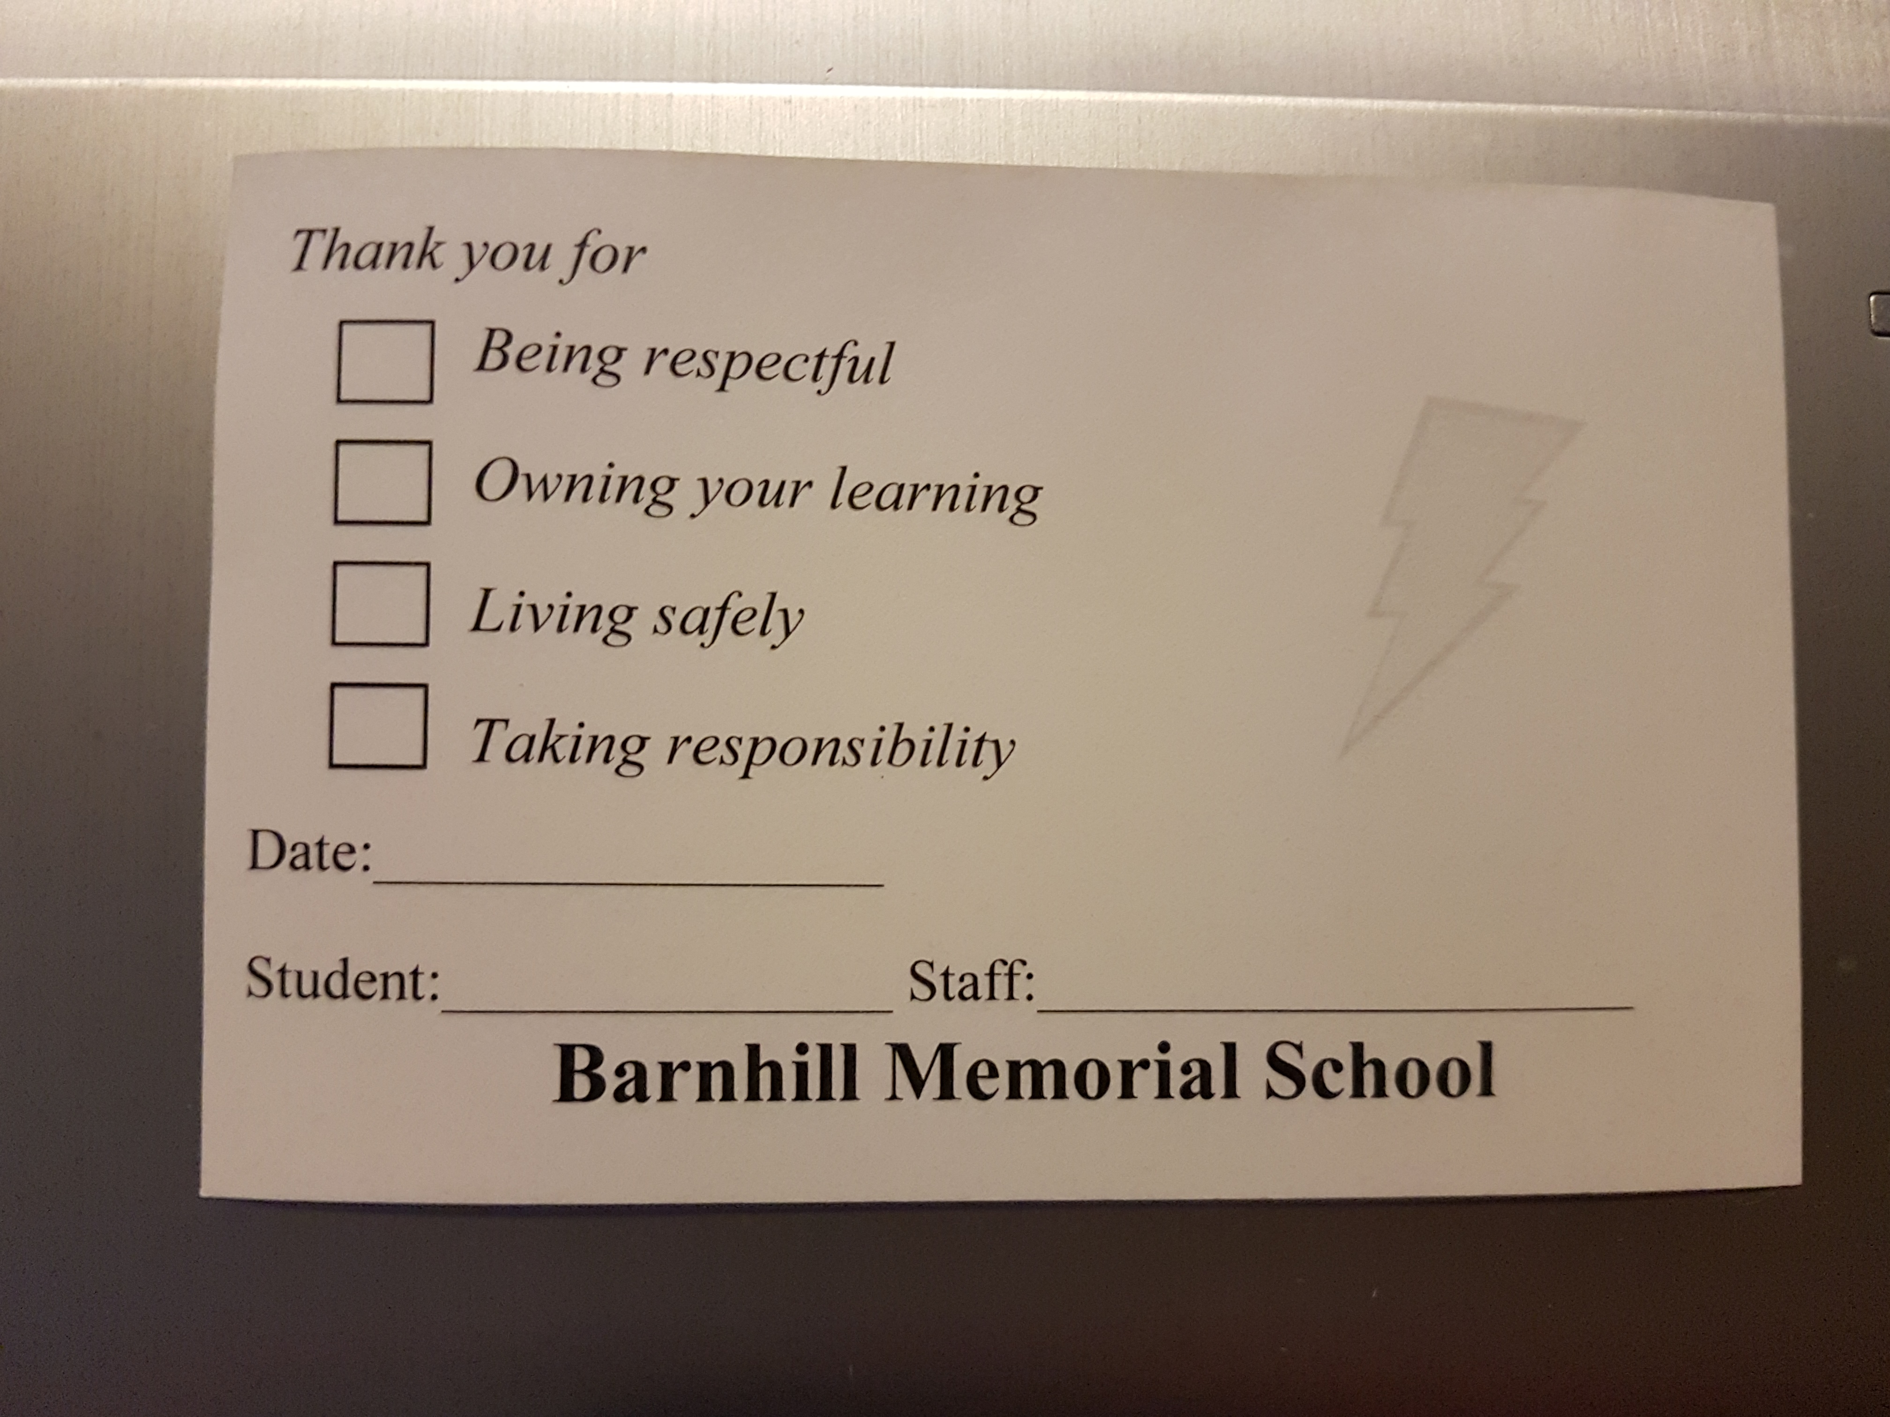
Barnhill BOLT
Be Respectful
Own Your Learning
Live Safely
Take Responsibility
You can receive a BOLT ballot from a Barnhill staff member for displaying one of the traits. We have weekly draws for Barnhill swag.

Slide 9
Grade 6 Classes
English Prime
French Immersion
Specialties
English Language Arts – 5 times a week
Math – 5 times a week
Post Intensive French – 3 times a week
Science - 3 times a week
Social Studies – 3 times a week
PDCP / Health – once a week
Physical Education – twice a week
English Language Arts - 3 times a week
Math – 5 times a week
French Immersion Language Arts – 5 times a week
Science - 3 times a week
Social Studies – 3 times a week
PDCP / Health – once a week
Physical Education – twice a week
Specialties are rotated throughout the school year. For example, all grade six students could have Art at the beginning of the school year, the grade seven students would have Music, and the eights would have Technology. After a few months, your speciality would change.
Art - 3 times a week
Music - 3 times a week
Technology - 3 times a week

Slide 10
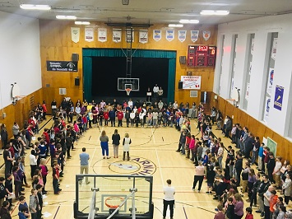
Barnhill Supports &
Activities
Supports
Activities
Guidance
Resources / Co-Teaching Model
Academic Intervention
  Ex: Math help on Tuesday
Homework Help
Peer Helpers / SRC
Foundation Support
Intramurals
Math enrichment
Games Room
Learning Commons
Student Representative Council
  Celebrate Assembly Speakers
  and Tech Crew
School Musical
Reading Buddies – St. Rose
Best Buddies
GSA
Anti-Discrimination Day

Slide 11
Barnhill Sports Teams
Cross Country – male/female
Soccer – male/female
Badminton – male/female
Basketball – male/female
Volleyball – male/female
Flag Football – one team with males & females
Track & Field – male/female

Slide 12
Parent-Teacher Communication
Agenda
Phone/Email
An agenda will be provided to all grade six students in the fall.
An agenda is an excellent form of communication for parents and teachers to stay connected.
Homeroom teachers will make initial contact with families within the first few weeks of school.
Email can be used throughout the year to connect with home, as well as phone calls.

Slide 13
Parent-Teacher Communication Continued…
Lightning News/Social Media
The Barnhill Lightning News will be on the Barnhill Memorial School Website, and in our front lobby each Monday morning. The news has updates, as well as important dates to make note of.
Barnhill updates the website weekly to inform home of important information: http://web1.nbed.nb.ca/sites/district8/schools/barnhill/pages/welcome.aspx
We are also on Twitter https://twitter.com/BarnhillMiddle
and Facebook! https://www.facebook.com/pages/category/Middle-School/Barnhill-Memorial-School-172223096823543/

Slide 14

Closed Campus
Barnhill Memorial School is a closed campus for the safety of our students.
Students are to remain on-site when they arrive in the morning until they are dismissed at the end of the day.
A parent/guardian must sign his/her child out in the office if he/she has to leave for any reason prior to dismissal.
Drop-off and pick-up area in the morning and after school is
at the Cenotaph, between Barnhill and St. Rose School.

Slide 15

Your Daily Schedule
8:20 am Arrival
8:25 – 8:35 Homeroom
8:35 - 9:00 Foundations
9:00 – 10:00 Period 1
10:00 – 10:05 Break
10:05 -11:05 Period 2
11:05 - 11:10 Break
11:10 - 12:10 Period 3
12:10 - 12:45 Lunch
12:50 - 1:50 Period 4
1:50 - 1:55 Break
1:55 - 2:55 Period 5
2:55 pm Dismissal

Slide 16
How to Properly Enter the School
Yard supervision begins at 7:50 AM. Students wait outside until 8:20 AM, when the doors will be opened.
Go immediately to your entry door and make your way to your locker in a calm and orderly manner.
Gather all necessary materials for your first class and use the washroom/get a drink before homeroom.
Upon arriving in class, take a seat and begin silent reading.
If entering the school after the bell, sign in, and obtain a late slip from the office before walking to your class.

Slide 17
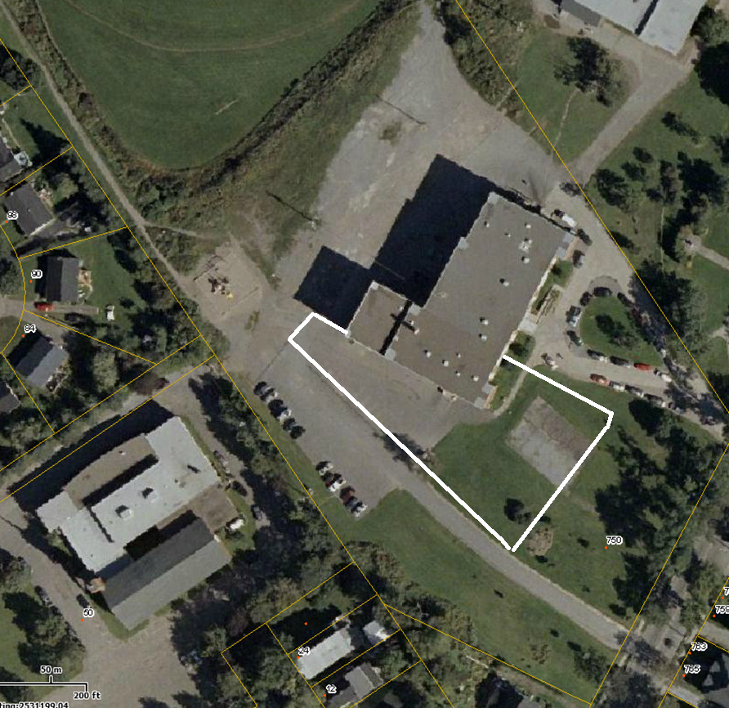
Morning Boundaries

Slide 18
How to Properly Exit the School
Go to your locker immediately following period 5. Gather your belongings and you may leave for the day.
Be mindful of personal space when walking to and working at your locker.
Bus students walk to the bus area.
Walkers leave school grounds immediately.
If you stay for an after school activity, report to the designated area – make sure transportation has been arranged beforehand.
Students must remain with that teacher while in the building.

Slide 19

Nutrition Breaks
There are two breaks in the morning. One between 1st and 2nd period and another between 2nd and 3rd period. They are each 5 minutes.
In the afternoon, between 4th and 5th period, you have a third break. This break is also 5 minutes in length.
During these times you may:
Go to the bathroom;
Get a drink from the fountain;
Get a snack from your locker;
Get the books you need for your next class.

Slide 20
Lunch
All students eat for the first half of lunch. You may eat in the Lunch Room, the Lightning Lounge, or the Balcony. The canteen is open for the first half of lunch. Hot Lunch is also available and is to be picked up during this time.
At transition, all students go outside.
When the bell rings, you line up at one of the side doors. You wait for the teacher on duty to unlock both doors. You go straight to your locker and gather all of your materials for 4th period. You go directly to your 4th period class. YOU DO NOT HAVE A LOT OF TIME. DO NOT WASTE IT.

Slide 21
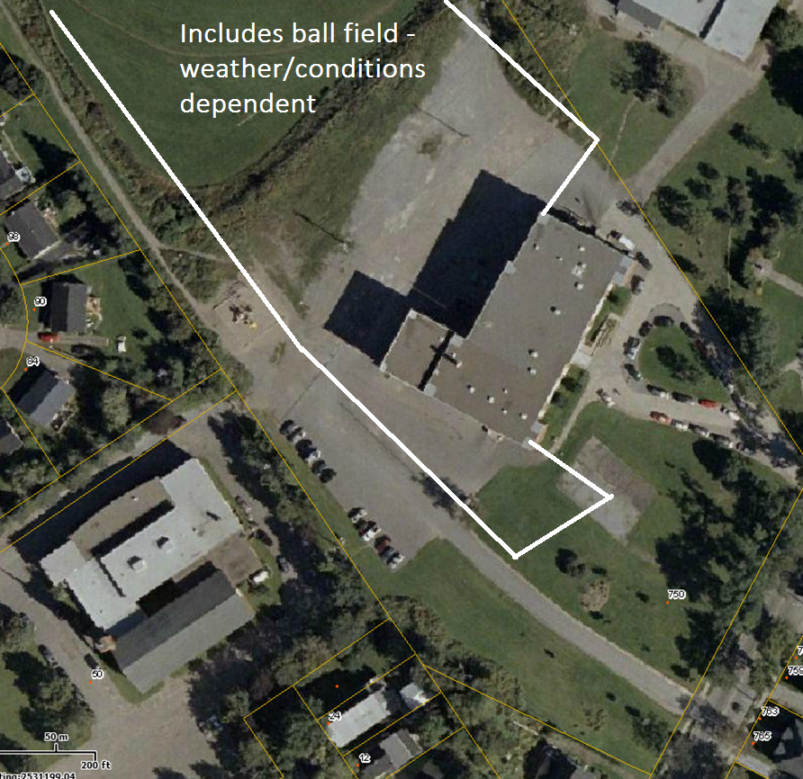
Noon Boundaries

Slide 22


Nut/Scent Free Policy
ASD-S is nut and scent free. We at Barnhill, wish to create a healthy environment for all students and staff.

Slide 23


Phone Use and Electronic Device Policy
The office phone is available for use. Details are outlined in your Agenda.
The Electronic Device Policy is also outlined in your Agenda.
Texting: Students can receive texts before 8:20 AM, at lunch, and after 2:55 PM.

Slide 24
Missed Work
It is your responsibility to catch up on missed work when you are absent.
Follow these steps:
  Check your teacher’s homework website. http://web1.nbed.nb.ca/sites/district8/schools/barnhill/Pages/Homework-Blogs.aspx
  Call or text a friend from your class and ask him/her what assignment(s) you have for homework.
  Ask your teachers if you are uncertain.

Slide 25

Lost and Found Items
Please be responsible for your own items.
If you have lost an item, there is a Lost & Found bin outside the gym.

Slide 26
Going From Class to Class
Use an indoor voice (with this many people, it gets noisy VERY QUICKLY!)
please WALK from class to class AND stay TIGHT TO The righT.

Slide 27
Entering and Leaving Classrooms
Please do not enter ANY classroom until YOU ARE GREETED BY A TEACHER.
If a teacher is not outside waiting for you when the bell rings, line up outside his/her classroom. Use an indoor voice and wait patiently.
As for leaving the classroom, the teacher dismisses you, NOT the bell.

Slide 28
Using the Washroom
Washroom breaks are for emergencies only. Please try to wait until break or lunch.
Always sign out when you leave the room for any reason (washroom, medical appointment, etc.) every teacher has a sign out binder in his/her classroom. You need to indicate what time you left, where you went, and what time you returned.
Go to the washroom that is closest to the class that you are currently in.

Slide 29
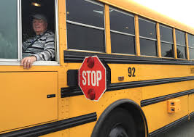
Transportation
Travelling on a school bus is a privilege.
Follow the rules, be respectful to your bus driver, and enjoy your ride!

Slide 30


School Dances
We have several dances each school year.
All school dances start at 6:30 and end at 8:30.
The price of admission is $5.
If you would like to invite a guest from another Middle School, you must sign them in ahead of time in the office. You must speak with Ms. Ferguson.

Slide 31
Communication
We are excited to see you in the fall!
If you have any questions, please feel free to contact:
  Principal - Jill Ferguson at Jill.Ferguson@nbed.nb.ca
  Vice Principal (Acting) Liza Muise at Liza.Muise@nbed.nb.ca

