Slide 1


Lightning News
April 3 – April 6

Slide 2
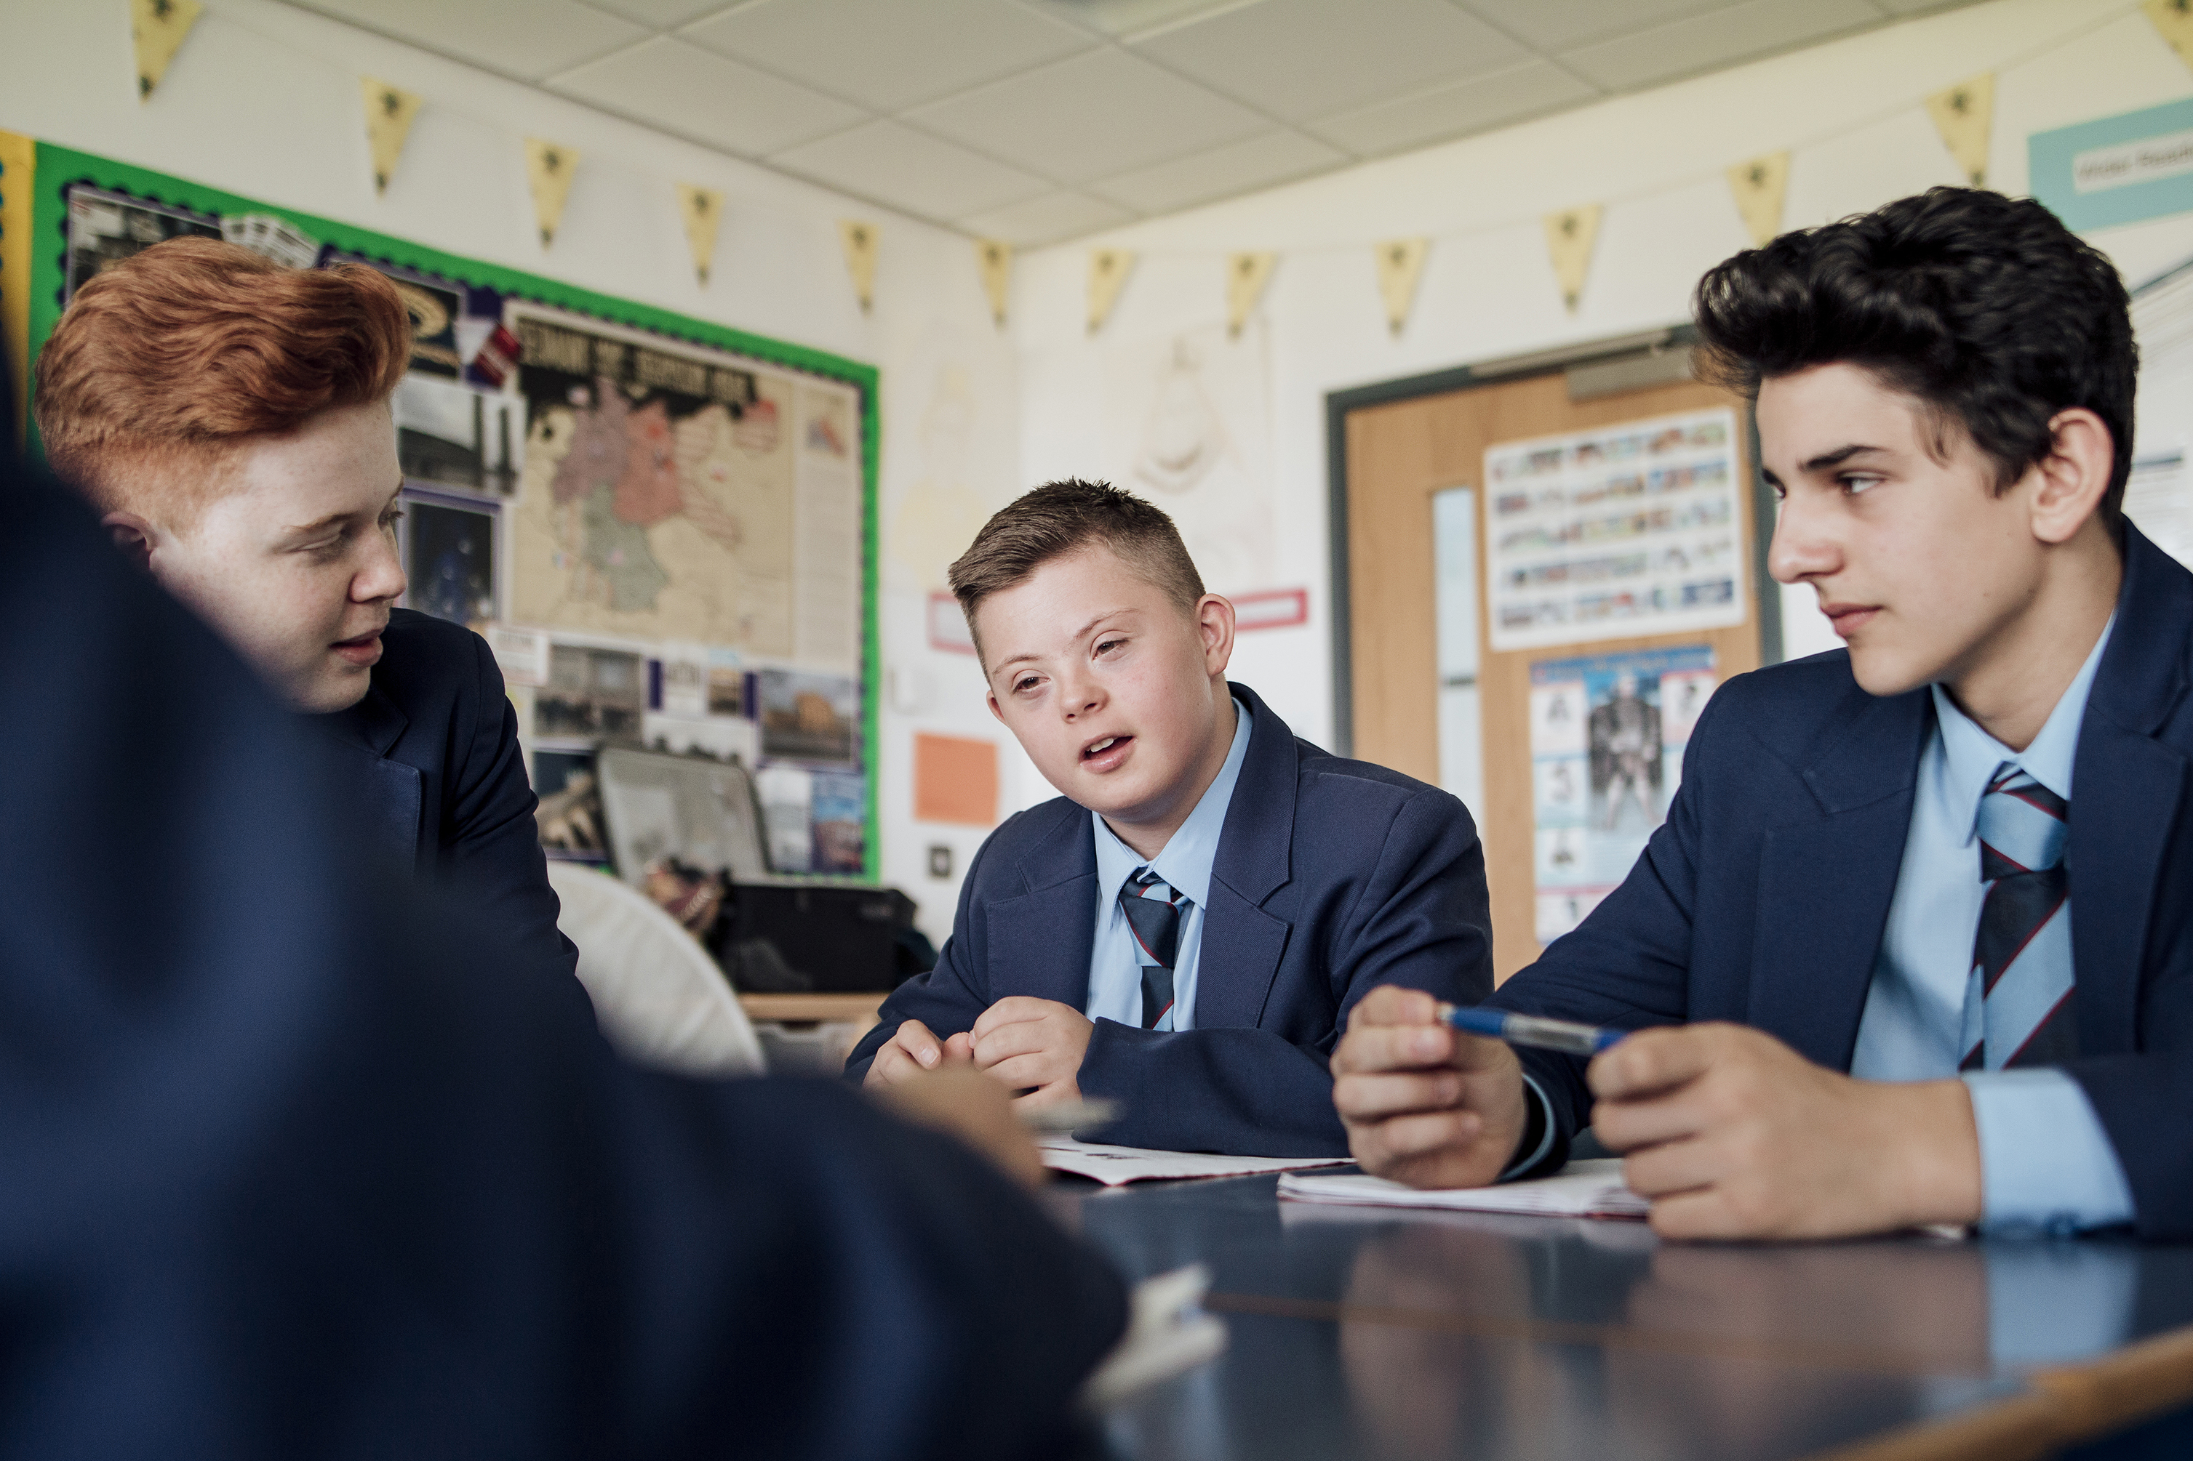
The theme for the month is “citizenship.”
Personal qualities of a good citizen:
Honesty –tell the truth.
Integrity – be morally upright.
Responsibility – to be accountable for yourself and your actions.
Respectfulness - treat others how you want to be treated.

Slide 3

Happy Easter!
Good Friday is April 7^{th.}
Easter Monday is April 10th.

Slide 4
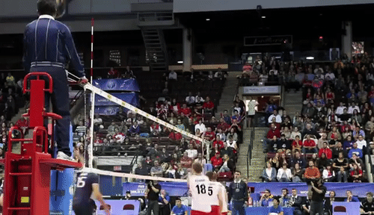
Volleyball
Monday April 3rd – Boys Volleyball practice 3pm – 4:30pm
Tuesday April 4th – Boys Volleyball game @ FHS.
Wednesday April 5th – Girls Volleyball practice 3pm – 4:30pm
Thursday April 6th – Girls Volleyball game here vs FHS.

Slide 5

Report Cards:
All students will be bringing their report card home on Thursday, April 6th.
Letters of information regarding the Parent/Guardian/Teacher conferences will be included in the report card envelope.
Conferences will be Thursday, April 13th and Friday, April 14th.

Slide 6

Immunization
The grade 7 HPV immunization clinic is on Wednesday, April 5th. Please remember to eat breakfast and wear short sleeved shirts.

Slide 7
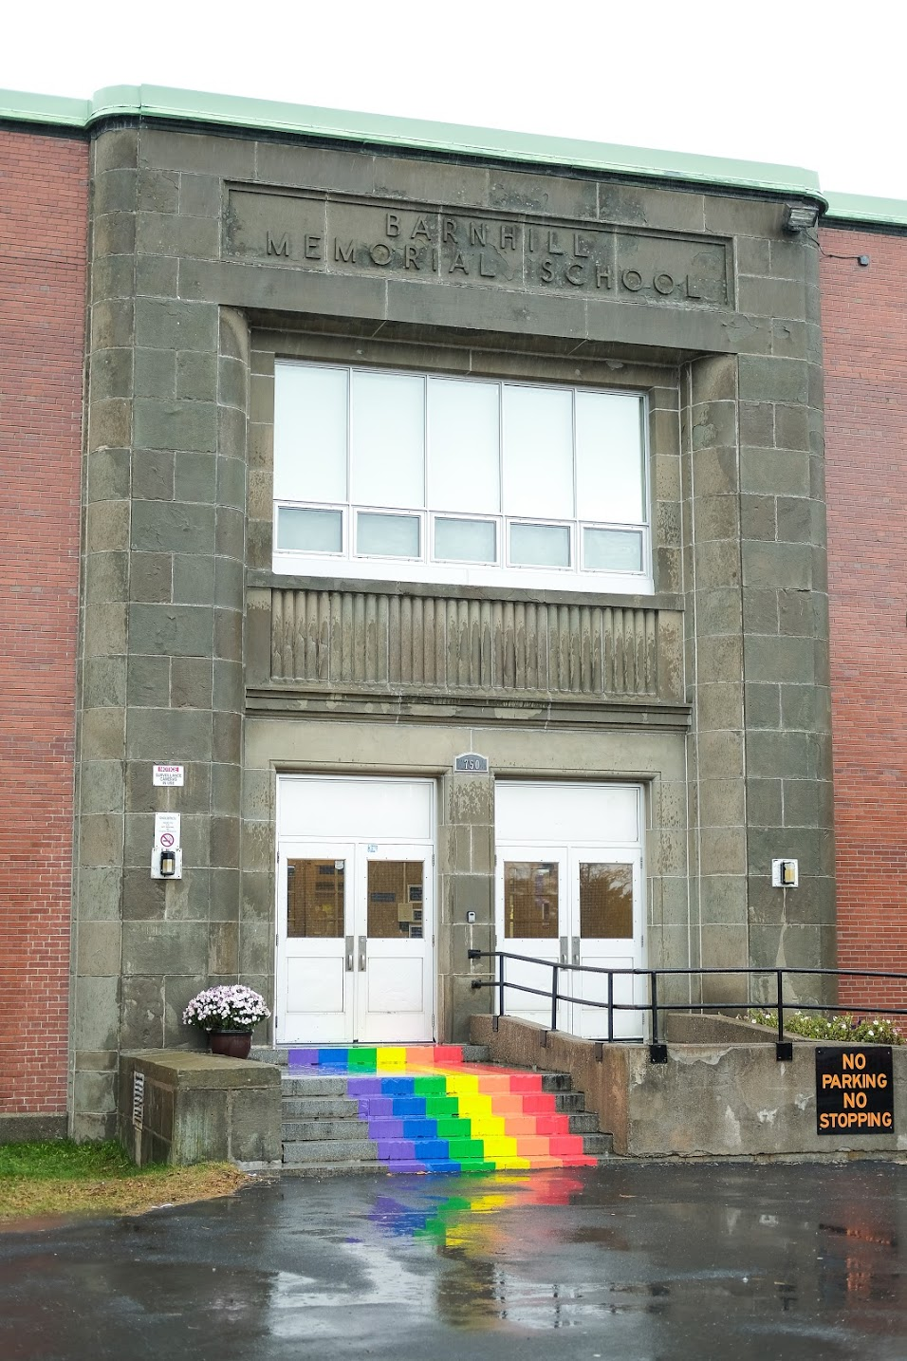
Thank you and have a great week.

