Slide 1
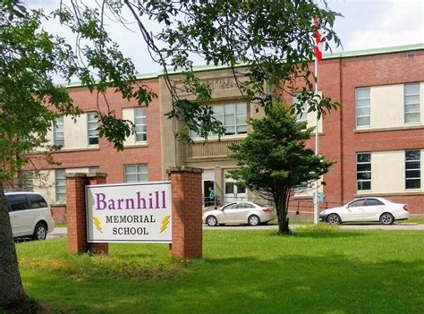

Lightning News
June 19 -23 , 2023

Slide 2

June Theme - Perseverance
We hope everyone enjoys their final week of the school year.
~ Thank you from everyone at Barnhill Memorial School.

Slide 3

June is Pride Month in Canada

Slide 4


Barnhill
Memorial
Middle School
We recognize and celebrate the history, heritage, resilience and diversity of First Nations, Inuit and Metis across Canada.
This Photo by Unknown Author is licensed under CC BY

Slide 5

Lost and Found
There will be a locker clean out this week and students will be bringing items home for the summer.
Any of the items that have been left behind will be donated to the “Clothes Closet” at Hillcrest Church for charity.

Slide 6



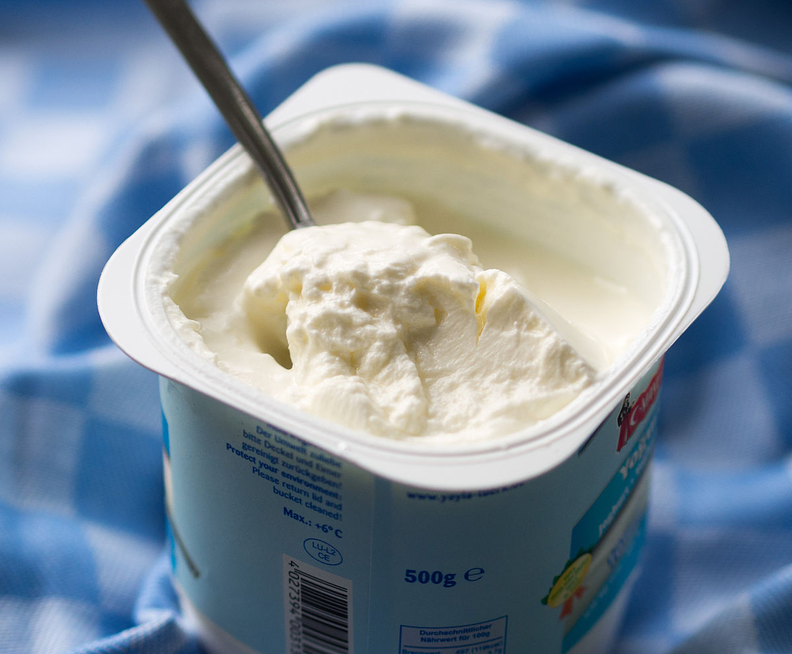
The Healthy Breakfast Program
The Healthy Breakfast Program will be available until the last day of school, Friday June 23rd.
There will not be a hot lunch on Friday, June 23rd.
This Photo by Unknown Author is licensed under CC BY-NC-ND
This Photo by Unknown Author is licensed under CC BY-SA
This Photo by Unknown Author is licensed under CC BY-SA

Slide 7
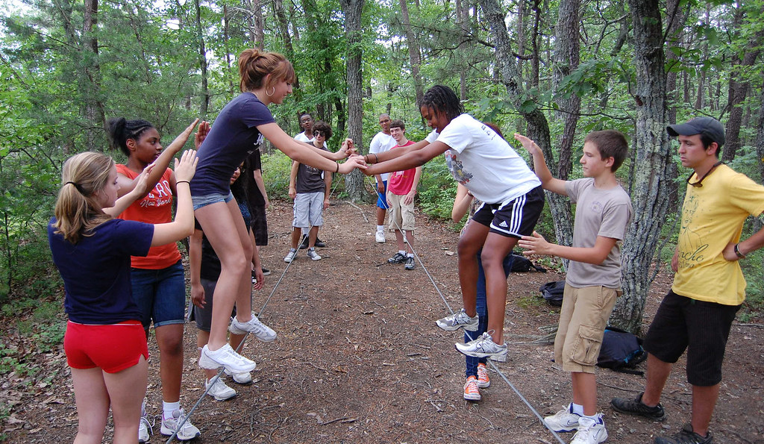
Outdoor Field Day
Mrs. Graham and Ms. Jenkin’s have organized a fun-filled day of outdoor activities for all our students to enjoy on Monday, June 19th.
This Photo by Unknown Author is licensed under CC BY-NC

Slide 8
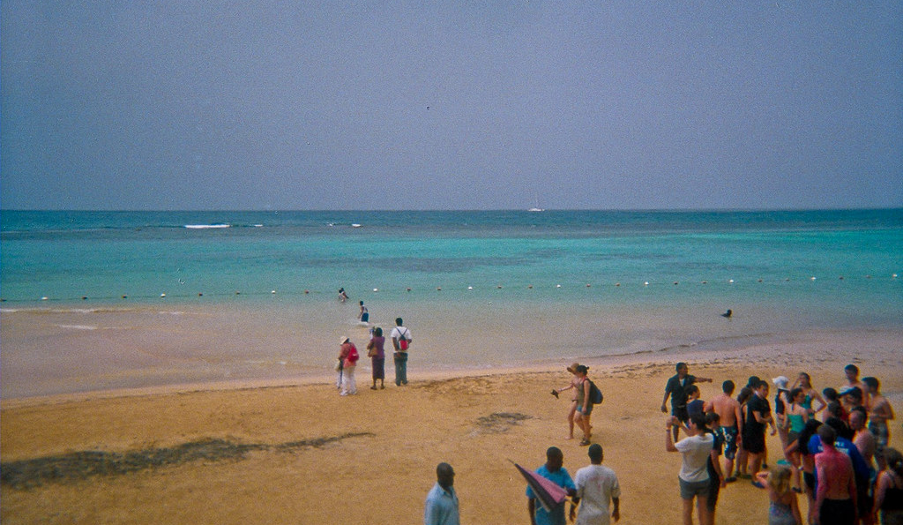
Tuesday, June 20th is New River Beach Day with the Rain Date being on Wednesday, June 21st.
New River Beach Day has become a tradition at Barnhill Memorial School and one that all students and staff enjoy.
Please bring your lunch, towels, sunscreen, bathing suit and plenty of water to enjoy while out in the sun.
This Photo by Unknown Author is licensed under CC BY-SA-NC

Slide 9

Awards Assembly will be Thursday, June 22nd at 10:00 a.m.
The Athletic Awards will be at 1:00 p.m.
We will be recognizing students for their leadership, perseverance, and citizenship in the school environment and on teams.

Slide 10

Go LIGHTNING!!!!!
On Thursday, June 22nd is the Moving Up Ceremony for the grade 8 students and their guests.
The Ceremony will begin at 5:00 p.m. with doors opening at 4:30 p.m.
There will be a reception for the grade 8 students and guests after the certificates have been awarded.
To complete the evening there will be a final dance ($5.00 at the door) until 8:30 p.m. for all students.
This Photo by Unknown Author is licensed under CC BY-NC

Slide 11

Final Day of School for students is Friday, June 23rd.
Please come to school and get your report cards, your yearbook and say your good bye’s.
Grade 8’s we wish you all the best as you move up to high school.
Grade’s 6 and 7 we will see you in the Fall.
This Photo by Unknown Author is licensed under CC BY-NC-ND

Slide 12

Barnhill does their BEST- BETTER EVERY SINGLE
TIME!
HAVE A GREAT SUMMER!!

