Slide 1



Lightning News May 23rd – 26th.
May theme of the month – “Gratitude.”
“What a wonderful miracle, if only we could look through each other’s eyes for an instant.” ~ Thoreau ~

Slide 2


Please wear Gray for Brain Tumour Awareness on Friday, May 26th.

Slide 3

enjoy the Production of Alice.
It is this week!
You can purchase tickets in advance at the office.
The play will be in our gymnasium on May 24th and May 25th ~ Seating will be first come first serve, there is no reserved seating.

Slide 4
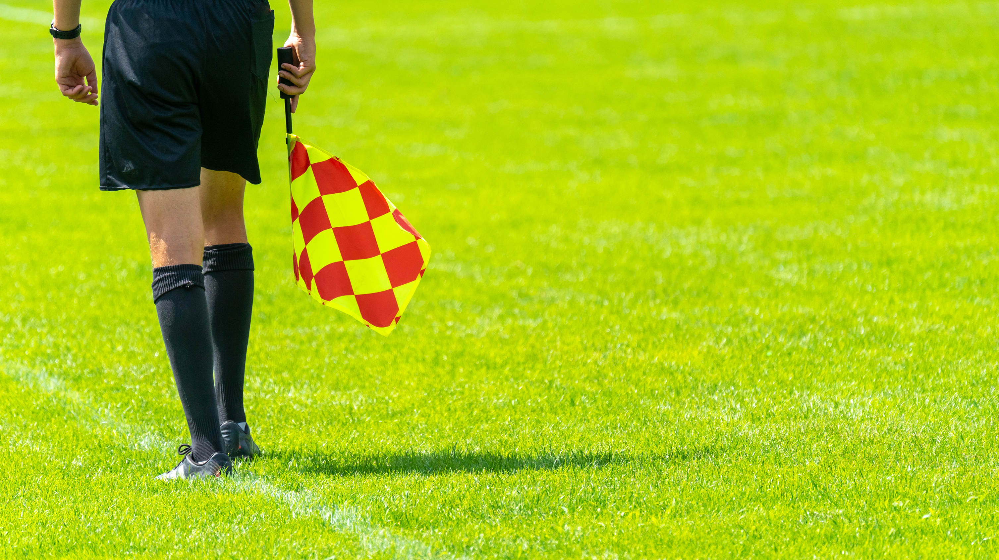
Athletics
Flag Football
Tuesday to Thursday: Flag Football practice from 3:00 – 4:30 p.m.
Flag Football Tournament on Sunday, May 28th at Shamrock Field.

Slide 5

May is Asian Heritage Month:
This is a month to take the opportunity to learn more about the diverse culture and history of Asian communities in Canada.
This month is also a reminder for all of us to come together to combat anti-racism and discrimination in all it’s forms.

Slide 6
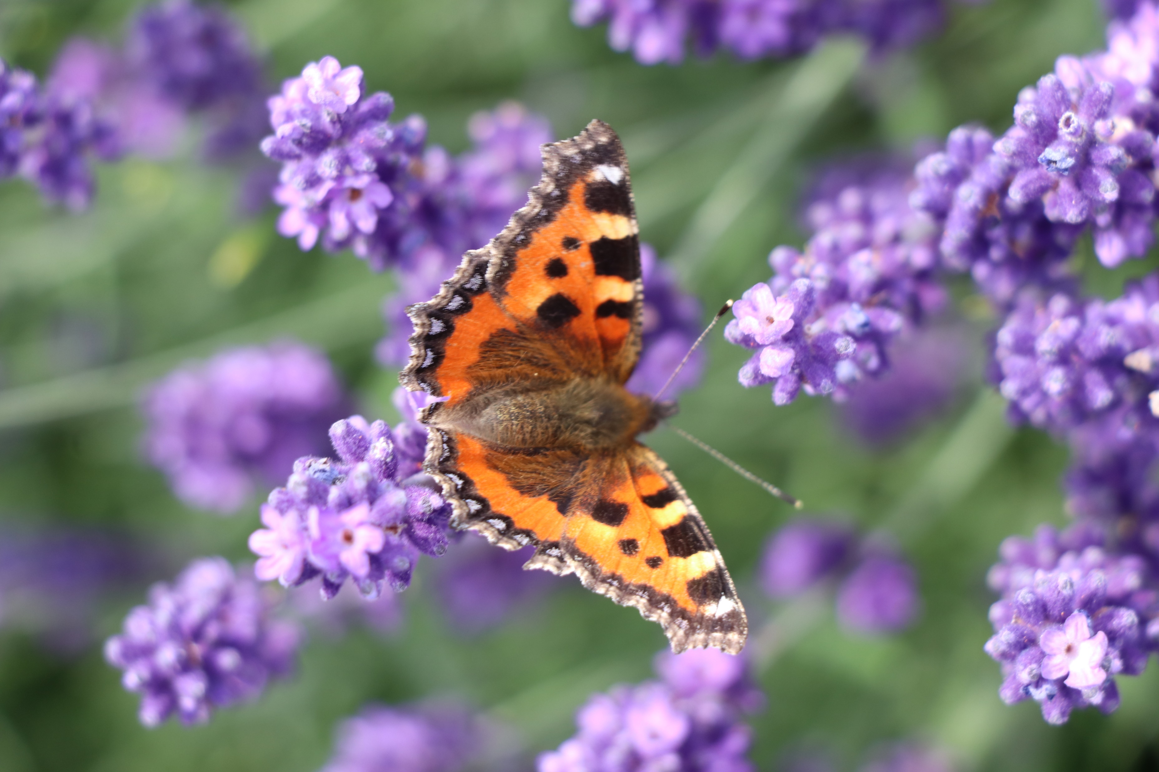
Upcoming
Food Allergy Awareness:
Wear purple on Monday, May 29th in honour of Caroline Lorrette who passed away from an allergic reaction to dairy.
www.sweetcarolinefoundation.ca

Slide 7

Mental Health
Raise awareness of mental illness, fight discrimination and provide support through becoming more aware of the facts.
Everyone struggles, just be a nice human.

Slide 8
Upcoming events
We are very Excited to have the Harbour View Band to Come and perform for us on Monday, June 5th at 11:15 a.m.
June 6th – Grade 6 Timbertop field trip this for Madame Cullinan, Madame Lise and Madame Murphy’s classes.
June 7th – Track & Field meet at UNBSJ Rain date is June 8th.
June 13th - Grade 8 High School visits to Harbour View/ St. Mac’s and Saint John High.
June 14-17th – Grade 8 Quebec Trip
June 15th – Grade 6 Bowlarama field trip from 12:30 – 2:30 p.m.
June 16th – Grade 7 Bowlarama field trip from 12:30 – 2:30 p.m.
June 19th – Outdoor Field Day
June 20th – New River Beach
June 21st – New River rain date
June 22nd - Award assemblies during the school day, Moving Up ceremony & Year End dance. The ceremony starts at 5:00 p.m. and the dance is from 7:00 p.m. – 8:30 p.m.
June 23rd – Last Day for students, report cards and yearbooks go home.

Slide 9

Breakfast, Snacks, and Lunch
We will have pizza and a canteen at lunch on Friday, May 26th .
We are selling Mr. Freeze for $1.00 at the canteen to help fundraise for the grade 8 Quebec Trip.
Healthy breakfast items are available every morning for all students.
Enjoy your long weekend.

