Slide 1
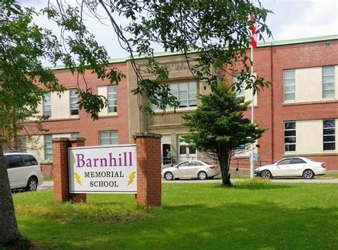

Lightning News
April 11th – 14th , 2023

Slide 2

April Theme – Citizenship
“Education is the process by which the individual relates to the universe, gives citizenship in this changing world and shares kindness with others to create goodness in their soul.”
~Anonymous~

Slide 3

Responsibilities as a Canadian Citizen
To help people in your community.
To obey the law.
To vote in elections when you are 18 or older.
To protect Canada’s Heritage including cultural and architectural.
To take care of the environment by avoiding waste and pollution.
To take responsibility for oneself and one’s family.
To respect the rights and freedoms of others.

Slide 4

Helping Others in the Community
Millions of volunteers give their time to help others, without being paid.
Helping people in need, helping at school or community groups, volunteering at a food bank or other charity, or assisting newcomers to Canada, are all great ways to help the community.
Volunteering teaches us new skills and helps us to make new friends.

Slide 5

This Week in History
Terry Fox
April 12, 1980
Terry Fox begins his run across Canada, raising $23,000,000 for cancer research. His right leg had been amputated due to bone cancer. By September, he had made it half-way (3,339 miles) before lung cancer forced him to stop.
This Photo by Unknown Author is licensed under CC BY-NC-ND

Slide 6

April is Autism Awareness Month
MYTH:
Individuals with autism do not want to make friends.
FACT:
Autism impairs social interactions of the individual. This does not mean that they don’t want to socialize. They may seem unfriendly or reluctant on the outside, but this results from the fact that they may struggle with social skills.

Slide 7

April is Autism Awareness Month
Myth:
Vaccinations can cause Autism.
Fact:
While there is no known single cause of ASD, there is no evidence to support a link between vaccines and ASD.
(American Academy of Pediatrics, 2017).

Slide 8

Parent/Guardian
Student/Teacher Conferences
Parent/guardian/student/teacher conferences:
Please book your conference time, the letter of information is in your child's report card envelope.
Conferences:
Thursday, April 13th 4:00 p.m. – 7:00 p.m.
~ These will be in-person.
Friday, April 14th 9:00 a.m. – 11:00 a.m.
~ These will be virtual
NO SCHOOL FOR STUDENTS
on Friday, April 14th.

Slide 9
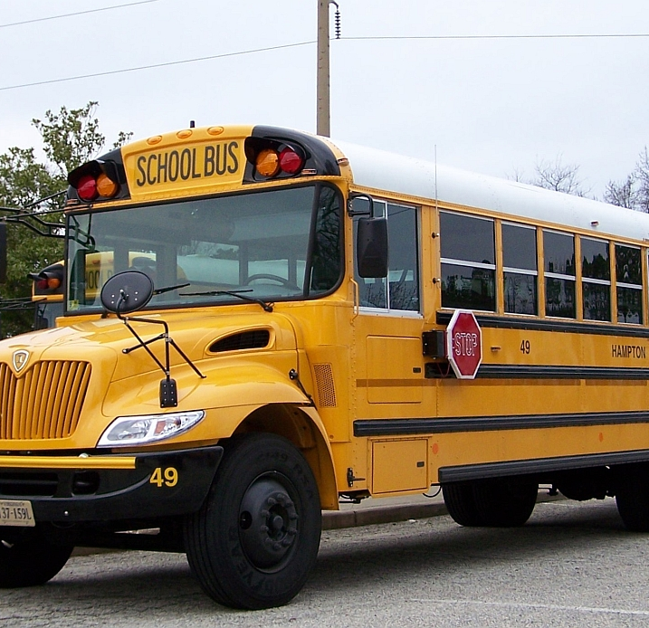
School Bus Guidelines
The bus is an extension of school and the same protocol and expectations of behaviour extend to the school bus.
Students are to only travel on their own assigned bus. Students are not to travel on different buses.

Slide 10

Athletics:
Volleyball practices:
Tuesday, April 12th is boys from 3:00 p.m. – 4:30 p.m.
Wednesday, April 13th is girls from 3:00 p.m. – 4:30 p.m.

Slide 11

On the Horizon:
Harvey Studios will be in on Thursday, April 20th to take pictures of all our teams and groups. They will also take pictures of our new students and students who missed out on their pictures in the Fall.

Slide 12

Barnhill does their BEST- BETTER EVERY SINGLE
TIME!
HAVE A GREAT WEEK!!

