Slide 1
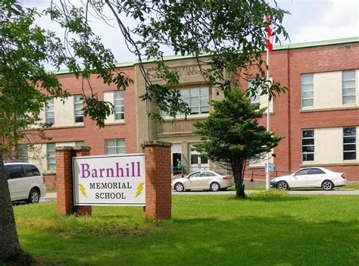

Lightning News
April 17 – 21, 2023

Slide 2

April Theme – Citizenship
“Good citizenship in person needs to flow over into good citizenship online. It has a lot of the same principles: respect, being kind and meeting expectations.”
~J. Felty~

Slide 3

Digital Citizenship
Digital citizenship refers to the responsible use of technology by anyone who uses computers, the Internet, and digital devices to engage with society on any level.
That can mean checking a bank account, purchasing a product, or simply keeping in touch with a friend.
As a result, there’s a major difference between good digital citizenship and bad digital citizenship.

Slide 4

Digital Citizenship
Good Digital Citizenship
Connecting with one another, empathizing with each other, and creating lasting relationships through digital tools.
Bad Digital Citizenship
Cyberbullying, irresponsible social media usage, and a general lack of knowledge about how to safely use the Internet.

Slide 5

PCAP – on- line assessment.
All our students will be participating in the Pan-Canadian Assessment Program (PCAP) starting with practice on April 17th.

Slide 6

Wednesday April 19th
Humour Day
With a healthy dose of humour, life is just easier to cope with.
It lowers stress levels and helps us to see things in a different light.
Because laughter is good for us, humour can play an important role in our health.

Slide 7

PSSC is on Tuesday, April 18th from 6:00 p.m. – 7:00 p.m. in Room 28.
All are welcome!

Slide 8

April is Mathematics and Statistics Awareness Month
The aim has been to increase the level of interest in the study of mathematics.
Also, to increase the level of understanding and appreciation for the wide range of applications for mathematics.

Slide 9

April is Autism Awareness Month
Autism is a developmental disability that a person is born with and impacts social and communication skills and behaviour.
Autism is a spectrum meaning the range of experiences is wide, varied and vast. Every autistic person is different. They all have their own unique strengths.

Slide 10

How to be more supportive, accepting and inclusive
When it comes to being accepting of each other, it all comes down to kindness. Be kind to everyone no matter their differences.
Talk about Autism respectively, honour people’s preferences for communication styles, and don’t assume things about Autism.

Slide 11

Saturday April 22 Earth Day
To coincide with Earth Day, we are organizing a school wide clean up of the yard on Friday, April 21st.
We are also sending out a challenge to all staff and students to bring a “litter less” lunch.
Please pack all your food items in re-usable containers so we will not have any garbage.

Slide 12

Grade 8 Quebec Cultural Trip
Payments
It is important to ensure your payments are up to date, to finalize the remaining details of the trip.
For example, hotel rooms; students are picking their rooming partners however rooms cannot be confirmed until numbers are finalized.
If there are any concerns, please contact liza.muise@nbed.nb.ca

Slide 13

Yard Sale time!
Where: Barnhill Gym
When: May 27th
Time: 8am – 1pm
Why: For families to raise some funds, selling no longer wanted treasure. Great way to for grade 8 students to earn some spending money.
Cost: To rent a 6-foot table is $12, and 2 for $20.
Contact: Please contact Liza Muise for more questions – 506-658-5972 liza.muise@nbed.nb.ca

Slide 14



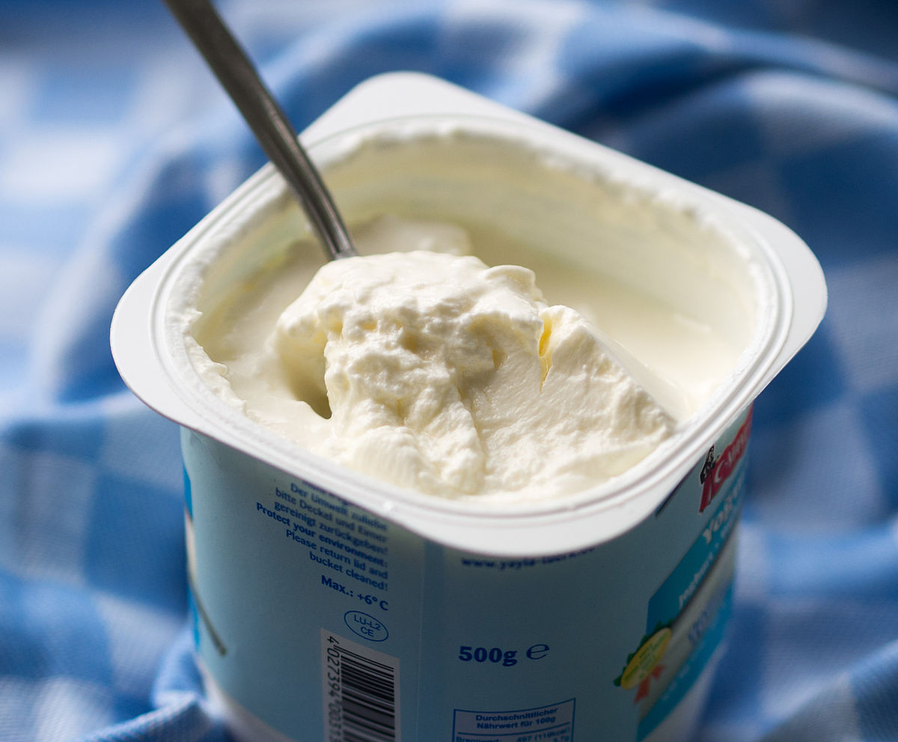
Student Led Breakfast Program/Hot Lunch and Canteen
Nut Free, healthy, individually wrapped breakfast items and snacks available.
This program is open to all students.
We have hot lunch of Pizza every Friday, please order on cashless schools.
Our canteen is open every Friday at noon and all items are $1.00 or $2.00 each.
This Photo by Unknown Author is licensed under CC BY-NC-ND
This Photo by Unknown Author is licensed under CC BY-SA
This Photo by Unknown Author is licensed under CC BY-SA

Slide 15

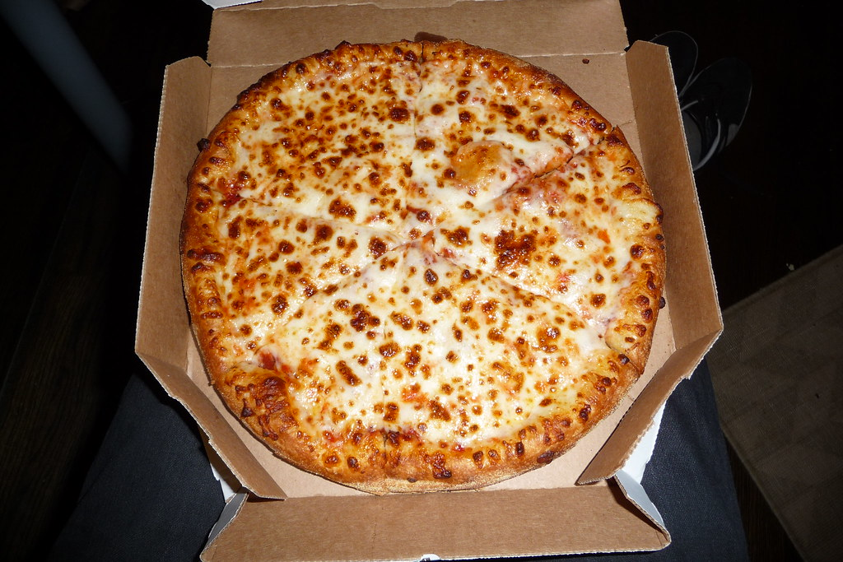


Spring Fling & Canteen
The dance is on Thursday, April 20th from 6:30 p.m. – 8:30 p.m.
$5.00 at the door.
We also have a canteen, and all items are $1.00 or $2.00.
Please come and enjoy!

Slide 16

Volleyball: All practices are from 3:00 p.m. – 4:30 p.m.
Monday, April 17th Boys' practice.
Tuesday, April 18th Boys’ game here versus Bayside
Wednesday, April 19th Girls’ practice.
Thursday, Girls’ game at Bayside.
All team pictures are on Thursday, April 20th.

