Slide 1

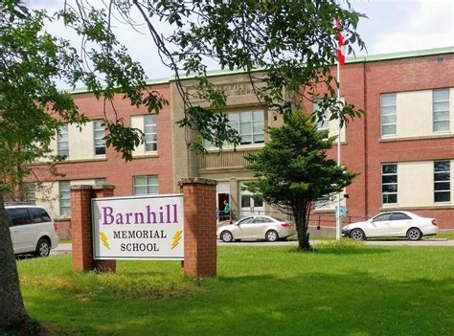
Lightning News
June 12th – 16th, 2023

Slide 2
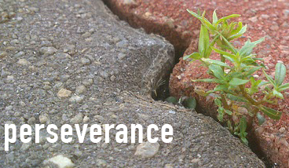
June Theme - Perseverance
“Education is the most powerful weapon which you can use to change the world.”
~Nelson Mandela~

Slide 3
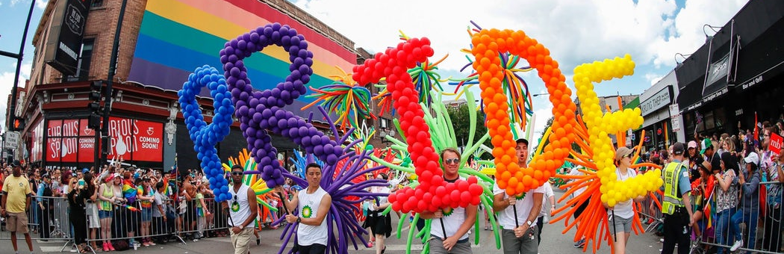
June is Pride Month in Canada

Slide 4

National Indigenous History Month
In June, we commemorate National Indigenous History Month 2023 to recognize the history, heritage and diversity of First Nations, Inuit and Métis peoples in Canada.
It is also an opportunity to recognize the strength of present-day Indigenous communities.

Slide 5

Art competition, open to all students. Please create a cover for the 2023-2024 school agenda and submit it to Ms. Dennis.

Slide 6

Breakfast, Snacks, and Lunch
Reminder that breakfast snacks are in the office every morning.
We will have pizza, please do not forget to place your order on Cashless Schools for Friday. We also have a canteen on Friday, and we sell drinks and snacks for $1.00 - $2.00 each.
This Photo by Unknown Author is licensed under CC BY-NC-ND

Slide 7
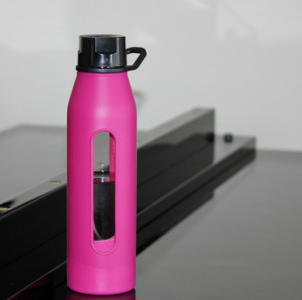
Water Bottle
We strongly encourage everyone to bring a water bottle to use at school. With the warmer weather and outdoor activities, we want everyone to stay hydrated.
We have numerous water fountains and coolers throughout the school.
We also sell Barnhill water bottles in the office for $5.00 each.

Slide 8



On Tuesday, June 13th all grade 8 students will be going to their respective high school for a tour and an information session. A light lunch will be provided. This will be from 11:45 a.m. until 12:30 p.m.
In the Fall the students will still have their special day to start the school year.

Slide 9
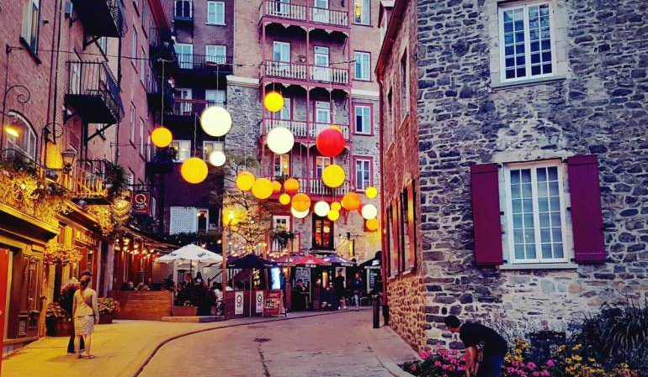
Quebec City
Grade 8 Students are going to Quebec City on Wednesday, June 14th. Please ensure you are at the school for 6:30 am. The bus will be leaving at 7:00 am sharp!
Any final questions, please call Mrs. Muise at 658-5972.
This Photo by Unknown Author is licensed under CC BY-NC-ND

Slide 10

Bowling
Grade 6 students will be bowling on Thursday, June 15th from 12:30 p.m. – 2:30 p.m.
Grade 7 and remaining grade 8 students will be bowling on Friday, June 16th 12:30-2:30pm
Please remember to bring a lunch and some extra spending money. Please leave your phone at school or at home.
We will be walking over to the Bowlarama and it is $10.00 to play if you did not pay your student fee.
This Photo by Unknown Author is licensed under CC BY-NC
This Photo by Unknown Author is licensed under CC BY-NC

Slide 11

Upcoming events for the Final week of school.
June 19th – Outdoor Field Day.
June 20th – New River Beach.
June 21st – New River Beach rain date.
June 22nd - Awards Assemblies at 10:00 a.m. and 1:00 p.m. for Athletics. In the evening is the Moving Up Ceremony, begins at 5:00 p.m.
Year End Dance from 7:00 p.m. -8:30 p.m.
June 23rd – Last Day for students.

Slide 12

Lost and Found
Please check for clothing, water bottles, school supplies in the lost and found.
Anything not claimed will be donated to charity at the end of June.

