Slide 1

Lightning News
June 5th – June 9th.
“Take passion and determination anywhere you go, and we promise you, you will go far.”
- Dorethea Jackson
The theme for the month of June is “Perseverance.”

Slide 2

Pride Month
June is Pride Month in Canada. Every year during the month of June, the LGBTQ+ community celebrates in several different ways. We are always inspired by real life stories. In New Brunswick we are inclusive in education, we work to accept everyone.

Slide 3


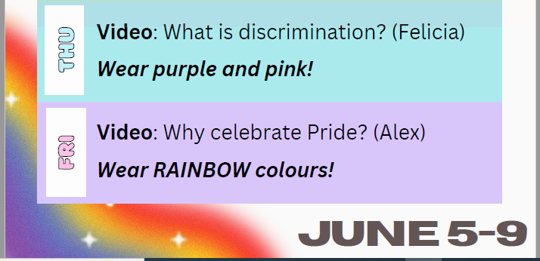

Slide 4

Performance
On Monday, June 5th - The Harbour View High School Band is coming to perform in our gymnasium at 11:15 a.m.

Slide 5

On Tuesday, June 6th the three grade 6 FI classes are going to Timber Top and our two grade 6 Prime classes are going to Wolastoq Park for Field Trips and picnics.
On Wednesday, June 7th from 9:30 a.m.- 11:30 a.m. We welcome all the future grade 6 students from their elementary schools to come join us for a tour, activities and an assembly.

Slide 6
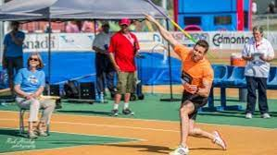
Track and Field
June 7th is the Middle School Track Meet at U.N.B. We are very excited; we have 85 athletes participating. Mrs. Graham, Mr. Savoie and Mr. Duff will be the coaches for the team.

Slide 7
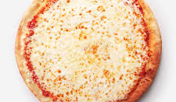
Breakfast, Snacks, and Lunch
Reminder that breakfast snacks are in the office every morning,
We will have pizza, please do not forget to place your order on Cashless Schools for Friday. We also have a canteen on Friday, and we sell drinks and snacks for $1.00 - $2.00 each.
We are also selling Mr. Freeze for $1.00 each for fundraising for the Quebec Cultural Trip.

Slide 8

Youth Rock the Rink Summer Kick Off Dance at the River Valley Community Center
On Friday, June 9th from 8:30 p.m. – 11:00 p.m. for grades 6 – 8.
This dance is a fundraiser for the U15 Boys Team NB Ball Hockey. The Grit Ball Hockey Team are going to Newfoundland in July for nationals.

Slide 9




On Tuesday, June 13th all grade 8 students will be going to their respective high school for a tour and an information session. A light lunch will be provided.

Slide 10

Quebec City
Grade 8 Students are going to Quebec City, on Wednesday, June 14th. Please ensure you are at the school for 6:30 am. The bus will be leaving at 7:00 am sharp!
We are excited for this opportunity and can’t wait for you to make some final memories with your classmates.

Slide 11

Bowling
Grade 6 students will be bowling on Thursday, June 15th from 12:30 p.m. – 2:30 p.m.
Grade 7 and remaining grade 8 students will be bowling on Friday, June 16th 12:30-2:30pm
Please remember to bring a lunch and some extra spending money. Please leave your phone at school or at home.
We will be walking over to the Bowlarama and it is $10.00 to play if you did not pay your student fee.

Slide 12

Upcoming events for the Final week of school.
June 19th – Outdoor Field Day
June 20th – New River Beach
June 21st – New River Beach rain date
June 22nd - Awards Assemblies at 10:00 a.m. and 1:00 p.m. for Athletics. In the evening is the Moving Up Ceremony & Year End Dance
June 23rd – Last Day for students

Slide 13

Lost and Found
Please check for clothing, water bottles, school supplies in the lost and found.
Anything not claimed will be donated to charity at the end of June.

