Slide 1

Lightning News
June 6 – June 10
“Take passion and determination anywhere you go, and we promise you, you will go far.”
- Dorethea Jackson

Slide 2

Performance
June 7th - The Harbour View High School Band is coming to perform in our gymnasium at 11:15 a.m.

Slide 3

Pride Month
June is Pride Month in Canada. Every year during the month of June, the LGBTQ+ community celebrates in several different ways. We are always inspired by real life stories. In New Brunswick we are inclusive in education, we work to accept everyone.

Slide 4

Music Club!
Music Club this week:
Monday ~ Group #4
Tuesday ~ Group #5
Wednesday ~ Group #1
Thursday ~ No Club
Friday ~ Group #2

Slide 5
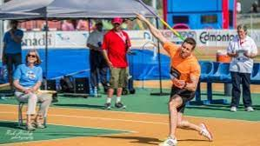
Track and Field
June 8th is the Middle School Track Meet at U.N.B. We are very excited; we have 85 athletes participating. Mrs. Graham, Madame VanBuskirk and Ms. Harris will be the coaches for the team.

Slide 6
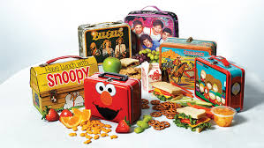
Lunch
Grade 6 will be in the lunchroom this week.
Students will not transition on indoor days.
Tuesday there is a GSA meeting during the second half of lunch.
Wednesday at noon, Mme Lise hosts “Mandela colouring hour.”
Thursday:
- Art Club for the second half of lunch
- SRC meeting at lunch
- Christian Fellowship meeting at lunch

Slide 7
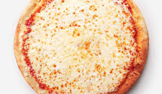
Breakfast, Snacks, and Lunch
Reminder that breakfast snacks will be outside of the office until 8:45 each morning.
We will have pizza and a canteen at lunch on Friday.

