Slide 1
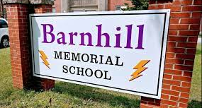
Lightning News
May 16th – 20th
May theme of the month - Integrity
“The true mark of integrity is the ability to face challenges head – on, handle conflict calmly, and admit mistakes quickly.”
- Barry Davenport

Slide 2

Important
On May 17th, we mark the International Day Against Homophobia and Transphobia, we recognize this day as critical to our work in the promotion of equality, social justice, rights and dignity for all people.
May is Food Allergy Awareness Month in Canada
May is Mental Health Awareness Month
What is anxiety? | APA - YouTube

Slide 3

Retro Week
Today is the “BOLT Assembly, during 5th period.
We are also be a 60’s Theme Day.
Tomorrow – May 17th – dress like you came from the 70’s.
Wednesday – May 18th – 80’s Theme.
Thursday – May 19th – 90’s Theme.
Friday – May 20th – from the 2000’s.

Slide 4
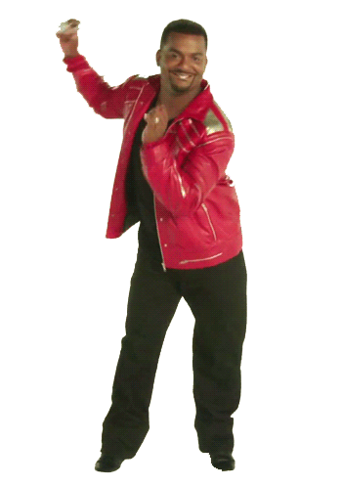
Dance May 19th
The school dance is This Thursday from 6:30 p.m. – 8:30 p.m.
$5.00 at the door.
Students may invite one guest from another middle school to this dance. Sign – ins are to be completed with Mrs. Muise or Ms. Ferguson.

Slide 5
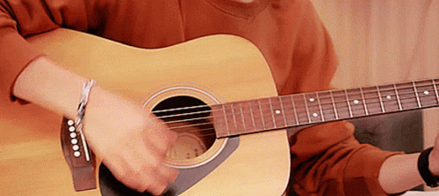
Music Club!
Music Club this week:
Monday ~ group #2 – Lise, Cullinan & Smith
Tuesday ~ group #3 – Beyea, Cullinan & Stout
Wednesday ~ group #4 – Stuart, Van & Seales
Thursday ~ group #5 – Murphy, Pierce & Holland
Friday ~ group #1 - MacDonald

Slide 6
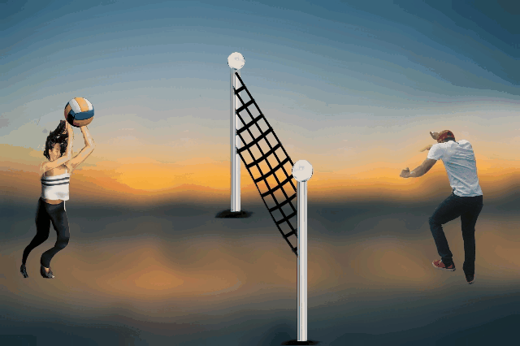
Athletics
Volleyball playoffs will be this week.
The boys’ team plays today at Barnhill vs. Forest Hills
The girls’ team plays Tuesday, at Barnhill vs Bayside JV team.
Please come out and cheer on your lightning!
Flag Football: Practice Today and Wednesday from 3:00 p.m. – 4:30 p.m.

Slide 7
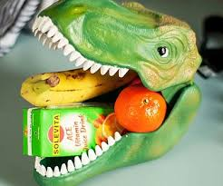
Grade 6 will be in the lunchroom this week.
Reminder: Students will not transition on indoor days. Therefore, make sure you choose your lunch locations wisely.

Slide 8
Lunch Groups
GSA
  Tuesday’s Second half of lunch
Mandela Coloring Hour
  Wednesday’s during lunch hour in Mme Lise Classroom
Art Club
  Thursday during lunch in Art room
SCR Meeting
  Thursday during lunch in Mr. MacDonald’s Classroom
Christian Fellowship
  Thursday during lunch in Mr. Smith’s Classroom

Slide 9
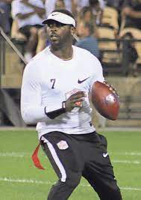
Upcoming
There is NO school for anyone on Monday, May 23rd ~ this is the Victoria Day holiday.
May 27th and 28th – Flag Football Tournament at Shamrock Park. These games are always awesome to watch, so please go out and support the Barnhill Lightning Team.

Slide 10

Yard Sale and craft sale
Barnhill is hosting a yard sale on May 21st, you can buy a table to sell or come and shop!
Barnhill is hosting a craft sale on May 28th, you can buy a table to sell or come and shop!

Slide 11

Breakfast, Snacks, and Lunch
Reminder that breakfast snacks will be outside of the Lightning Lounge until 8:45 each morning.
We will have pizza and a canteen at lunch on Friday.

