Slide 1

Lightning News
May 29 – June 2
The theme for the month of June is “Perseverance.” ~ “Patience, persistence and perspiration make an unbeatable combination of success.” ~ Napoleon Hill ~
We have three days of May this week and we are wrapping up with the theme of “Gratitude.”
“Joy is the simplest form of gratitude.” ~ K. Barth

Slide 2

Go LIGHTNING!!!!!
We wish our Flag Football Team all the best as they compete in the Tournament this Sunday, May 28th at Shamrock Park.
Thank you to Mr. Savoie and Mr. Duff for coaching the team.
Please take the opportunity to support our team by being a ‘Super Fan.”

Slide 3
Monday, May 29th at 6:00 p.m.
~ Very important meeting to discuss all the final details for the Quebec Cultural trip.
~ There will be a short presentation and questions answered to finalize the details.

Slide 4
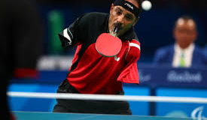
Disability awareness week
Disability Awareness Week 2023 is this week - DAW – This is the 36th year and the theme for this year’s campaign is “Accessibility =Inclusion.”

Slide 5
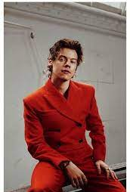
Wear RED On Wednesday
Wear red on Wednesday, May 31st in support of National Access Ability Week.
Share why you are wearing red, and what you pledge to do in the year ahead to enhance accessibility and inclusion in your school and community.

Slide 6
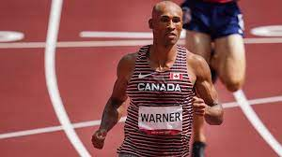
Track and Field
Practices are everyday after school from Monday ~ Wednesday
3:00 p.m.-4:30 p.m.
This is preparation for the Track and Field meet at UNBSJ on Wednesday, June 7th.

Slide 7
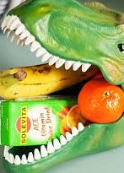
Wear Purple on Monday, May 29th for Food Allergy Awareness.
Food Allergy Awareness:
Build awareness and help those with food allergies to live with confidence.

Slide 8

Breakfast, Snacks, and Lunch
Reminder that breakfast items are in the office everyday for all students.
We will have pizza and a canteen at lunch on Friday.
On Thursday, June 1st and Friday, June 2nd ~ Mr. Freeze will be sold for $1.00 each – this is a fundraiser for Quebec.

Slide 9

Lost and Found
Please check for clothing, water bottles, school supplies in the lost and found.
Anything not claimed will be donated to charity at the end of June.

