Slide 1

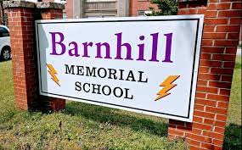

Lightning News May 8th – 12th
May theme of the month – “Gratitude.”
Be grateful for who you are.
“Acknowledge the good that you already have in your life is the foundation for all abundance.” ~ E. Tolle ~

Slide 2
No school for students on Monday, May 8th. This is a N.B.T.A. Day for staff.
~ All students will return to school on Tuesday, May 9th.

Slide 3
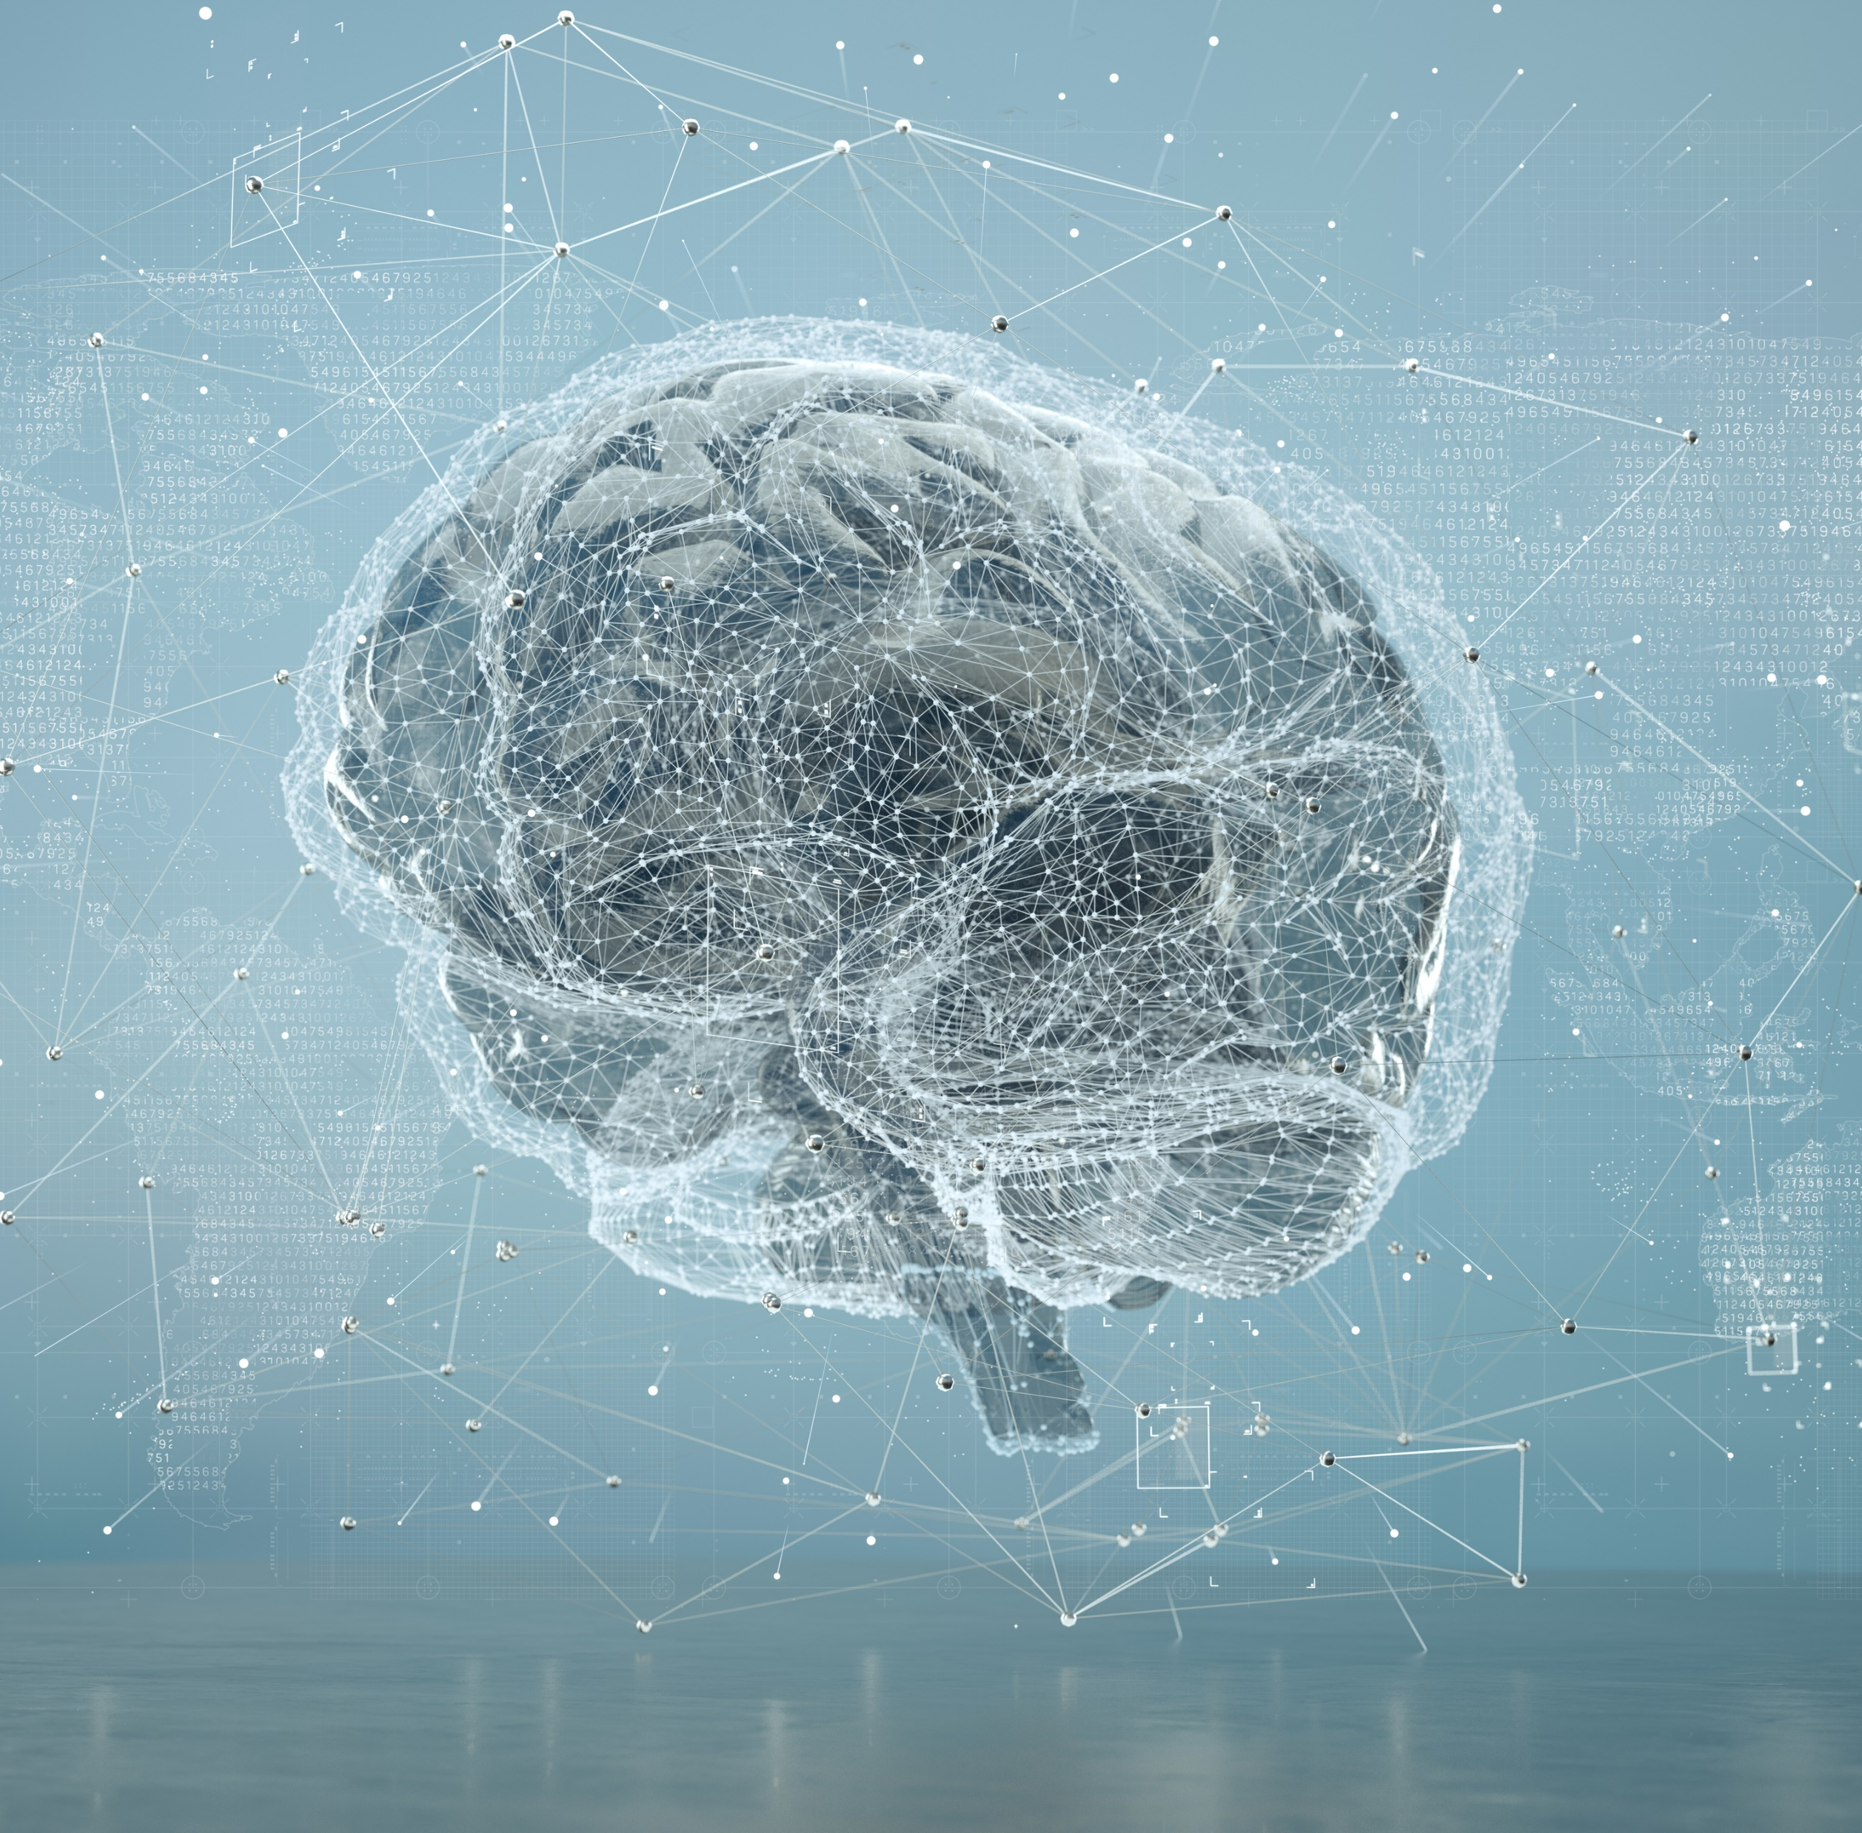

May is Brain Tumour Awareness Month. Wear Gray in May . Practice resilience, gratitude and Self-Care.

Slide 4
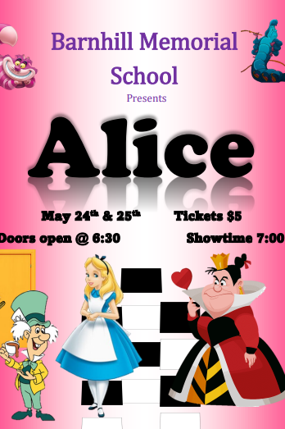
enjoy the Production of Alice.
You can purchase tickets in advance at the office.
The play will be in our gymnasium on May 24th and May 25th ~ Seating will be first come first serve, there is no reserved seating.

Slide 5
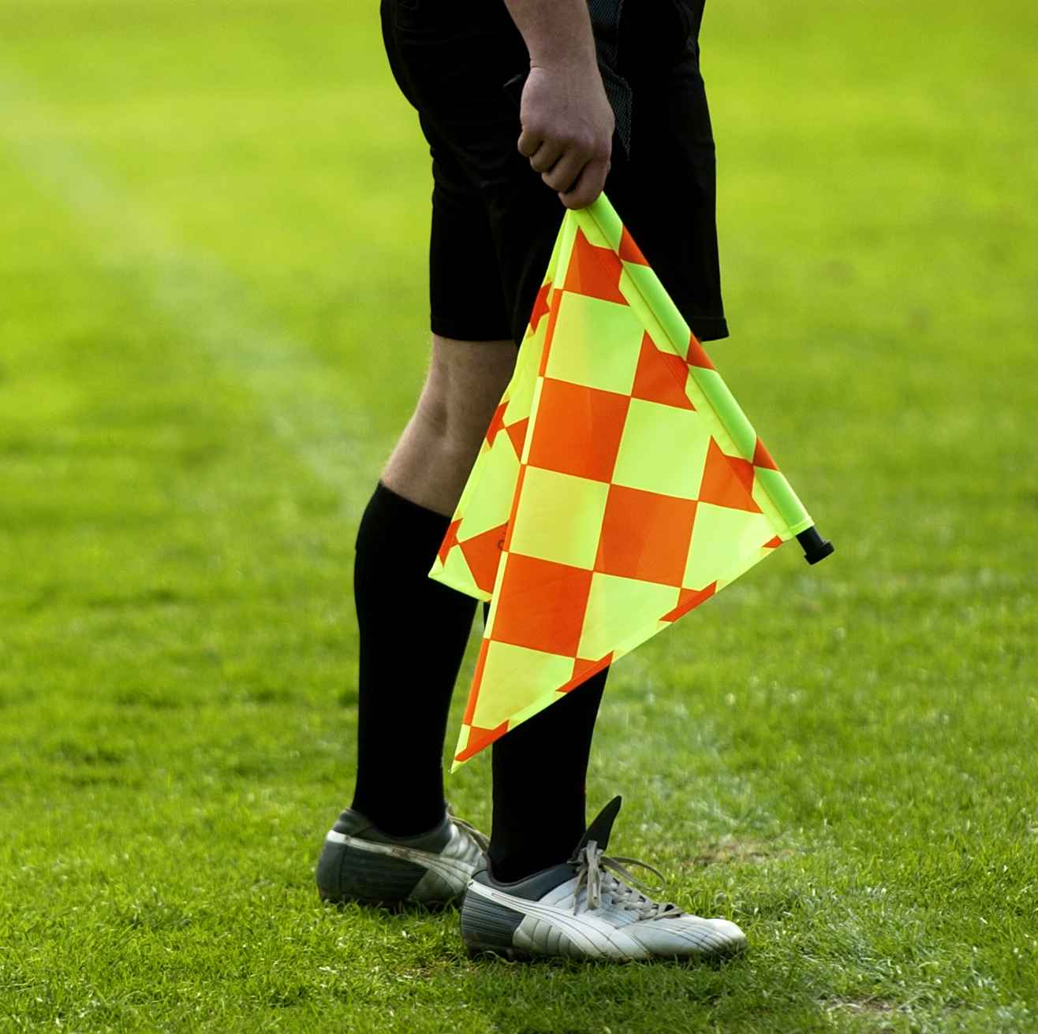
Athletics
Volleyball: Tuesday, Boys game at MNS.
Girls game here at Barnhill vs MNS.
Wednesday, Girls game at RVMS.
Flag Football: Practice on Wednesday and Thursday from 3:00 p.m. – 4:30 p.m.

Slide 6
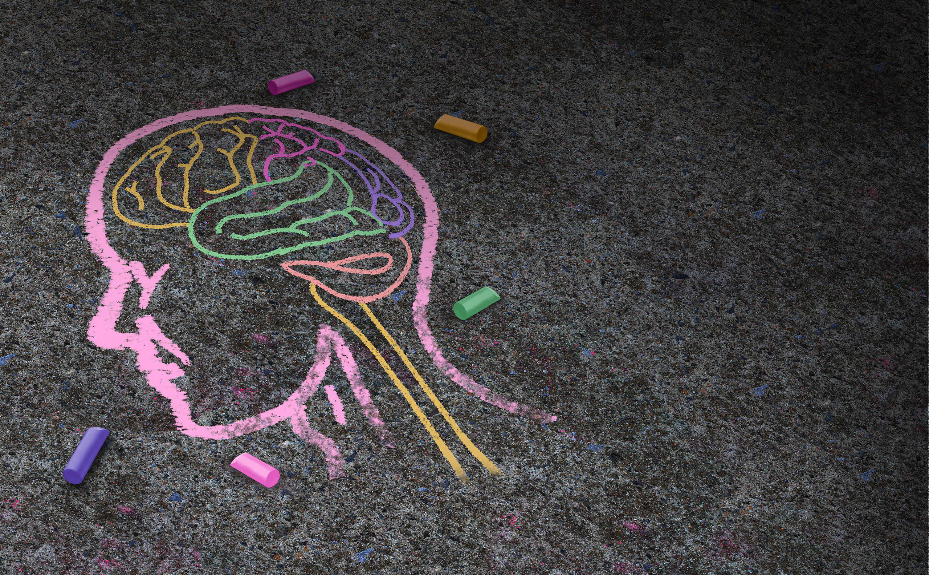
Mental Health
Mental Health: We need to be aware and look at how an individual’s environment impacts their mental health, suggestions for making changes to improve and maintain mental well-being, and how to seek help for mental health challenges.

Slide 7

Upcoming
There is NO school for anyone on Monday, May 23rd ~ this is the Victoria Day holiday.

Slide 8
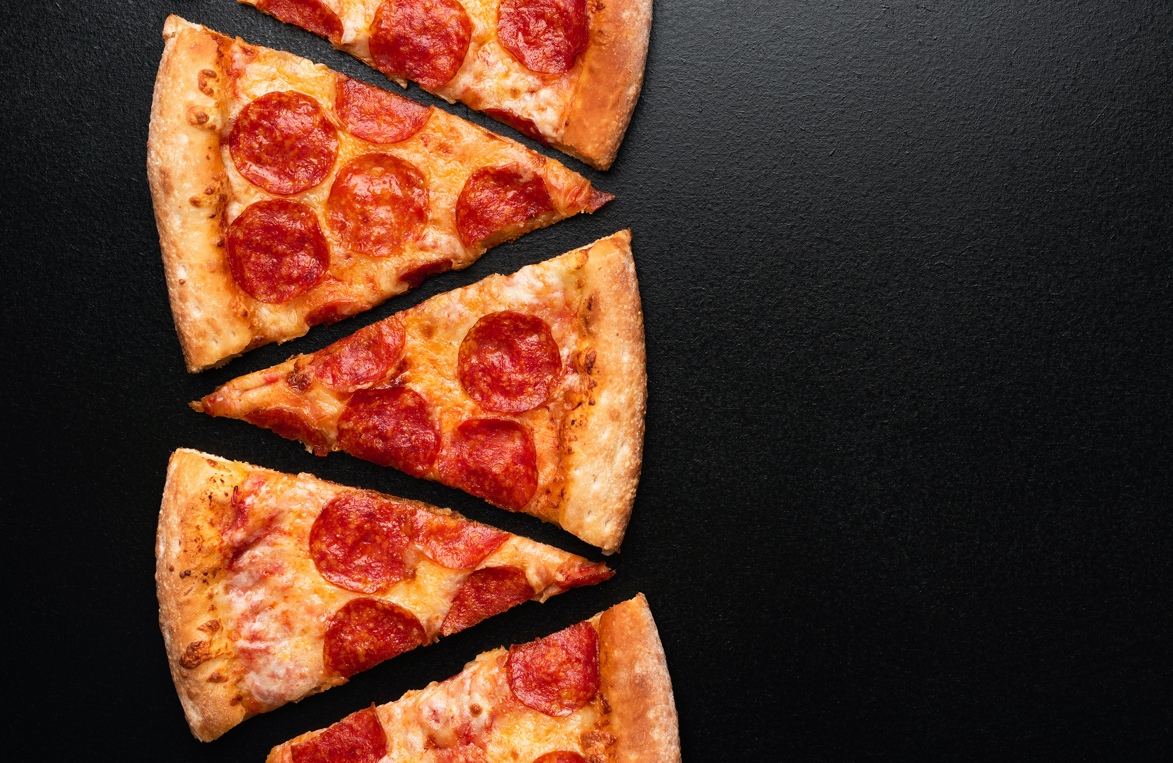
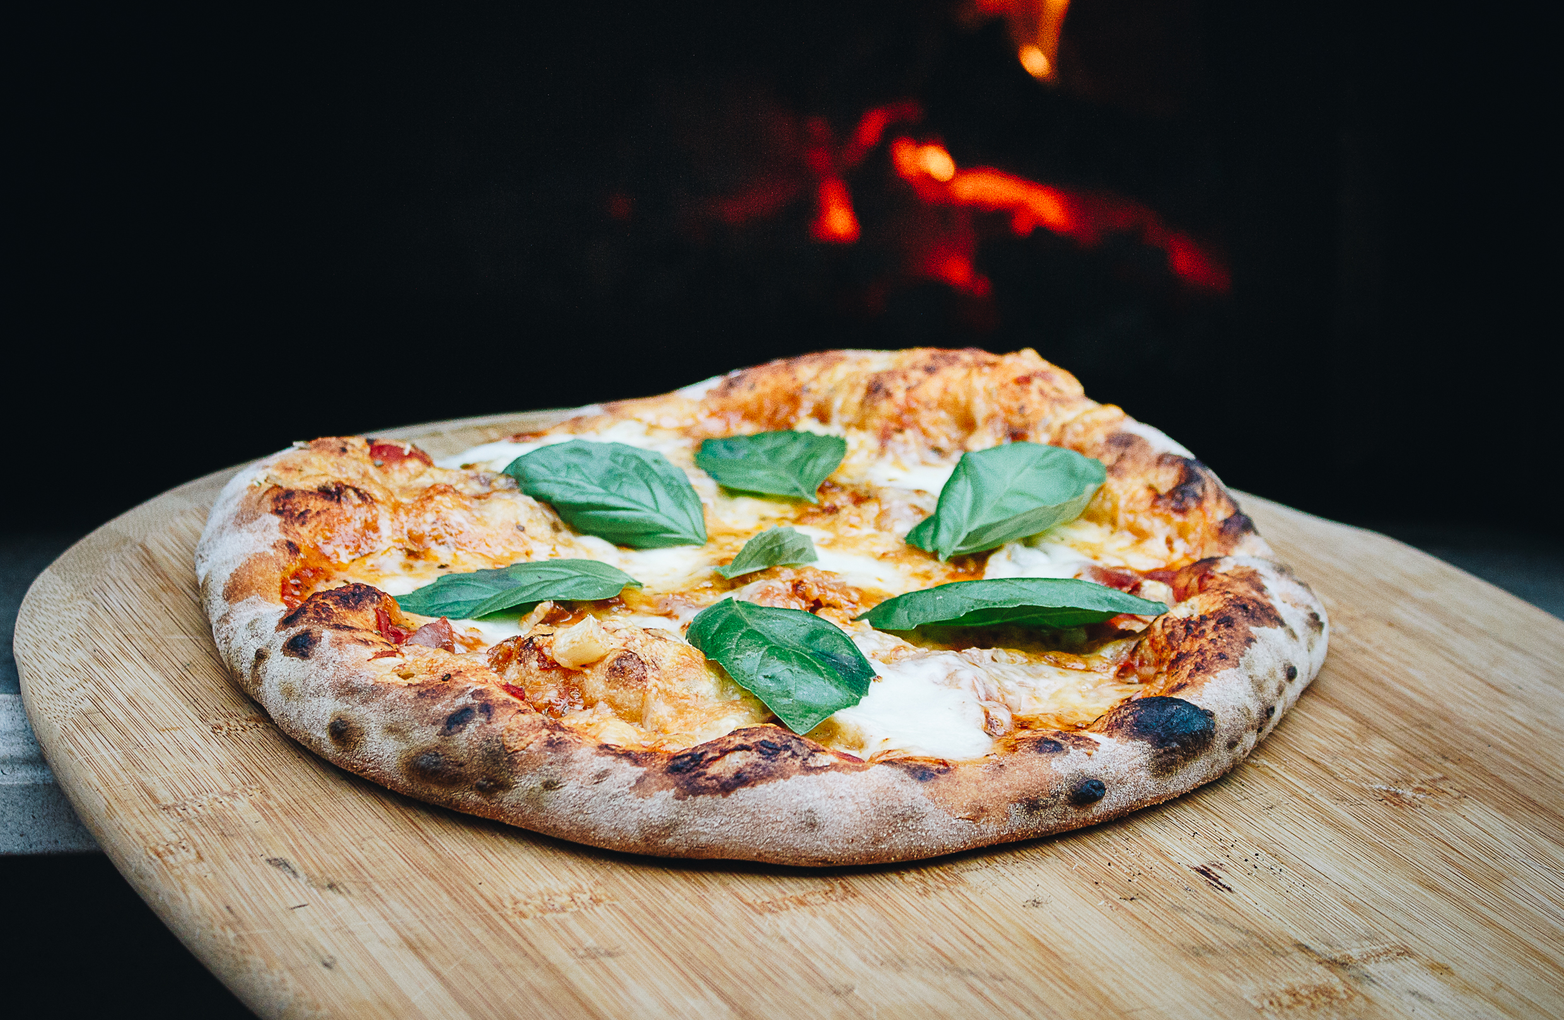
Breakfast, Snacks, and Lunch
We will have pizza and a canteen at lunch on Friday, May 12th.
Healthy breakfast items are available every morning for all students.
Enjoy your weekend.

