Slide 1
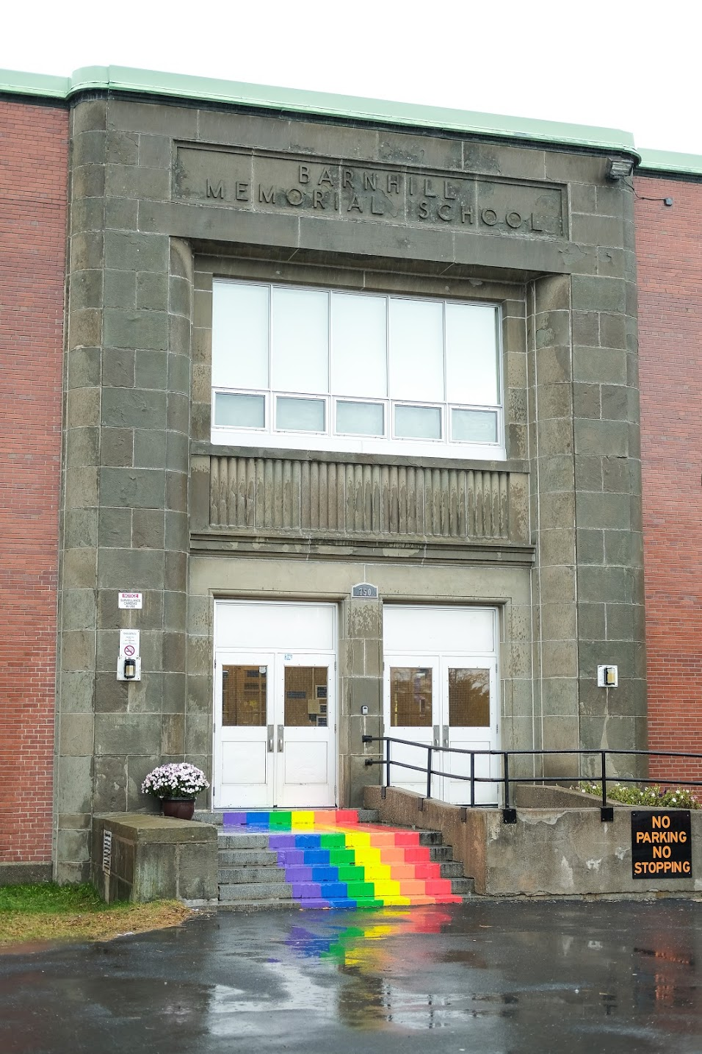
Lightning News
November 6th – 10th.

Slide 2

Breakfast, Snacks, and Lunch
Reminder that breakfast snacks will be in the front lobby until 8:45 each morning.
We will have pizza and a canteen at lunch on Friday, November 10th.

Slide 3

Kiwanis Calendar Fundraiser.
Great way to make money! Go to the office to sign out Calendars
This Photo by Unknown Author is licensed under CC BY-SA-NC

Slide 4

Athletics
Badminton try-outs continue this week and
are from 3:00-4:30.
Monday-Grade 7 Boys
Tuesday- Grade 7 Girls
Wednesday- Grade 6 Boys
Thursday- Grade 6 Girls

Slide 5

Intramurals
Monday- Badminton
Tuesday- Mat Ball
Wednesday- Badminton
Thursday- Basketball
Friday- Badminton

Slide 6


Barnhill Remembers…
We would like your help with a special project for Remembrance Day.
We are asking families to submit a photo of a family member who has served in any capacity in the Canadian military. These photos will be used in our Remembrance Day Ceremony on November 10.
We ask that photos be submitted via email to ANDREA.DENNIS@NBED.NB.CA by Monday November 6th. In your submission, please specify which student is connected to the person in the photo and how that person served.
Thank you for your support!

Slide 7
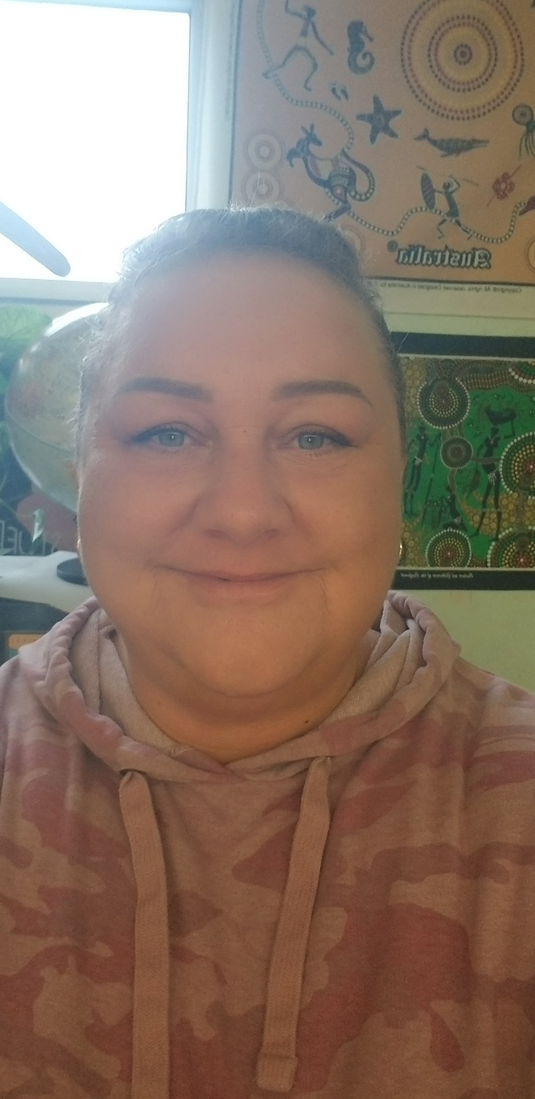
Mrs. Nancy Fosmark
BARNHILL STAFF SPOTLIGHT
Educational Assistant
EA Experience: 7 years
Years at Barnhill: 6
What do you love about teaching? “Working with kids.”
Interest/Activities: gardening, billiards, painting, crafts and watching movies.

Slide 8


Slide 9

On the horizon...

Slide 10

Upcoming News
There is NO school for students on Monday, November 13th. It is Remembrance Day.
New Electronic Device Policy will be implemented on Tuesday, November 14th.

Slide 11

Bring your smile…… November 15th!

Slide 12
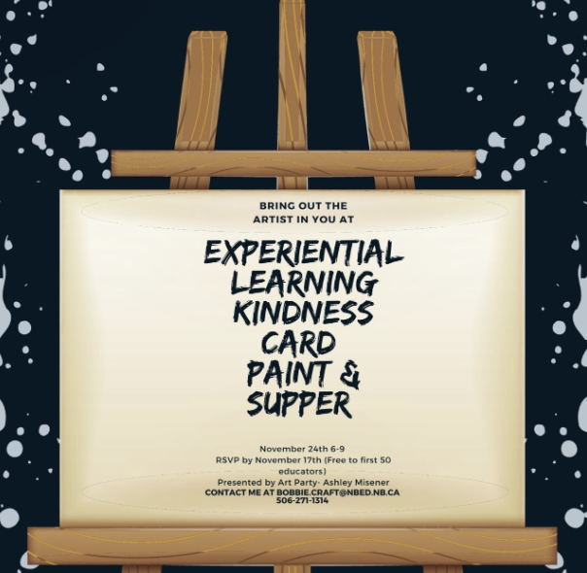
Eat and Paint!

Slide 13

November 18th in the school gymnasium.
7am for sellers to set up
8am - 1pm for customers to shop!
Book a table by contacting Mrs. Muise
Liza.muise@nbed.nb.ca
$15 per table – all money raised will help a student go on the Quebec trip.
** Grade 8 students – selling their products/designs will receive their table free ** Entrepreneurial opportunity. **

