Slide 1
Lightning News
October 30th – November 3rd.

Slide 2
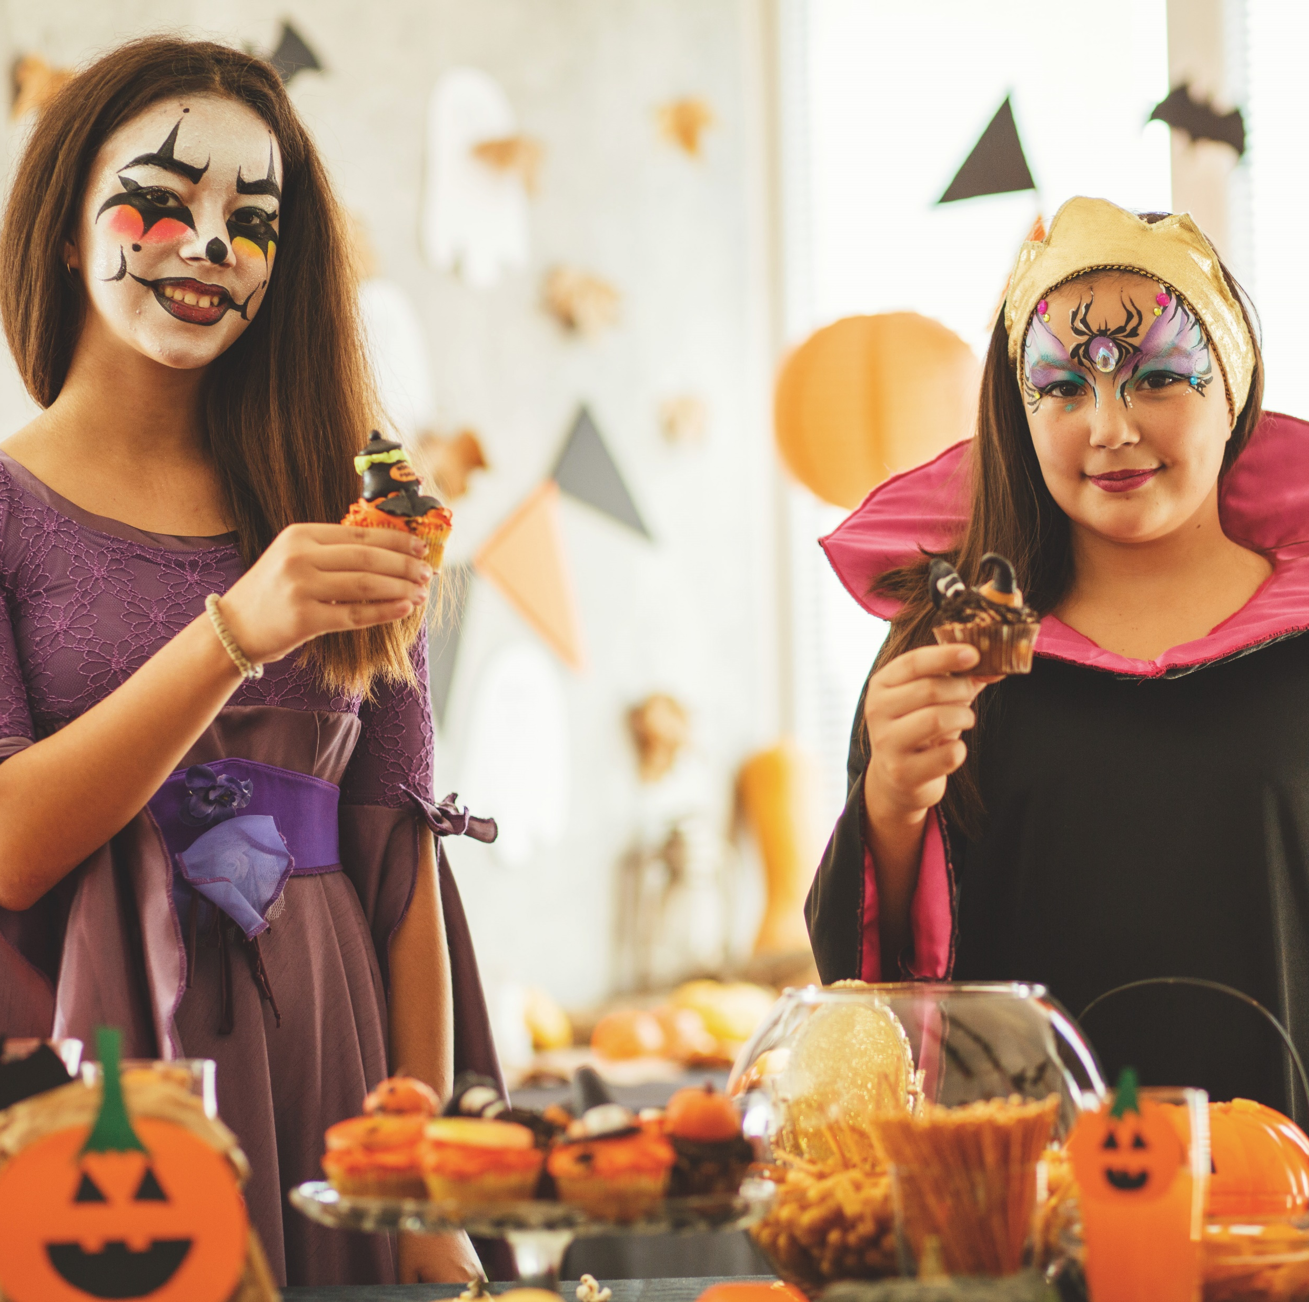
Halloween Activities & Costume Day
Tuesday is Halloween and we encourage students to dress up in the Halloween spirit for the day! No weapons or face coverings allowed. There will be a prize for best costume!
Thank you to SRC for hosting a great Halloween Dance for students. We appreciate all our teacher and parent volunteers for helping us as well. A special shout out to Grade 7’s Oliver Colpitts for his awesome design of the Haunted Hallway. It was spooktacular!

Slide 3
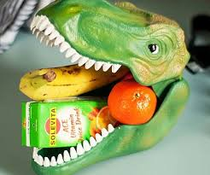
Breakfast & Lunch
Reminder that breakfast snacks will be in the front lobby until 8:45 each morning.
We will have pizza and a canteen at lunch resume on Friday, November 10th.

Slide 4
Kiwanis Calendars – Grade 8 Fundraiser
All calendars and money are due November 17th.
You can bring your money and calendar stubs in when they are sold to Mrs. Muise and Mrs. Sloat
We have lots of calendars left, which is a great chance for you to earn money.
This Photo by Unknown Author is licensed under CC BY-SA-NC

Slide 5
Volunteers Needed
Do you want to volunteer in your child’s school?
There are lots of need for volunteers to come to Barnhill.
- Coaches, Dances, Clubs, Breakfast, Lunch help and working in the classrooms.
Please contact Ms. Ferguson or Mrs. Muise

Slide 6
Basket draws!
We are in need of items for our gift basket. This is a fundraising opportunity for our grade 8s to raise money for Quebec. Any item you can donate will be very appreciated. Last day to bring in items is November 3rd.
We’d like to do a draw for a basket full of chocolate bars. What a treat! If you can donate chocolate bar that would be wonderful.

Slide 7
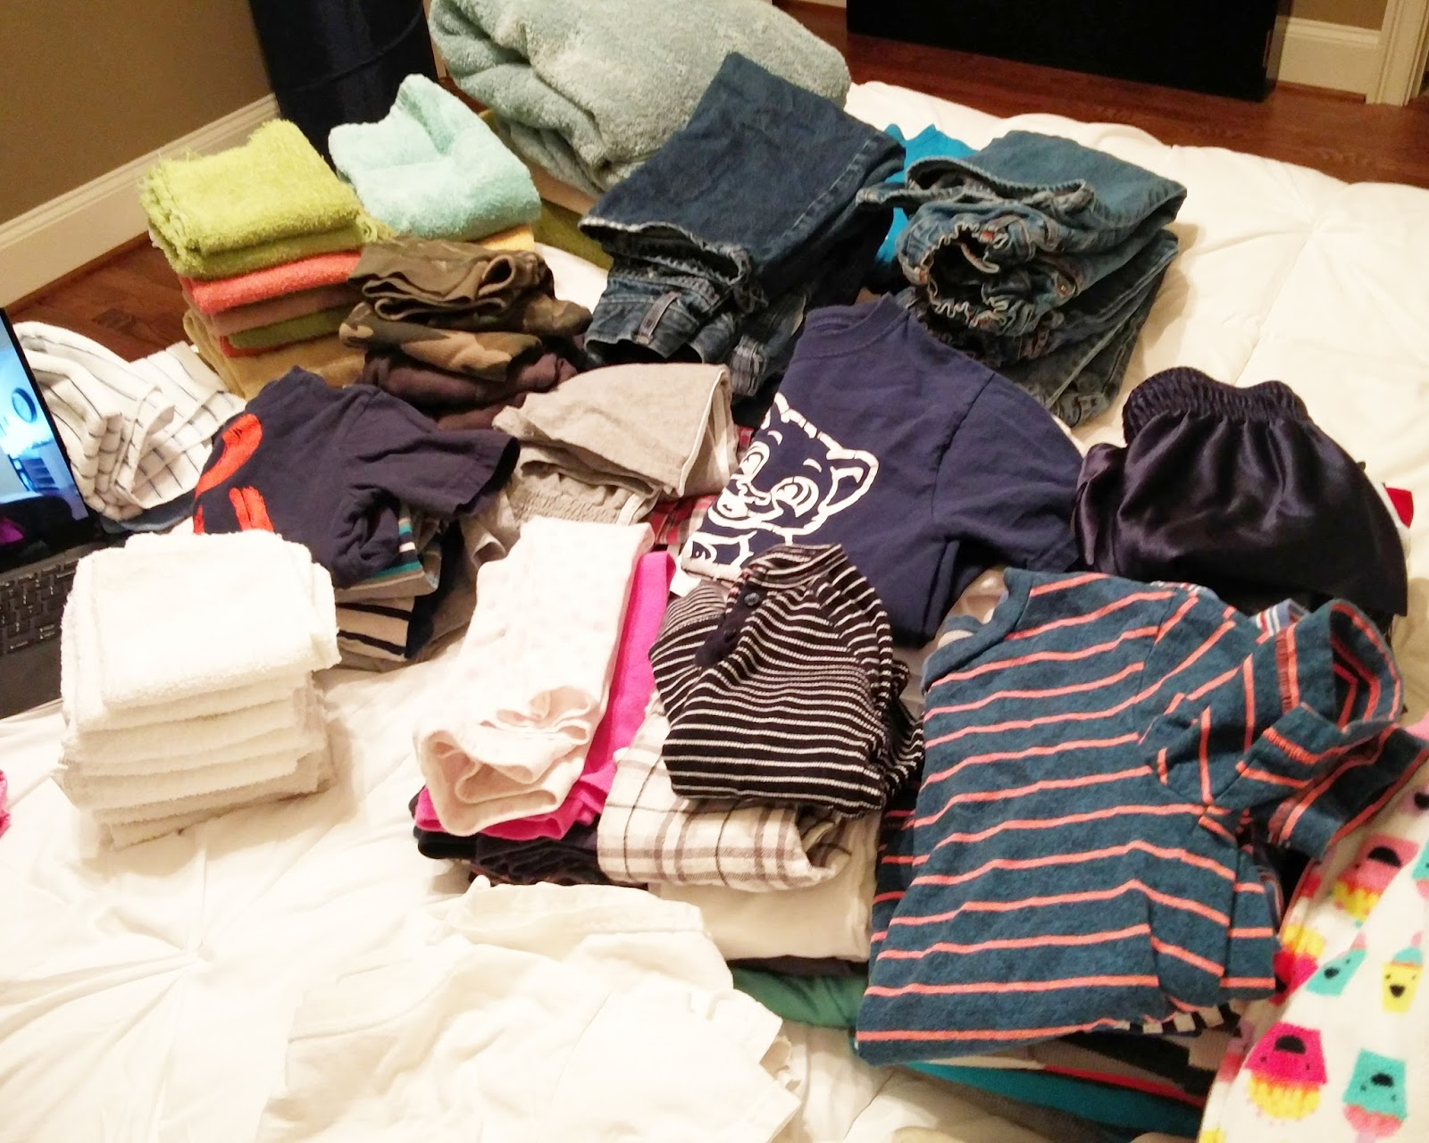
Lost and Found
We have a full Lost and Found bin! If you are missing items, please look for them in the bin. It is located outside of the gymnasium. If items are not claimed, they will be donated to charity at the end of the month!

Slide 8
Socktober
This is the last week to bring in socks!
Thank you to those who have donated already!
This Photo by Unknown Author is licensed under CC BY-SA-NC

Slide 9
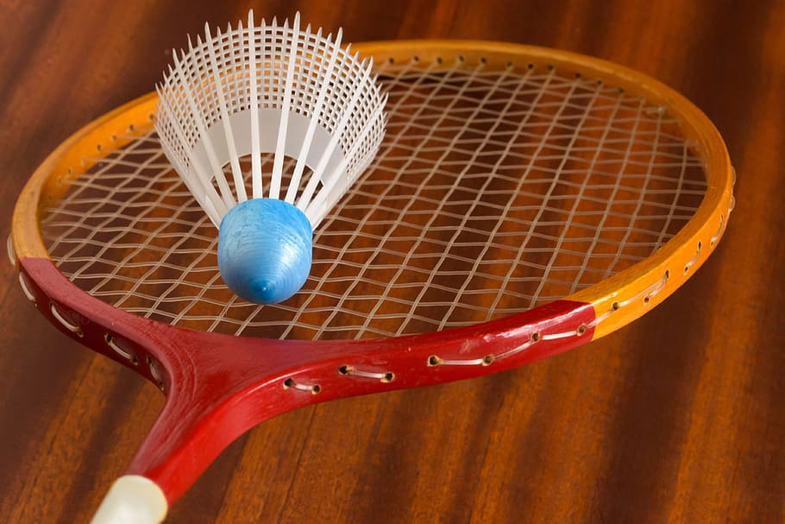
Athletics
Badminton tryouts will take place in the next 2 weeks. All tryouts are from 3:00-4:30. Please make sure your drive is here by 4:30. If you have any questions, please see Mr. Stuart.
The schedule is as follows:
Wednesday, Nov. 1st - grade 8 boys
Thursday, Nov. 2nd - grade 8 girls
Monday, Nov. 6th - grade 7 boys
Tuesday, Nov. 7th - grade 7 girls
Wednesday, Nov. 8th - grade 6 boys
Thursday, Nov. 9th - grade 6 girls
Exhibition soccer is finished for the season! Thank you for coming out and learning some new skills!

Slide 10
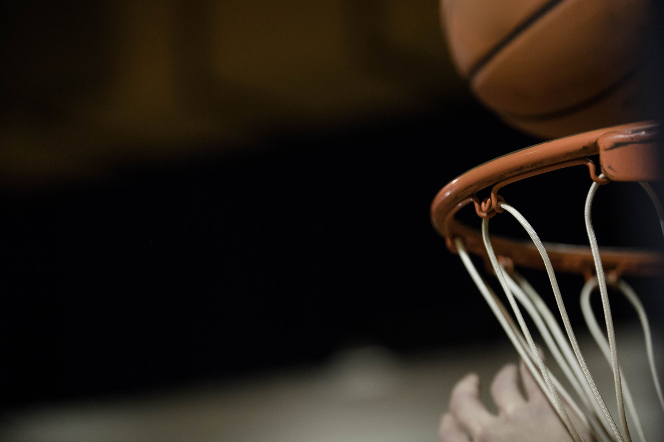
Intramurals
Monday- badminton
Tuesday- mat ball
Wednesday- badminton
Thursday- basketball
There is a 30 student maximum- please arrive at the beginning of lunch.

Slide 11
Student have been competing in a modified Newcomball tournament!
Finals are next week!

Slide 12
We are hosting a Career Fair on Wednesday, November 15th from 1:00 p.m. – 2:30 p.m.

Slide 14
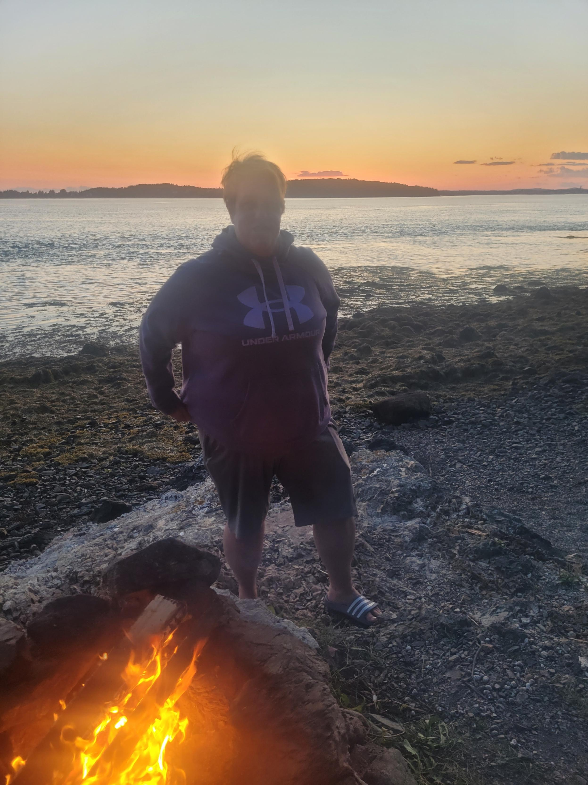
Mrs. Melissa Fawcett
BARNHILL STAFF SPOTLIGHT
Educational Assistant
EA Experience: 15 years
Years at Barnhill: 14
What do you love about teaching? “Progress being made.”
Interest/Activities: Kayaking, hiking, camping and traveling

Slide 15
Upcoming
There is NO school for students on Friday, November 3rd it is a Professional Learning day for staff.
Remembrance Day Ceremony is on Friday, November 10th at 10:15 a.m.
Remembrance Day Holiday is Monday, November 13th. There is no school.
November 18th- Holiday Craft Fair 8:00 a.m. – 1:00 p.m.

Slide 16
November 18th 7am for sellers 8am - 1pm for shoppers
Book a table by contacting Mrs. Muise
Liza.muise@nbed.nb.ca
$15 – all money raised will help a student go on the Quebec trip.
** Grade 8 students – selling their products/designs will receive their table free ** Entrepreneurial opportunity. **

Slide 17
Barnhill Remembers…
We would like your help with a special project for Remembrance Day.
We are asking families to submit a photo of a family member who has served in any capacity in the Canadian military. These photos will be used in our Remembrance Day Ceremony on November 10.
We ask that photos be submitted via email to andrea.dennis@nbed.nb.ca. In your submission, please specify which student is connected to the person in the photo and how that person served.
Thank you for your support!

