Slide 1

Lightning News
October 9th – 13th.

Slide 2

It is a three-day week, this week.
Have a very enjoyable Thanksgiving Holiday. Take the opportunity to think about what you are “grateful” for.
Friday, October 13th is a professional learning day for staff. There is no school for students.

Slide 3

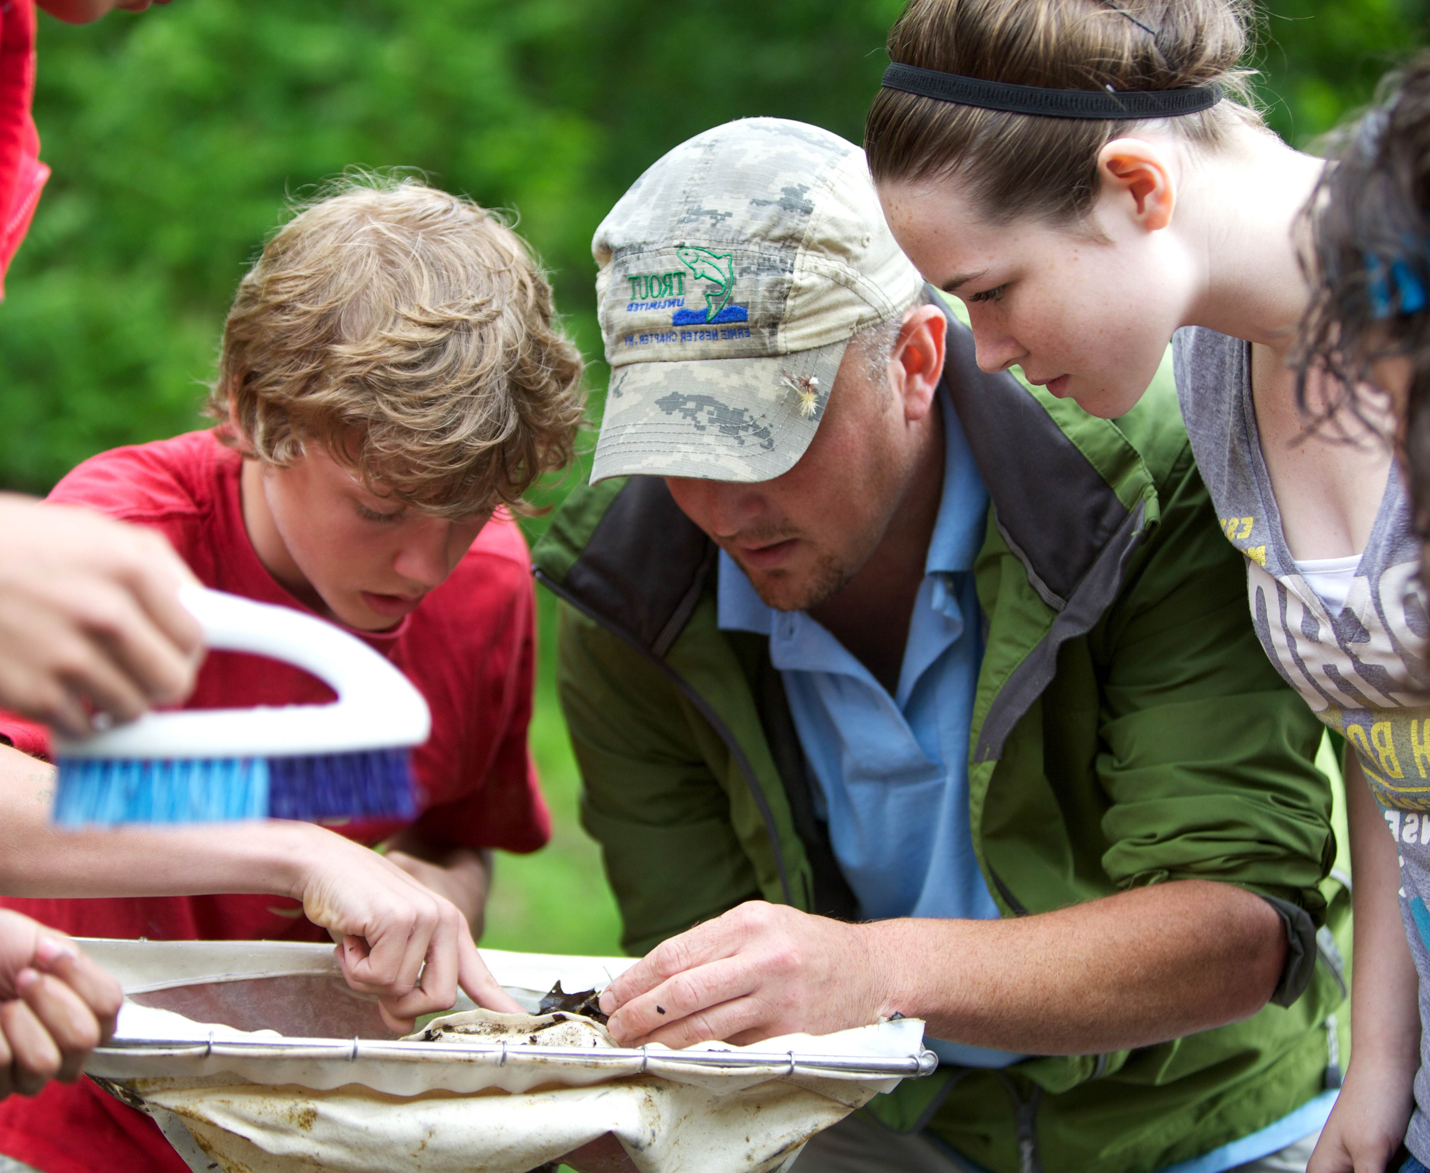
October is for Outdoor Learning
We have an awesome outdoor classroom called “The Lightning Dome” for all students to learn in the fresh outdoors. We encourage all classes to go outside with their teacher to learn while the weather is still nice!

Slide 4
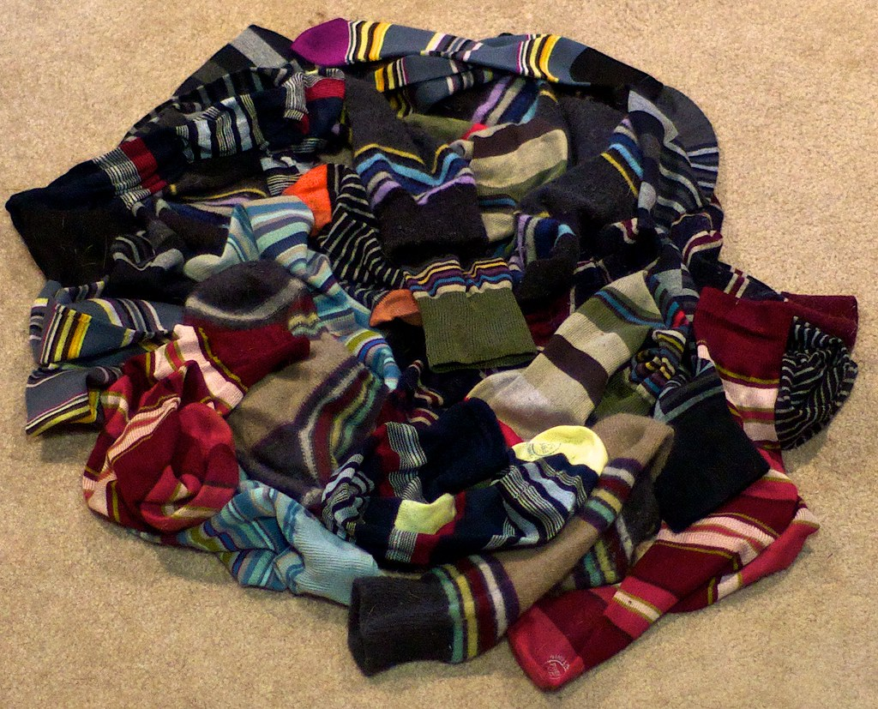
Socktober
In the month of October, Barnhill collects new pairs of warm socks to support the needs in our community. If you would like to donate, please send in the socks with a student and they will be collected by our SRC. Our goal this year is to collect 200 pairs of socks!
This Photo by Unknown Author is licensed under CC BY

Slide 5
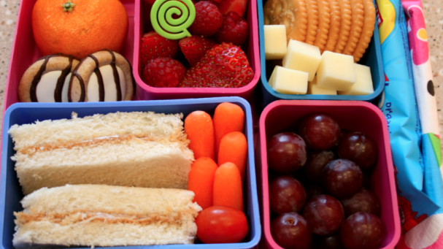
Lunch and Canteen
Breakfast Program
We want our students to start their day in the right way, therefore, we have healthy breakfast options available in the front lobby every morning for all students. Ms. Galbraith, and Daniel will be in the lobby every morning until 8:45 a.m.
Students are to continue to bring a packed lunch every day.
Due to the Professional Learning day on Friday, the canteen and Hot Lunch will resume on October 20^{th.}
This Photo by Unknown Author is licensed under CC BY

Slide 6

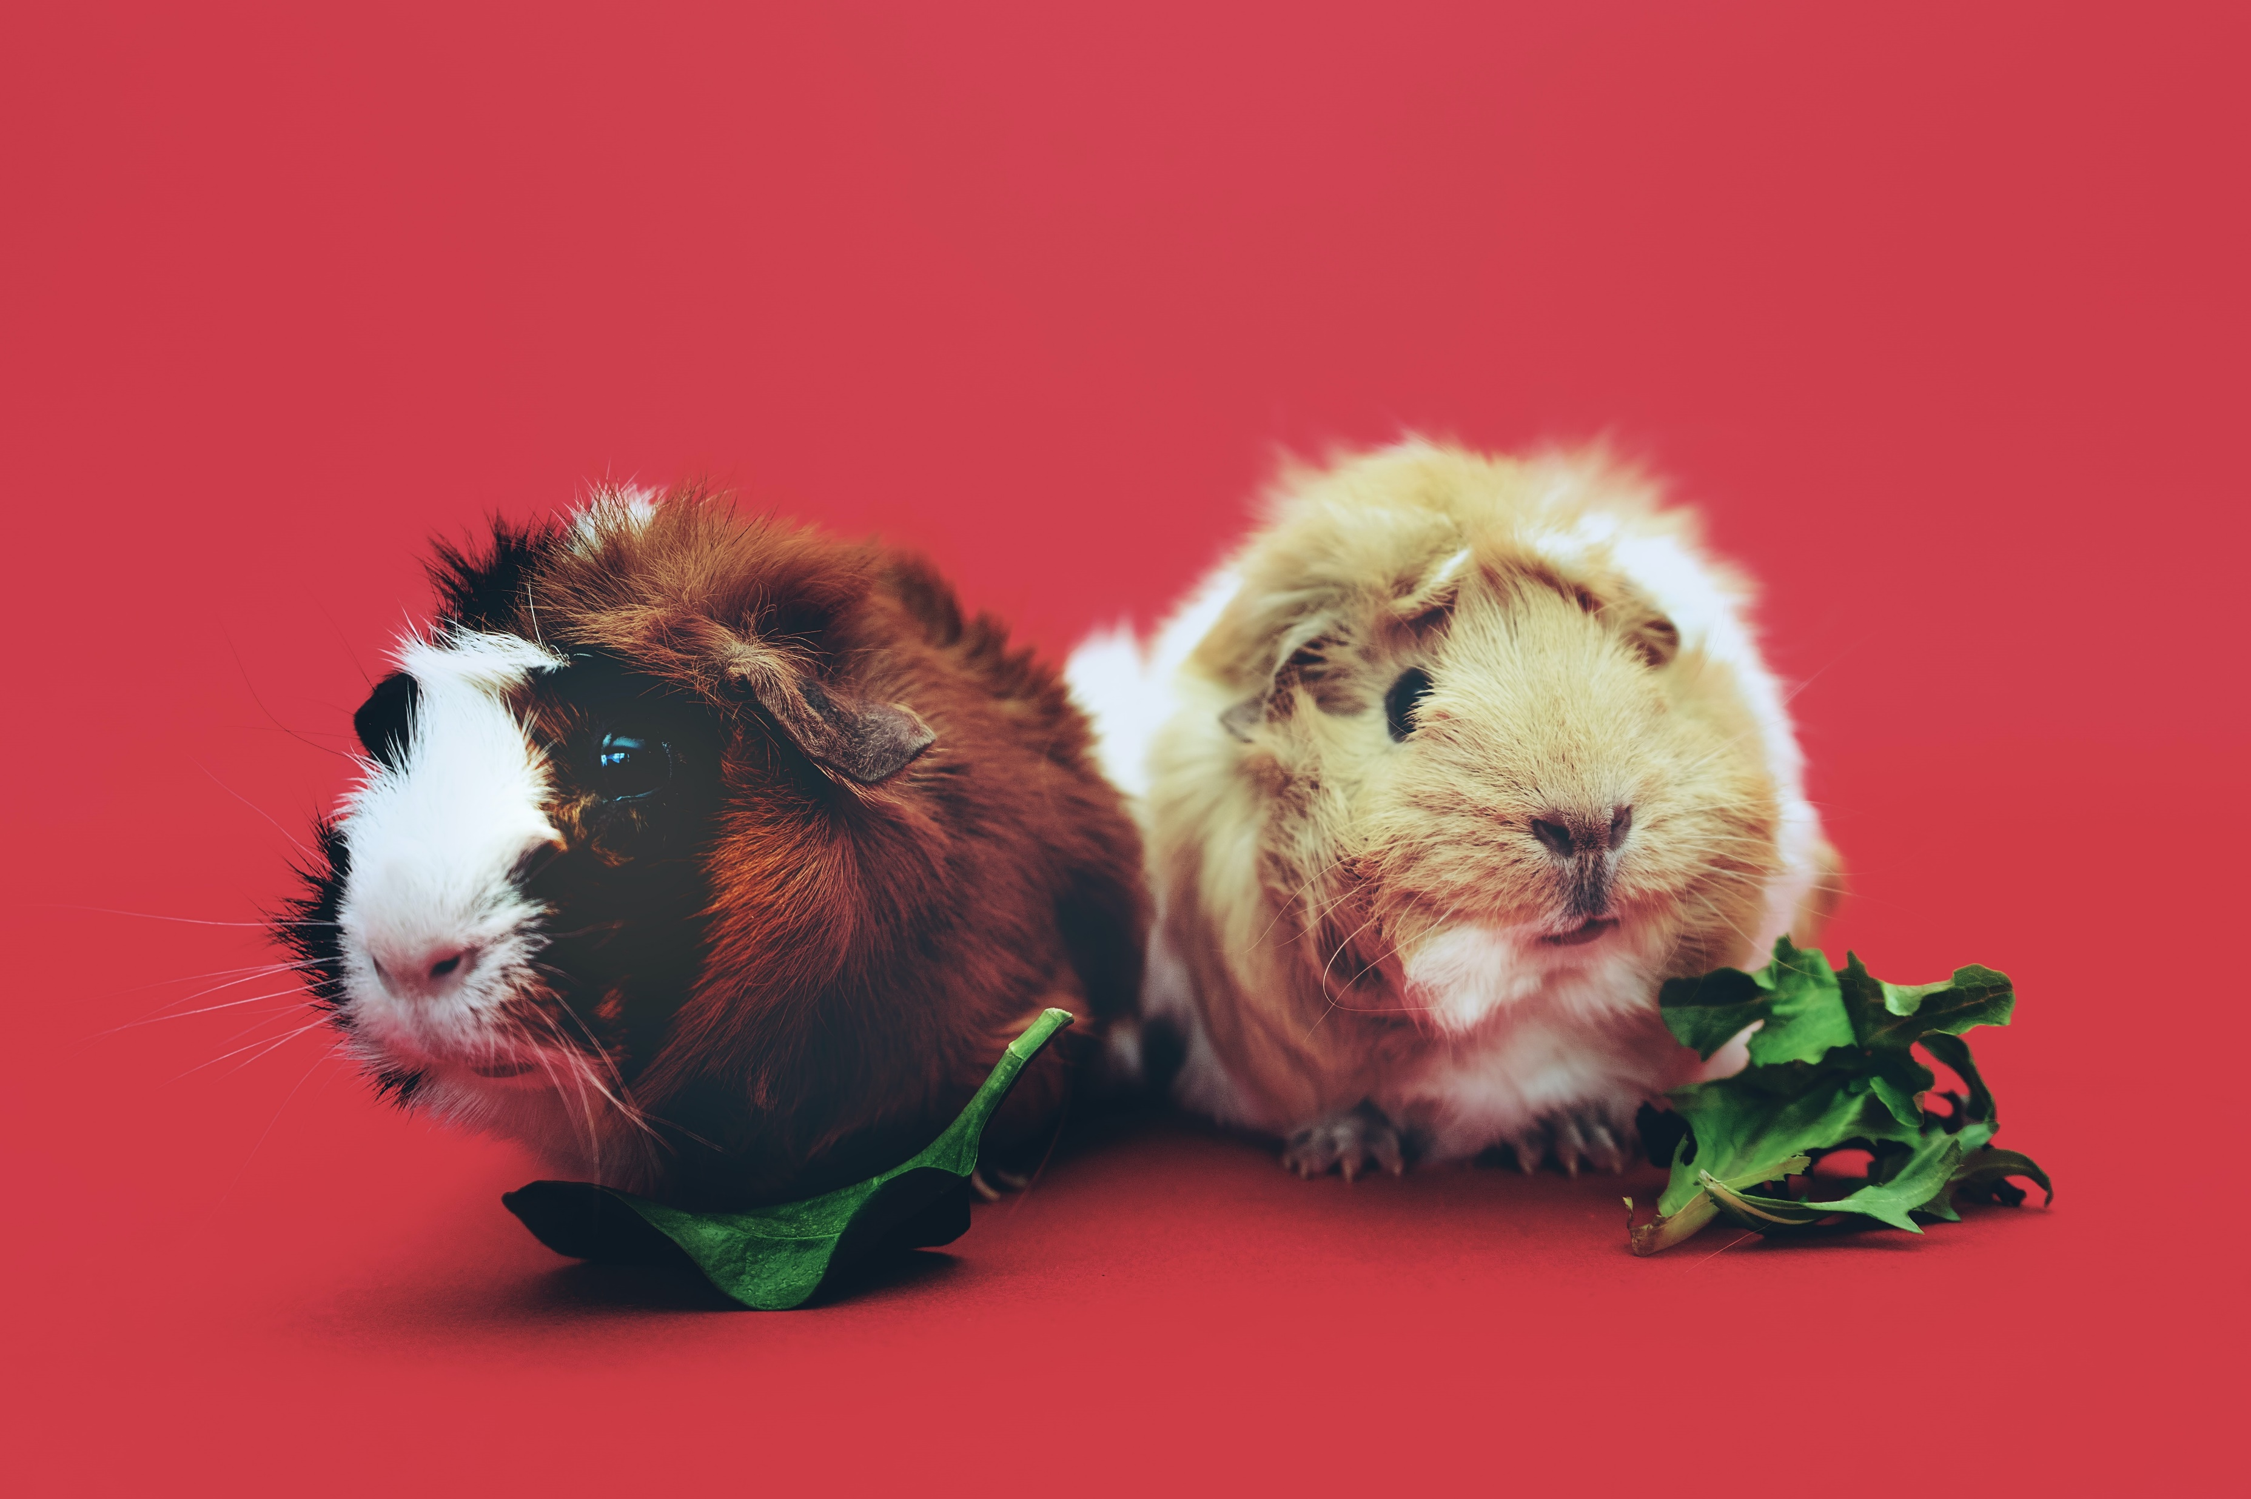
Clubs
SRC: The SRC meets every Monday at the beginning of Lunch in the SRC Room.
GSA: The Gender and Sexuality Alliance will meet every Thursday in Room 30 at Lunch. All are welcome!
Guinea Pig club with Mrs. Muise is every Thursday at lunch. Please go to the Bolt Center at the beginning of Lunch.
Best Buddies has started this week with Ms. Vanderbeck.

Slide 7

Athletics
Cross Country City Finals are Wednesday, October 11 at Forest Hills School. Runners should arrive at 3:30 for the walk-through. There is no practice this week. Please see Mme. Lamprea with any questions.
Ultimate Frisbee practice is Tuesday and Thursday from 3:00-4:00. Please see Mrs. Graham or Mr. Duff with any questions.
We are offering a Girls & Boys Soccer exhibition team on Wednesday and Thursday from 3:00 - 4:00. No try-out required, just show up and have fun! We will meet in the field at 3:00. Please see Ms. Dennis or Mr. Staples with any questions.

Slide 8
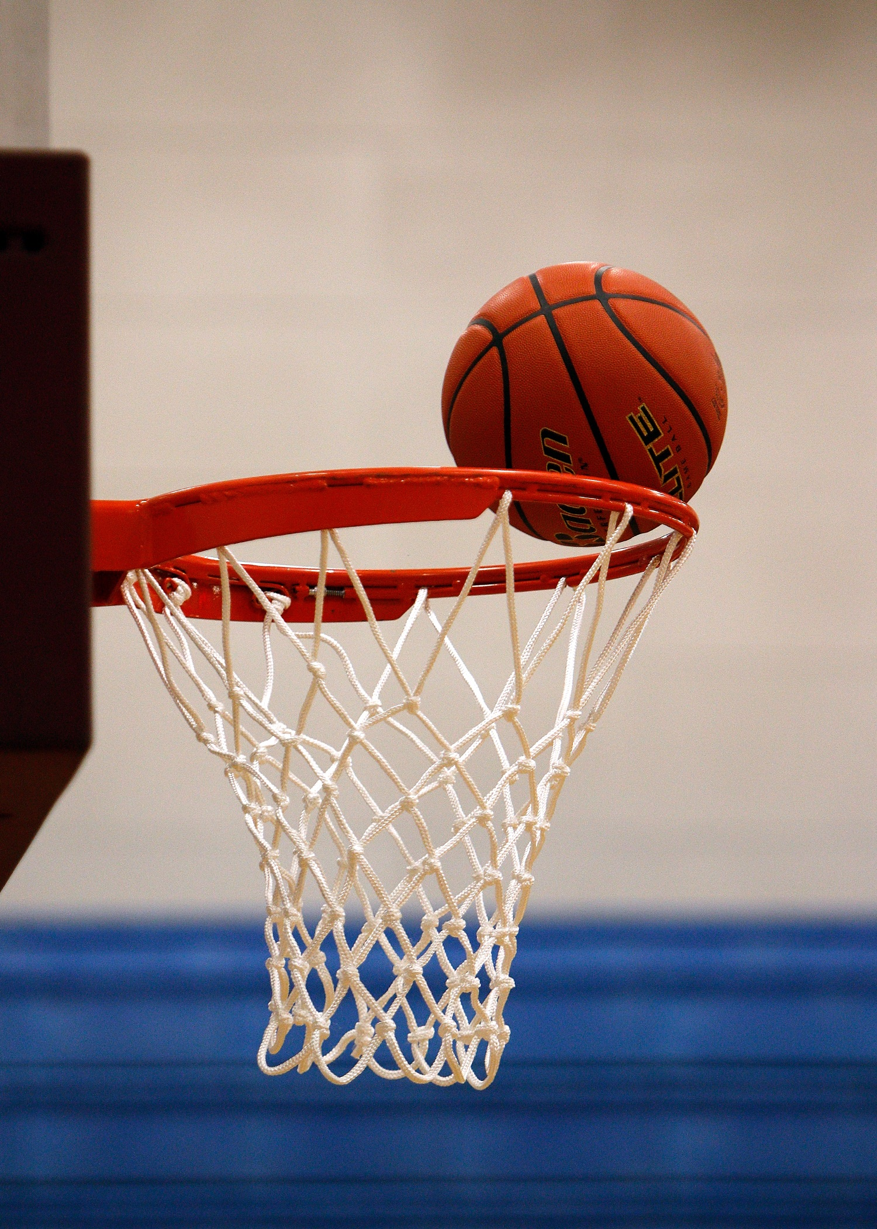
Intramurals October 10th – 12th
Tuesday - 4 Square
Wednesday – Mat Ball
Thursday – Basketball
Please bring your lunch. There is a 30-student maximum.

Slide 9
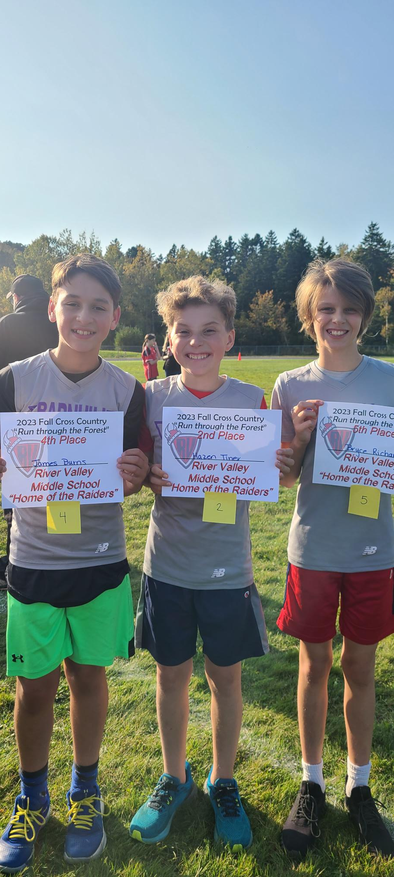
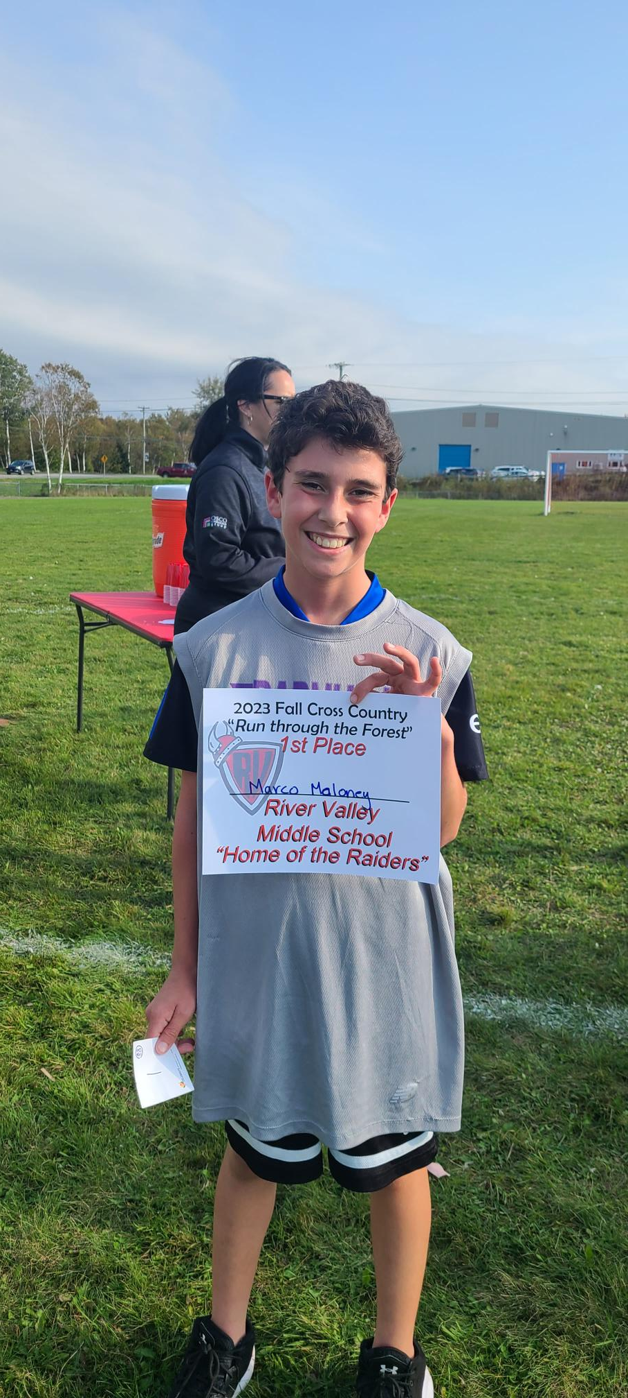
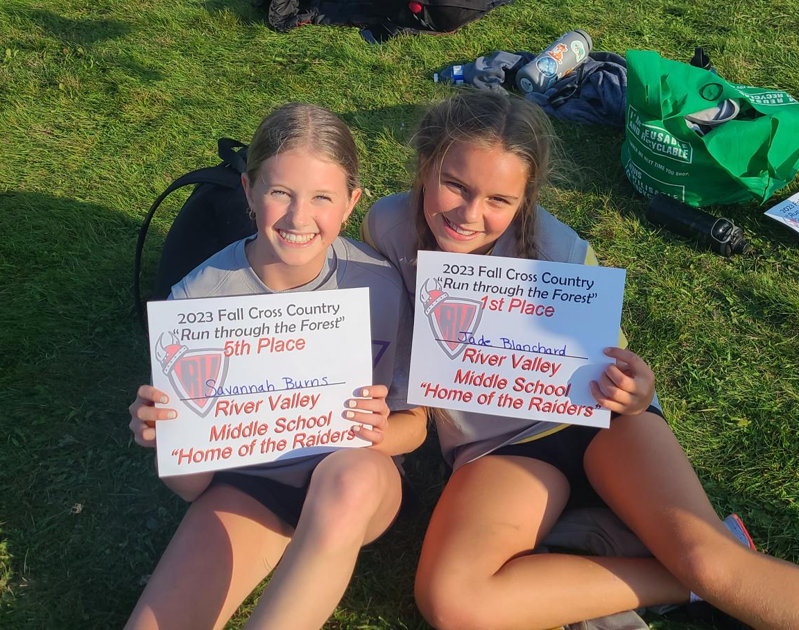
Cross Country Results
Another great effort by our Cross Country Team who had a meet at Rivervalley this week. Way to go Lightning!
Grade 8 Boys Girls
1st Connor Breen- McKnight 2nd Maddie Lavigne
Grade 7 Boys Girls
2nd Hazen Tiner 1st Jade Blanchard
4th James Burns 5th Savannah Burns
5th Bryce Richardson
Grade 6 Boys Girls
1st Marco Maloney 4th Akshaya Dileep

Slide 10

Students of the Month – September
Each month, teachers are recognizing the efforts of students to live by to BOLT Matrix. The following are our Students of the Month for September:
Grade 6
Kate Norton
Kamden Pitre
Claire Estabrooks
Calvin Vos
Grace Martin
Grade 7
Aiden Foley
Finn Holland
Kelson DiLiberatore
Cole Nagle
Ellie Clark
Grade 8
Ansan Jinto
Ryker Gerrits
Lily Dow
Rachael Mawhinney
This Photo by Unknown Author is licensed under CC BY-NC-ND

Slide 11

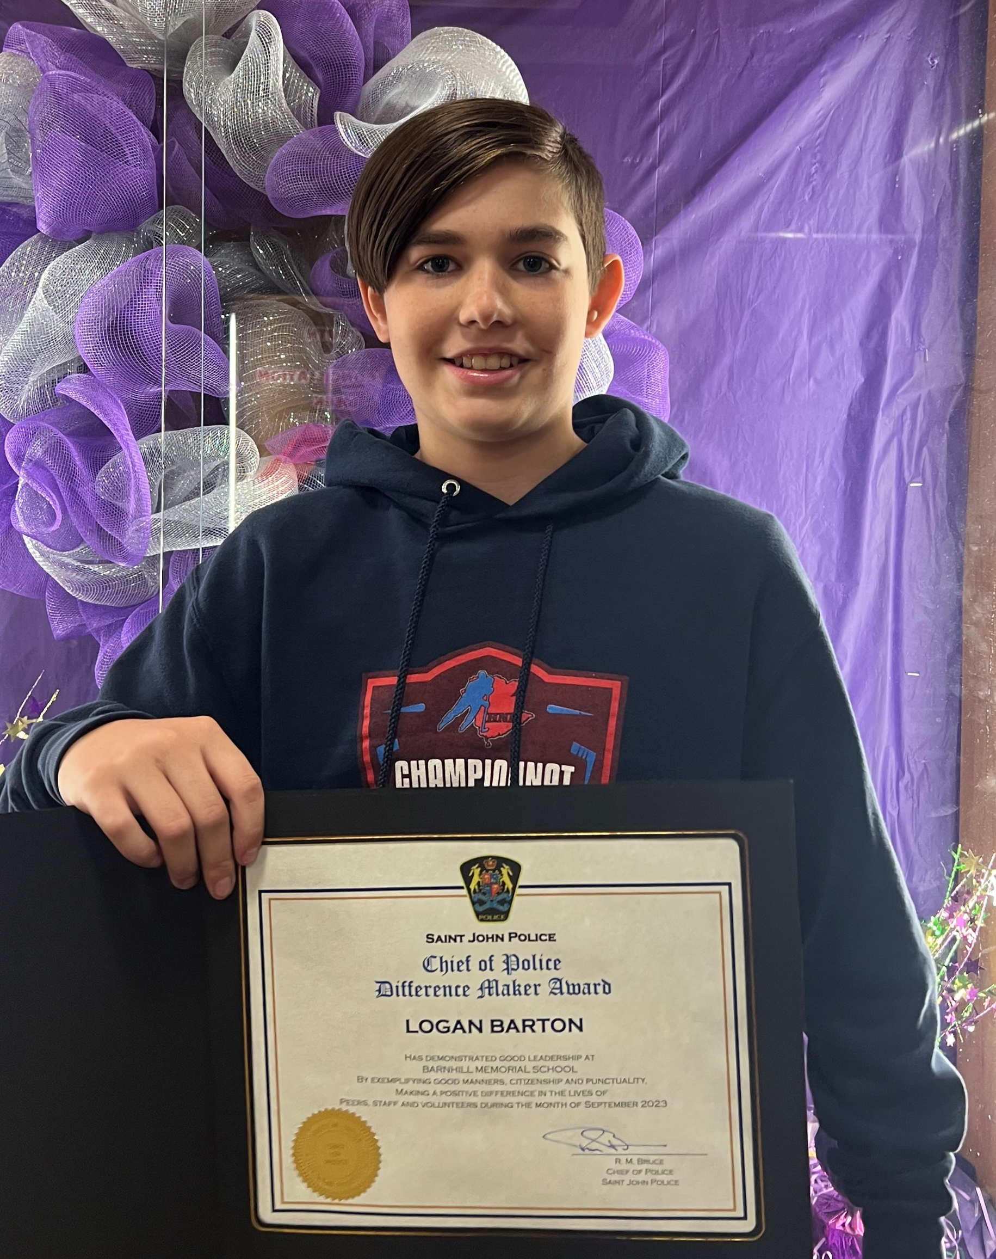
Difference Maker Award
We are proud to be participating in the “Difference Maker” initiative. This is an award given out by the Saint John Police Force to Middle School students in the city.
Criteria and eligibility:
One student from grade 6-8 per school, per month
Student must demonstrate leadership in punctuality, good manners, kindness, and citizenship
Student must contribute to making a difference in the lives of peers, staff, and volunteers, and is dedicated to a positive, healthy school environment
The “Difference Maker”
recipient for September is Grade 8
student Logan Barton!

Slide 12

SRC – Student Representative Council
Our SRC has been hard at work this year setting us up for a good year! We wanted to take a moment to introduce our Office Ambassadors. You may notice them in the office, answering phones, taking messages, and supporting Mrs. Stevenson, Mrs. Muise or Ms. Ferguson.
Our Office Ambassadors this year are:
Sadie Shepherd
Nathan Pitre
Addison Estey
Audrina McKinnon
Rachael Mawhinney
Madeline Grasse
Other SRC positions include:
News Team
Promotions
Dance Committee
Canteen
Hot Lunch Helpers
Tech Crew

Slide 13
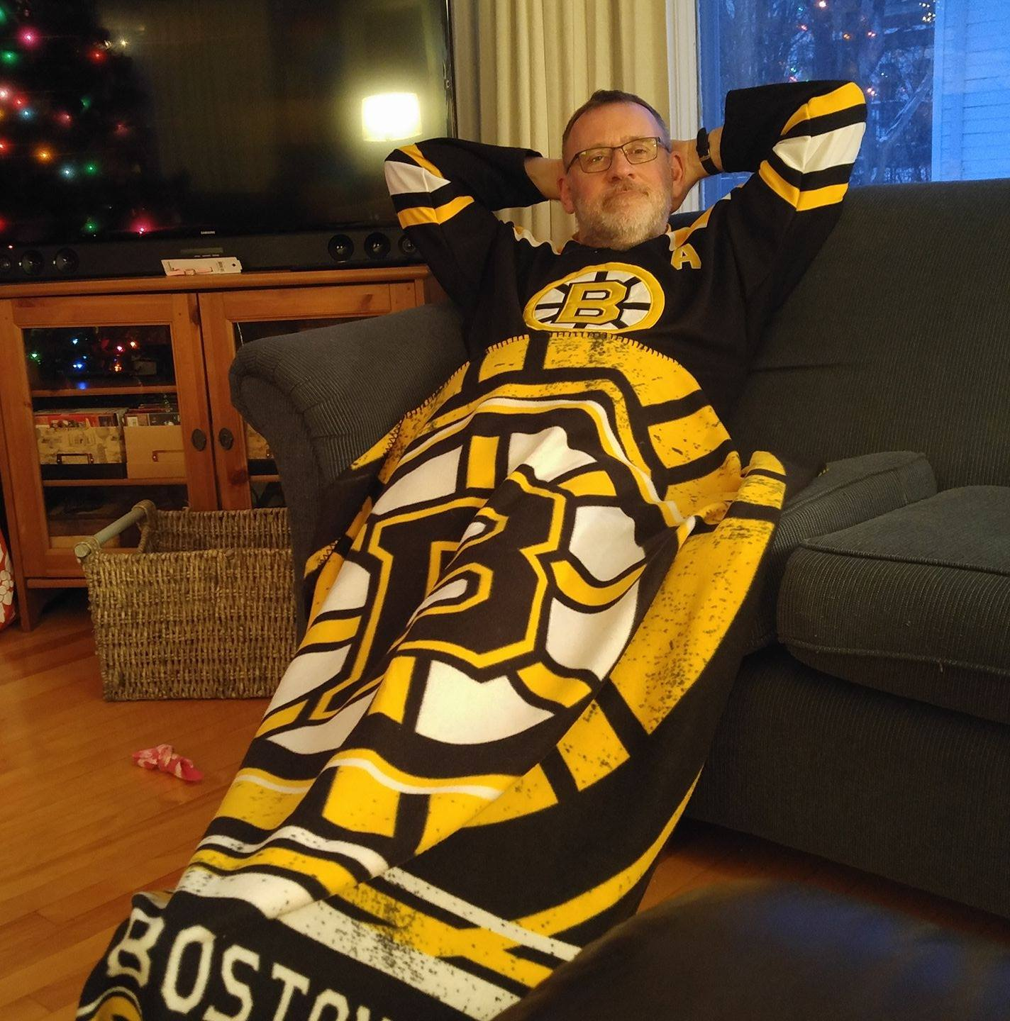
Mr. Frank Stuart
BARNHILL STAFF SPOTLIGHT
Has a Grade 6 homeroom and teaches Tech and Grade 8 Social Studies
Teaching Experience: 27 years
Years at Barnhill: 19
What do you love about teaching? “Helping students learn something new.”
Interest/Activities: Golf
Interesting Fact: Once spent 30 days living in a tent above the Arctic Circle (220km above)
Family: Wife and son

Slide 14


Slide 15
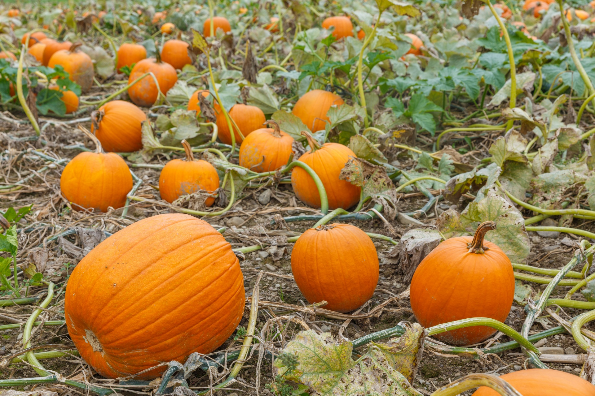
On the Horizon…
This Photo by Unknown Author is licensed under CC BY-SA

Slide 16


Picture Day!
Put your smile on! Picture Day will be on Tuesday, October 17th.
This Photo by Unknown Author is licensed under CC BY-NC

Slide 17
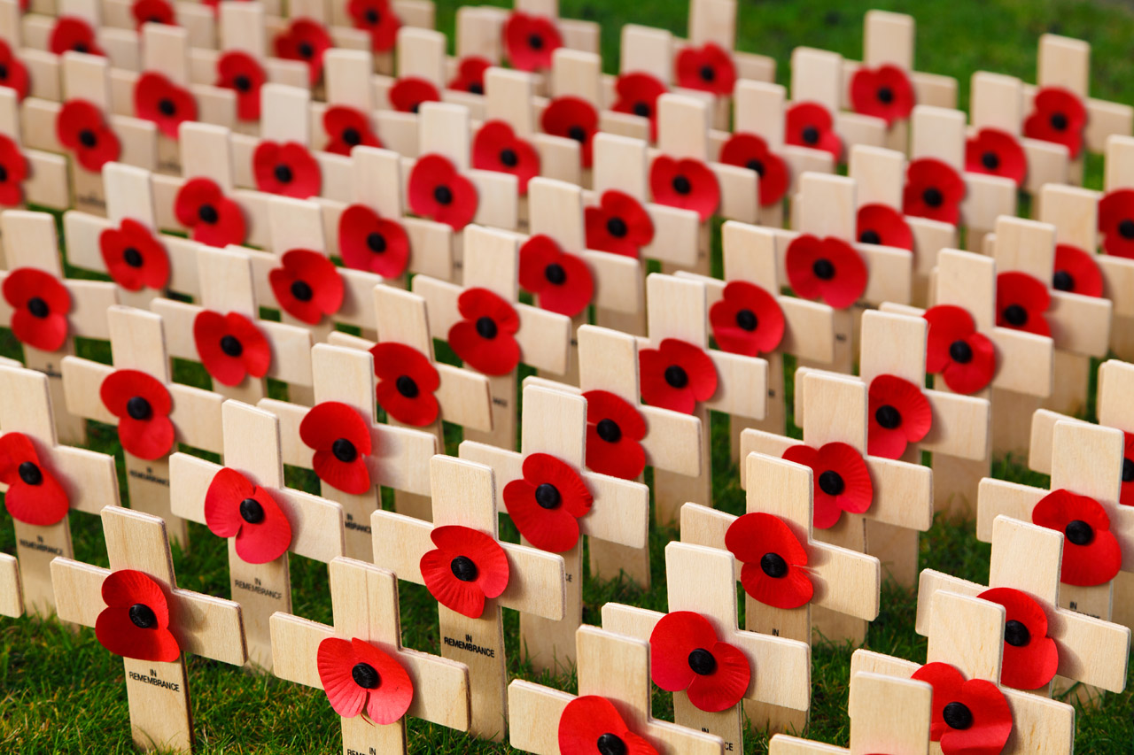
Remembrance Day Events
The Legion’s Annual Remembrance Day contest to open to all students! For detailed information, please visit www.remembrancecontests.ca/ Entries are due on November 10th.
Our Remembrance Day Ceremony will be on November 10th at 10:15 a.m. Community members are welcome.

