Slide 1

Lightning News
September 11th – 15th.
“Obstacles don’t have to stop you. If you run into a wall, don’t turn around and give up. Figure out how to climb it, go through it, or work around it.”
-Michael Jordan

Slide 2
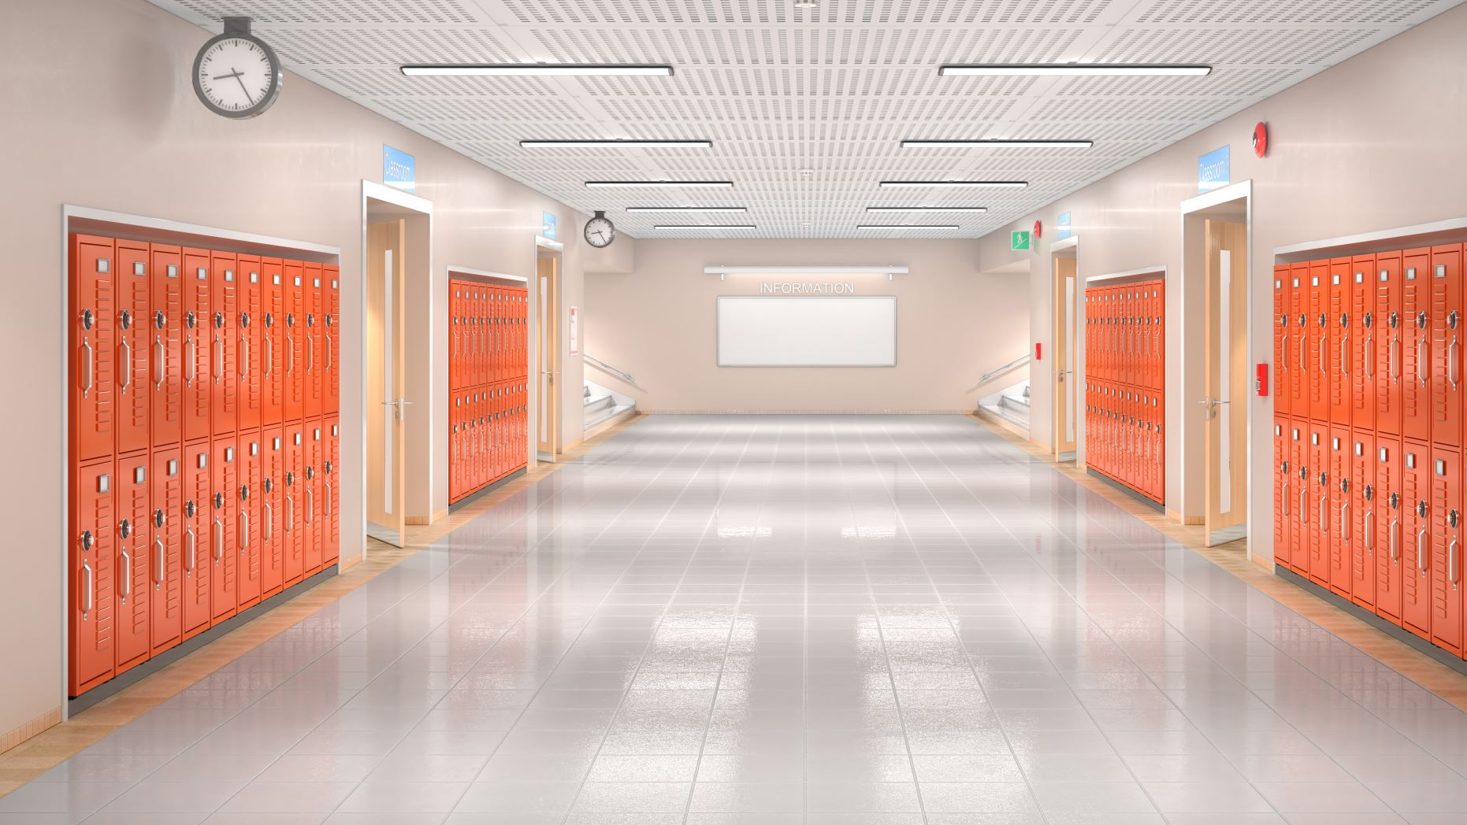
Welcome
We have new lockers in our school for all the students. We want these lockers to stay in great shape so please treat them with respect. Also, please remember all students need to bring their lock to keep their personal items safe. Only share your combination with your homeroom teacher.

Slide 3

Campaign of Respect
During Foundations, classes will be learning about respect in all areas of their lives!

Slide 4

Lunch
We ask that all students bring a healthy lunch everyday.
The first day for our canteen will be this Friday, September 15th. All snacks and drinks are $1.00 or $2.00.
The hot lunch program will start on Friday, October 6th.

Slide 5
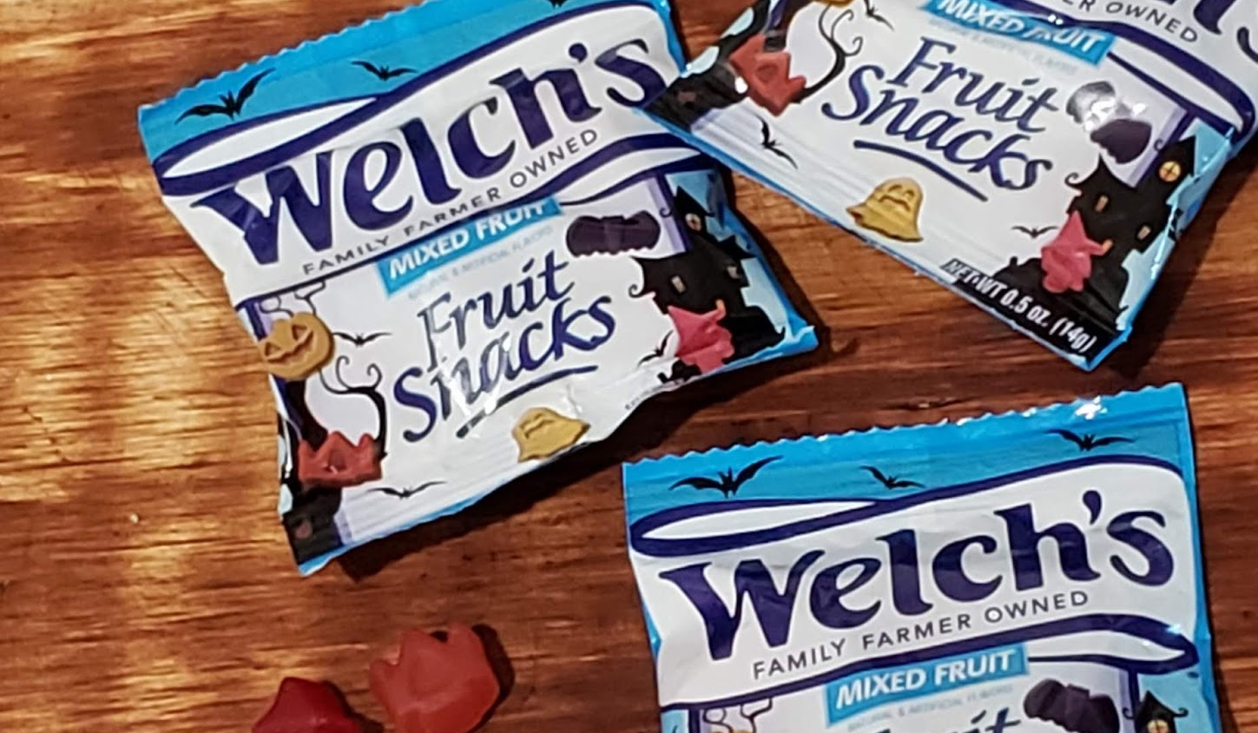
Healthy Breakfast Program
We have a healthy breakfast program that is available to all students every morning in the gym lobby.
This Photo by Unknown Author is licensed under CC BY-NC-ND

Slide 6


Slide 7
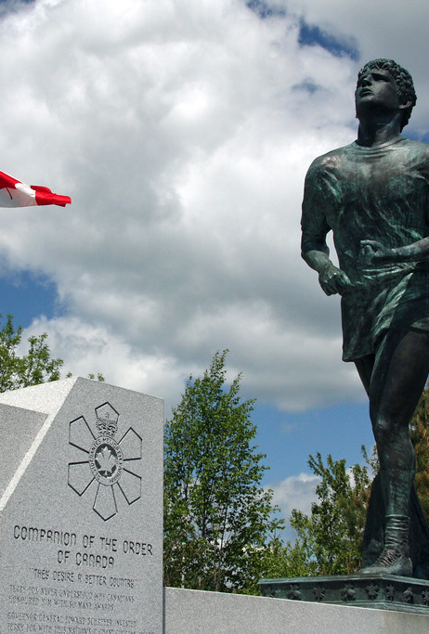
Terry Fox Walk/Run
This will be Monday, September 18th.
Please bring your toonie for Terry and give it to your homeroom teacher. We will also have a donations account set up on cashless schools.
This will be a whole school event beginning at 1:00. Wear comfortable shoes and dress for the weather!
This Photo by Unknown Author is licensed under CC BY-SA-NC

Slide 8
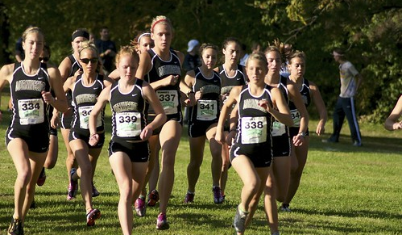
A
Cross Country has started, and Madame Lamprea is the coach.
Practices are Monday and Thursday from 3:00-3:45.
This Photo by Unknown Author is licensed under CC BY-NC-ND
Cross Country

Slide 9
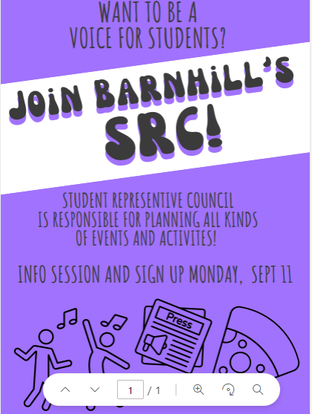
Student Council will begin this week with faculty advisors Ms. Seales and Ms. Dennis.
We will hold an information session for all members in the SRC Room on Monday, Sept 11 at the beginning of Lunch. If you were on SRC last year or want to be this year, you must attend this meeting. Bring your lunch! If you have questions, see Ms. Seales or Ms. Dennis.

Slide 10

On the Horizon:
The first dance of the year will be on September 21st from 6:30-8:30. The cost is $5.
There is no school for students on Friday, September 22nd .
PSSC Meeting on Monday, September 25th from 6-7 pm. All are welcome.

