Slide 1




Lightning News
September 18th – 22nd

Slide 2

Terry Fox Day – September 18th
z
We are participating in the Terry Fox run/walk again this year. This event will be for everyone on Monday afternoon. Wear comfortable footwear!
Please bring your “toonie” and give to your homeroom teacher for Terry or donate on cashless schools.
Thank you for your support!

Slide 3

Athletics
z
Cross Country practice is Monday at
3:00-3:45 pm.
The Cross-Country Meet is September
20th at Wolastoq Park. Meet Mme. Lamprea
at the park at 4:15 pm.
Ultimate Frisbee Tryouts are Tuesday and Thursday from 3pm-4pm. Please see Mrs. Graham or Mr. Stuart with questions.
If you are interested in playing community hockey, please contact Ashley Nickerson at ashley_nickerson@hotmail.com

Slide 4

Intramurals September 18-21
Monday - Badminton
Tuesday - 4 square
Wednesday - Mat ball
Thursday – Basketball
Please bring your lunch. There is a 30-student maximum.

Slide 5


Clubs
SRC:
Thank you to all the students who applied to be on our SRC! It is looking like we are going to have a great group. All students who have applied will meet in the SRC room on Monday at the beginning of lunch.
GSA:
The Gender and Sexuality Alliance will be starting up this week! Join us on Thursday in Room 30 at Lunch. All are welcome!

Slide 6


Slide 7
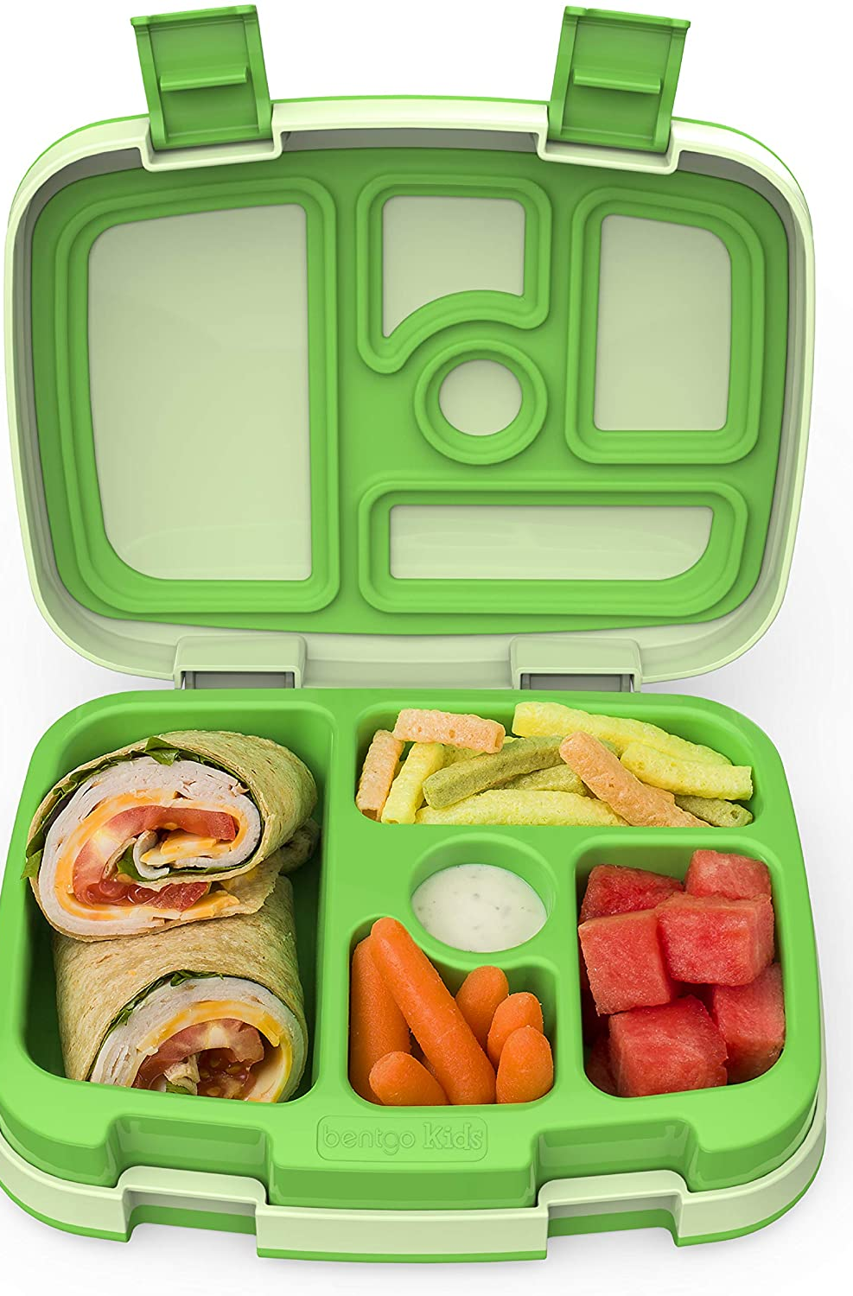
Lunch
Students are to continue to bring a packed lunch every day.
Hot Lunch will begin on Friday, October 6th. The Hot Lunch option is cheese pizza for $2.50 per slice. Please pay in advance on Cashless Schools.
z

Slide 8
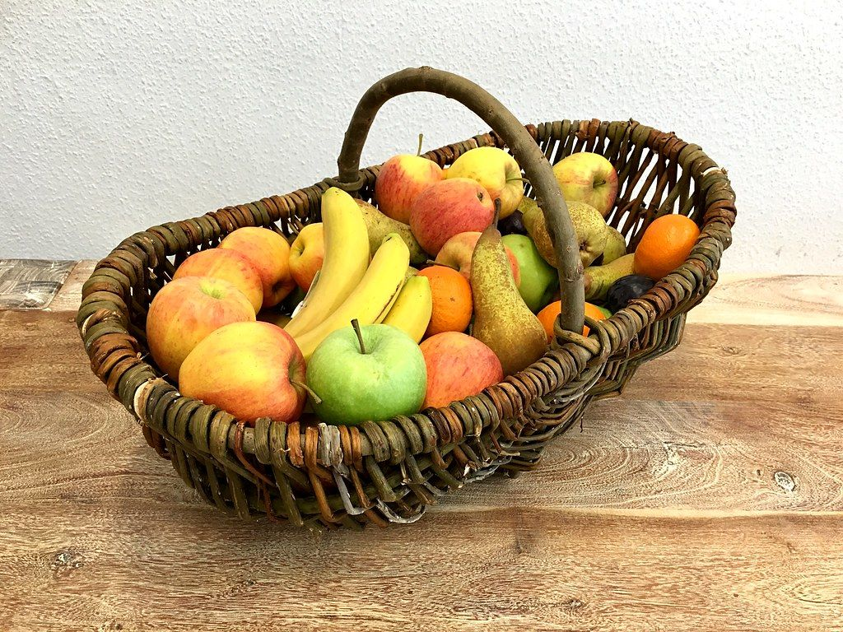
Breakfast Program is available in the morning for all students.
z
We want our students to start their day in the right way, therefore, we have healthy breakfast options available in the front lobby every morning,
This Photo by Unknown Author is licensed under CC BY

Slide 9

NO SCHOOL!
Friday, September 22nd is a Professional Learning day for staff. There is no school for students.

Slide 10

On the Horizon…

Slide 11
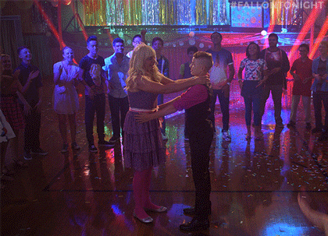
Welcome Back School Dance.
z
SRC will be hosting a school dance on Thursday, September 21st from 6:30 p.m. – 8:30 p.m. It will be $5.00 at the door.
There is NO school for students on Friday, September 22nd.

Slide 12
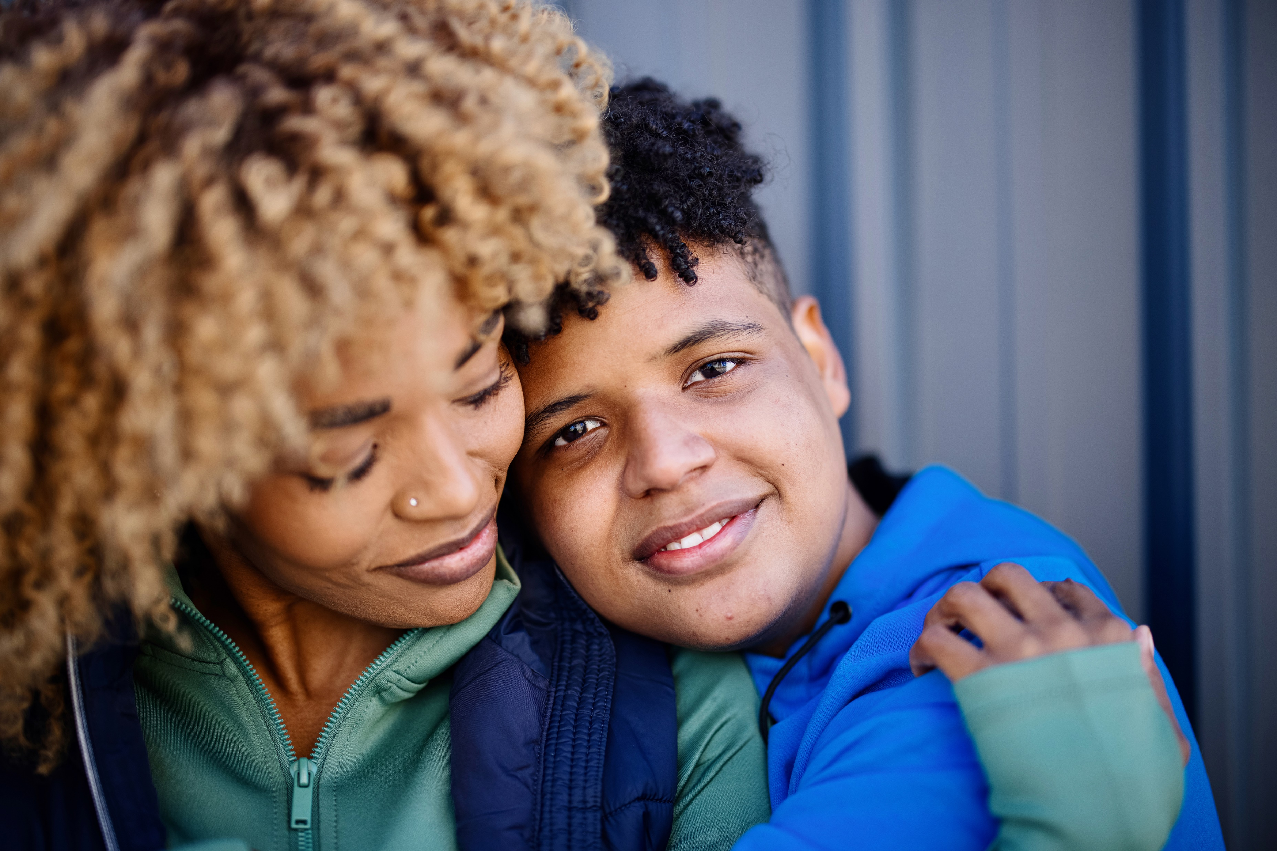
PSSC
Would you like to be a voice in your child’s education? Please join our Parent School Support Committee! We will meet on Monday, September 25. All are welcome!

Slide 13
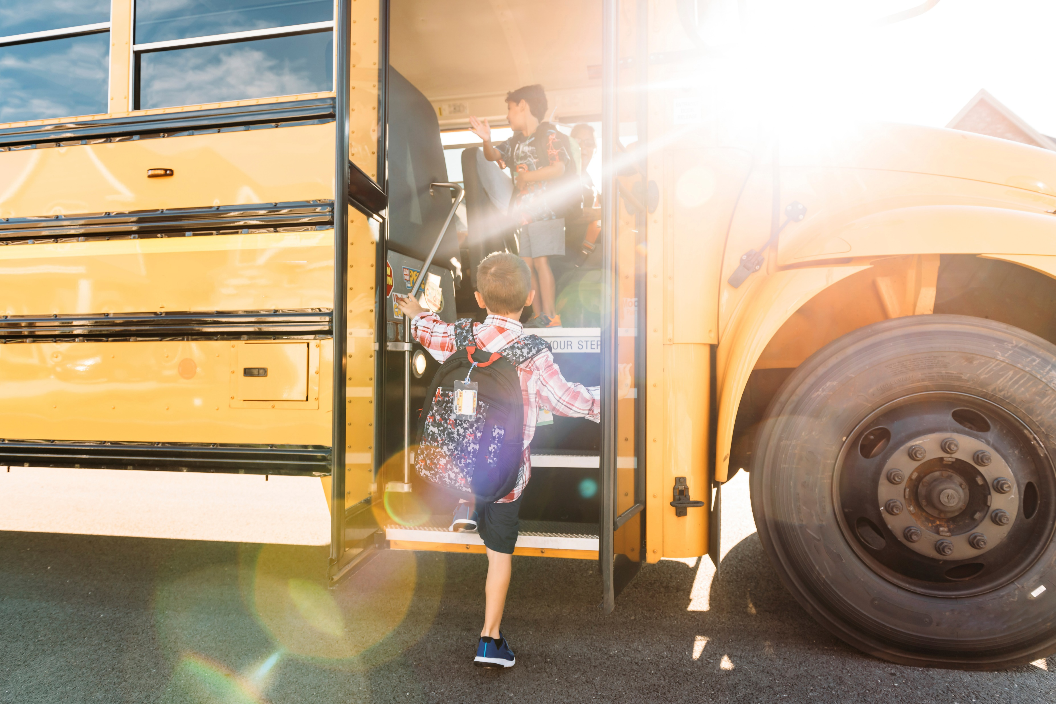
Bus Safety
Bus Safety practice will take place on Tuesday, September 26th beginning at 9:30 a.m.

Slide 14

Orange Shirt Day - Friday, September 29
z
Friday, September 29 will be Orange Shirt Day in recognition of the individual, family, and community intergenerational impacts of Residential Schools.
This Photo by Unknown Author is licensed under CC BY-SA-NC

Slide 15

Immunizations
Horizon Health will be in the school on October 4th to administer immunizations to our Grade 7 students.

Slide 16

Picture Day!
z
Put your smile on! Picture Day will be on Tuesday, October 17th.
Harvey Studios will be in to take all the pictures of students and staff.
This Photo by Unknown Author is licensed under CC BY-SA-NC

Slide 17

Legion Remembrance Day Contest
The Royal Canadian Legion is sponsoring its Annual Poster and Literary Contest!
This contest to open to all students!
For detailed information, please visit www.remembrancecontests.ca/
Entries are due on November 11th.

