Slide 1

Lightning News
September 25th – 29th

Slide 2

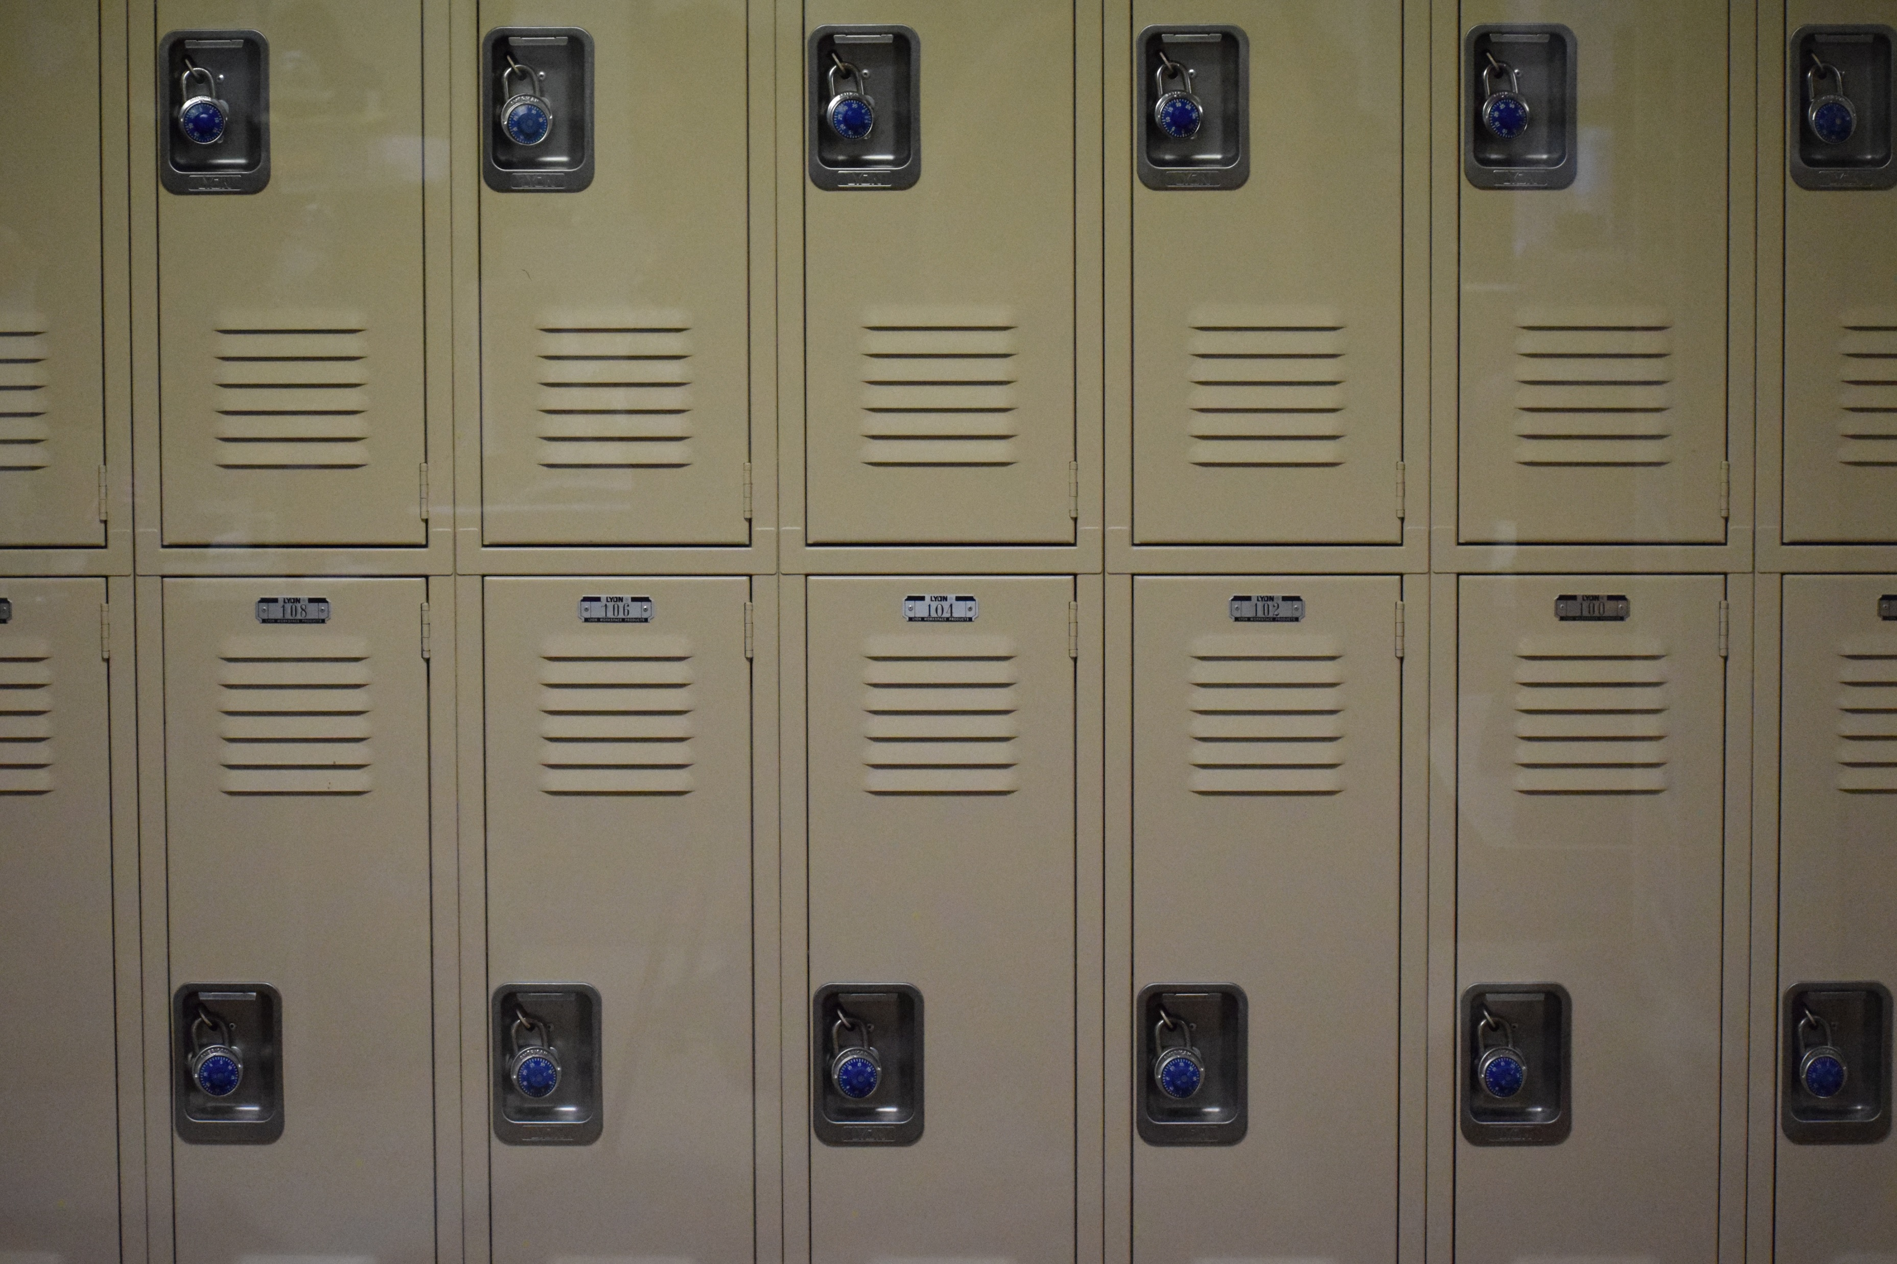
Lockers and locks:
All students have been provided with a locker in the school to keep their personal belongings safe. All students require a lock for their locker, please ensure your child has a lock for their locker by the end of this week.
Students: only give the combination of your lock to your homeroom teacher.

Slide 3

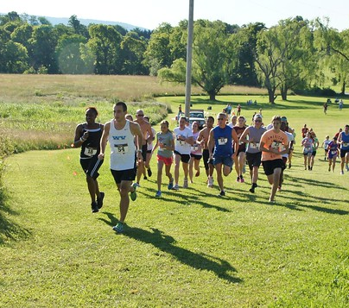
Athletics
Cross Country practice is Monday and
Wednesday from 3:00 – 3:45 p.m.
The Cross-Country Meet is September
26th at Forest Hills School. Be there by 3:30 for team warmup and walk through. Any questions, please ask Madame Lamprea.
Ultimate Frisbee is Wednesday and Thursday from 3pm-4pm. Please see Mrs. Graham or Mr. Duff with any questions.

Slide 4
Congrats to our Cross Country Team!
A special shout out goes to our cross-country team for their fantastic effort in their first cross-country meet! Hazen Tiner placed 2nd and we had many other Top 10 finishers.​
Way to go Lightning!

Slide 5
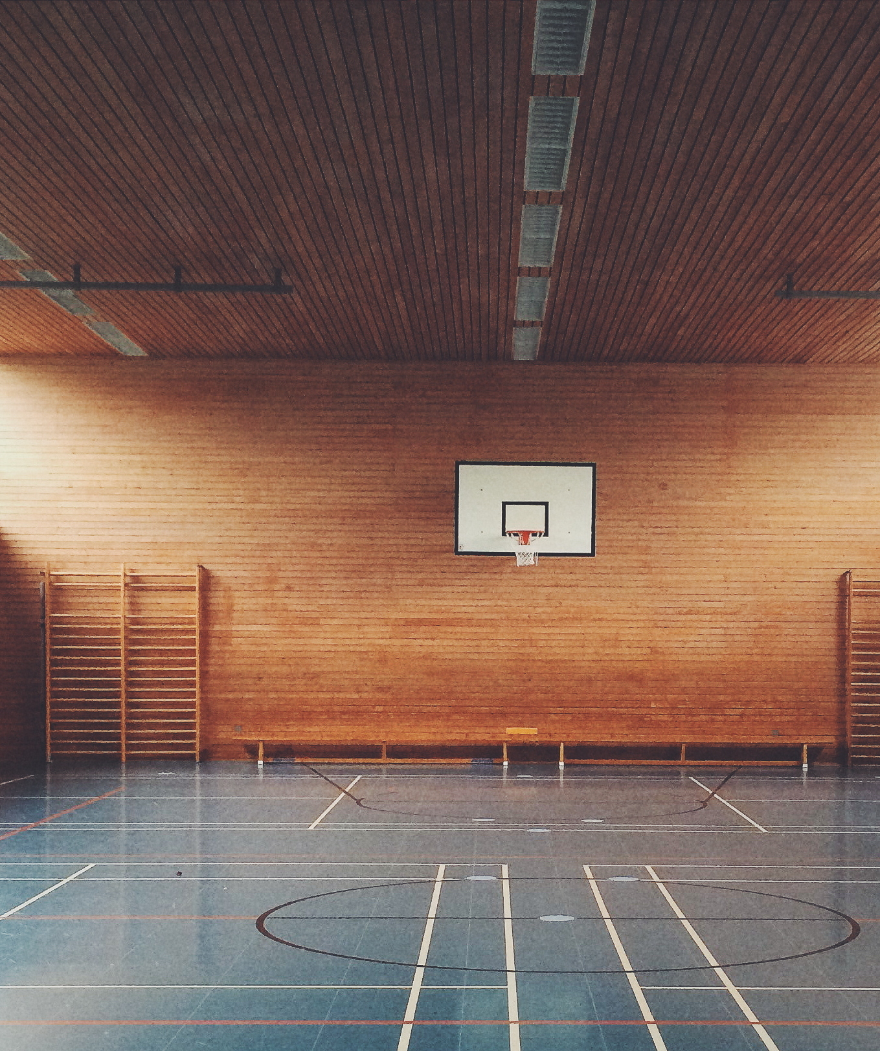
Gym Helpers Wanted!
If you are interested in being a student gym helper, please write a letter to Mrs. Graham stating why you would be a good choice. A gym helper will help set up equipment in the gym, help with the outdoor field activity day, the Dodge Hunger Newcomball tournament and other activities throughout the year.
All letters must be in by Friday, Sept. 29th. No late letters will be accepted.

Slide 6
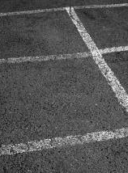
Intramurals September 25th - 29th
Monday - Badminton
Tuesday - 4 Square
Wednesday - Matball
Thursday – Basketball
Friday - Wall Soccer
Please bring your lunch. There is a 30-student maximum.
This Photo by Unknown Author is licensed under CC BY-NC-ND

Slide 7


Clubs
SRC: The SRC meets every Monday at the beginning of Lunch in the SRC Room.
GSA: The Gender and Sexuality Alliance will meet every Thursday in Room 30 at Lunch. All are welcome!
Guinea Pig club with Mrs. Muise each Thursday at lunch. Please go to the Bolt Center.

Slide 8

Bus Safety
Bus Safety practice will take place on Tuesday, September 26th beginning at 9:30 a.m.
This will be for all classes.
This Photo by Unknown Author is licensed under CC BY-SA-NC

Slide 9

Orange Shirt Day - Friday, September 29
Please take the opportunity to wear an orange shirt on Friday, September 29th in recognition of the individual, family, and community intergenerational impacts of Residential Schools.
SRC will be providing a video presentation for all classes on Friday morning.

Slide 10
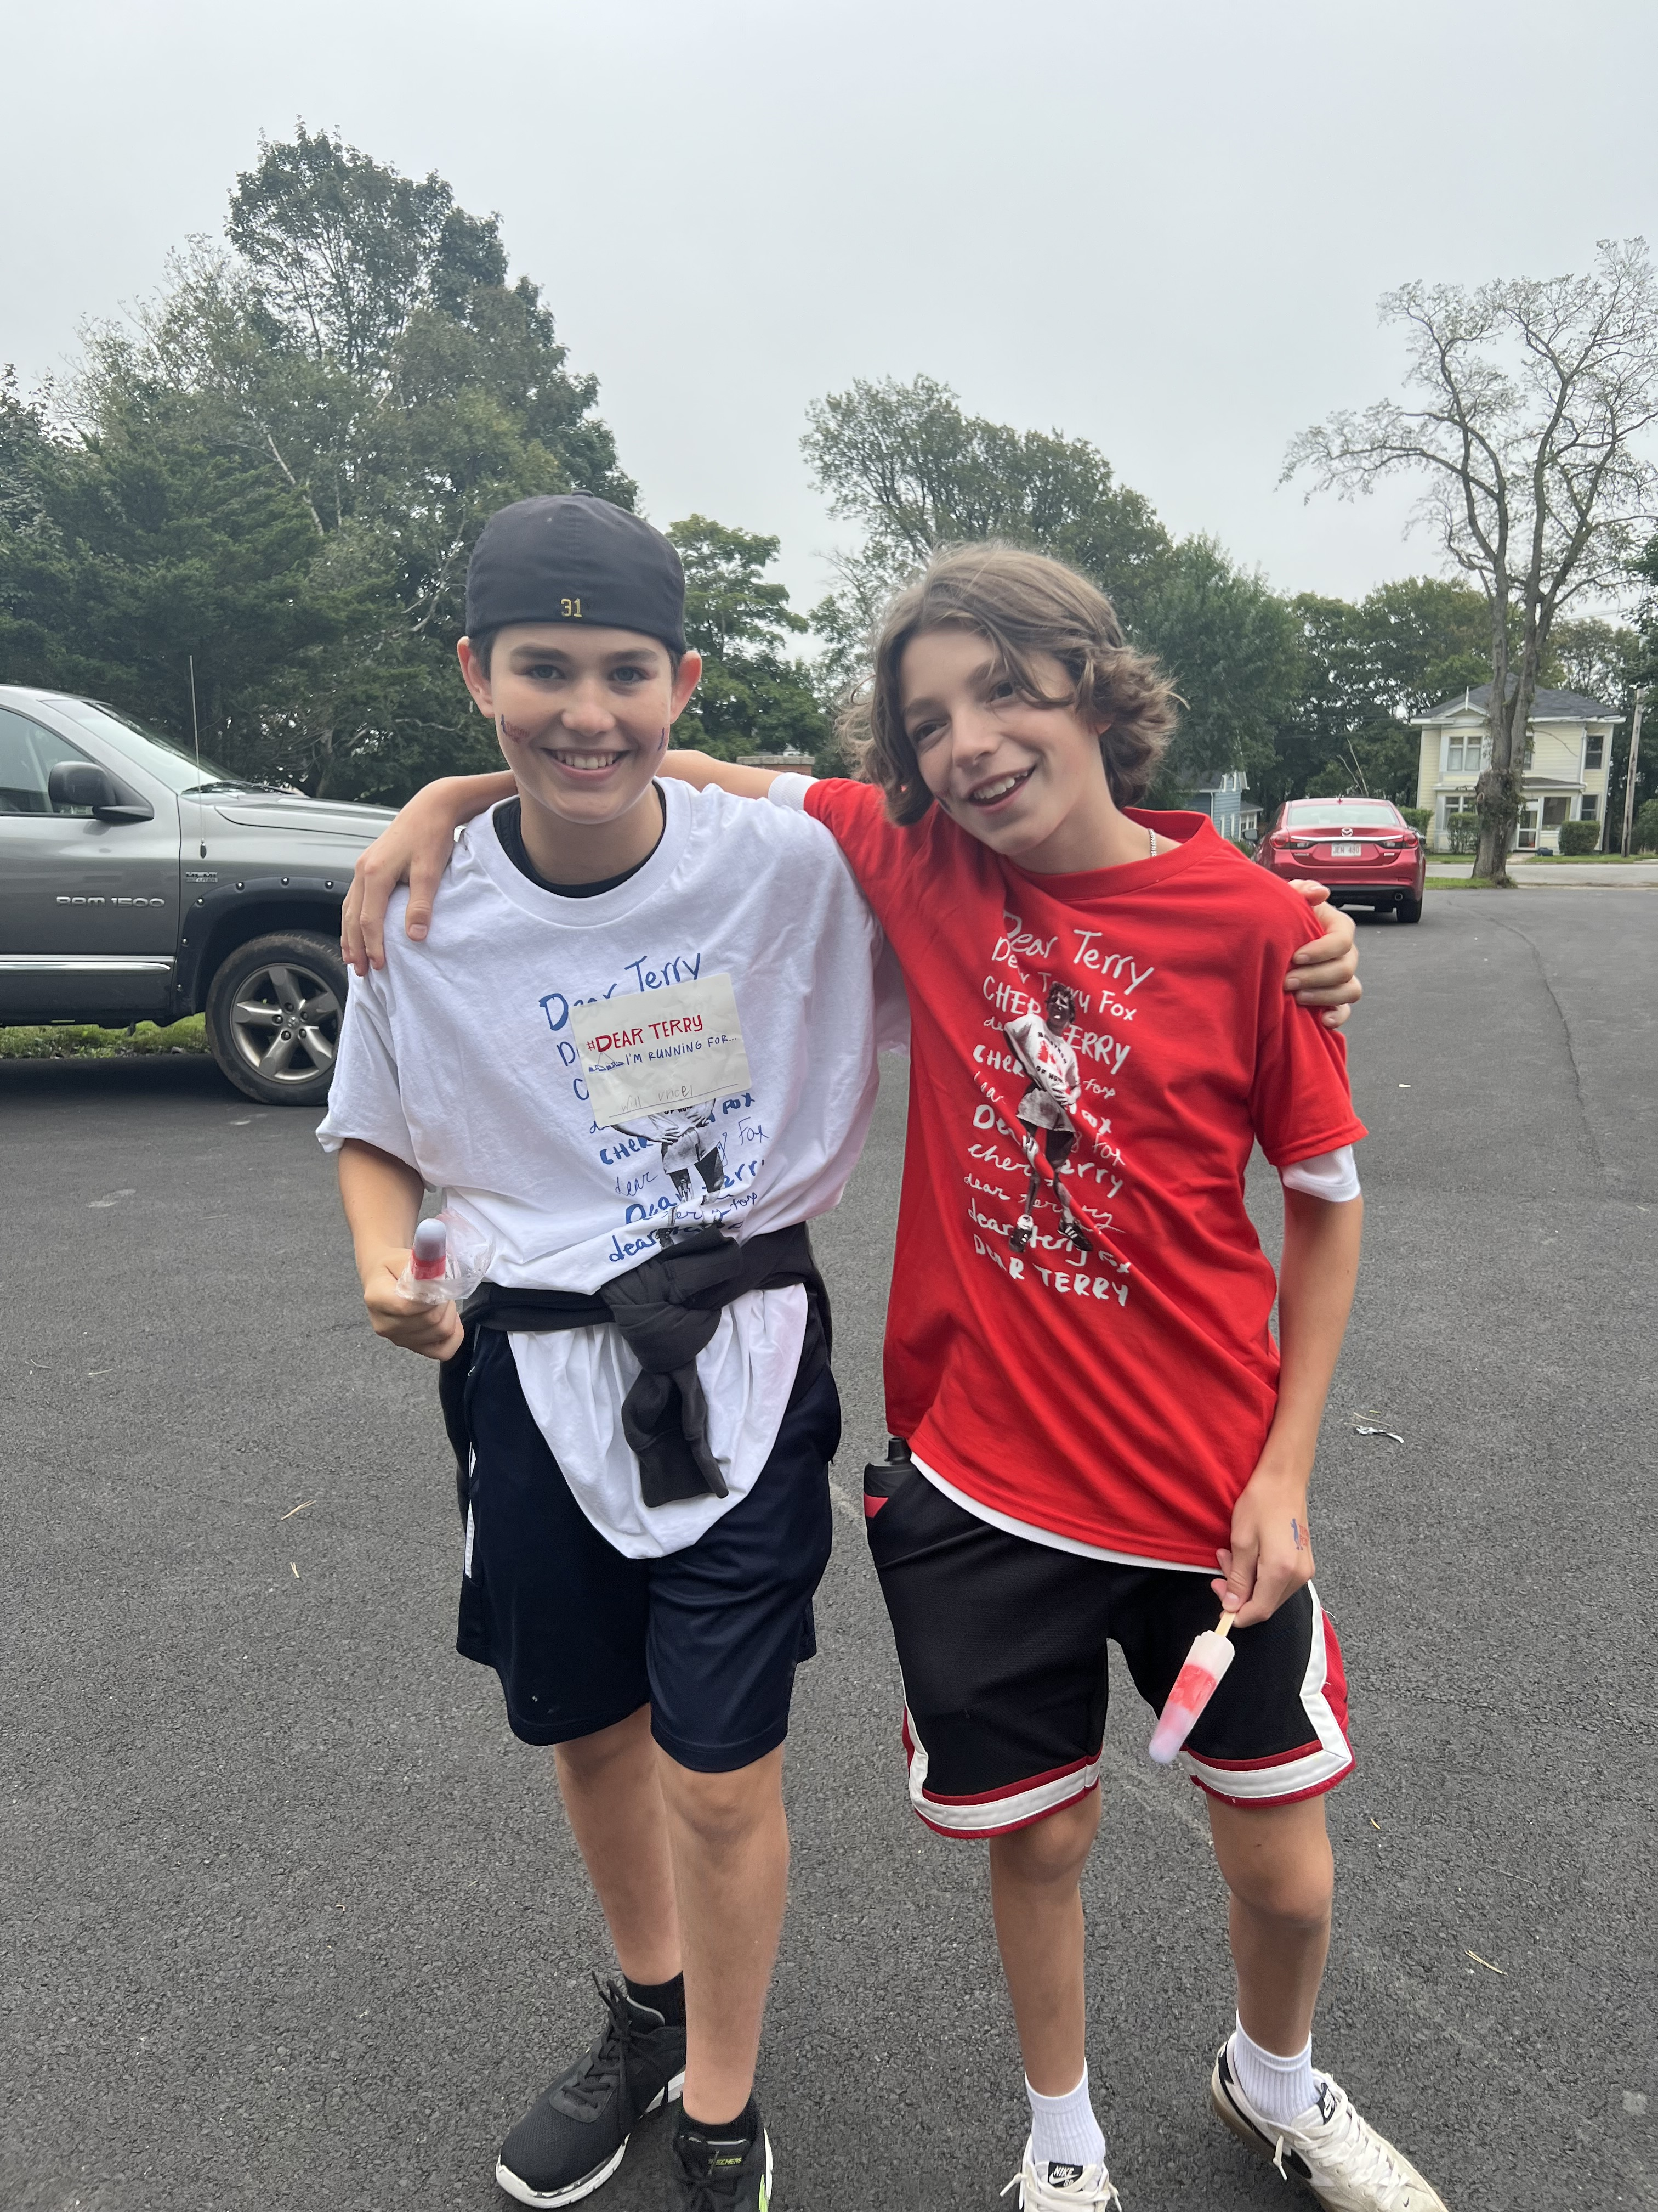
Terry Fox Day
Thank you to those who brought in their toonies for Terry or donated on Cashless school.
Our Terry Fox run/walk was wonderful!

Slide 11
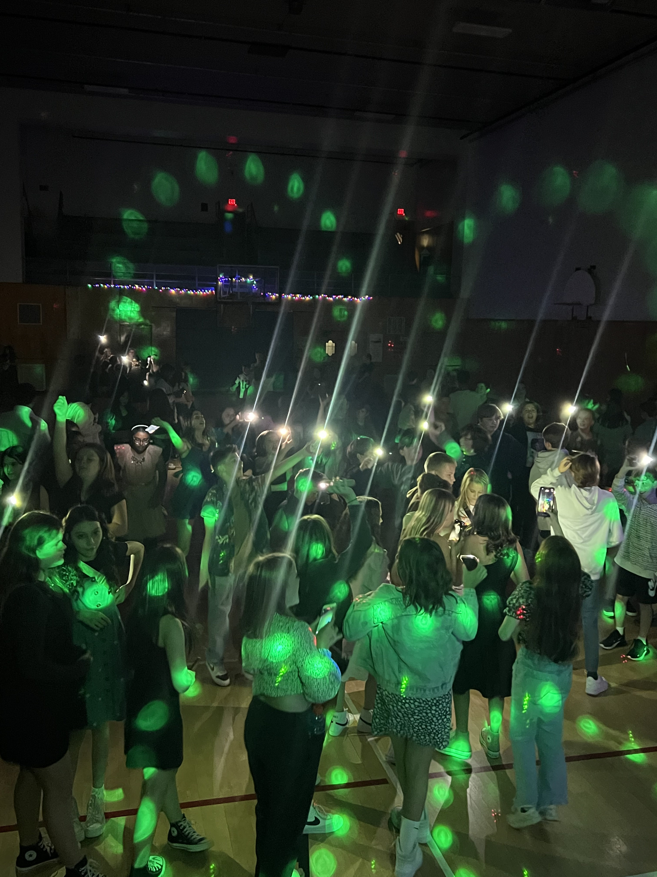

Welcome Back Dance!
Our first dance was a huge success! Thank you to SRC for hosting, Teachers and parents for volunteering, and students for having a great time!
We are already looking forward to the next event!

Slide 12
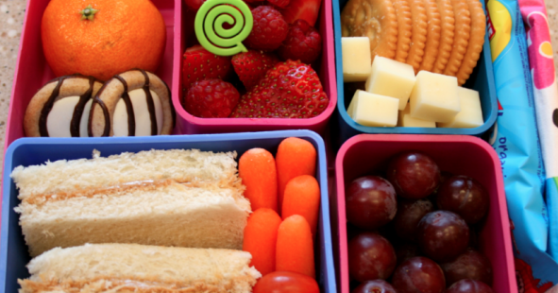
Lunch and Canteen
Students are to continue to bring a packed lunch every day.
We will have a canteen this Friday, September 29th at lunch, all items are $1.00 - $2.00 each.
Hot Lunch will begin on Friday, October 6th. The Hot Lunch option is cheese pizza for $2.50 per slice. Please pay in advance on Cashless Schools.
This Photo by Unknown Author is licensed under CC BY

Slide 13

Breakfast Program
We want our students to start their day in the right way, therefore, we have healthy breakfast options available in the front lobby every morning for all students. Ms. Galbraith, and Daniel will be in the lobby every morning until 8:45 a.m.
This Photo by Unknown Author is licensed under CC BY-NC

Slide 14

PSSC
Would you like to be a voice in your child’s education? Please join our Parent School Support Committee. This committee’s purpose is to ensure everyone is working towards the same goals. We will meet on Monday, September 25, from 6:00 – 7:00 p.m. All are welcome!
This Photo by Unknown Author is licensed under CC BY-NC

Slide 15
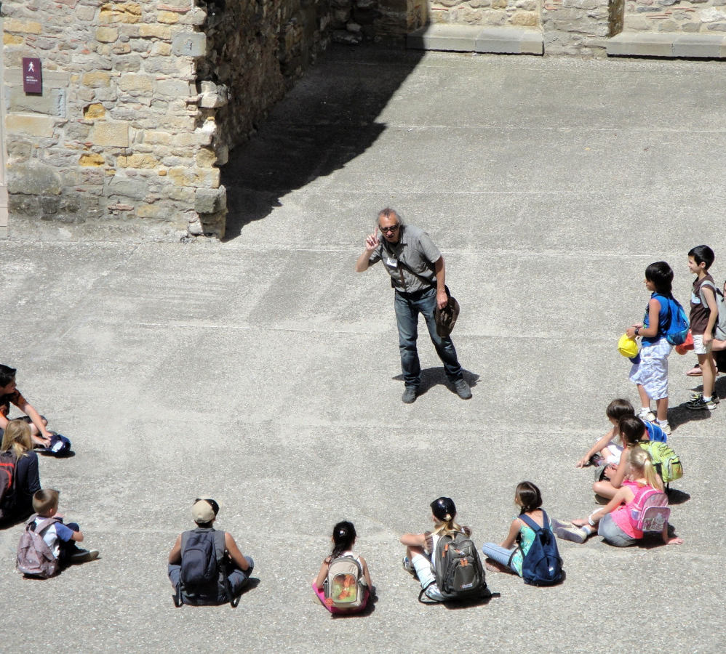
Learning Outdoor Challenge
Starting on Sept. 29th and throughout the month of October, we are encouraging all classes to learn outdoors.

Slide 16


Slide 17

On the Horizon…

Slide 18

October 2nd is the National Day for Truth and Reconciliation.
There is no school.
This Photo by Unknown Author is licensed under CC BY-NC-ND

Slide 19

Quebec Cultural Trip Meeting
There will be a parent meeting on Tuesday October 3rd, from 5:30 to 6:30.
We will discuss a loose itinerary and possible cost for our upcoming grade 8 June Cultural Quebec Trip.
Also, a brief discussion on fundraisers
If you have any questions, please contact Mrs. Muise
  Liza.muise@nbed.nb.ca

Slide 20

Immunizations
Horizon Health will be in the school on October 4th to administer immunizations to our Grade 7 students.
All grade 7 students will be offered two vaccines: a booster vaccine and a vaccine that is effective in preventing most HPV related cancers.
Please fill out the online consent form by September 27th.
This Photo by Unknown Author is licensed under CC BY

Slide 21

Picture Day!
Put your smile on! Picture Day will be on Tuesday, October 17th.
Harvey Studios will be in to take all the pictures of students and staff.
This Photo by Unknown Author is licensed under CC BY-SA-NC

Slide 22

Legion Remembrance Day Contest
The Royal Canadian Legion is sponsoring its Annual Poster and Literary Contest!
This contest to open to all students!
For detailed information, please visit www.remembrancecontests.ca/
Entries are due on November 11th.

