Slide 1


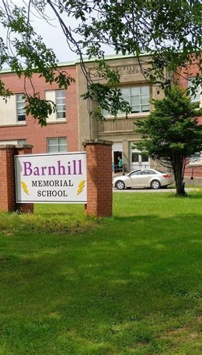
Lightning News
March 20th – 24th,
2023

Slide 2

March Theme Honesty
“The first step toward greatness is to be honest.”
~ Proverb ~
~ This week is a 4-day week, no school on Friday the 24^{th.}
It is a Professional Learning Day for staff.

Slide 3

Honesty
Being honest means more than telling the truth. When you’re honest, you’re sincere. You have a sense of honor and fairness. You’re trustworthy and genuine. And you’re not just honest on the outside, you’re honest on the inside too. You don’t lie to anyone, including yourself.
That sounds hard and sometimes it is. But you probably know someone who has these qualities. And if you’re fortunate, that person is your friend.

Slide 4

It’s Finally Spring!!
Monday, March 20th is the first day of Spring
As it gets warmer, we look forward to spending more time outdoors to take advantage of the nice weather and get some fresh air.
What is your favorite outdoor activity??

Slide 5


World Down Syndrome Day – is Tuesday, March 21st
World Down Syndrome Day (WDSD) is a day to raise awareness about Down syndrome in schools and communities
Video – Excerpts from “Just Like You” (3 min)
https://www.youtube.com/watch?v=Q4p9GyWXWcw
Here at Barnhill Memorial School, we have an excellent Best Buddies program, if you need more information, please contact Mr. MacDonald: evan.macdonald@nbed.nb.ca

Slide 6

Use people first language
When someone has a disability and you are talking about them, always say WHO they are before anything else.
“This is my friend Ethan. He loves playing piano.”
“This is Susan, and she is really good at soccer.”
“ My friend Maggie has three older brothers. She also has Down syndrome”
Describe who the person is first, not their disability.

Slide 7

Report Cards go home April 6th.
If you have not completed assignments or tests, please talk to your teacher on Monday or Tuesday. Teachers cannot mark nothing!

Slide 8
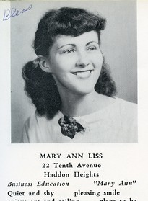
Yearbooks for 2022-2023
Grade 8 students ~ Please email your submission to Mrs. Muise at liza.muise@nbed.nb.ca
If you have any questions regarding your submission and what you need to write, please speak with Mrs. Muise.
Please order your Yearbook, everyone received a Yearbook order form. They are due to Harvey Studios by March 25th, students can bring the forms back to the school prior to that date.
This Photo by Unknown Author is licensed under CC BY-SA-NC

Slide 9


Athletics
Volleyball is everyday this week from 3:00 – 4:30 p.m.
Mon. & Wed. ~ Girls’ practice.
Tues. & Thurs. Boys’ practice.

Slide 10

March is Nutrition Month!
Calcium: A Nutrient of Concern in Canada
Canadians are not getting enough calcium leading to a widespread calcium inadequacy and putting bone health at risk.
DID YOU KNOW?
Calcium is needed to:
  Achieve peak-bone mass in teens
  Keep bones strong and healthy in adults
  Slow bone loss and prevent fractures in older adults

Slide 11

Calcium Inadequacy
Milk products, including milk, cheese and yogurt make the largest contribution to Canadians’ calcium intake
Most Canadians are consuming less than 1 cup (250ml) of milk, less than 1 ounce of cheese (30g) and less than 2 tablespoons (30ml) of yogurt each day.
Make sure to increase your calcium intake.
This Photo by Unknown Author is licensed under CC BY

Slide 12

Barnhill does their BEST EVERY SINGLE TIME!
HAVE A GREAT WEEK!!

