Slide 1

Lightning News
October 23rd. ~ 27th.
This Photo by Unknown Author is licensed under CC BY-NC

Slide 2
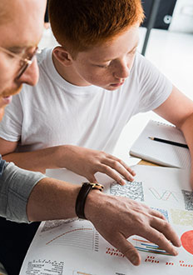
PSSC meeting on Monday, October 23rd from 6:00 p.m. – 7:00 p.m.
(PSSC) Parent School Support Committee is for all parents who would like to have a voice in supporting the school in educational priorities and planning for improvements in the school. The committee addresses broad issues related to the education of all students, with the goal of enhancing student learning.

Slide 3
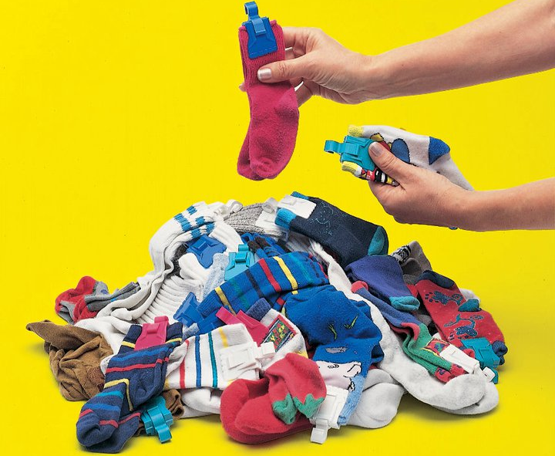
Socktober
If everyone: staff, students and community members brought in just “one” pair of socks, we would have over 400 pairs of socks to donate to charity. So please just get a new pair of socks, bring them into the school for those in need! It is getting colder outside, and warm feet make a big difference!
Thank you in advance for your donation.
This Photo by Unknown Author is licensed under CC BY-SA-NC

Slide 4

Kiwanis Calendars – Grade 8 Fundraiser
This is a fabulous fundraiser in which all students in grade 8 can make money for their trip.
All calendars and money are due November 17th.
You can bring your money and calendar stubs in when they are sold.
Each student can take 5 at a time, then come back for more!
Please speak with Mrs. Muise or Ms. Sloat regarding the Kiwanis Calendar fundraiser.
This Photo by Unknown Author is licensed under CC BY-SA-NC

Slide 5
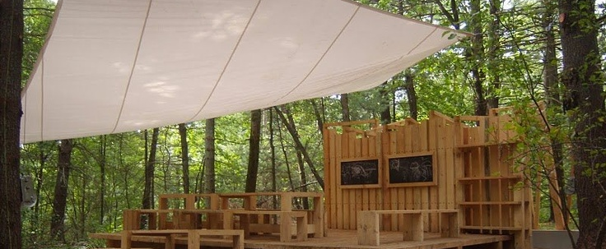

This month take the advantage to learn outside, while the weather is still nice.
Enjoy the “Lightning Dome” our beautiful outside classroom.

Slide 6

Barnhill is hosting their Haunted Scary Story Competition!
We are looking for writers. Enter if you dare! More details to come…

Slide 7
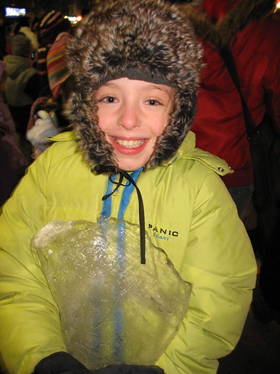
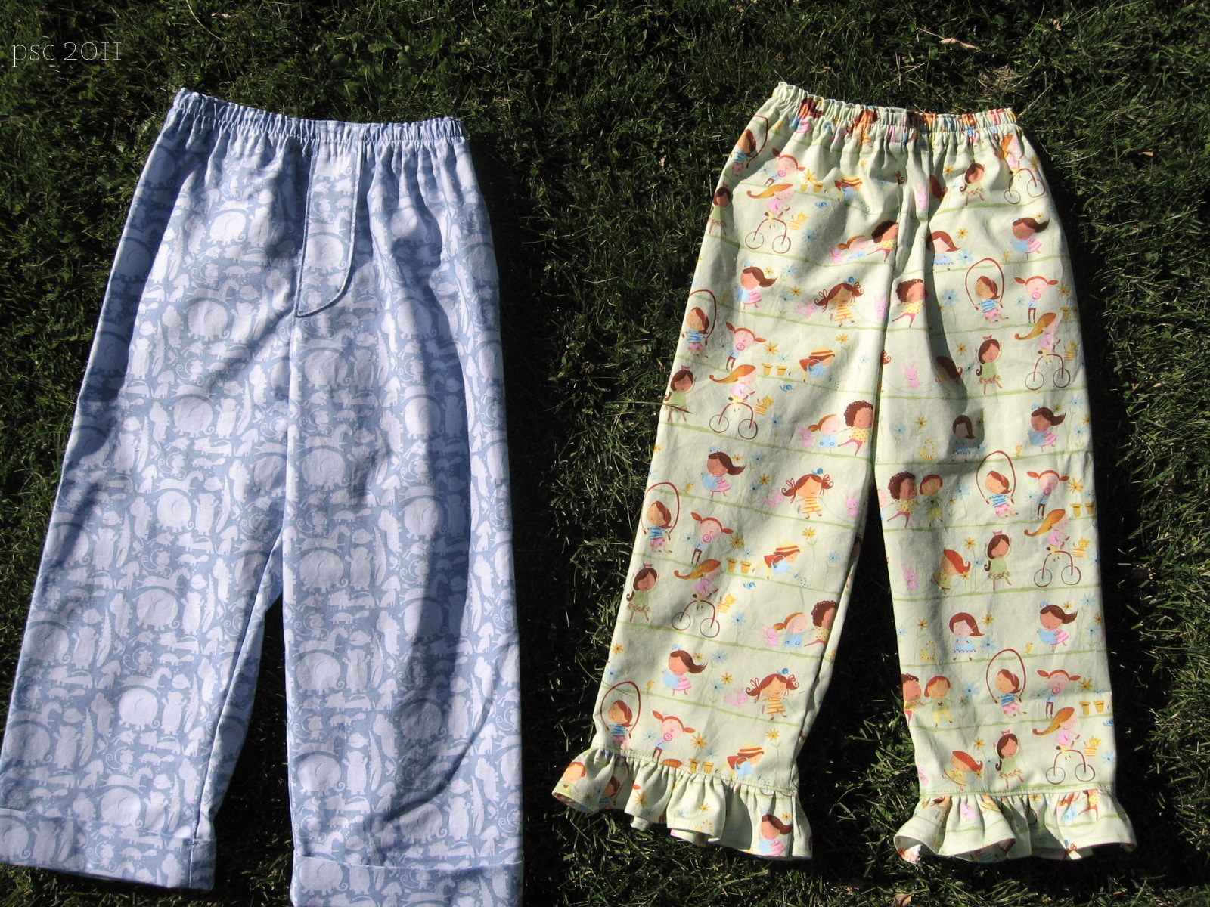
Dress for the weather.
The weather is changing, and it is getting colder outside.
Please come dressed to be outside. All students are outside in the morning prior to the beginning of school, and they are outside at noon.
It is best to dress in layers.
Please do NOT wear pajamas to school. Pajamas are for lounging at home and bed.
This Photo by Unknown Author is licensed under CC BY-SA-NC
This Photo by Unknown Author is licensed under CC BY-ND

Slide 8
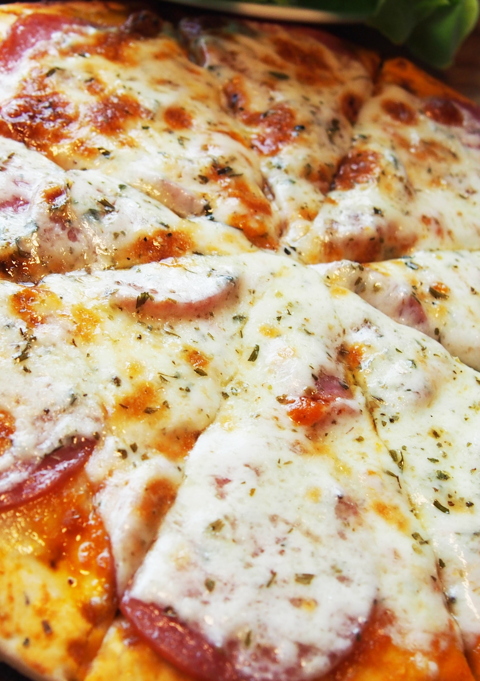
Every Friday we have Hot Lunch and a Canteen
Please order Pizza on Cashless School.
The canteen is open at lunch and all items are either $1.00 or $2.00

Slide 9

Athletics
Please check the board outside of the gym for weekly sports updates and the intramural schedule.
Ultimate Frisbee is on Monday, October 23rd. It will be from 3:00 p.m. – 4:00 p.m.
Exhibition soccer for boys and girls continues Wednesday and Thursday from 3:00 – 4:00 p.m. See Ms. Dennis or Mr. Staples with questions.

Slide 10
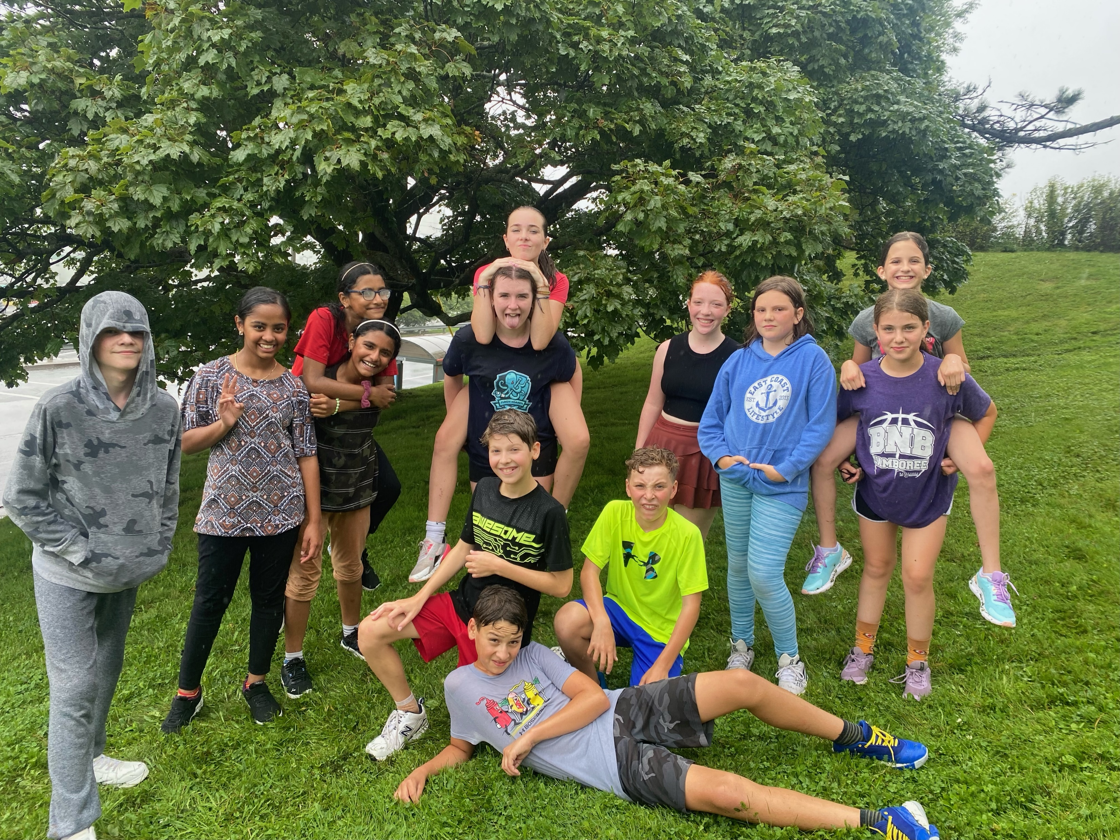

Congratulations Cross Country!
A huge congratulations to our Cross-Country team who placed FIRST
in the City & District Cross Country Finals! We are so proud of the runners!
Way to go Lightning!

Slide 11
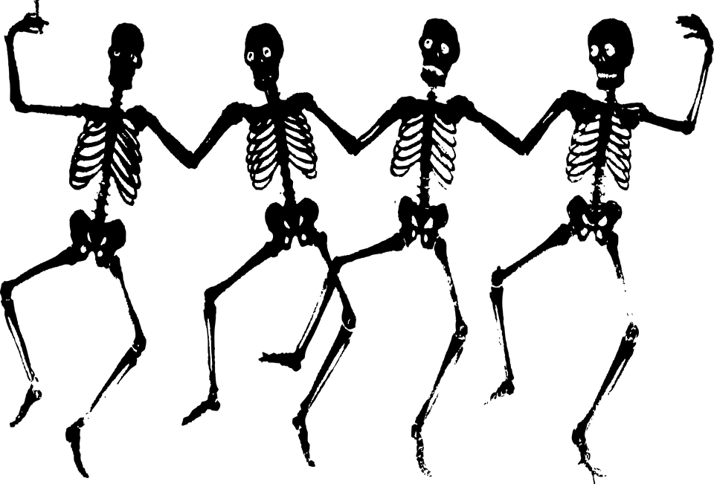
Halloween Dance
The Halloween Dance is this Thursday from 6:30 p.m. to 8:30 p.m.
* It is $5.00 at the door.
* Please wear a costume! However, NO Masks and NO weapons.
* Sign-Ins are available. To sign-in a student from another school, please see Ms. Ferguson in the morning, at lunch or on break.
* There will also be a Haunted Hallway experience. This is an additional cost of $2 and is completely optional.

Slide 12
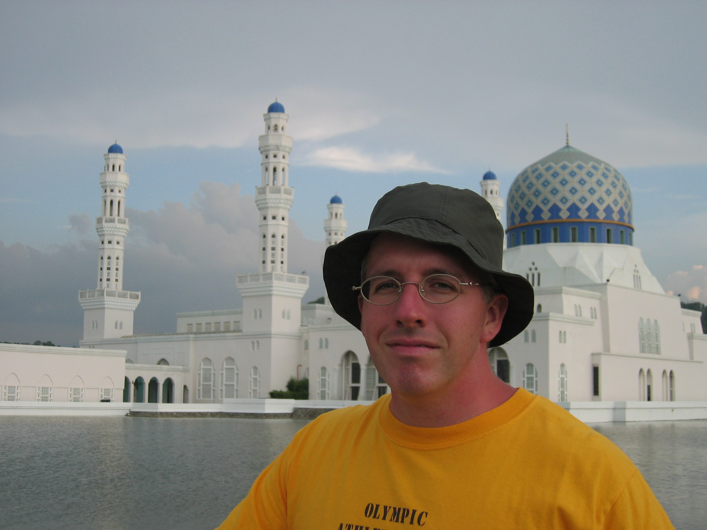
Mr. Daniel Staples
BARNHILL STAFF SPOTLIGHT
Teaches Personal Wellness, PIF and Science
Teaching Experience: 10 years
Years at Barnhill: First year
What do you love about teaching? “Getting a chance to build connections with the next generation and shape young minds.”
Interest/Activities: Working out, reading, travel and cooking
Interesting Fact: Can read Chinese characters (a lot of them!)
Family: Wife and one daughter

Slide 13


Slide 14
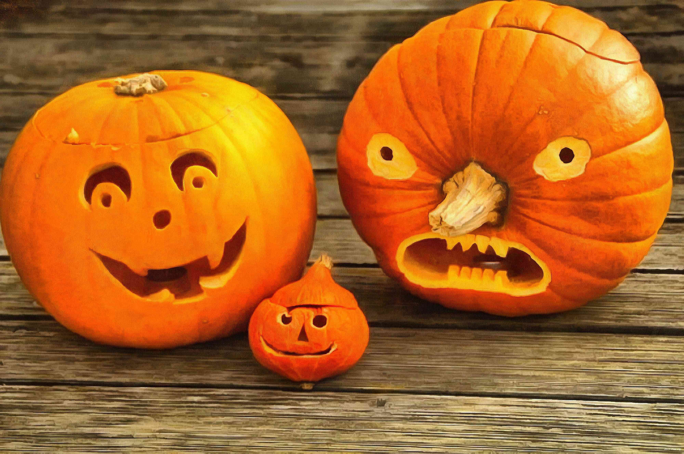
On the Horizon…
Please stay tuned for all the new and exciting events at Barnhill.
This Photo by Unknown Author is licensed under CC BY-SA

Slide 15
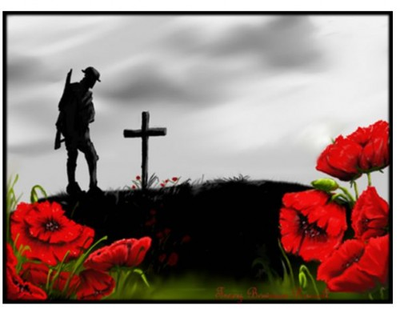
Remembrance Day Events
The Legion’s Annual Remembrance Day contest to open to all students! For detailed information, please visit www.remembrancecontests.ca/ Entries are due on November 10th.
Our Remembrance Day Ceremony will be on November 10th at 10:15 a.m. Community members are welcome.
This Photo by Unknown Author is licensed under CC BY-NC-ND

Slide 16

Barnhill Remembers…
We would like your help with a special project for Remembrance Day.
We are asking families to submit a photo of a family member who has served in any capacity in the Canadian military. These photos will be used in our Remembrance Day Ceremony on November 10.
We ask that photos be submitted via email to andrea.dennis@nbed.nb.ca. In your submission, please specify which student is connected to the person in the photo and how that person served.
Thank you for your support!

