Slide 1

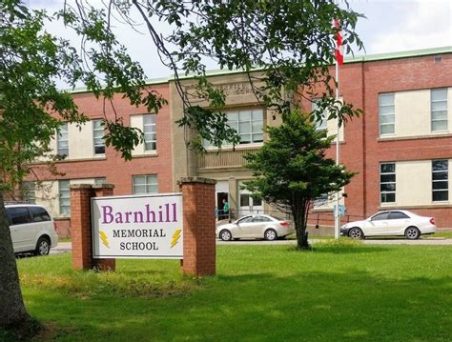
Lightning News
November 8 – 12

Slide 2
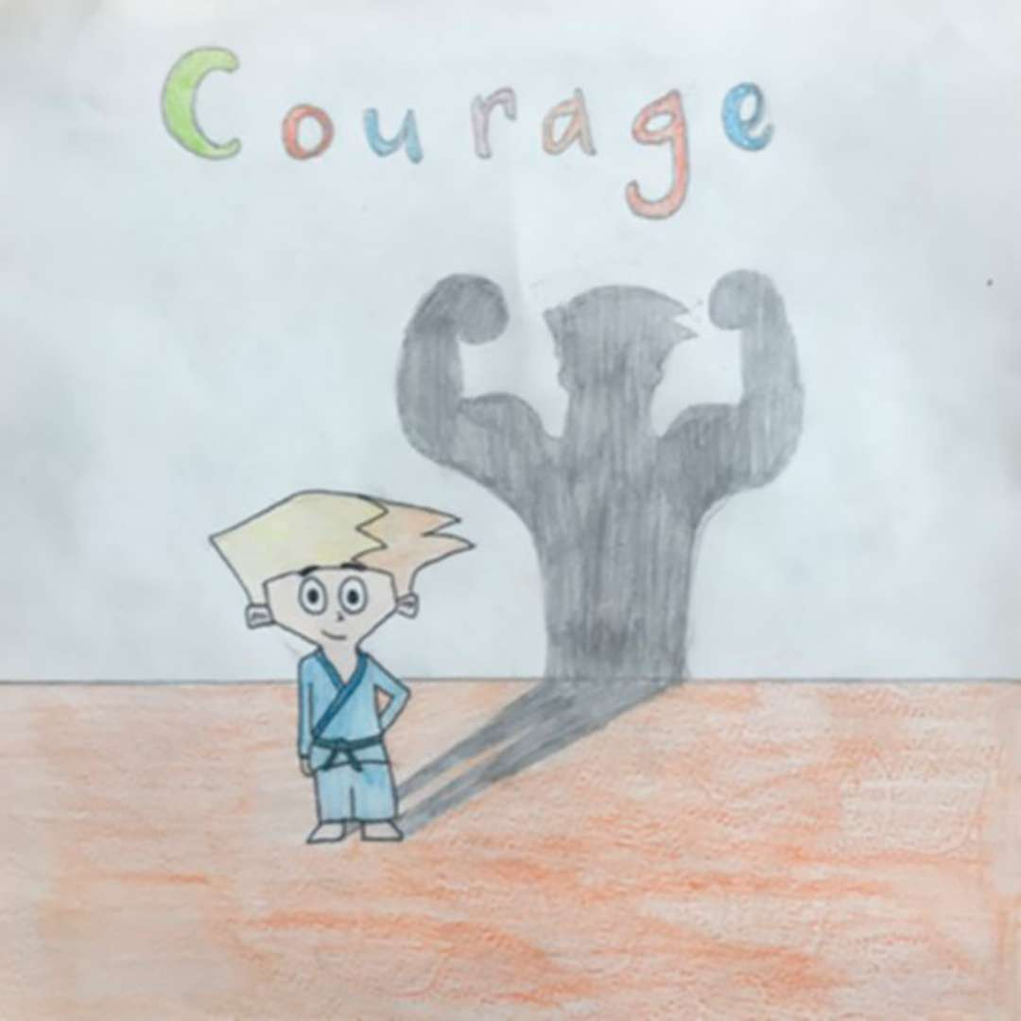
November Theme
Courage
“Do what you can with what you have where you are.”
~ Theodore Roosevelt ~

Slide 3
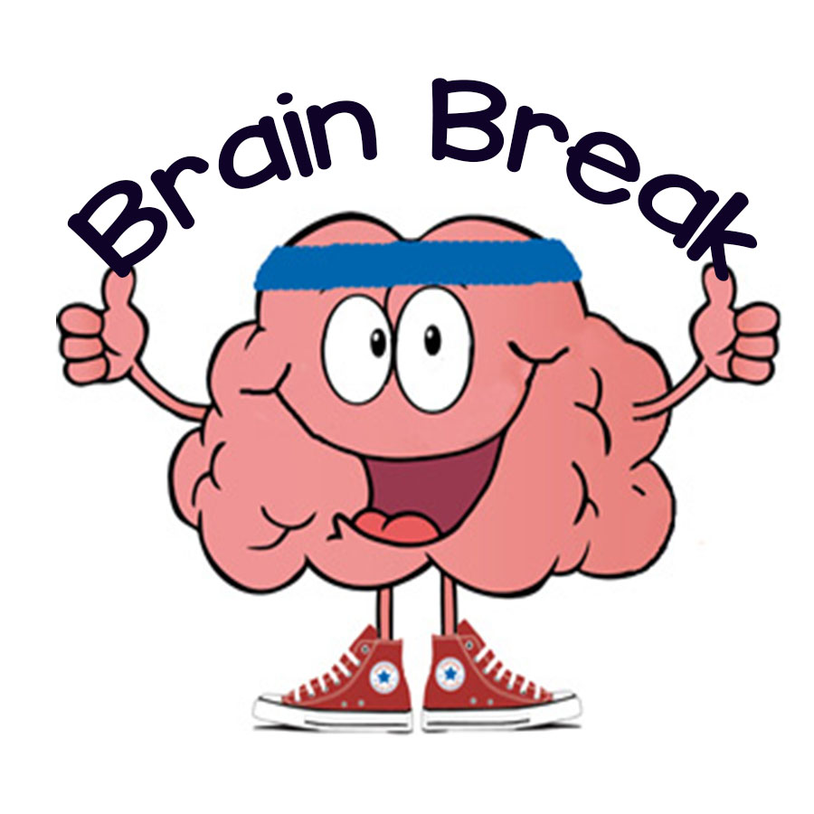
Home Learning
While you are in your home learning environment, take active brain breaks to recharge the body and brain. Take a nature walk for fresh air or kick around a soccer ball. Throw on some music and just allow your body to move.
Ensure you always have healthy and nutritious snacks and meals close by to enjoy!

Slide 4

Creativity
If you want to stay creative, we have two competitions:
1. Create a sign for outside with the word “Bienvenue” in it! We want to show our community that we have a French Immersion program in our school.
2. Create a holiday scene for the cover of a Christmas Card for Barnhill Memorial School.
You can drop your submissions off to the school between 12:00 noon and 2:00 p.m. or you can take a picture and email them to our ART teacher Mrs. Kim Roy at kim.roy@nbed.nb.ca All submissions are due by the end of the day on Friday, November 12th.

Slide 5
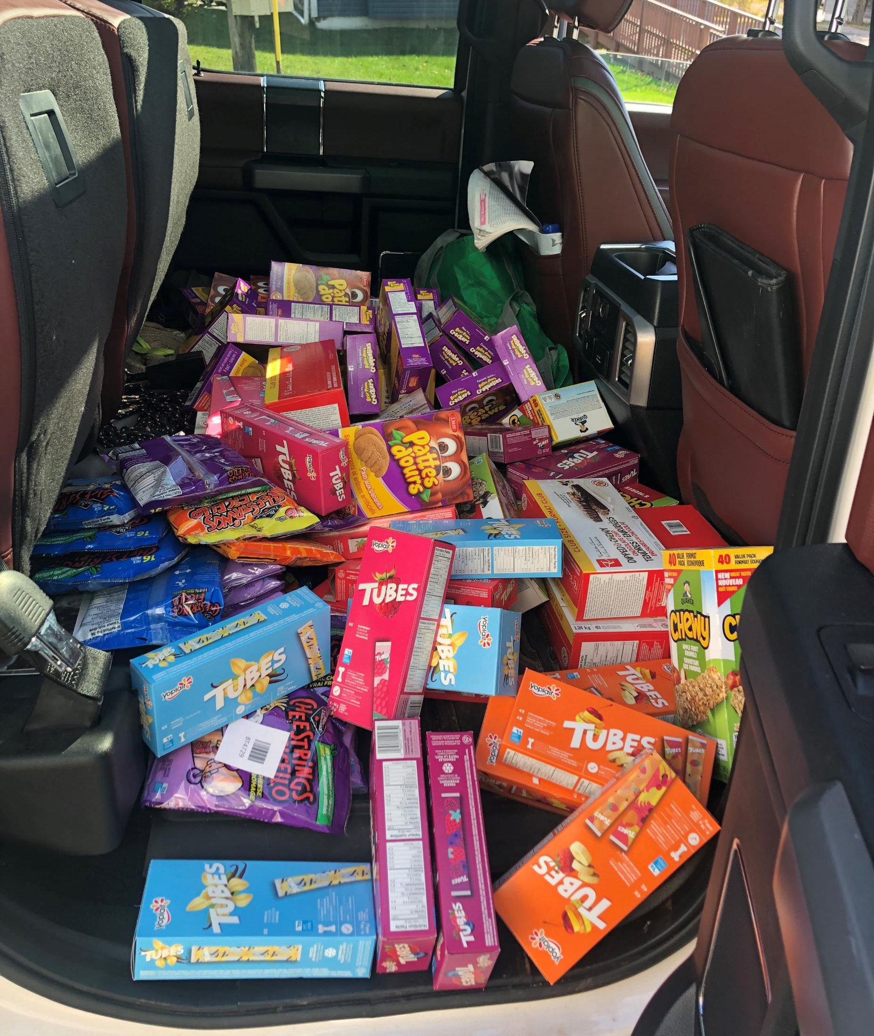
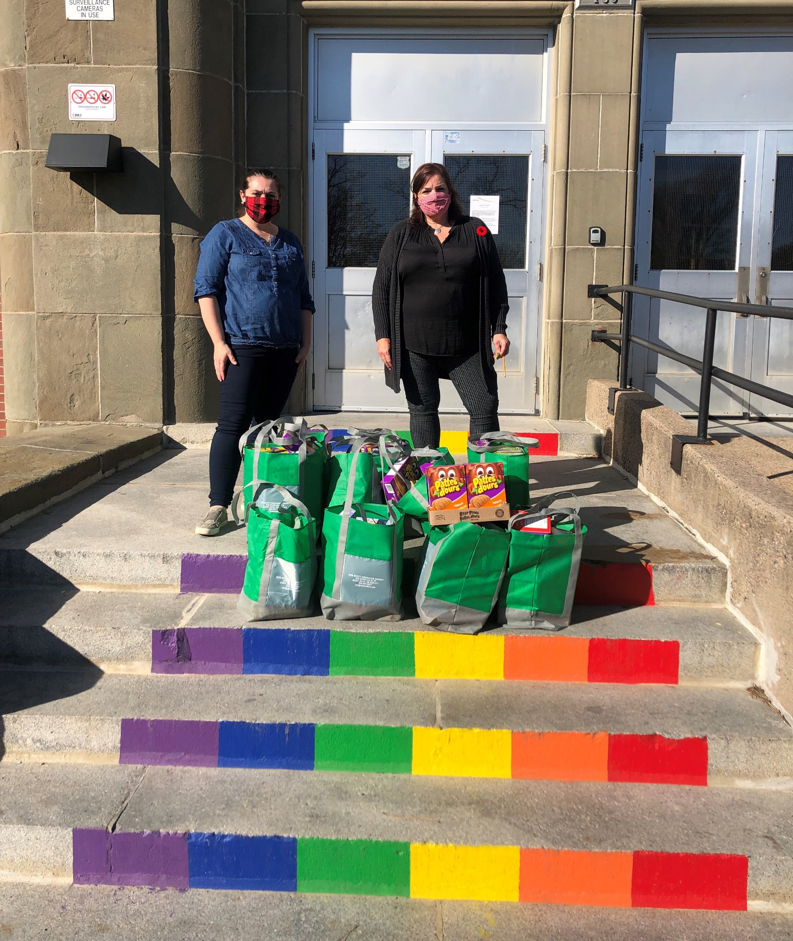
Breakfast Program
This week Mr. Rob Scott from Rob Scott Insurance met Mrs. Muise and I at the school to deliver groceries for our student led breakfast program, there will be tons of healthy options at breakfast for you when you return to school.

Slide 6

Guidance
Mr. Savoie in Guidance is also available and can be reached at bruce.savoie@nbed.nb.ca

Slide 7

Upcoming Events
No school on November 11th – this is Remembrance Day – a holiday.
No school on November 19th – this is a professional learning day.
Report cards will be given to students on November 29th.
We are working with Harvey’s Studio regarding our School yearbook and student pictures. We will provide you with details once we have everything scheduled with Harvey’s. Thank you for your patience.

Slide 8

Barnhill does their BEST- BETTER EVERY SINGLE
TIME!
Enjoy your week!

