Slide 1
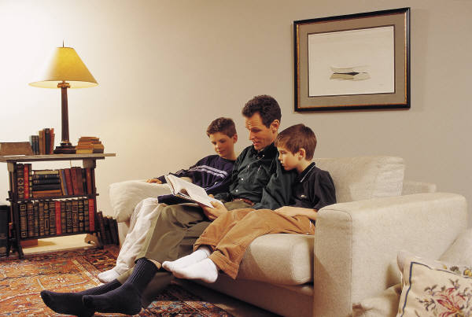
Read by Example
Daily reading (with your child, to your child, or being read to by your child)
Discuss books
Make it fun
Make it a shared activity
Keep it real (read for a real purpose)
EEKK*
*Elbow to Elbow, Knee to Knee

