Slide 1


Hello Summer!
Guess what’s right around the corner...

Slide 2

ENTREPRENEURSHIP 110 PRESENTS:
Our Welcome to Summer Sale!
We have 23 Unique Businesses to choose from
for all of your shopping needs!
Online Launch is May 31st – June 4th

Slide 3

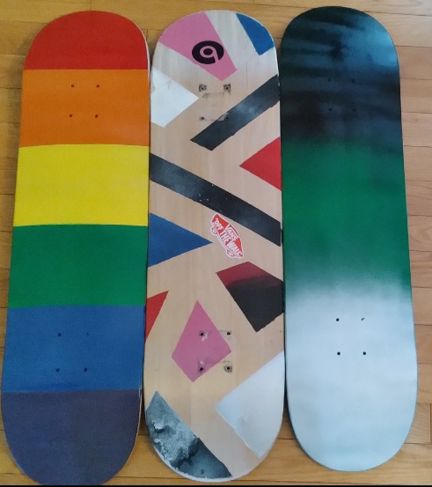
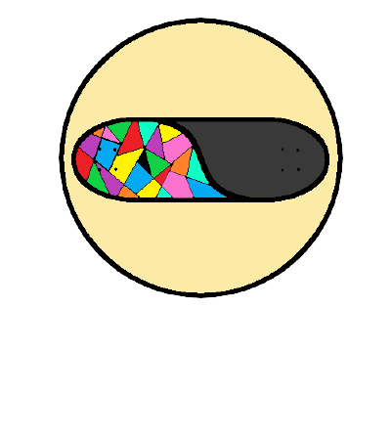
Spritz decks
Be yourself, Be unique.
Each board is $40.
Instagram: spritz_decks

Slide 4

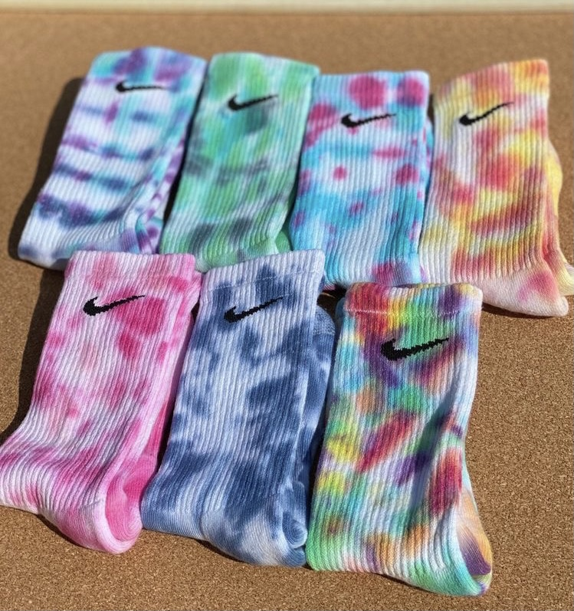
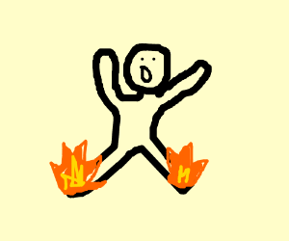

EACH PAIR IS ORIGINAL
"THESE SOCKS ARE ON FIRE!"
NO TWO PAIRS THE SAME
.
$10 FOR A FIRE PAIR OF OG SOCKS!!

Slide 5
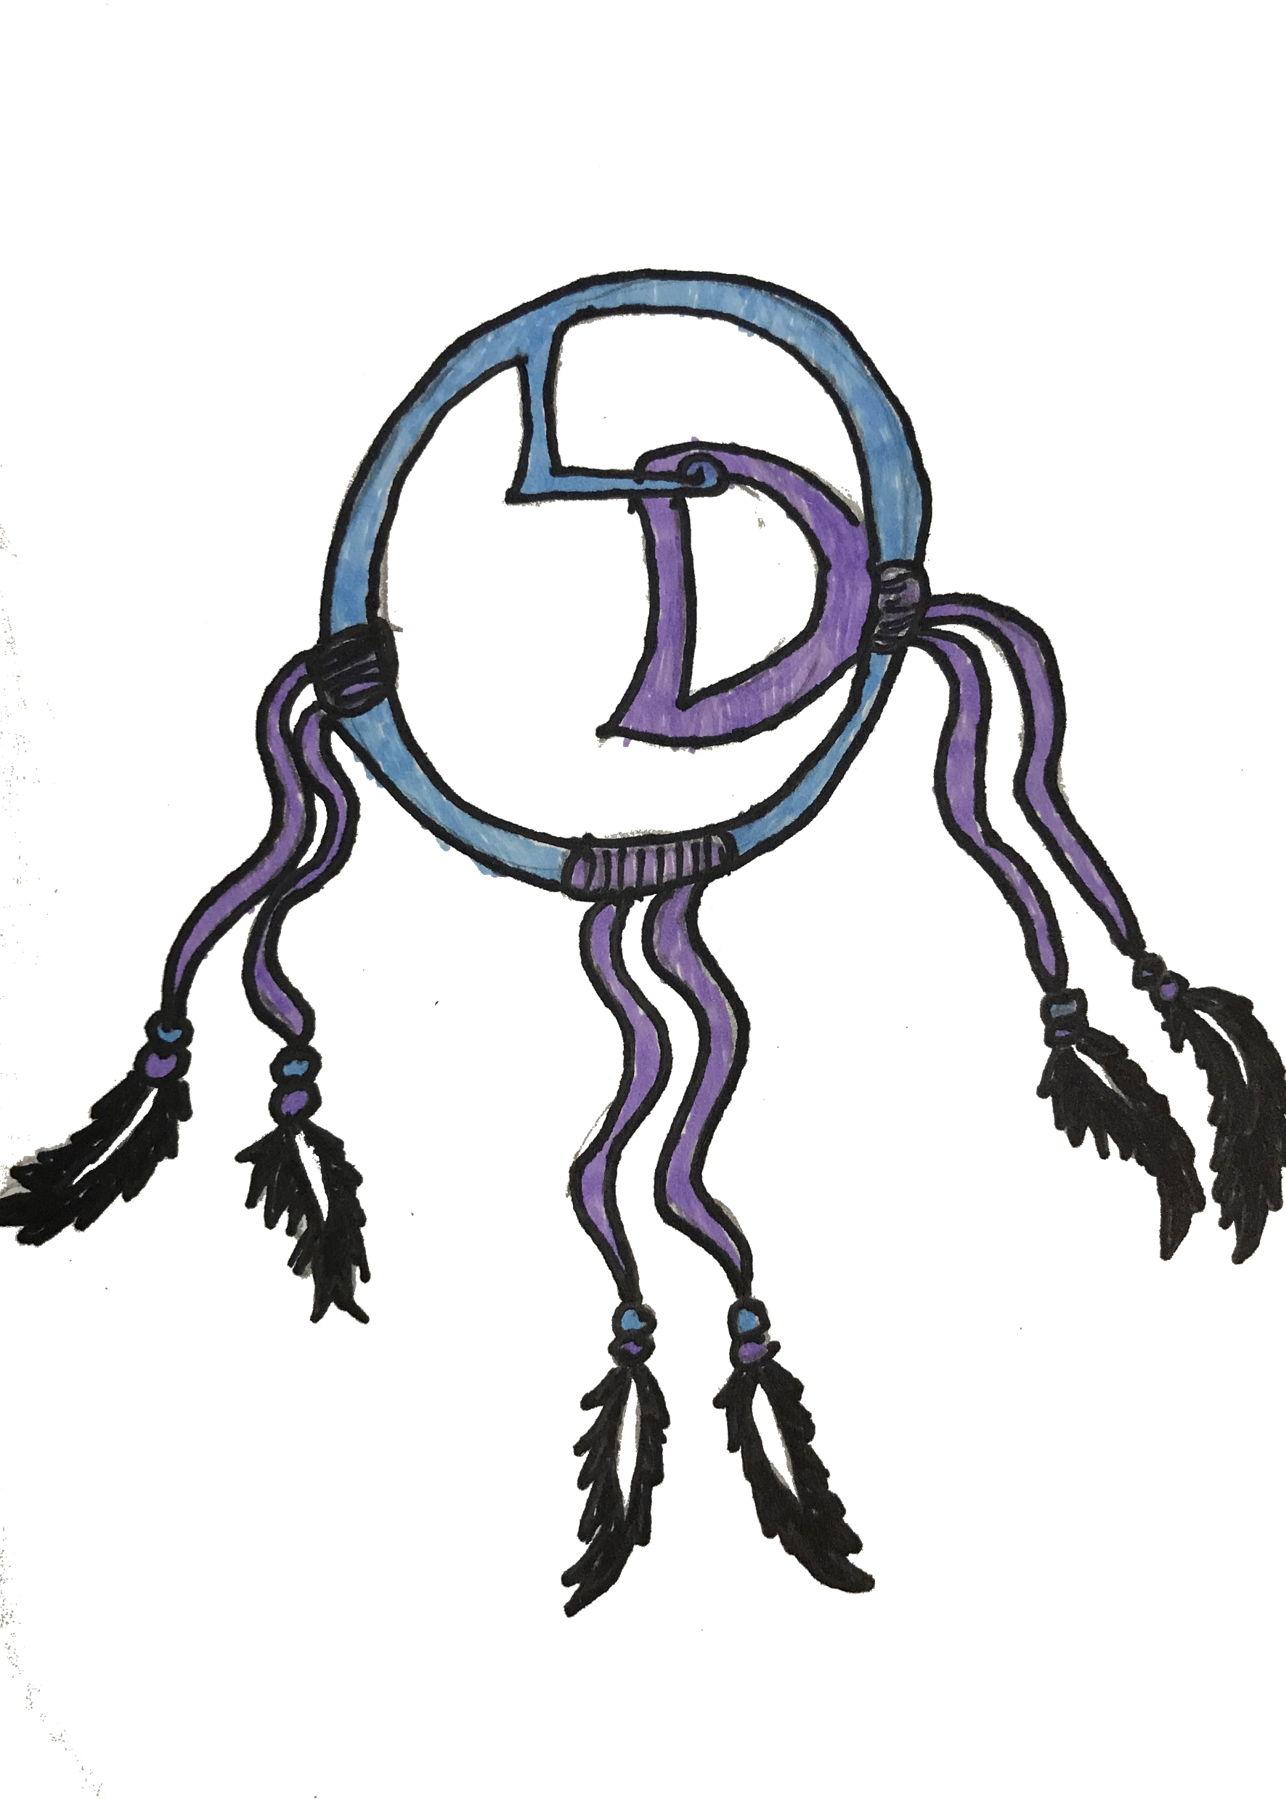
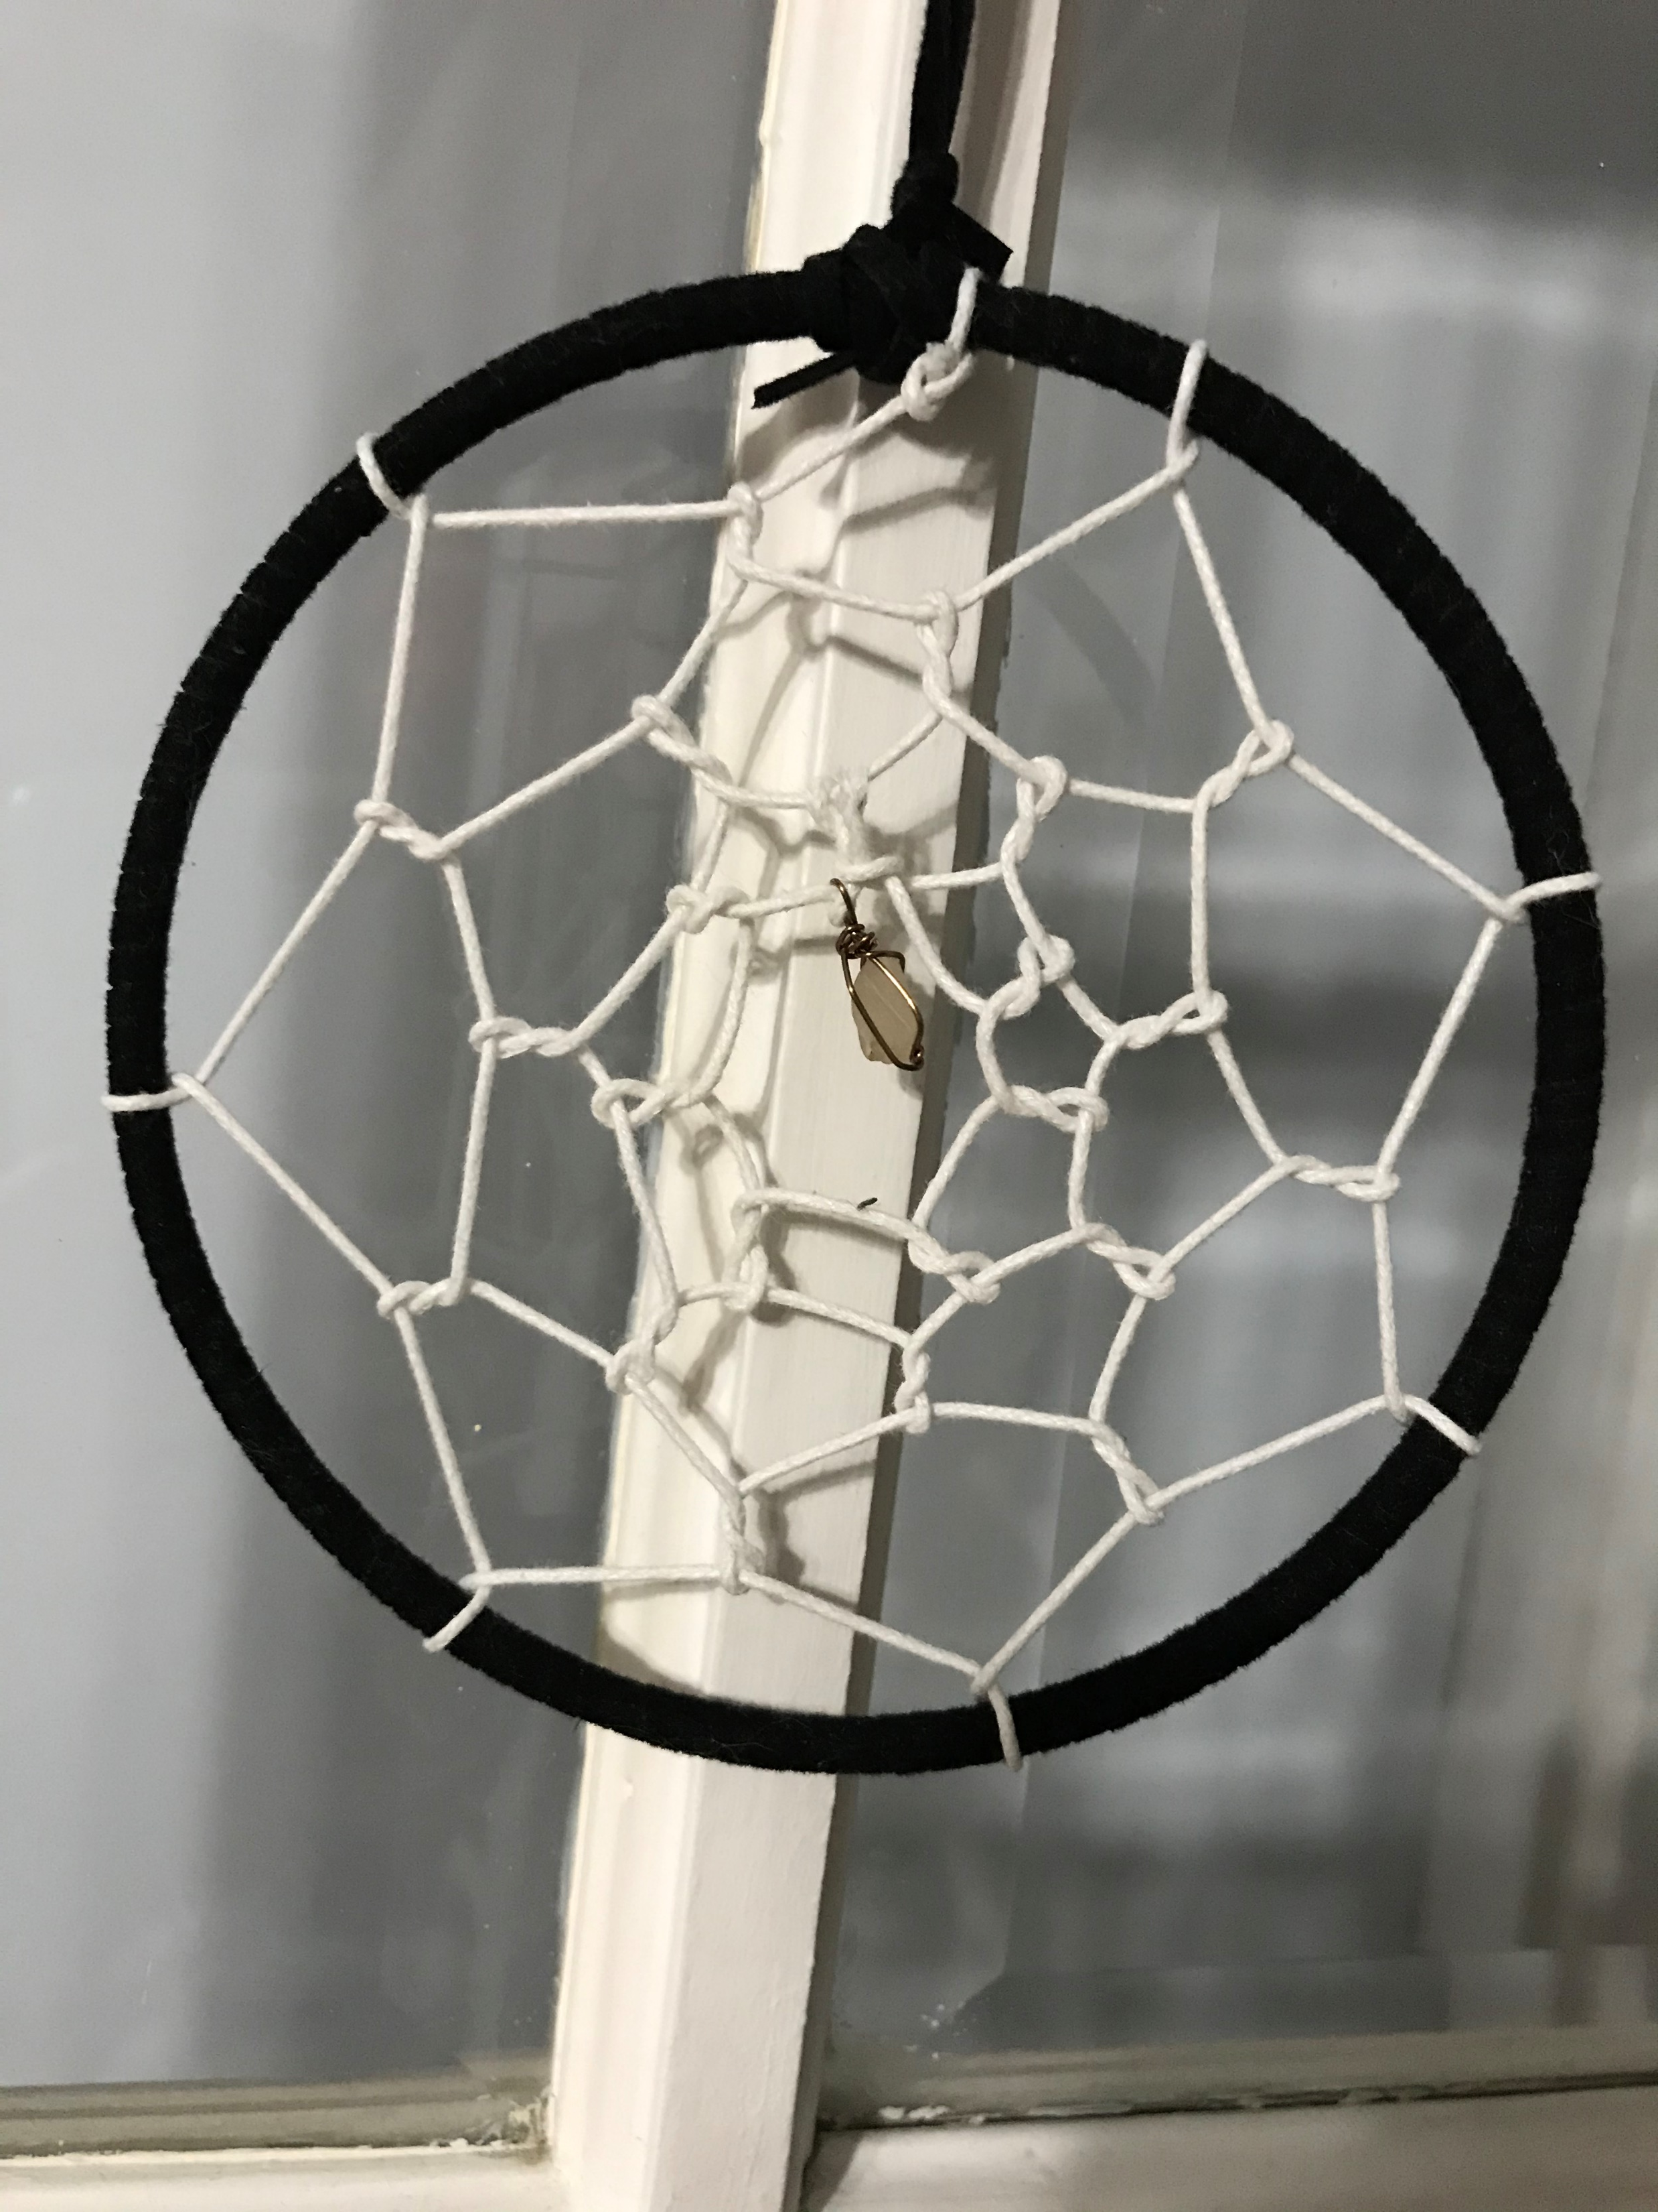
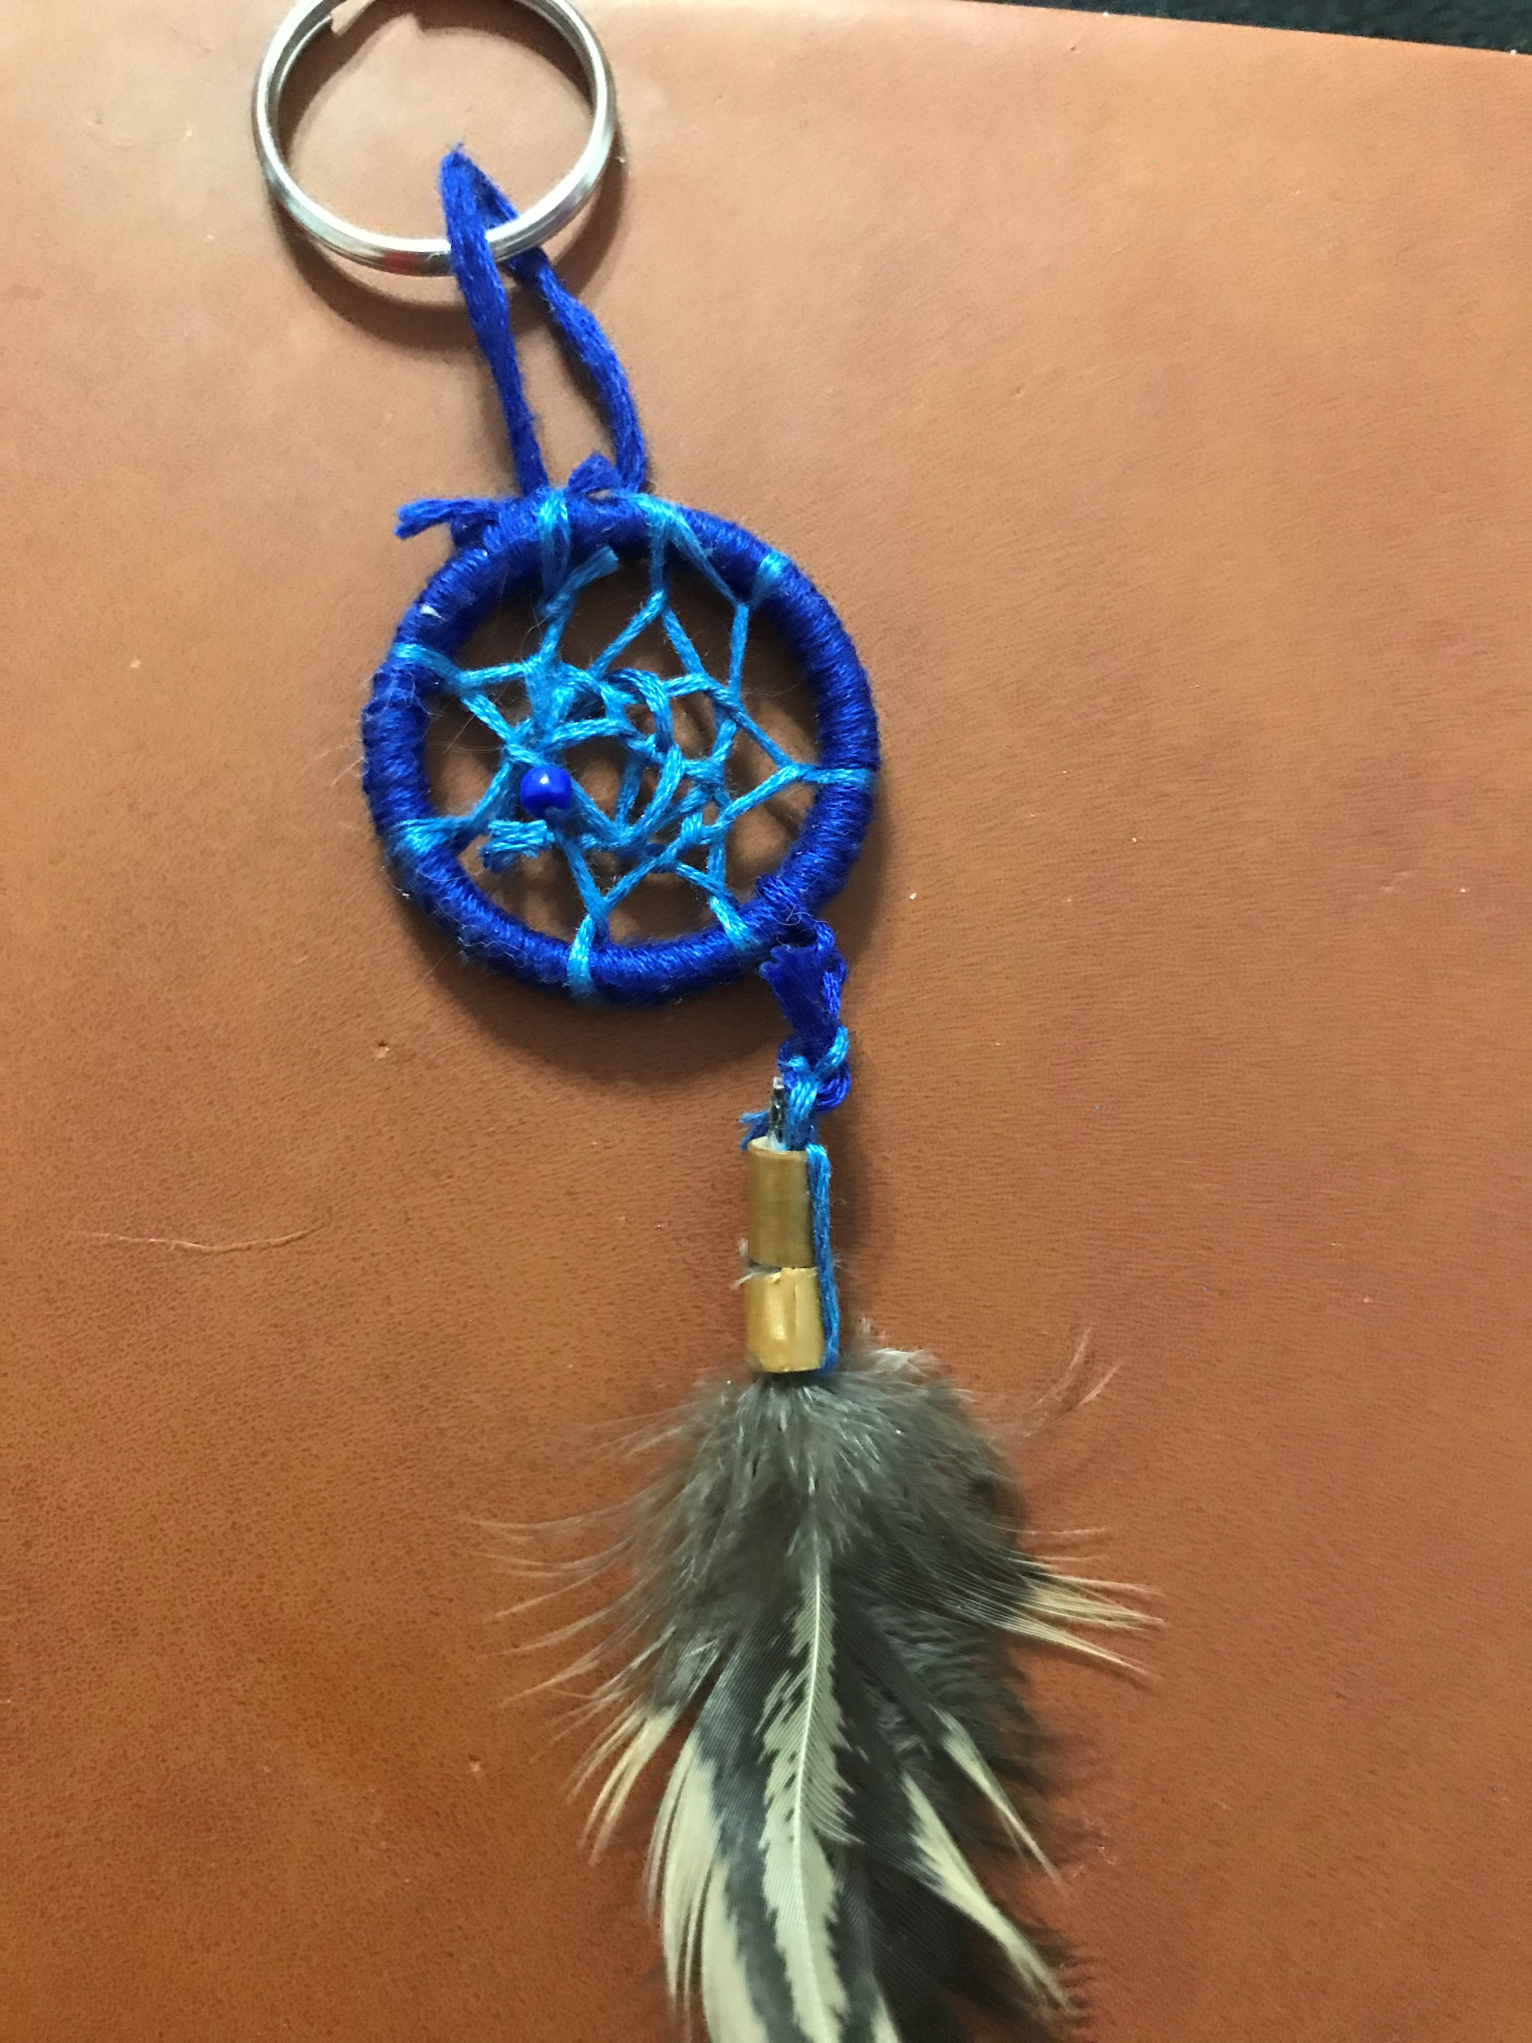
For all your dream catching needs
Lunar Dreams
Market opens May 31st- June 4th
Will take early orders! Contact on Instagram @lunar_dreams_2021 if you would like to make an order early
$20 for Large Dream Catchers
$5 for Key Chain

Slide 6


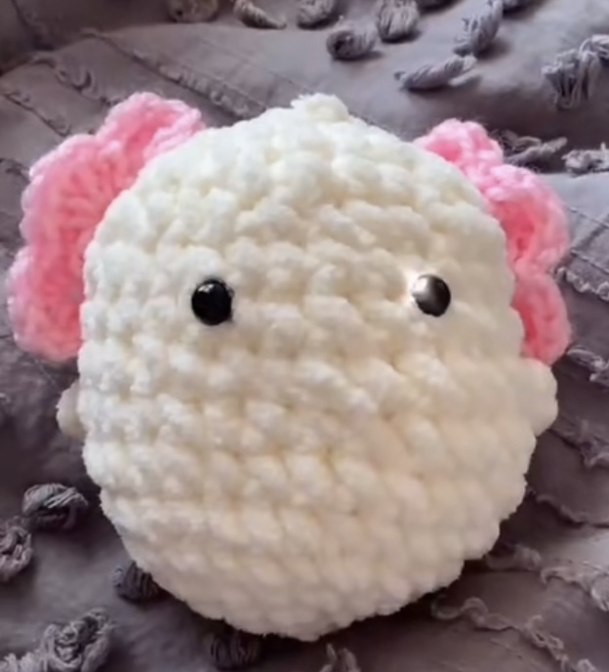
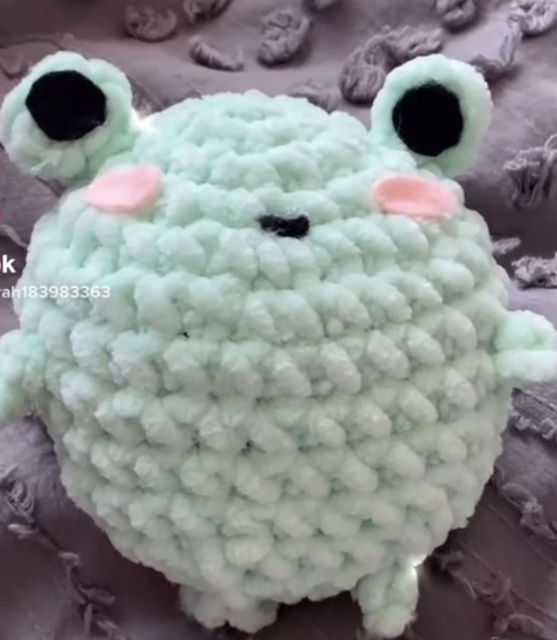
Crochet Stuffed Animals
bears
cows
frogs
pigs
bees
axolotls
Only $10
ducks

Slide 7

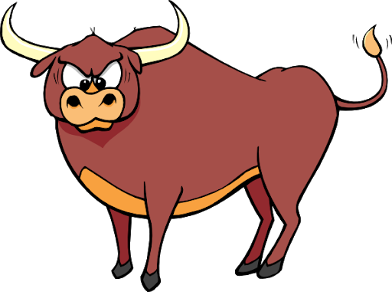



Jackson’s Beef Jerky
Don’t miss the action, buy from the Jacksons!
($4.99 per small bag)

Slide 8
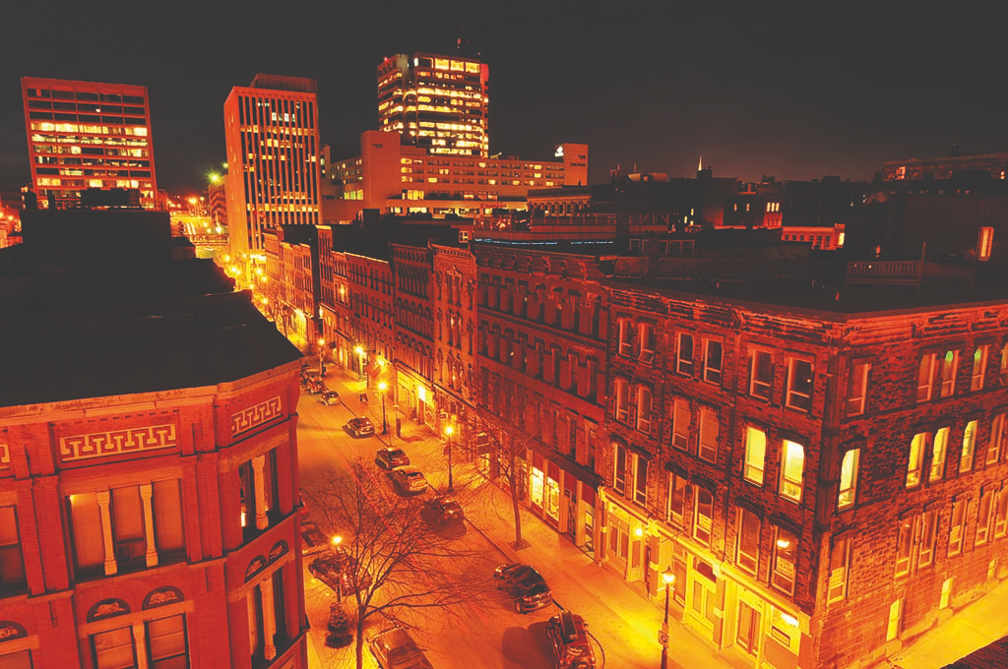
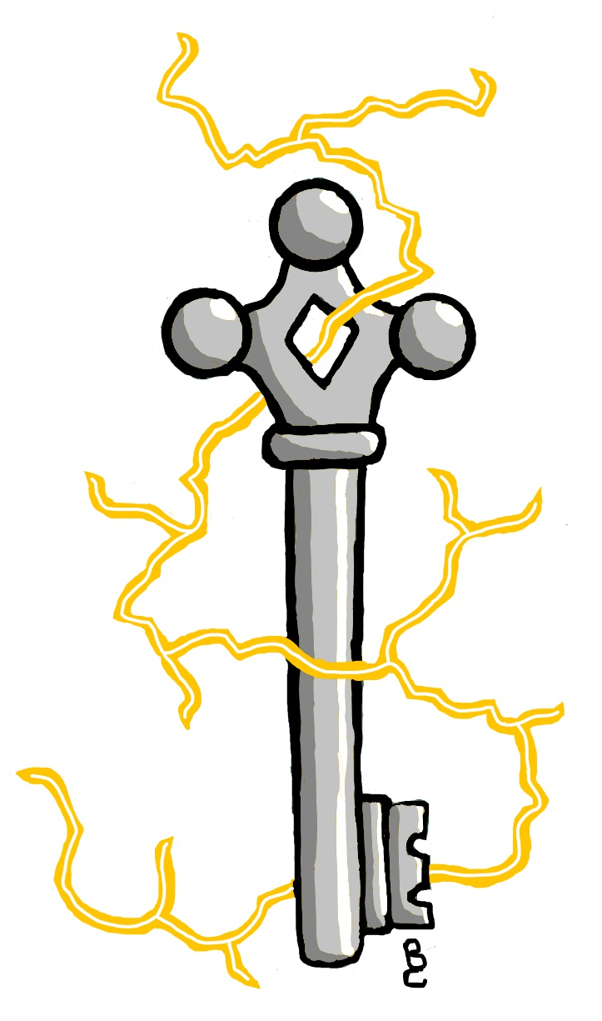




With designs for all interests Such as…
(And many more!)
Women Empowerment…
Anime…
“Driven by the City”
$3.00 per sticker
By Luke McLaughlin

Slide 9


$15 for Press-on NAILS with glue and a nail file!

Slide 10
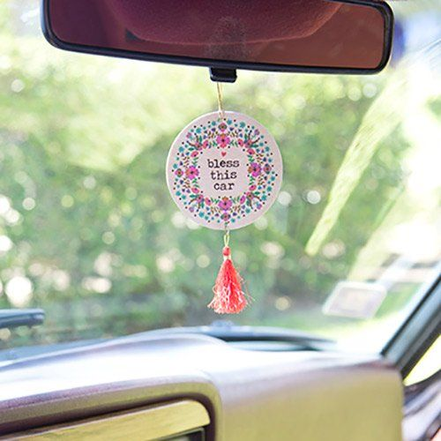
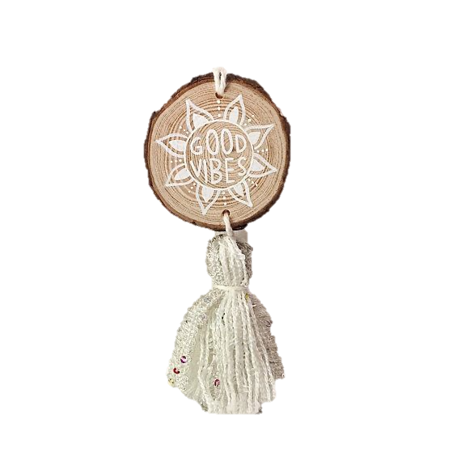
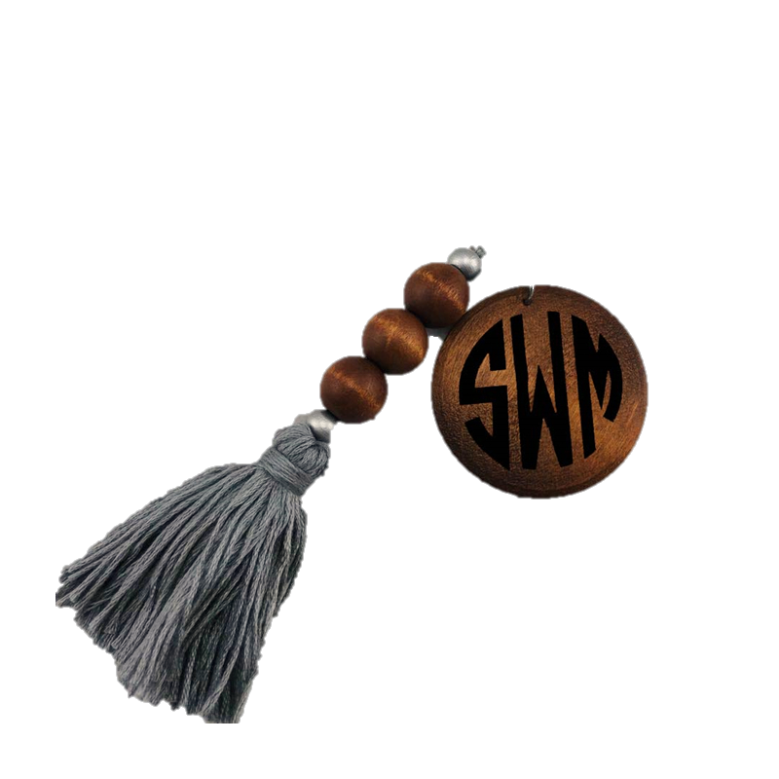
Beads & Beyond
6$ FOR A CAR CHARM
High Class and Handcrafted
5$ FOR A KEYCHAIN

Slide 11


Personalized
Blankets: 25$
Pillow Case Set: 15$
A Set (Blanket+ Pillow cases): 35$
II Scream, You Scream, We All Scream for Personalized things.

Slide 12

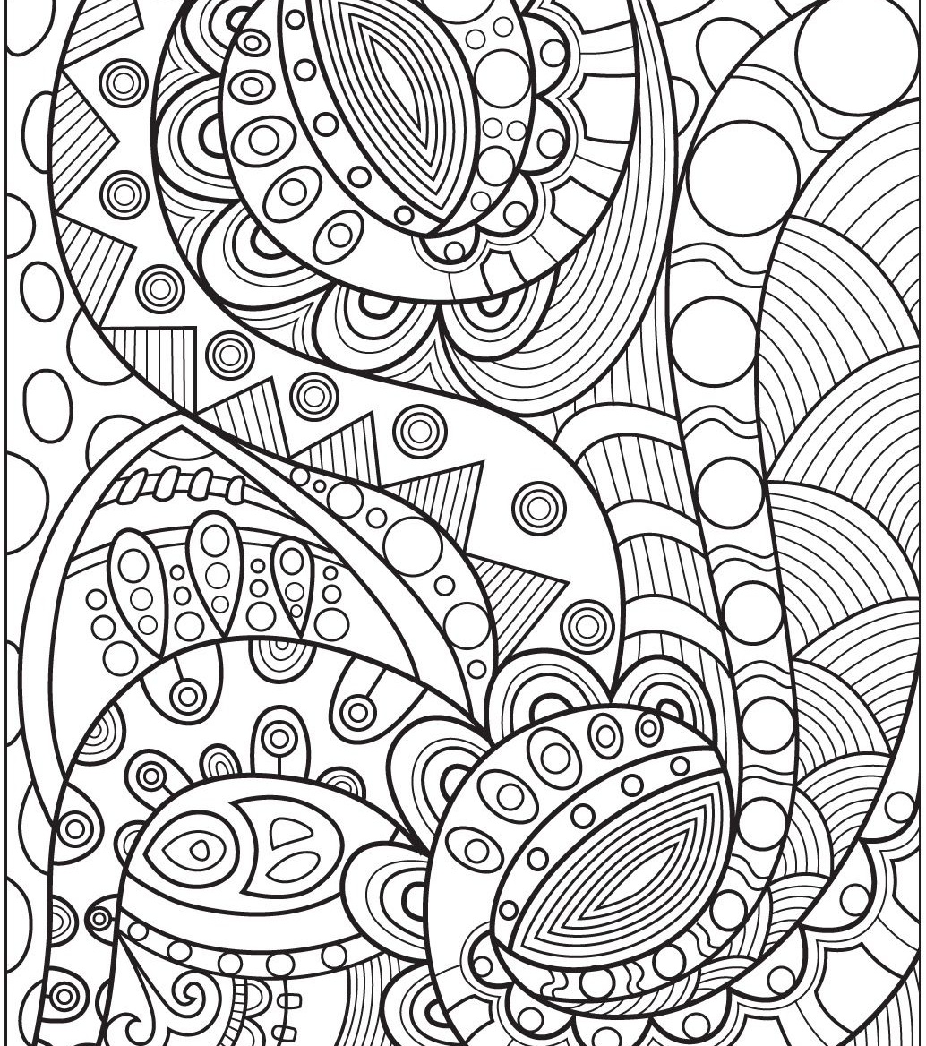

$5 Colouring Books
Colour Your Worries Away

Slide 13
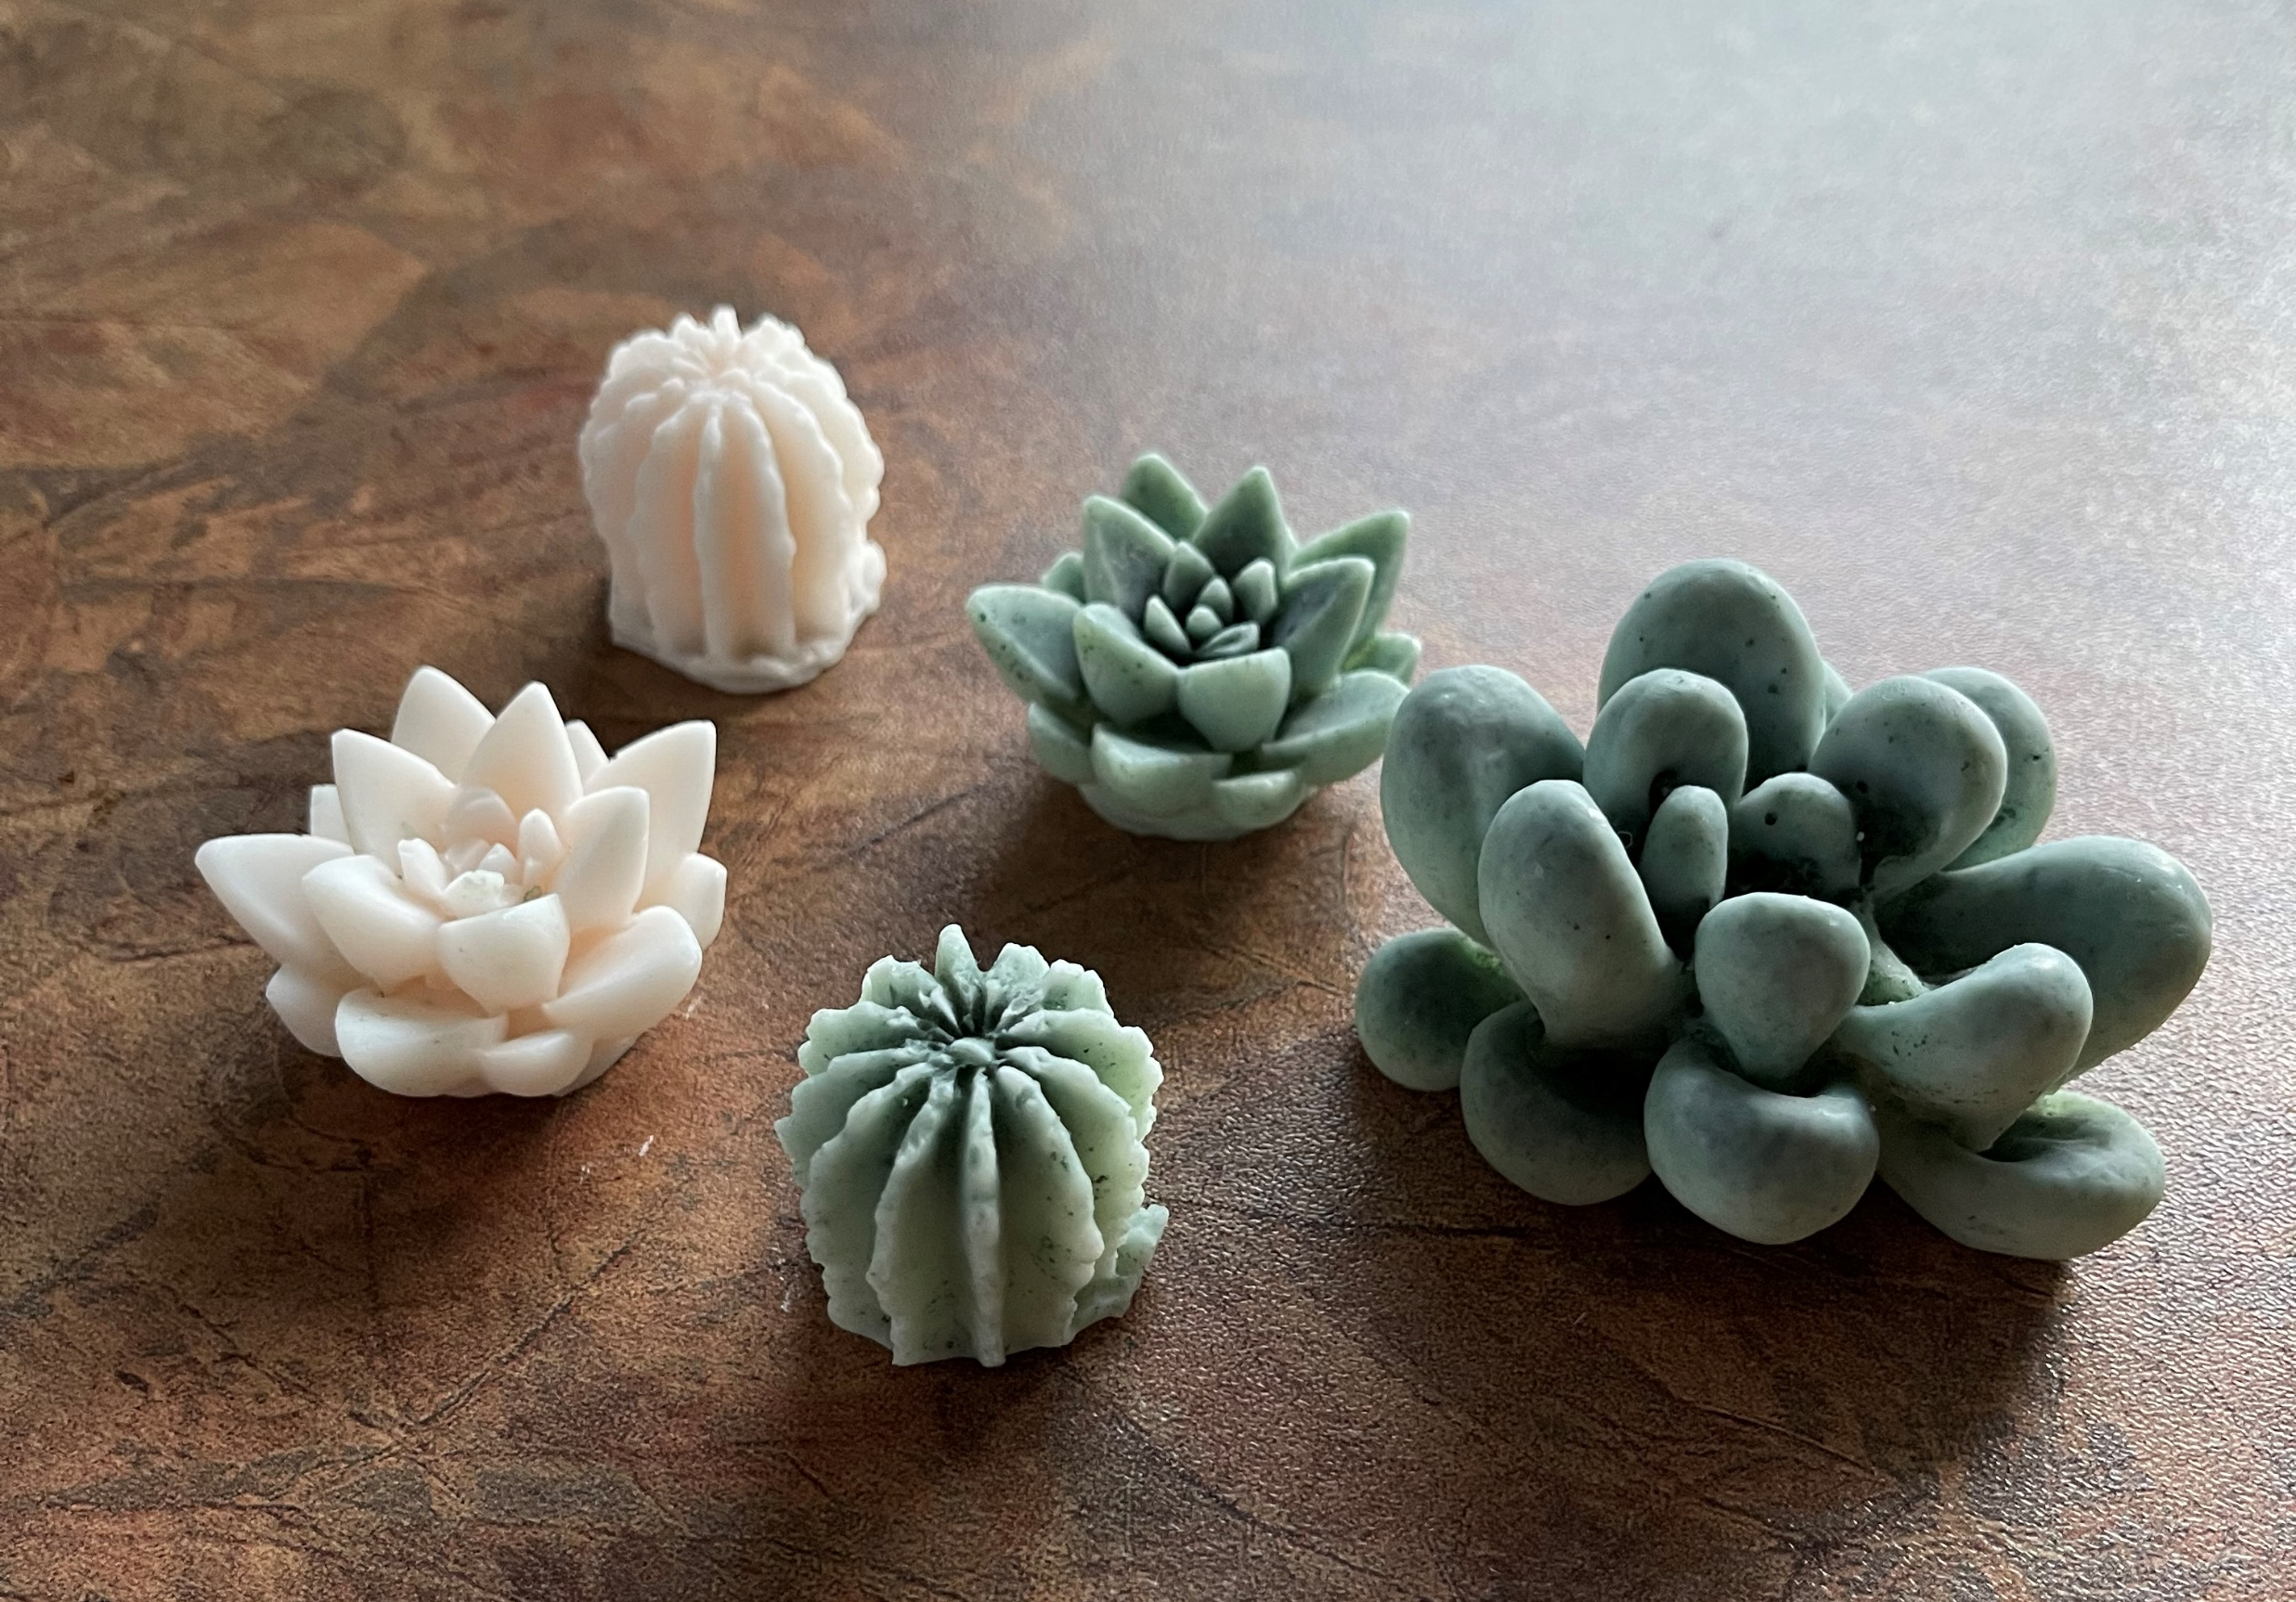
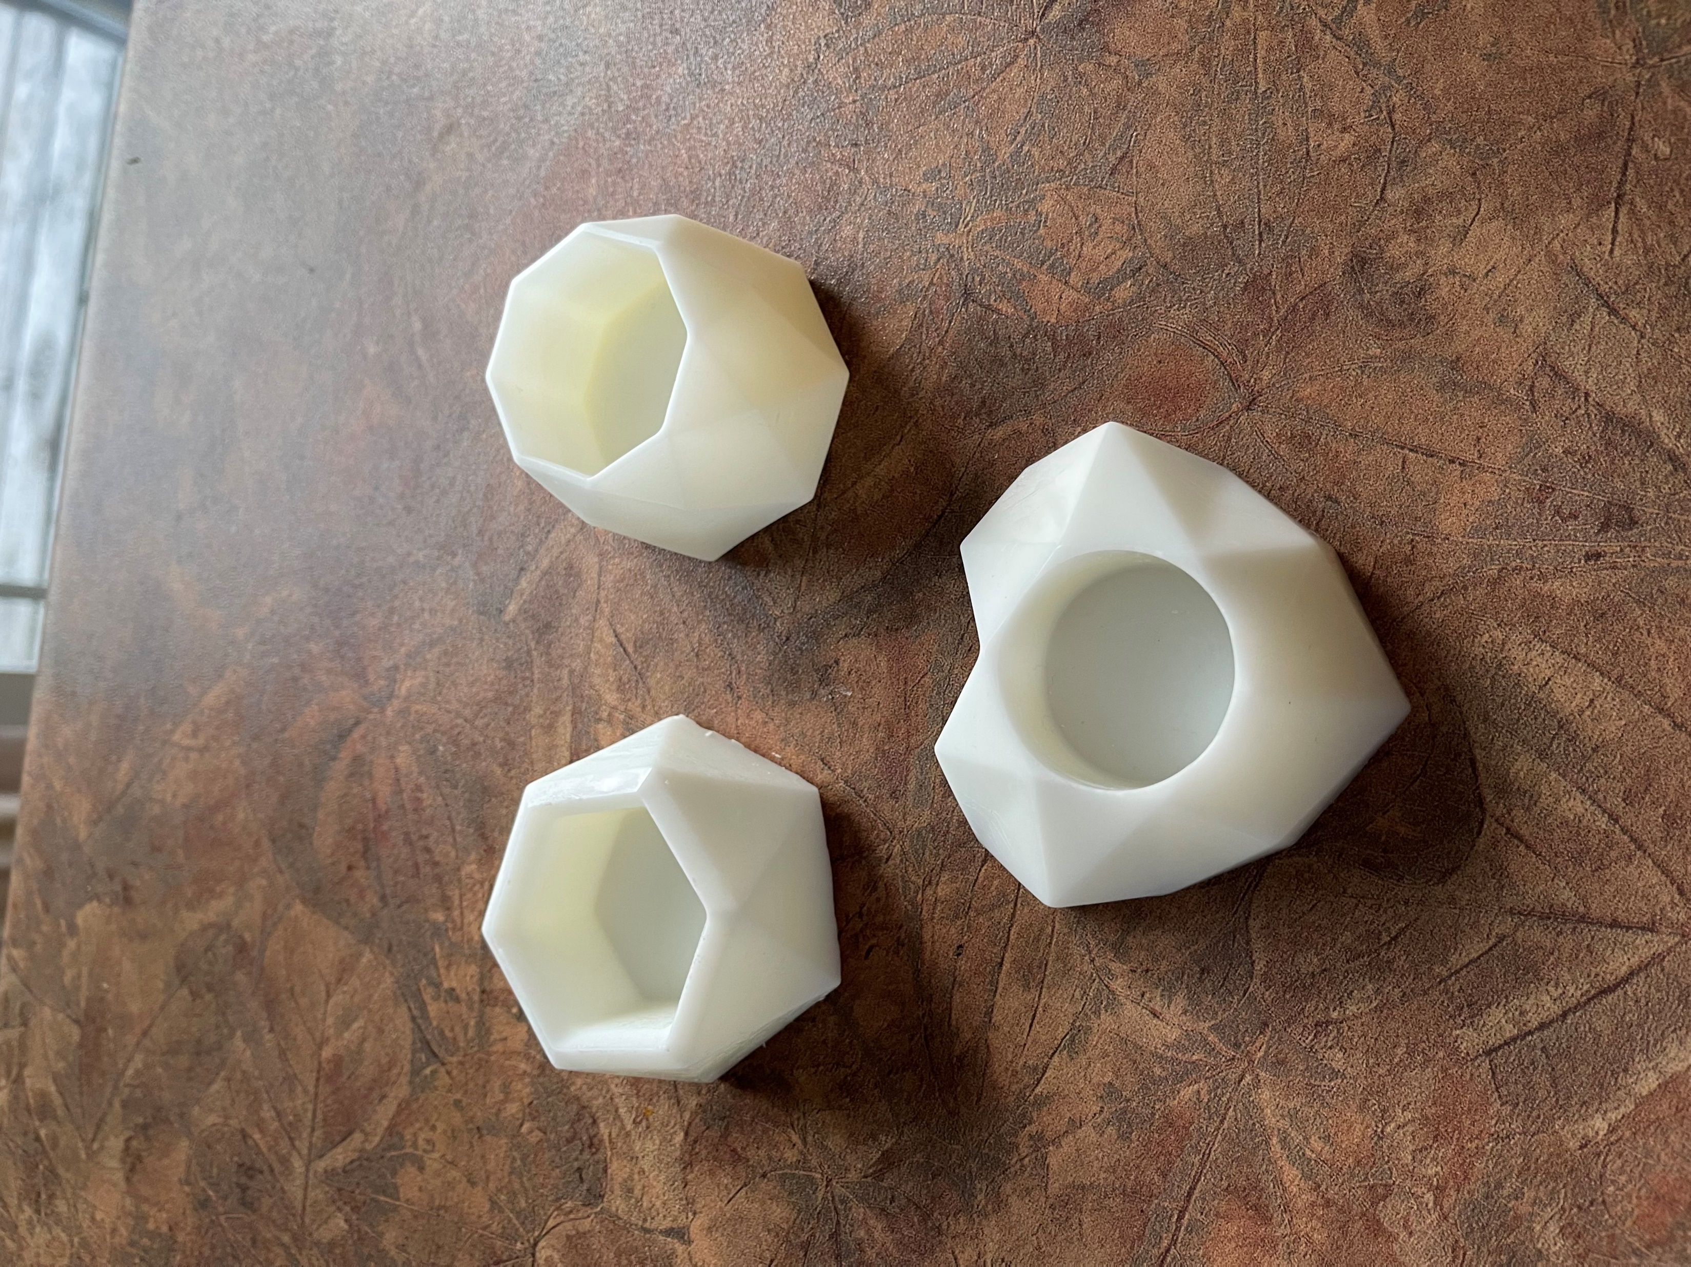


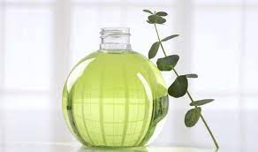

Small Succulent -$6
Large Succulent-$8
Scents:
Citrus, Eucalyptus, and Lilac
Mix and Match!

Slide 14
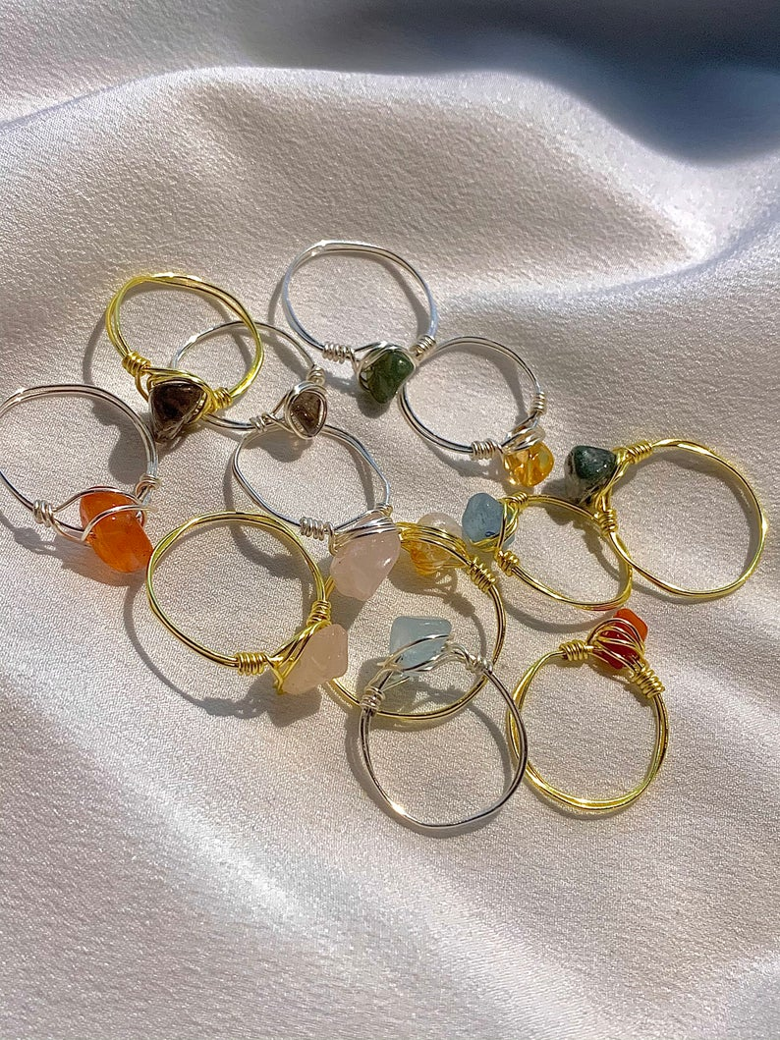

Because bling is you're thing
$5 ONLY
Crystal Inc.
Jasmine Parker &
Destiny Vaughan

Slide 15

Food or nail rush? I’ll have a Nail Rush.
12$ press on nails!

Slide 16

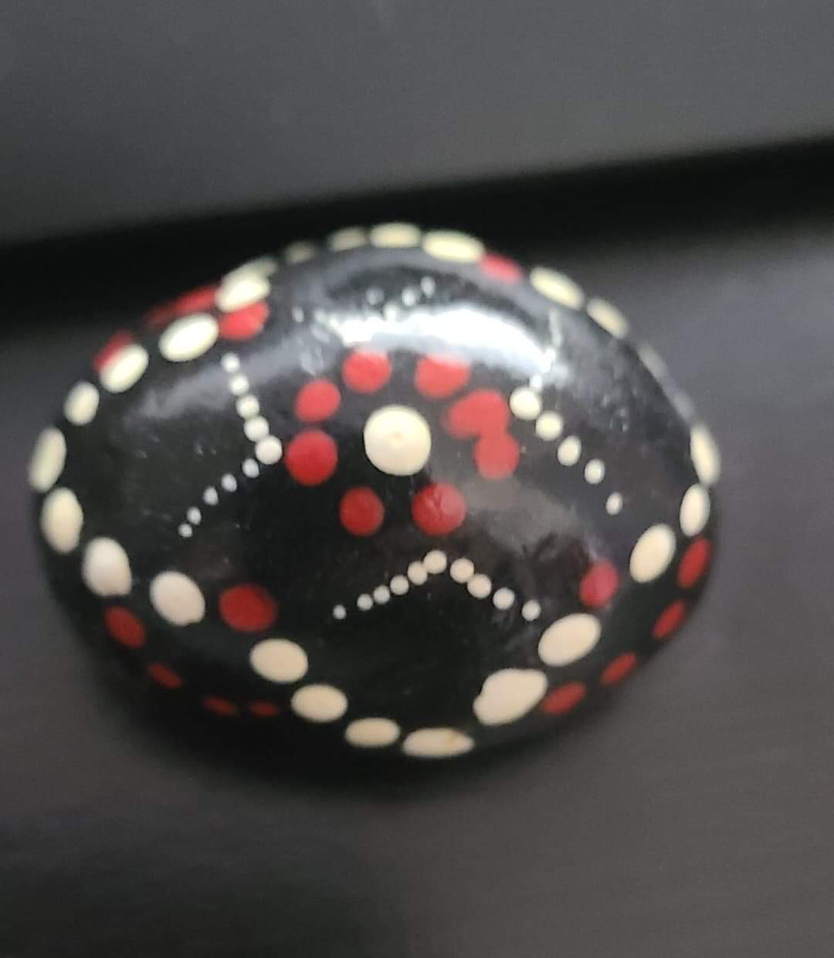
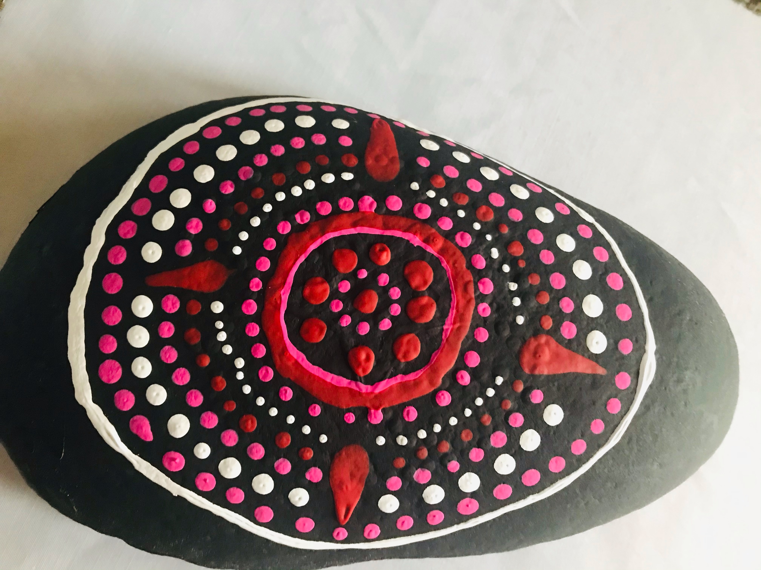
The Mandala Effect
Prices
Big Rocks - $5.00
Small Rocks - $3.00
Deals
Two Big Rocks for $8.00
Three Small Rocks for $7.00
Created to Create

Slide 17

$10
for six!
Wax tarts
Let the stress melt away

Slide 18

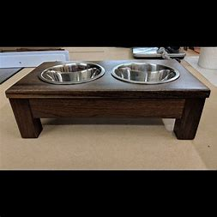
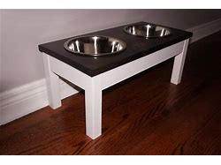
Critter comforts
Prices:
$30 a bowl stand
$5 extra to have it customized with you cat or dog's name.
Your pet, Our passion

Slide 19

Superfly Fishing Flies
3 for $5
Want to be Superfly? Get a fishing fly!

Slide 20

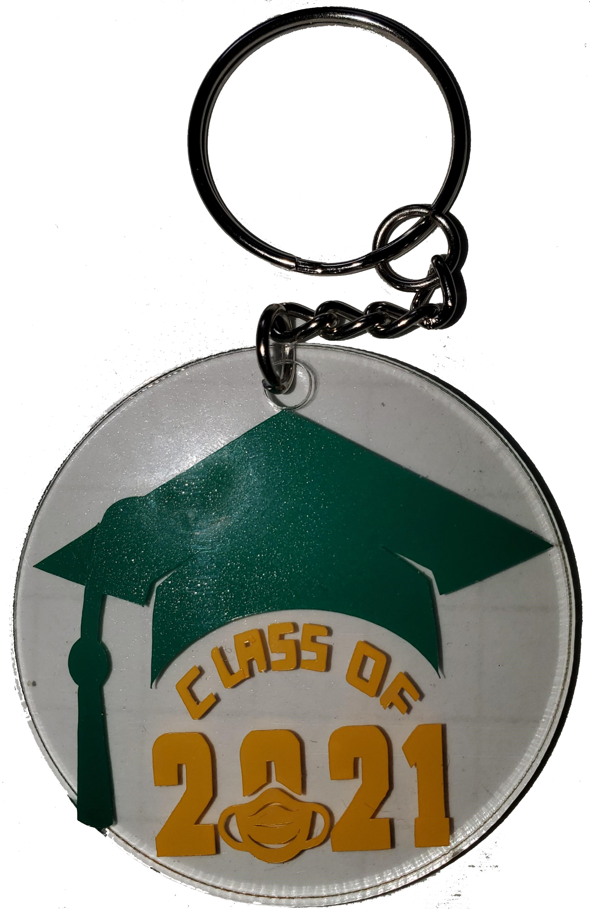
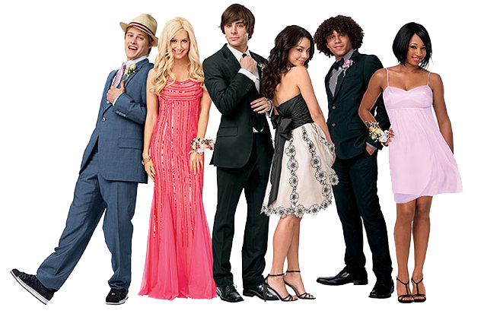
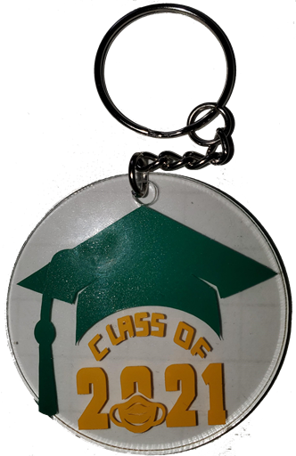
Remember the good times…
$5.00 Per Keychain
Richard Crossman

Slide 21
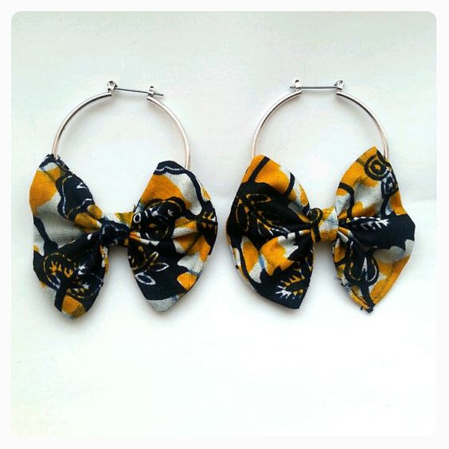

HANDMADE ANKARA PRINT EARRINGS
1 for $7
2 for $!2
Order yours from
May 31st- June 4th

Slide 22

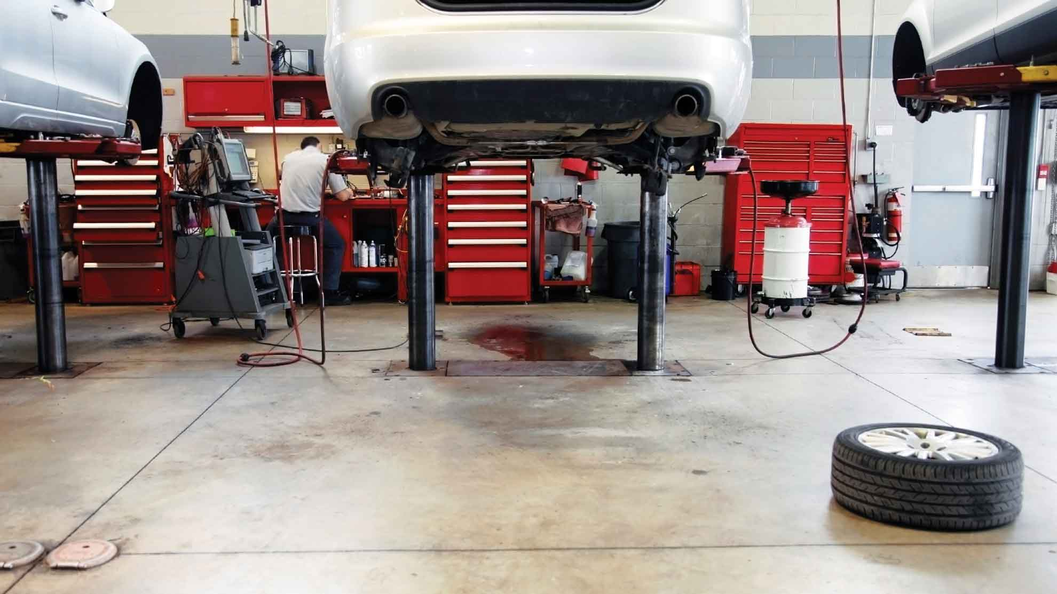



We have the best of the best decals
$5/Decal

Slide 23

Choice Apparel
T-Shirts come in black and white, and we have any size that you want!
~It’s All About Perspective~
Only $15 Per T-Shirt!
20% of all proceeds go towards mental health initiatives!

Slide 24



Cartes
ONLY $2.00

Slide 25

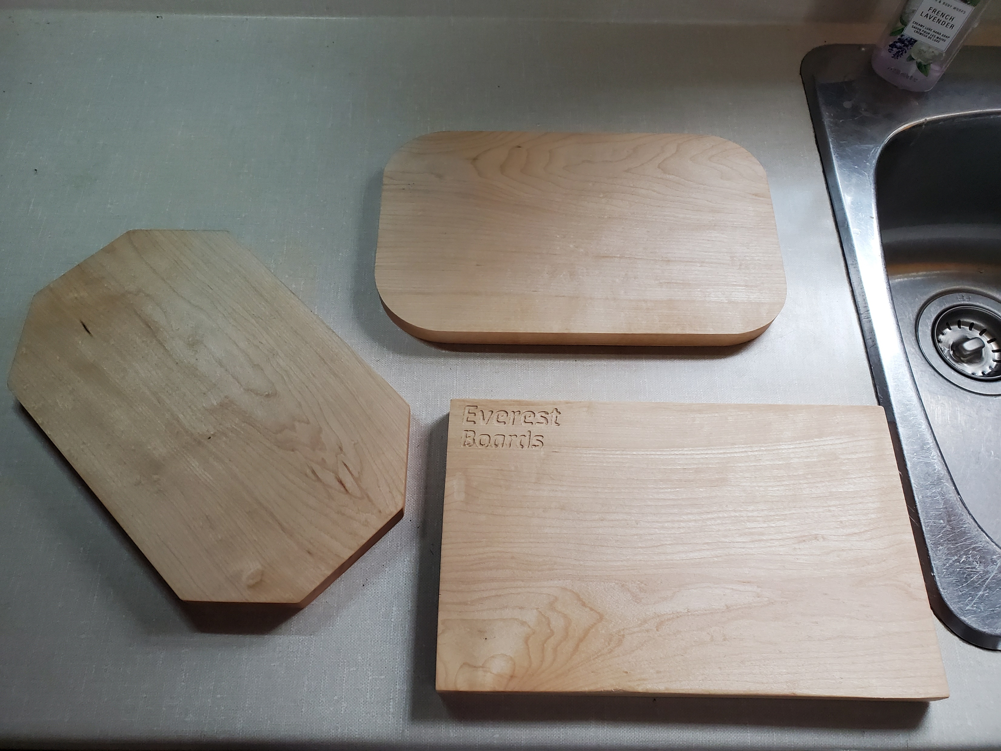
“Tough as the mountain.”
All boards will have an engraving of “Everest
Boards” into it.
$25.00 each
By: Drake DeMerchant

Slide 26
EACH BUSINESS WILL HAVE THEIR OWN FACEBOOK PAGE TO ORDER FROM. LINKS WILL BE PUT ON HAPPENINGS IN THE HIVE.
BUSINESS LAUNCH WILL BE NEXT MONDAY, MAY 31ST UNTIL FRIDAY JUNE 4TH. THANK YOU FOR SUPPORTING THESE STUDENT ENTREPRENEURS!

