Slide 1
Saints in Action
Faith in Action

Slide 2
Saints in Action 2014-2015
Saint Malachy’s Tradition!
Including raffle, run for the cure and Saints in Action – our school raised over $40,000 last year!
We are an awesome school which gives back to our community throughout the year!
Saints in Action?
Safe Harbour – $900, 2100 pairs of socks, 800 household items and 10 paintings
Breakfast Club - $500 and 700 breakfast items
Many volunteer hours!
S.A. Kettle Drive – 100 students, 30 staff – raised nearly $7000!

Slide 3

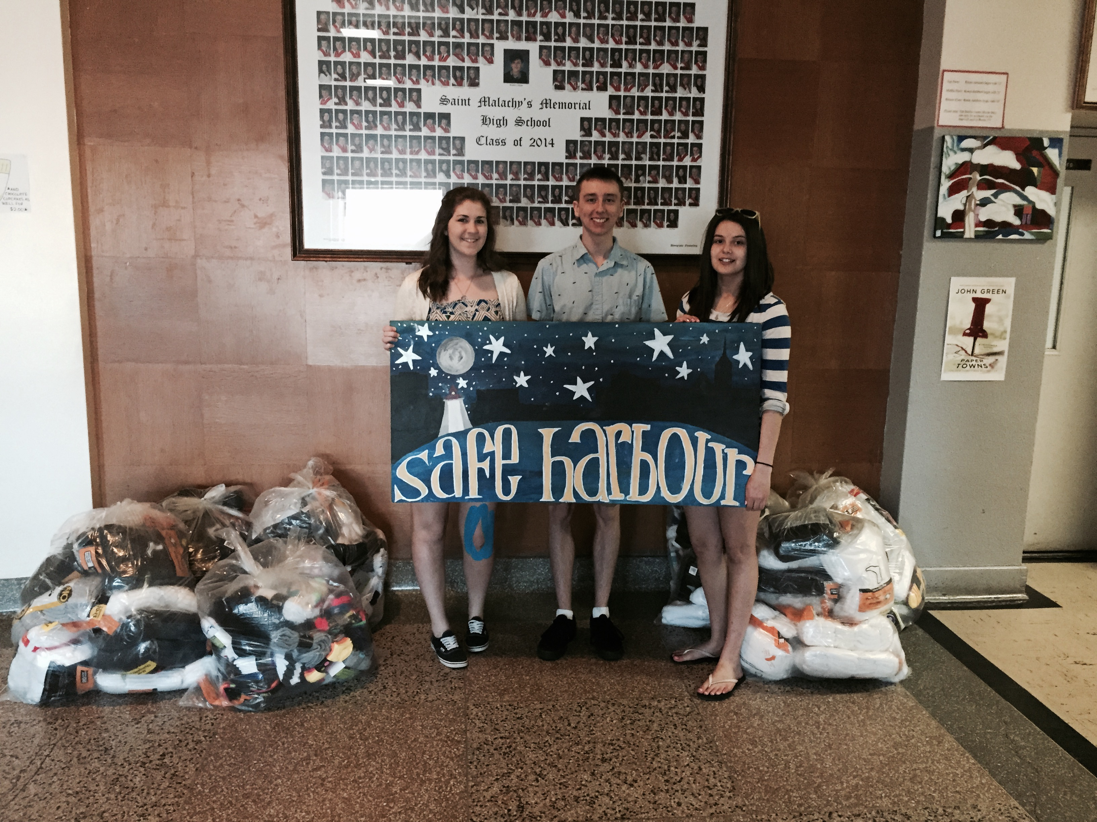
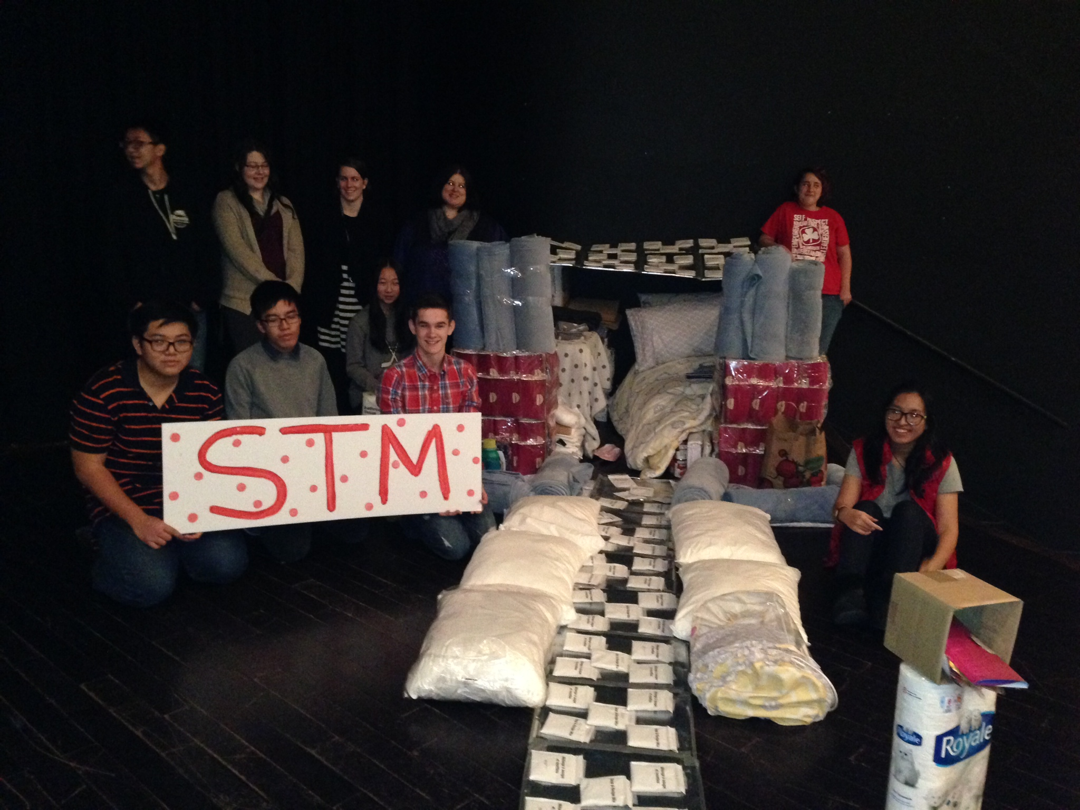
Safe Harbour / Clothing Drives
Run the Stock Our Shelves Competition in the fall and the Sock Drive in the Spring
Stock and maintain our school based clothing store
Other initiatives
Meets in Room 004

Slide 4
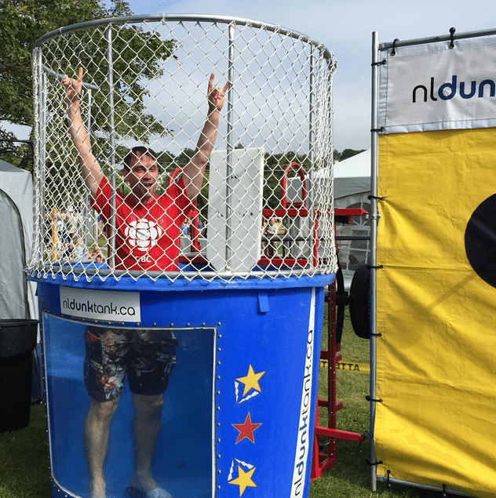
Saints Care Street Fair
In conjunction with our Booster Club execute the Street Fair to raise funds for our school and Safe Harbour!
Ideas:
Dunk Tank
Horizontal Bungee
Bouncy Castles
And more!
Meets in Room 031

Slide 5

English Language Learner Mentors
Tutor students in subjects of your expertise
Get to know some students from abroad
Explain some New Brunswick and teen slang so that these students are not lost!
Meets in Room 110

Slide 6
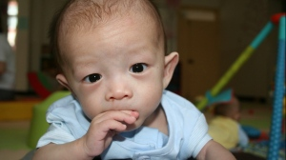
Heroes in Red
Raise money and awareness for the orphans struggling to survive in China. Money raised will go towards transportation to and from hospitals, for food and surgeries.
Charity – First Hugs
Meets in the Learning Commons (Connected to Key Club)

Slide 7

Me to WE
This is an opportunity to make something your own! Think Local and Act Global.
With like minded students run projects right here to raise money/ awareness for local issues and global problems.
Opportunities to attend We Day in Halifax
Meets in Room 205/177

Slide 8

Paint It Forward – Room 173

Slide 9

Breakfast Club /Food Drives
Support students in need right here at STM by;
  Baking
  Cleaning
  Cooking
  Planning menus
  Running food drives
  Meets in Room 175

Slide 10

Positive School Environment
Anti-bullying
Anti – racism
Anti – discrimination
G.S.A. Actions
Random Acts of Kindness
Education and awareness raising about issues that matter to you!
Meets in Guidance, Room 213 and Room 219

Slide 11

Saint Support
Support students in building by building a fund we can use to buy what a student needs, when they need it!
  Backpacks
  Food
  Clothes
  Prom dresses
  Bus cards
  And more…
Meets in Room 215

Slide 12

Volunteering
(Grade 11 & 12 ONLY)
Community Food Basket
Salvation Army
St. John the Baptist King Edward School
St. Vincent de Paul
Outflow
And more…
Go weekly to these local charities

Slide 13
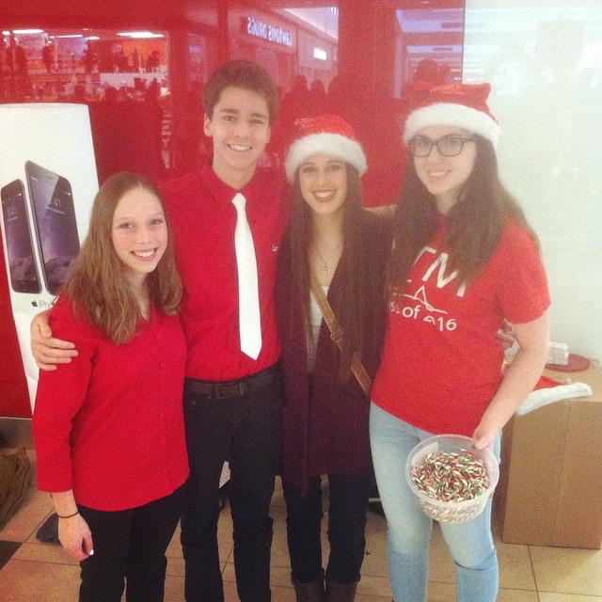
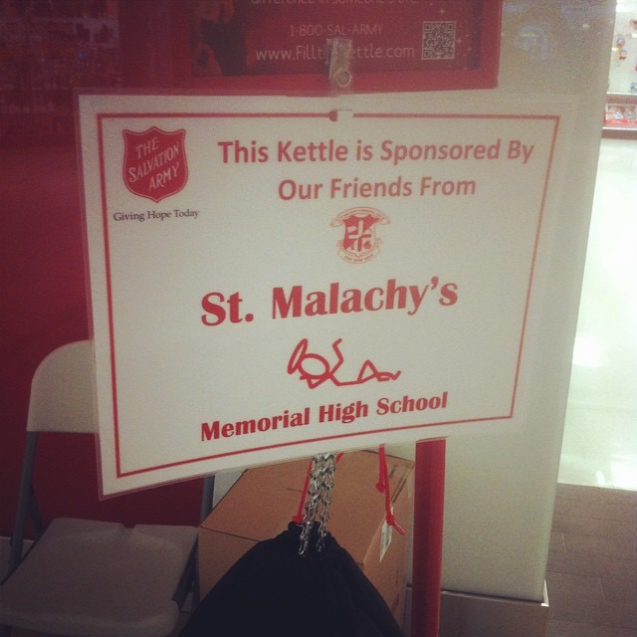
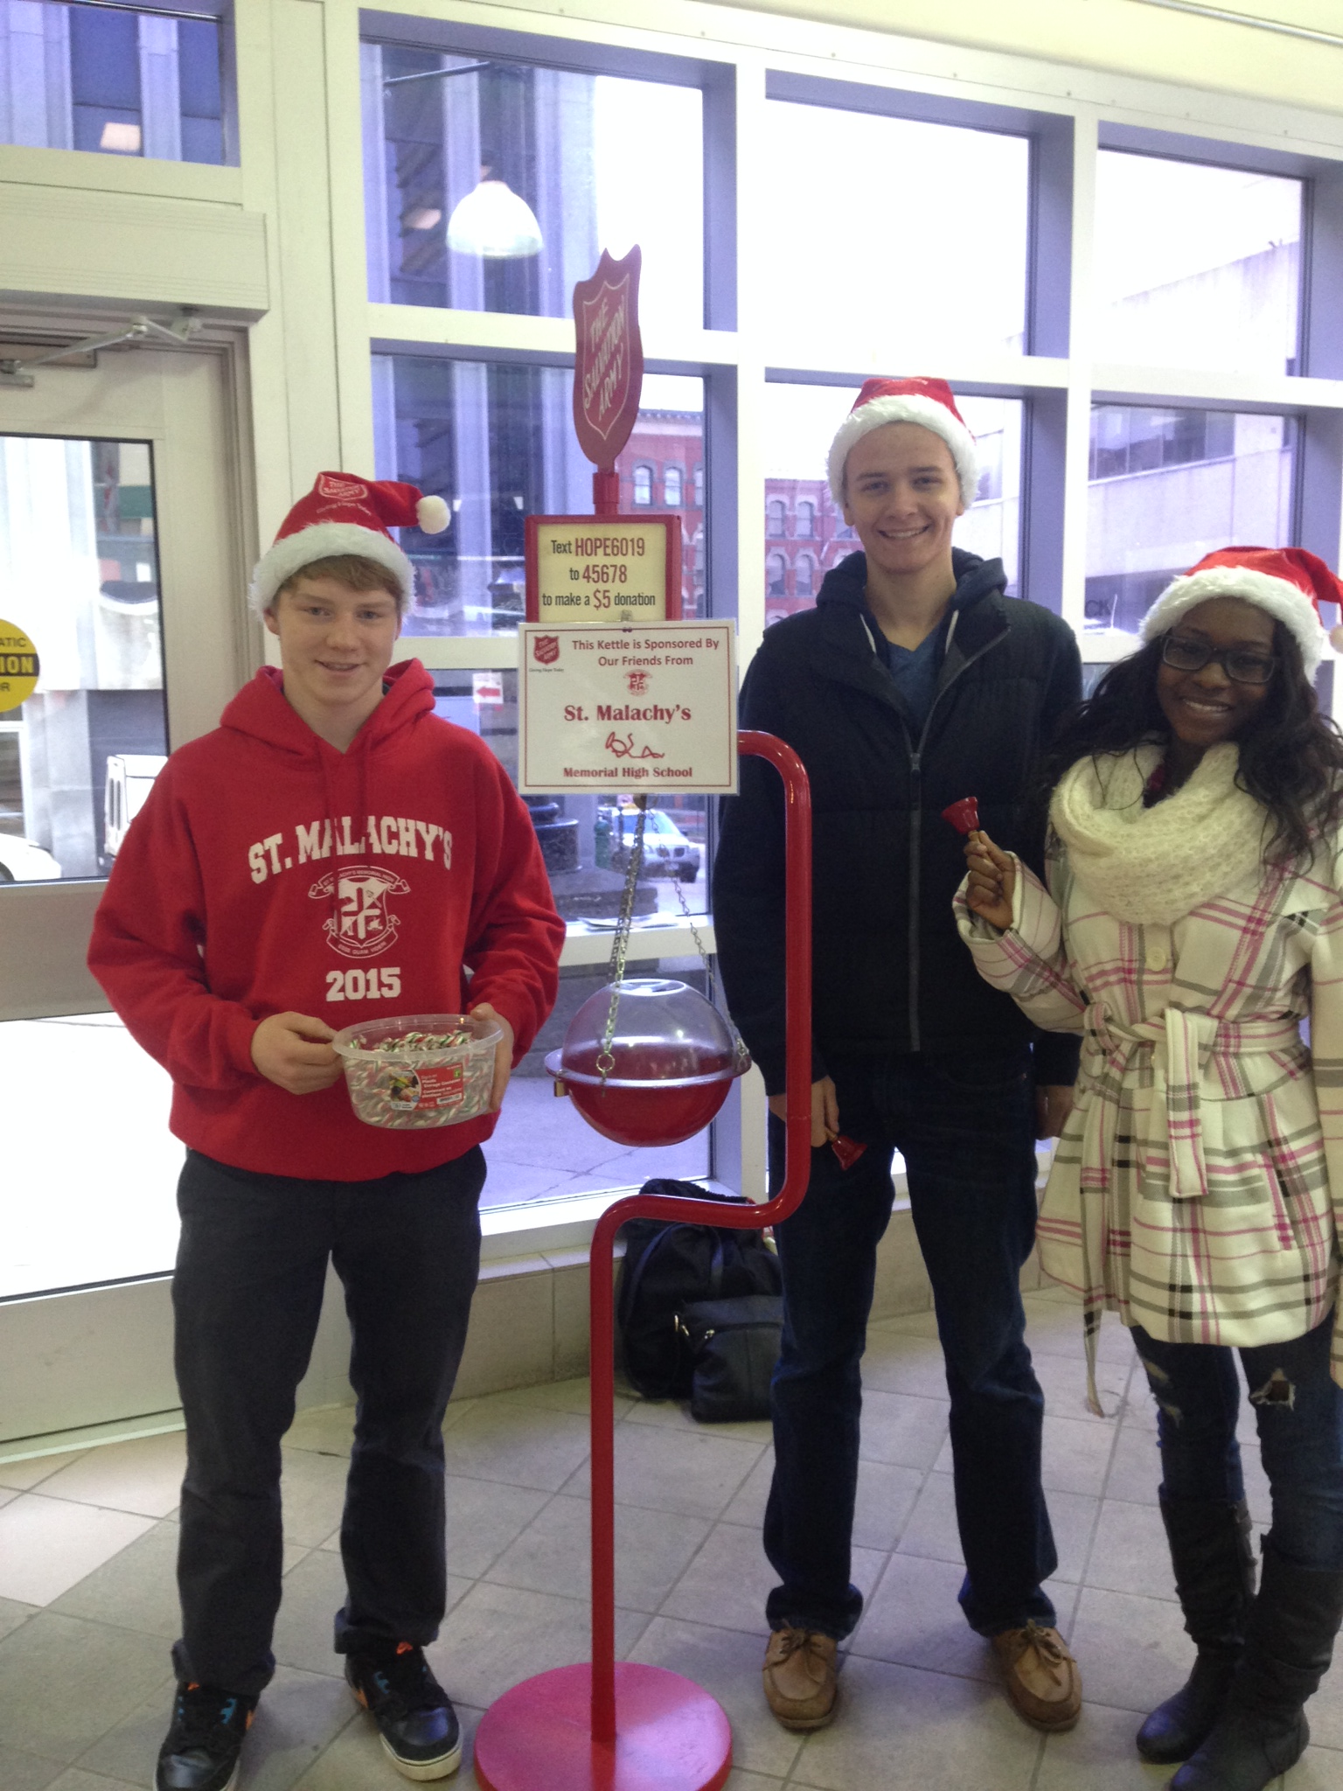
Kettle Drive 2015!
Saturday Dec 12
Mark your calendar!
Find a friend to sign up with you!
Plan some entertainment!
GOAL: Over 7000 dollars…

