Slide 1

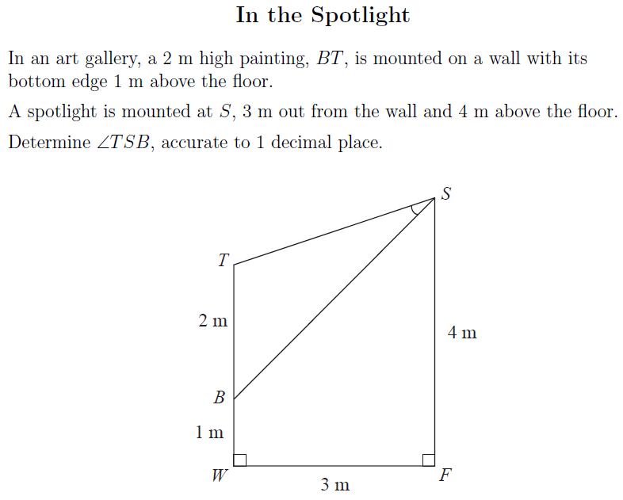
STM Numeracy Problem of the Week
November 14th - 20th, 2013
Submit your answers by Wednesday @ 3pm
in the Learning Commons or Room 219

