Slide 1

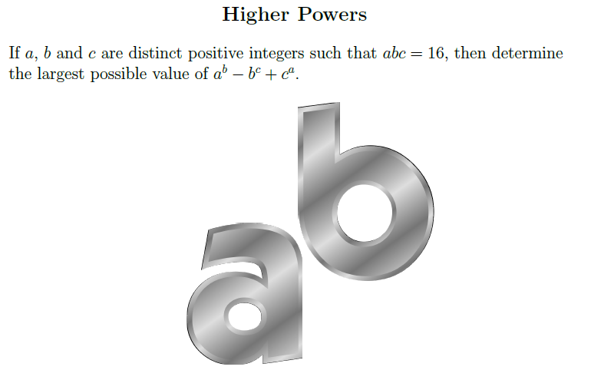
STM Numeracy Problem of the Week
November 21st – 27th, 2013
Submit your answers by Wednesday @ 3pm
in the Learning Commons or Room 219
Congratulations to last week’s winner:
Drake Lehman

